Slide 1
Exploring Microsoft Office 2013 Excel Comprehensive
by Mary Anne Poatsy, Keith Mulbery, Jason Davidson
Chapter 10
Imports, Web Queries,
and XML
Notes:
In this chapter, you will use Microsoft Office Excel 2013 to import data from a variety of sources.

Slide 2
Objectives
Import data from external sources
Create a Web query
Manage connections
Convert text to columns
Notes:
The objectives of this chapter are:
Import data from external sources
Create a Web query
Manage connections
Convert text to columns
The objectives continue on the next slide.

Slide 3
Objectives
Manipulate text with functions
Use Flash Fill
Understand XML syntax
Import XML data into Excel
Notes:
The objectives of this chapter are:
Manipulate text with functions
Use Flash Fill
Understand XML syntax
Import XML data into Excel

Slide 4
Importing Data from External Sources
Importing—inserting external data into current application
Embedded files
Edited in Excel
Changes not reflected in source
Linked files
Changes made in source
Refresh required to update Excel data
Notes:
Importing is the process of inserting external data into the current application.
Embedded data can be edited directly in Excel. Any changes made are not reflected in the source data.
External data imported as a connection creates a link to the original data source. Changes made to the original data source are not automatically reflected in Excel. For the Excel data to be changed, refresh is required.
Information on importing data from external sources continues on the next slide.

Slide 5
Importing Data from External Sources
Most common imported file types:
Text files
Access database files
Text files
Have .txt file extension
Contain characters: letters, numbers, and symbols
Data delimited by special characters
Notes:
Two of the most common file types imported into Excel are text files and Access database files.
A text file has a .txt file extension. It contains characters such as letters, numbers, and symbols and includes punctuation and spaces.
Text files have special characters that separate data by special symbols called delimiters such as spaces, tabs, or commas.
Information on importing data from external sources continues on the next slide.

Slide 6
Importing Data from External Sources
Notes:
Text files using commas to separate the data are called comma separated values (CSV). This slide shows the source file in Notepad containing commas, and the result of the imported file in Excel, where each item separated by commas is placed in separate columns. Notice the first line in the source file is not actual data, but headings describing what each item in the file is.
Information on importing data from external sources continues on the next slide.

Slide 7
Importing Data from External Sources
Notes:
When importing text files, the Text Import Wizard is used. Wizards ask questions, and the responses determine how the data will be imported.
As see in the first step, the file is indicated as being separated by a delimiter, the first line represents header, and the corresponding check box must be selected.
Information on importing data from external sources continues on the next slide.

Slide 8
Importing Data from External Sources
Notes:
As seen in the next step, the type of delimiter is selected. The final step, which is not shown, allows you to select which columns will be imported. In this example, all the columns are imported.
Information on importing data from external sources continues on the next slide.

Slide 9
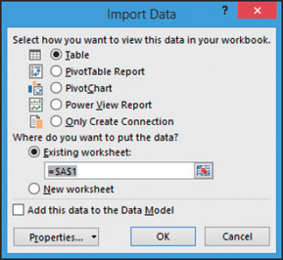
Importing Data from External Sources
Notes:
Data imported from Access can be in the form of a table or a query. To link data from Access, click the DATA tab and click From Access in the Get External Data group to open the Select Data Source dialog box. Begin by selecting the object type—table or query and which one(s). Indicate how the data will be imported into Excel.
Information on importing data from external sources continues on the next slide.

Slide 10
Importing Data from External Sources
Notes:
When data is imported as a table, it is formatted as an Excel table style. Notice that filter arrows are displayed so the data can sorted and filtered.
In addition to importing data from text files and Access databases, Excel can import data from:
• SQL Server.
• Analysis Services.
• Windows Azure Marketplace.
• OData Data Feed.
• XML Data Import.
• Data Connection Wizard.
• Microsoft Query.

Slide 11
Creating a Web Query
Notes:
A Web query creates a link to the Web page. To create a Web query, the New Web Query dialog box is used. As seen in the slide, there are several options, the most important of which is the URL for the Web page.
Web queries have limitations:
A Web page may contain data that are not structured as a table even though the data appear to be in a table format.
Excel connects a Web query to a specific URL, if the URL changes you will receive an error message.
If the Web site requires a login, the query generally will not work because the login and password are not stored.

Slide 12
Managing Connections
Linked data:
Data on a Web page or external database can change
Changes are not reflected in Excel
Connections should be periodically refreshed
Click Refresh All in the Connections group
Click the Refresh All arrow in the Connections group
Right-click in a range of data and select Refresh
Notes:
When working with linked data, data on a Web page or data in an external database can change. Remember, because the data is linked, changes in the source are not automatically reflected in Excel. To make sure that the Excel data are current, the connections to the original external data source should be periodically refreshed.
There are three ways to refresh data:
• Click Refresh All in the Connections group on the DATA tab to refresh all connections in the active workbook.
• Click the Refresh All arrow in the Connections group and select Refresh to update data for the range containing the active cell.
• Right-click in a range of data and select Refresh to update that data only.
Information on managing connections continues on the next slide.

Slide 13
Managing Connections
Notes:
The list of all connections is displayed in the Workbook Connections dialog box. As seen in the slide, connections can be managed by adding or removing them. The properties can be examined and changed by clicking Properties in the dialog box or by clicking Properties in the Connections group, clicking the Refresh All arrow, and selecting Connection Properties, or clicking Connections in the Connections group and clicking Properties. One of the properties allows the data to be refreshed in the background—the number of minutes between refreshes can be selected or you can select to refresh when the file is opened.

Slide 14
Converting Text to Columns
Imported text may not be structured correctly
Notes:
When data are imported from an external source, the data may not be structured in a desired form. As an illustration, consider the example shown. The names of individuals in the original source are combined and treated as an entity, which is shown on the left. However, you may want to treat each component individually, as shown on the right.
Excel has several text functions to help manipulate text strings, and these will be examined in the next objective.

Slide 15
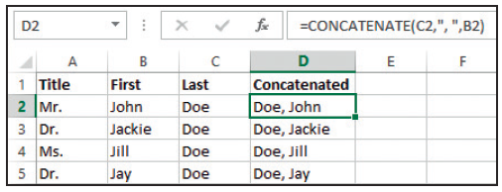
Manipulating Text with Functions
Excel text functions:
CONCATENATE =CONCATENATE(text1,text2)
Notes:
The CONCATENATE function can join up to 255 individual text strings into a single text string.
Information on manipulating text with functions continues on the next slide.

Slide 16
Manipulating Text with Functions
Excel text functions:
PROPER =PROPER(text)
UPPER =UPPER(text)
LOWER =LOWER(text)
Notes:
The PROPER function capitalizes the first letter of each word in a text string.
The UPPER function converts text strings all into uppercase letters.
The LOWER function converts text strings all into lowercase letters.
Information on manipulating text with functions continues on the next slide.

Slide 17
Manipulating Text with Functions
Excel text functions:
SUBSTITUTE =SUBSTITUTE(text,old_text,new_text, instance_num)
TRIM =TRIM(text)
LEFT or RIGHT =LEFT(text,num_chars) or =RIGHT(text,Num_chars)
MID =MID(text,start_num,num_chars)
Notes:
The SUBSTITUTE function substitutes or replaces new text for old text in a text string.
The TRIM function removes leading and trailing spaces in a text string, but spaces between words are not removed.
The LEFT function returns the specified number of characters starting at the left (beginning) of a text string.
The RIGHT function returns the specified number of characters starting at the right (end) of a text string.
The MID function returns the specified number of characters from the middle of a text string, based on a starting position and the number of characters.
Note: These functions can be combined using nesting, which means using a function within another function. For example, =UPPER(CONCATENATE(A2,”, ”,A3)) concatenates the contents of cell A2 with the contents of cell A3, but a comma and a space are inserted between the two. Finally, the concatenated string is converted into all uppercase letters.

Slide 18
Using Flash Fill
Flash Fill
Enter data in 1 or 2 cells to establish a pattern
Excel completes the data entry
Can be used generate new columns
Notes:
Flash Fill is an Excel feature that:
Allows you to enter data in one or two cells to set an example.
Excel completes the data entry for you.
Can be used with data in existing columns, and generate new columns of data following the pattern.
Note: The data within a column must be structured in such a way that Flash Fill can recognize the data pattern.
Information on using Flash Fill continues on the next slide.

Slide 19
Using Flash Fill
Notes:
As shown in the slide, column A has a pattern of city/state. In column B, San Diego is entered indicating that column B should be populated with the city names.

Slide 20
Understanding XML Syntax
eXtensible Markup Language (XML)
Developed by World Wide Web Consortium (W3C)
Standardized file format for exchanging data across
Applications
Operating systems
Hardware
Uses tags
Notes:
The World Wide Web Consortium (W3C) developed a standardized file format to use when exchanging data across applications, operating systems, and hardware. This standard is called eXtensible Markup Language (XML). As with other markup languages, XML uses tags as markers.
Information on understanding XML syntax continues on the next slide.

Slide 21
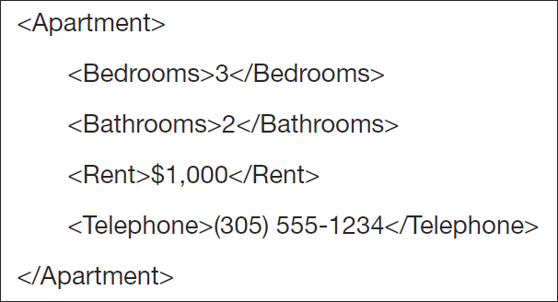
Understanding XML Syntax
Notes:
Unlike HTML, which uses tags to describe how the data is displayed, XML uses tags to describe the data itself. Consider the example shown in the text. If you read the top example in a newspaper, you would probably recognize it as details for an apartment. This same information written in XML appears at the bottom of the slide.
Information on understanding XML syntax continues on the next slide.

Slide 22
Understanding XML Syntax
Notes:
This slide shows an XML document that was created in Notepad. This example is an expansion of the previous slide, where information was limited to a single apartment. This XML document has information on three apartments, which are part of an Apartment Complex element. You can also see that additional information is part of each Apartment element.
Unlike HTML, which has a fixed number of tags, XML is extensible—which means new tags can be created to describe the data. What do you think the <W-DHookups> describes? Also take note of the syntax for starting and ending tags.

Slide 23
Importing XML Data into Excel
Notes:
Data from an XML file can be opened using the Open dialog box and selecting an XML document or connecting the source document using Get Data on the DATA tab. The slide shows the result of using the Open dialog box.
If necessary return to Slide 23 to see the data written in XML and compare it with the data shown in this slide. As you can see the tags have become the column headings with the data appearing below them.

Slide 24
Summary
External data imported into Excel
Embedded
Changes made directly in Excel
Linked (connected)
Changes in source are not reflected in Excel
Data link must be refreshed
Notes:
When importing external data with Excel it can be:
Embedded—in which changes to the data can made directly in Excel.
Linked—in which changes made to the linked or connected data source are not reflected in Excel.
For changes to appear in Excel, the link must be refreshed.
The summary continues on the next slide.

Slide 25
Summary
External data file sources
Text files
Web queries
CSV
XML
Text functions
Notes:
Text files include data from Web queries, delimited text such as CSV, and XML documents containing tags. There are several text functions that can be used to manipulate textual data.

Slide 26
Summary (cont.)
External data file sources
Access databases
Tables
Queries
Notes:
Data imported from Access can consist of entire tables or the results of applying a query.

Slide 27
Questions
Notes:
As you complete this chapter on Excel, be sure you ask questions. You want to understand the concepts so that you can continue to build on them in future chapters.

Slide 28
Copyright
All rights reserved. No part of this publication may be reproduced, stored in a retrieval system, or transmitted, in any form or by any means, electronic, mechanical, photocopying, recording, or otherwise, without the prior written permission of the publisher. Printed in the United States of America.

