Slide 1
exploring Microsoft Office 2013 Volume 1
by Mary Anne Poatsy, Keith Mulbery, Lynn Hogan, Amy Rutledge, Cyndi Krebs, Eric Cameron, Rebecca Lawson
Chapter 3
Excel Charts
Notes:
This chapter reviews Excel charts and how to depict data visually.

Slide 2
Objectives
Select the data source
Choose a chart type
Move, size, and print a chart
Add chart elements
Notes:
The objectives of Chapter 3 include:
Select the data source
Choose a chart type
Move, size, and print a chart
Add chart elements

Slide 3
Objectives (continued)
Format chart elements
Apply a chart style and colors
Modify the data source
Create and customize sparklines
Notes:
Additional objectives include:
Format chart elements
Apply a chart style and colors
Modify the data source
Create and customize sparklines

Slide 4
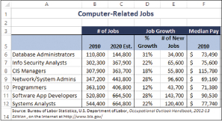
Chart Basics
A chart is a visual representation of numeric data
Notes:
An effective chart depicts data in a clear, easy-to-interpret fashion. It is a visual representation of numerical data that compares data and helps to reveal trends or patterns to help people make informed decisions. Figure 3.1 illustrates the computer-related jobs with growth percent and pay. Notice how the data is arranged in rows and columns.

Slide 5
Chart Basics
Chart elements include:
Chart Area
Plot Area
X-Axis
Y-Axis
Category Axis
Value Axis
Legend
Notes:
The chart area contains the entire chart and all of the elements. A region containing the graphical representation of the values in the data series is called the plot area. A data series is a group of related data points.
The X-axis is a horizontal border that provides a frame of reference for measuring data horizontally. The Y-axis is a vertical border that provides a frame of reference for measuring data vertically.
The category axis displays group names or labels to identify data.
The value axis displays incremental numbers to identify the values that are used to create a chart.
A legend is a key that identifies the color or pattern assigned to each data series in a chart.

Slide 6
Choosing a Chart type
Notes:
Table 3.1 illustrates the most commonly used chart types are column, bar, line, and pie. Each chart type is designed to provide a unique view to the selected data.

Slide 7
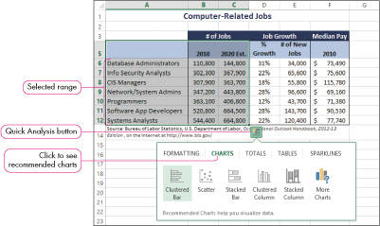
Creating a Charts
Select the data
Click the Quick Analysis button
Click the thumbnail of the chart you want
Notes:
Figure 3.3 illustrates steps to create a chart.
Select the data.
Click the Quick Analysis button.
Click CHARTS in the gallery.
Move the mouse over the suggested chart thumbnails to determine what chart would work best.
Click the thumbnail of the chart wanted.

Slide 8
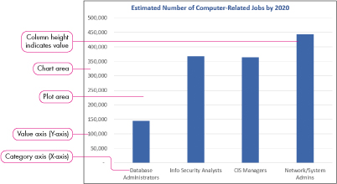
Column Charts
A column chart displays data vertically, with each data series forming a column
Notes:
Figure 3.6 illustrates a column chart, with chart elements, that plots the number of job titles and number of jobs by the year 2020.

Slide 9
Clustered Column Chart
Notes:
Figure 3.7 illustrates a clustered column chart, plotting the number of computer related jobs for the years 2010 and 2020.
Multiple data series include two or more sets of data. This chart illustrates two data series, one for each job title. A legend is included to help the reader distinguish the multiple data series. Each data series is depicted in a different color.

Slide 10
Reversing Categories and Data Series
Notes:
Figure 3.8 illustrates a clustered column chart, also plotting the number of computer related jobs in 2010 and 2020.
The role of categories and data series is reversed.

Slide 11
Stacked Column Chart
Notes:
Figure 3.9 illustrates a stacked column chart.
This type of chart places stacks of data in segments on top of each other in one column, with each category in the data series represented by a different color.

Slide 12
100% Stacked Column Chart
Notes:
Figure 3.11 illustrates a 100% stacked column chart.
This type of chart stacks data in one column per category, with each column having the same height of 100%. It shows the percentage that each data point contributes to the total for each category.

Slide 13
Bar Chart
Notes:
Figure 3.12 illustrates a clustered bar chart.
This type of chart compares values across categories using horizontal bars. Bar charts, like column charts, may plot single or multiple data series and appear clustered or stacked.

Slide 14
Line Chart
Notes:
Figure 3.13 illustrates a line chart.
This type of chart uses a line to connect data points in order to show trends over a period of time. The X-axis (Category axis) typically displays time units, and the Y-axis (Value axis) displays values for each point.

Slide 15
Pie Chart
Notes:
Figure 3.14 illustrates a pie chart.
This type of chart plots a single data series where each point is a sector with area proportional to the total of the series. A legend is used to display the category label for each data point in a different color. Data labels, such as percentages, are often portrayed on the pie wedges. An exploded pie chart separates one or more pie slices from the rest.

Slide 16
Changing the Chart Type
Using the Chart Tools contextual tab:
Click the DESIGN tab
Click Change Chart Type
Click ALL CHARTS
Select the desired chart type
Notes:
Once a chart is selected, Excel displays the Chart Tools contextual tab with tabs for DESIGN and FORMAT. You can change the chart type by clicking the Change Chart Type button in the Type group on the DESIGN tab.

Slide 17
Other Chart types
Notes:
Table 3.2 illustrates other chart types available in Excel.

Slide 18
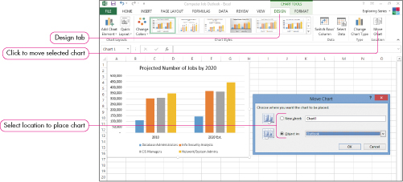
Moving a Chart
To move a chart:
Click the DESIGN tab
Click Move Chart under the Location group
Notes:
By default, a chart is placed in the same worksheet as the data source. You can also choose to move the chart to another location. The Move Chart dialog box, shown in Figure 3.17, offers choices for the chart location to be in a different or new worksheet.

Slide 19
Printing a Chart
To print an embedded chart:
Select the chart
Click the FILE tab
Click Print to display settings
Use the Print Selected Chart option
Notes:
If a chart is embedded on a worksheet with the data source, you can choose to print the data, the chart or the entire worksheet. To print only the embedded chart, select it first. Click the FILE tab, click Print, and, choose the Print Selected Chart option. If the chart is on its own worksheet, use the Print Active Sheets option.

Slide 20
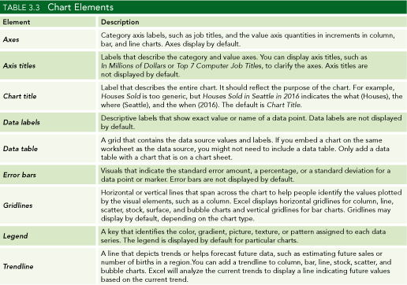
Chart elements
A chart element is a component that helps clarify the chart.
Notes:
Table 3.3 shows some of the elements available in a chart. They include the axes, axis titles, chart titles, data labels, and data table.

Slide 21
Chart elements
Notes:
Table 3.3 shows additional elements available in a chart. They include the error bars, gridlines, legend, and the trendline.

Slide 22
Chart Titles and Legend
A chart title is the label that describes the entire chart
An axis title is a label that describes either the category or value axis
A legend is used to distinguish data points in a pie chart or data series in a multiple series chart
Notes:
The Chart Elements button found on the right side of the chart contains options to add or edit the chart title, axis titles, and the legend.
Chart title options include Above Chart, Centered Overlay, or More Options. More Title Options offer fill, border, and alignment settings.
Axis title options include Primary Horizontal, Primary Vertical, and More Options.
Legend options include None and the desired location of the legend.

Slide 23
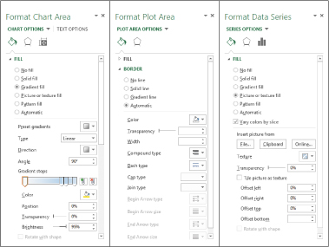
Formatting chart elements
To display a chart element’s task pane, double-click the chart element.
Notes:
You can apply multiple settings at once using a Format task pane. Figure 3.27 displays the Format Chart Area, Format Plot Area, and Format Data Series task panes.

Slide 24
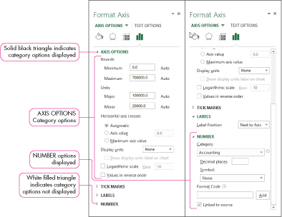
Format Axes
Excel computes starting, ending, and incremental values for display on the value axis
Notes:
By default, Excel will compute markers for the starting, ending, and incremental values on the Y-axis. To change settings, open the task pane and select the specific formats desired.

Slide 25
Insert and format data Labels
A data label is the value or name of a data point
Notes:
Data labels are descriptive labels that show the exact value of the data points on the value axis. Add data labels only when necessary to reduce a cluttered look to the chart.
Figure 3.29 illustrates formatting options for data labels.

Slide 26
Chart tools format tab
Notes:
Table 3.4 shows the Chart Tools Format Tab. This tab contains options to select a chart element, insert shapes, apply shape styles, apply WordArt styles, arrange objects, and specify the size of an object.

Slide 27
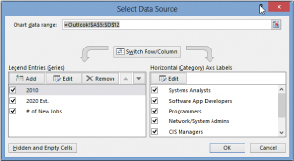
Create chart filters
A chart filter controls which data series and categories are visible in a chart
Notes:
The Select Data Source dialog box illustrated in Figure 3.37 can be used to add a new data series, remove an existing one, or edit the range on an existing series.

Slide 28
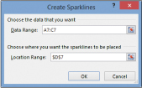
Creating a Sparkline
A sparkline is a miniature chart displayed in a single cell
Notes:
A sparkline is a small line, column, or win/loss chart contained in a single cell. It presents a condensed visual illustration of data. Unlike regular charts, a sparkline does not include chart layout objects such as a chart title or axes labels. To create a sparkline, click Line, Column, or Win/Loss in the Sparklines group on the INSERT tab. Insert the cell references in the Data Range box. Enter the range where you want the sparkline to appear in the Location Range box.

Slide 29
Summary
In this chapter, you have learned to create charts such as column, bar, pie, and line charts by selecting the data source.
You can modify an existing chart by changing the chart type, location, size, as well as how to print the chart.
You can insert, remove, and format chart elements such as titles, labels, and the legend.
Notes:
Chapter 3 has studied the creation and formatting of Excel charts. In this chapter, you have learned to create charts such as column, bar, pie, and line charts by selecting the data source. You can now modify an existing chart by changing the chart type, location, and size. You also learned how to print an embedded chart. Additionally, you can insert, remove, and format chart elements such as titles, labels, and the legend.

Slide 30
Summary
You can apply different chart styles and colors to format a chart.
You can modify the data source including adding or removing data and creating chart filters and switching rows and columns.
You can now create and customize sparklines.
Notes:
Chapter 3 also taught you to apply different chart styles and colors to format the chart visually. You also can now modify the data source by adding or removing data and creating chart filters and switching the rows and columns within a chart. Additionally, you can create and customize sparklines within your worksheet.

Slide 31
Copyright
All rights reserved. No part of this publication may be reproduced, stored in a retrieval system, or transmitted, in any form or by any means, electronic, mechanical, photocopying, recording, or otherwise, without the prior written permission of the publisher. Printed in the United States of America.

