Slide 1
exploring Microsoft Office 2013 Volume 1
by Mary Anne Poatsy, Keith Mulbery, Lynn Hogan, Amy Rutledge, Cyndi Krebs, Eric Cameron, Rebecca Lawson
Chapter 1
Introduction to Excel
Notes:
This chapter introduces you to Excel 2013 and the use of the spreadsheet.

Slide 2
Objectives
Explore the Excel window
Enter and edit cell data
Create formulas
Use Auto Fill
Display cell formulas
Manage worksheets
Notes:
The objectives of Chapter 1 include:
Explore the Excel window
Enter and edit cell data
Create formulas
Use Auto Fill
Display cell formulas
Manage worksheets

Slide 3
Objectives (continued)
Manage columns and rows
Select, move, copy, and paste data
Apply alignment and font options
Apply number formats
Select page setup options
Preview and print a worksheet
Notes:
Additional objectives include:
Manage columns and rows
Select, move, copy, and paste data
Apply alignment and font options
Apply number formats
Select page setup options
Preview and print a worksheet

Slide 4
Introduction to Spreadsheets
A spreadsheet is an electronic file used to organize related data and perform calculations
If data is altered, formulas automatically recalculate results
Notes:
A spreadsheet is an electronic file that contains a grid of columns and rows used to organize related data and perform calculations. Excel is a spreadsheet program used to create and modify electronic spreadsheets.
Before the existence of spreadsheet programs like Excel, people handwrote figures in paper ledgers to track quantitative data.
An electronic spreadsheet makes data-entry changes easy, and if the formulas are correctly constructed, the results recalculate automatically and accurately.

Slide 5
Exploring the Excel Window
A worksheet is a single spreadsheet that contains formulas, values, text, and visual aids
A workbook is a file containing related worksheets
Notes:
A worksheet is a single spreadsheet that typically contains descriptive labels, numeric values, formulas, functions, and graphical representations of data.
A workbook is a collection of one or more related worksheets contained within a single file. Each worksheet is identified by a sheet tab. By default, new workbooks have one worksheet.

Slide 6
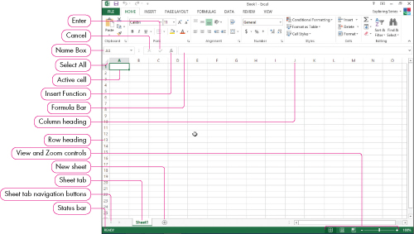
Exploring the Excel Window
Notes:
Figure 1.1 in the textbook illustrates elements specific to the Excel window.

Slide 7
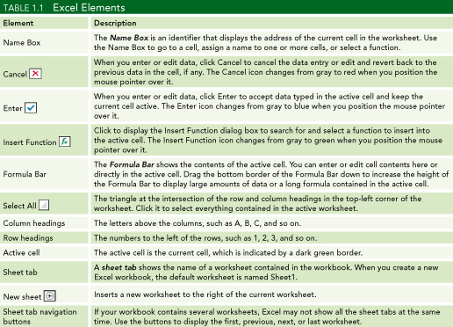
Exploring the Excel Window
Notes:
Table 1.1 in the textbook explains elements specific to the Excel window.
The Name Box displays the address of the selected cell. The Formula Bar displays the contents of a cell, including a text or numeric entry or the content of a formula. The Select All button is used to select the entire worksheet.
Row headings appear on the left side and are numbered 1, 2, 3, etc. Column headings appear above the columns and are labeled A, B, C, etc. Sheet tabs display the name of worksheets. The default worksheet name is Sheet1.

Slide 8
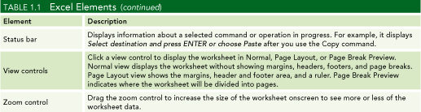
Exploring the Excel Window
Notes:
Table 1.1 in the textbook explains elements specific to the Excel window.
The Status bar displays information about a selected operation. The View controls control the Normal, Page Layout, or Page Break Preview displays. The Zoom controls increase or decrease the size of the worksheet onscreen.

Slide 9
Exploring the Excel Window
Worksheet rows lie horizontally
Worksheet columns lie vertically
A cell is the intersection of a row and column
A cell address or cell reference names a cell
Notes:
Worksheet rows lie horizontally and are numbered from 1 to 1,048,576. Worksheet columns lie vertically and are labeled from A to Z. Successive groups of 26 columns are labeled AA to AZ, BA to BZ, etc.
A cell is the intersection of a row and column. Each cell has a cell address made up from the column letter and row number.
For example, the cell address of the top left cell is A1.

Slide 10
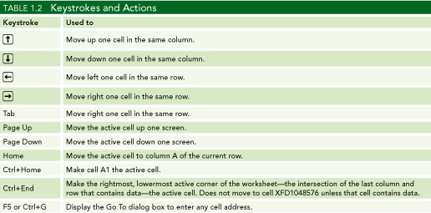
Navigating Worksheets
Notes:
Table 1.2 summarizes the keystrokes and actions used in Excel. The active cell is the current cell. To distinguish this cell, Excel places a dark green border around it and displays its cell address in the Name box. Excel offers many techniques to navigate to a particular cell, including mouse clicks, arrow keys, or pressing the Enter or Tab key.

Slide 11
Planning Structure of Worksheets
State the purpose of the worksheet
Decide what input values are needed
  An input area is a range of cells containing values
Decide what outputs are needed
  An output area is a range of cells containing results
Assign the worksheet inputs and results
  Use rows and columns
Notes:
It is important to plan the structure of a worksheet prior to entering data. First, state the purpose of the worksheet. For example, the purpose might be to compute the cost of a number of products given their quantity and unit cost.
Decide what input values are needed by establishing the input area. The input area is a range, or group, of cells.
Decide what output values are needed where the output area is also a range of cells.
Assign the inputs and results into rows and columns. For example, you may choose to enter each product in a row where the quantity and unit cost values are in columns. The result might also be placed in a column.

Slide 12
Planning Structure of Worksheets
Enter the labels, values, and formulas
Format the numerical values
Format the descriptive titles and labels
Document the workbook
Save and share the completed workbook
Notes:
After entering the input data consisting of labels (text) and values (numbers), check that the formulas are correct. Formatting the worksheet adds decorations to enhance readability and appeal. Numeric formats might include Currency format to display dollar signs or Percentage format to display a percent symbol. Text formats might include colors, fonts, and other styles. Documentation of a worksheet includes the current date, the name of the author, assumptions, purpose and other comments. Preview and prepare printouts for distribution in meetings and send electronic copies as needed.

Slide 13
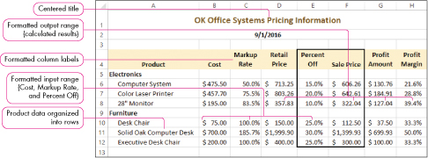
Planning Structure of Worksheets
Notes:
Figure 1.2 shows a what a completed worksheet might look like after planning the design and entering and formatting the data.

Slide 14
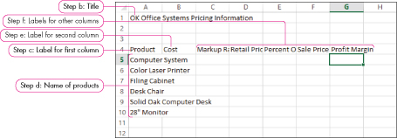
Entering Text
Notes:
Text is any combination of letters, numbers, symbols, and spaces not used in calculations. Special entries like phone numbers and Social Security numbers are considered to be text even though they contain digits. By default, text entries are left-aligned in a cell, although alignment options such as centering can be used. Multiple lines can be entered in the same cell by pressing the ALT+Enter key combination between the lines.

Slide 15
Entering Values
Notes:
Values and dates represent a quantity upon which math calculations can be performed. Values and dates can be entered using common formats, including percent and dollar signs. Examples include 9/15/2012 or $50.00. By default, numeric entries are right-aligned in a cell, although other alignments such as center or left are possible.

Slide 16
Entering Formulas
Formulas are combinations of cell addresses, math operations, values and/or functions
A formula begins with the equal sign (=)
  Examples:
  =A1+A2
  =C2*5
Notes:
Formulas are combinations of cell addresses, math operators, values and/or functions used in calculations. A function is a built-in formula, including SUM and AVERAGE functions.
Excel designates a formula with a preceding equal sign (=). One example of formula is =A1+A2 which adds the values in cells A1 and A2 and displays the sum. A second example of a formula is =C2*5 which multiplies the value in cell C2 by 5 and displays the product.

Slide 17
Entering Formulas
Cell D4 contains the formula =B4*C4
Cell C8 contains the formula =C4+C5+C6+C7
Notes:
When formulas are entered in a worksheet, the result appears in the cell. The formula itself is displayed in the Formula Bar when the cell is selected.

Slide 18
Editing Cell Content
Select Cell | Double-click Cell | Select Cell
1. Click in the Formula Bar. | 1. Make edits directly in the cell. | 1. Press F2.
2. Make changes in the Formula Bar. | 2. Press Enter. | 2. Make changes in the cell.
3. Click Enter on the left side of the Formula Bar. |  | 3. Press Enter.
Notes:
There are several methods that can be used when editing the contents of a cell. The cell contents can also be cleared by using Delete or by using the Clear option in the Editing group on the Home tab.

Slide 19
Mathematical Symbols
Operation | Common Symbol | Symbol in Excel
Addition | + | +
Subtraction | - | -
Multiplication | X | *
Division | ÷ | /
Exponentiation | ^ | ^
Notes:
The above table shows what mathematical keys to use when entering formulas in Excel.

Slide 20
Cell References in Formulas
It is best to use cell addresses in formulas versus actual data
  If cell A1 contains the value 5 and you need to add B1 to this value, use =A1+B1 versus =5+B1
If the data changes, Excel will recalculate the result
Notes:
It is best to use cell addresses in formulas rather than actual data. For example, if cell A1 contains the value 5, and you need to add B1 to this value, use =A1+B1 versus =5+B1
Remember, if the data changes, you want Excel to recalculate the answer.

Slide 21

Cell References in Formulas
Notes:
Figure 1.6 in the text shows examples of different formulas.

Slide 22
Order of Precedence
Order of precedence (operations) controls the sequence in which math operations are computed
  Parentheses
  Exponentiation
  Multiplication and Division
  Addition and Subtraction
Notes:
Order of precedence, also called order of operations, controls the sequence in which math operations are computed. Parentheses are done prior to exponentiation. This would be followed by multiplication and division, and finally addition and subtraction. Multiple operators of the same precedence are evaluated from left to right.

Slide 23
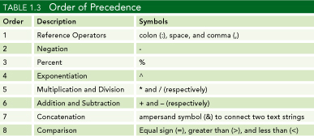
Order of Precedence
Notes:
Table 1.3 lists the complete order of precedence. The order of precedence can be changed by using parentheses.

Slide 24
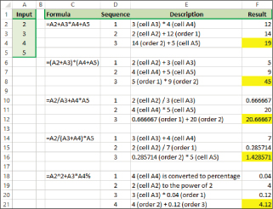
Order of Precedence
Notes:
Figure 1.7 shows formula results based on the order of precedence.

Slide 25
Using Auto Fill
Auto Fill enables you to copy the contents of a cell or cell range or to continue a series using the fill handle
  Example: Month names Jan, Feb, Mar form a series
The fill handle is the small green square in the bottom right corner of an active cell
Notes:
Auto Fill enables you to copy the contents of a cell or cell range or to continue a series using the fill handle. Excel recognizes several series, such as names of months or days of the week. The fill handle is the small green square in the bottom right corner of an active cell.

Slide 26
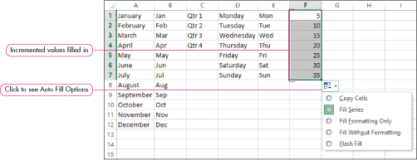
Using Auto Fill
Notes:
Figure 1.8 in the text shows examples of results of filling in months, abbreviated months, quarters, weekdays, abbreviated weekdays, and increments of 5. After the Auto Fill is used, Excel displays five Auto Fill Options: Copy Cells, Fill Series, Fill Formatting Only, Fill Without Formatting, or Flash Fill.

Slide 27
Displaying Cell Formulas
The result of a formula appears in a cell and the formula itself appears in the Formula bar
Press the Ctrl+` key combination to display formulas in the worksheet
This key combination acts as a toggle so can be used again to turn off the effect
Notes:
The result of a formula appears in a cell. The formula itself appears in the Formula bar. Press the Ctrl+` key combination to display formulas in the worksheet. This key combination acts as a toggle, so you can use it again to turn off the effect. You can also click Show Formulas in the Formula Auditing group on the Formulas tab.

Slide 28
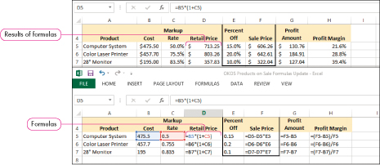
Displaying Cell Formulas
Notes:
See Figure 1.9 for an illustration of cell formulas and formula results.

Slide 29
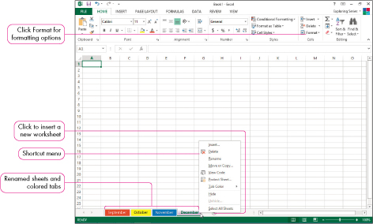
Managing Worksheets
Creating a multiple-worksheet workbook requires planning and maintenance
Notes:
Figure 1.16 shows a worksheet with colored tabs. Creating a multiple-worksheet workbook requires planning and maintenance. You can rename and apply colors to worksheet tabs for better identification. Worksheets can be moved, copied, inserted, and deleted to produce the best ordering.

Slide 30
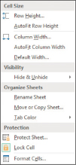
Organizing Worksheets
The Format Menu presents sheet commands
Notes:
Figure 1.17 shows the Format Menu. Renaming a sheet provides a clearer name than the default names Sheet1, Sheet2, etc. And, a sheet can be moved or copied to arrange the sheet order in the workbook. Color can be added to a sheet tab to identify the sheet and distinguish it from other worksheets.

Slide 31
Insert and Delete a Worksheet
Insert a worksheet to add a new worksheet to the workbook
Delete a worksheet when the data is no longer needed
Notes:
Inserting a worksheet in the workbook can be done at any time. The worksheet can be added by clicking the New sheet tab, clicking the Insert arrow on the HOME tab, right-clicking any sheet tab, or by pressing Shift+F11. Deleting a worksheet will eliminate extra data and reduce the file size. Deleting a worksheet can be done by clicking the Delete arrow on the HOME tab or right-clicking any sheet. If the sheet contains data, Excel will display a warning; if there is no data, Excel will not display a warning.

Slide 32
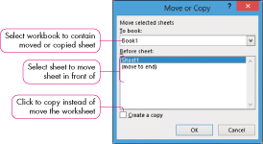
Moving or Copying Worksheets
Moving a worksheet changes its order among sheet tabs
Copying a worksheet makes a duplicate sheet at the new location
Notes:
Figure 1.18 shows a Move or Copy dialog box. Moving a worksheet changes its order among sheet tabs. The sheet can be also be dragged to its new location. Copying a worksheet makes a duplicate sheet. The sheet can also be dragged while holding the Ctrl key.

Slide 33

Inserting Rows and Columns
The Insert command offers several techniques to insert rows, columns, and cells
Notes:
Figure 1.19 shows an Insert dialog box. Excel offers many ways in which to insert content into an existing worksheet. Using the Insert command, you can select a row and add a new row above it, or you can select a column and add a new column to its left. If a single cell needs to be inserted, existing cells in the worksheet can be shifted down or right to accommodate the entry.

Slide 34
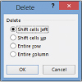
Deleting Rows and Columns
The Delete command offers several techniques to remove rows, columns, and cells
Notes:
Figure 1.20 shows a Delete dialog box. Excel also offers many ways to remove content from an existing worksheet. Using the Delete command, you can select a row or column and remove it. If a single cell needs to be deleted, existing cells in the worksheet can be shifted up or left.

Slide 35
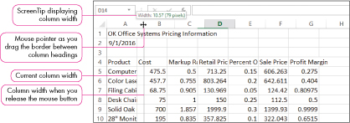
Adjusting Column Width
Column width is the horizontal measurement of a column
Notes:
Figure 1.21 shows changing the column width. The column width is the horizontal measurement of a column. A column should be widened to fully display all data. If it is too narrow, text entries may appear truncated and numeric entries will display the error message #####. To enlarge a column to accommodate the largest entry, double-click the column border to widen the column to the right. To manually alter column width, drag the column divider on the right side of the column. Alternatively, select the Column Width or AutoFit Column Width options on the Format menu.

Slide 36
Adjusting Row Height
Row height is the vertical measurement of a row
  The row height is automatically adjusted with a font size increase
  Using Alt+Enter to create multiple lines may require a row height adjustment
  Select Row Height from the Format menu
Notes:
The row height is the vertical measurement of a row. It is a value between 0 and 409 based on point size, where one point equals 1/72 of an inch. The row height is automatically adjusted if you increase the font size of the cell content. If you use Alt+Enter to create multiple lines, this may require a row height adjustment.
Manually adjust row height using the same techniques as for column width. You can drag the row divider or double-click the divider for a best fit. Alternatively, select the Row Height or AutoFit Row Height options on the Format Cells menu.

Slide 37

Hiding Columns and Rows
Hiding a column or row prevents it from displaying and printing
Unhiding a column or row returns it to view
Notes:
Figure 1.22 shows a hidden column and a hidden row. Hiding a column or row prevents it from displaying and printing. Use the Format command to hide or unhide the selected range.
Remember, the values in hidden columns and rows may be used in calculations.
Unhiding a column or row returns it to view. Select the columns or rows surrounding the hidden area and issue the Format command.

Slide 38
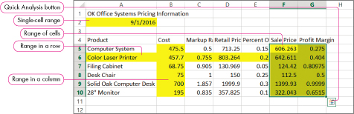
Selecting a Cell Range
A range is a group of adjacent or contiguous cells
A nonadjacent range contains a group of ranges that are not next to each other
Notes:
Figure 1.29 shows sample ranges. A range is a rectangular group of cells. The easiest way to select a range is to drag from the upper left cell to the lower right cell.
A nonadjacent range contains a group of ranges that are not next to each other. To create a nonadjacent range, select the first range, hold down the Ctrl key, and select the second range. Continue holding the Ctrl key to add more ranges to the group.
A range is selected to perform group formatting or to manipulate the group of cells as a unit with respect to moving, copying, or deletion.

Slide 39
Moving/Copying a Range
Moving/copying a range preserves text and values, but cell addresses in formulas will be altered in the pasted location
  Move a range by cutting it and pasting to the upper left corner of the destination
  Copy a range can by copying it and pasting to the upper left corner of the destination
Notes:
Moving/copying a range preserves text and values, but cell addresses in formulas, such as cell reference A1, will be altered in the pasted location. Move a range by cutting it and pasting to the upper left cell of the new location. The shortcut key combination for cutting is Ctrl+X and pasting is Ctrl+V. Copy a range by copying it and pasting to the upper left cell of the new location. The shortcut key combination for copying is Ctrl+C.

Slide 40
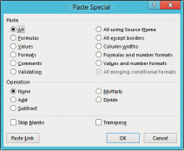
Using Paste Special
The Paste Special command is used to paste data from the clipboard using a different format
Notes:
Figure 1.32 shows a Paste Special dialog box. The Paste Special command is used to paste data from the clipboard using a different format. For example, you might want to paste the formula results but not the formulas, or you might want to paste the values but not the associated formats.

Slide 41
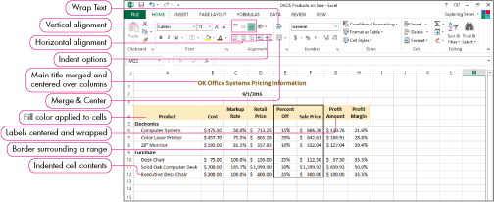
Formatting
Formatting accentuates and draws attention to meaningful portions of a worksheet
Alignment refers to how data are positioned in cells
Notes:
Figure 1.36 shows alignment options. Formatting accentuates and draws attention to meaningful portions of a worksheet. Horizontal alignment positions data between the left and right cell margins. Vertical alignment positions data between the top and bottom cell margins. The Merge and Center command is used to center a title over a range of columns.
To offset labels, text can be indented within a cell. You can use text wrapping to make data appear to lie on multiple lines without inserting a manual break with Alt+Enter. A border is a line that surrounds a cell or range. And Fill color is the background color of a cell or range.

Slide 42
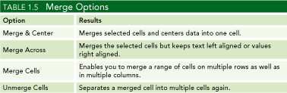
Merge and center labels
A range of cells can be merged together to become one cell
Data in merged cells are centered
Notes:
Table 1.5 shows the four merge options.

Slide 43
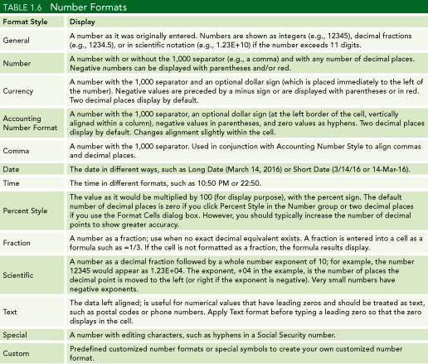
Numeric Formats
Notes:
See Table 1.6 for common numeric formats such as General, Number, Currency, Accounting, Comma, Date, and Time. Many numeric formats permit the user to specify the number of decimal places and options for negative values including parentheses and/or red color.

Slide 44
Numeric Formats (continued)
Notes:
Table 1.6 shows additional numeric formats including Percentage, Fraction, Scientific, Text, and Special. It is also possible to create your own Custom format. Many numeric formats permit the user to specify the number of decimal places and options for negative values.

Slide 45
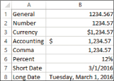
Numeric Formats (continued)
Notes:
Figure 1.37 illustrates several numeric formats as they appear on a worksheet.

Slide 46
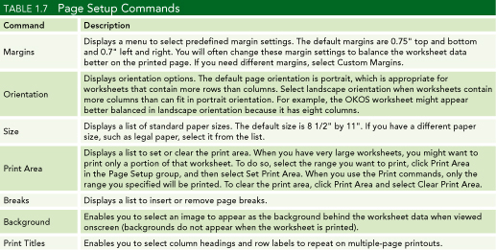
Using Page Setup
Page Setup contains many common print-related options
Notes:
The Page Setup Dialog Box Launcher contains many common print-related options. The Margins options set top, bottom, left and right page margins where the default values include 0.75” for top and bottom and 0.7” for left and right margins. The default Page Orientation is Portrait, while Landscape is used to print sideways. Landscape orientation is useful when there are more columns than rows.
The Sizes option lists standard paper sizes with the default set to 8.5” by 11”. In the Print Area option, it is possible to set the range of cells to be printed. The Break options allows you to insert and remove page breaks. The Background option is used to insert an image the worksheet background. This image does not appear when printed. The Print Titles option is used to print selected column headings at the top of each page.

Slide 47
Headers and Footers
A header is content appearing at the top of each printed page
A footer is content appearing at the bottom of each printed page
Notes:
A header is content that appears at the top of each printed page. A footer is content that appears at the bottom of each printed page. The Header/Footer tab of the Page Setup command also offers standard options, such as page number, as well as options for customization.

Slide 48
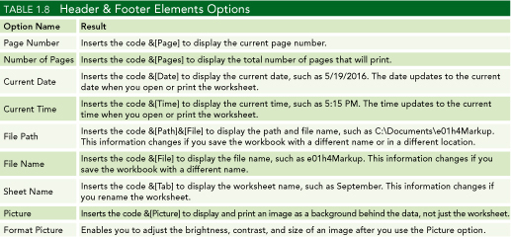
Headers and Footers
Notes:
Table 1.8 shows Header and Footer Element options.

Slide 49
Summary
In this chapter, you have learned how to enter and edit cell data.
You have created simple formulas with math operators as well as copied and displayed those formulas.
You can now manage a worksheet by manipulating rows, columns, and cells.
Notes:
Chapter 1 has introduced the basics of Excel data entry, formatting, creation of formulas, and management of workbooks.

Slide 50
Summary
You have learned basic formatting techniques to add visual appeal to text and numbers.
You can modify the page layout and create headers and footers.
You are able to print preview and finally print a worksheet.
Notes:
Chapter 1 has also introduced the basics of Excel label alignment and font options, number formatting, headers and footers, and printing of the worksheet.

Slide 51

Copyright
All rights reserved. No part of this publication may be reproduced, stored in a retrieval system, or transmitted, in any form or by any means, electronic, mechanical, photocopying, recording, or otherwise, without the prior written permission of the publisher. Printed in the United States of America.

