Slide 1
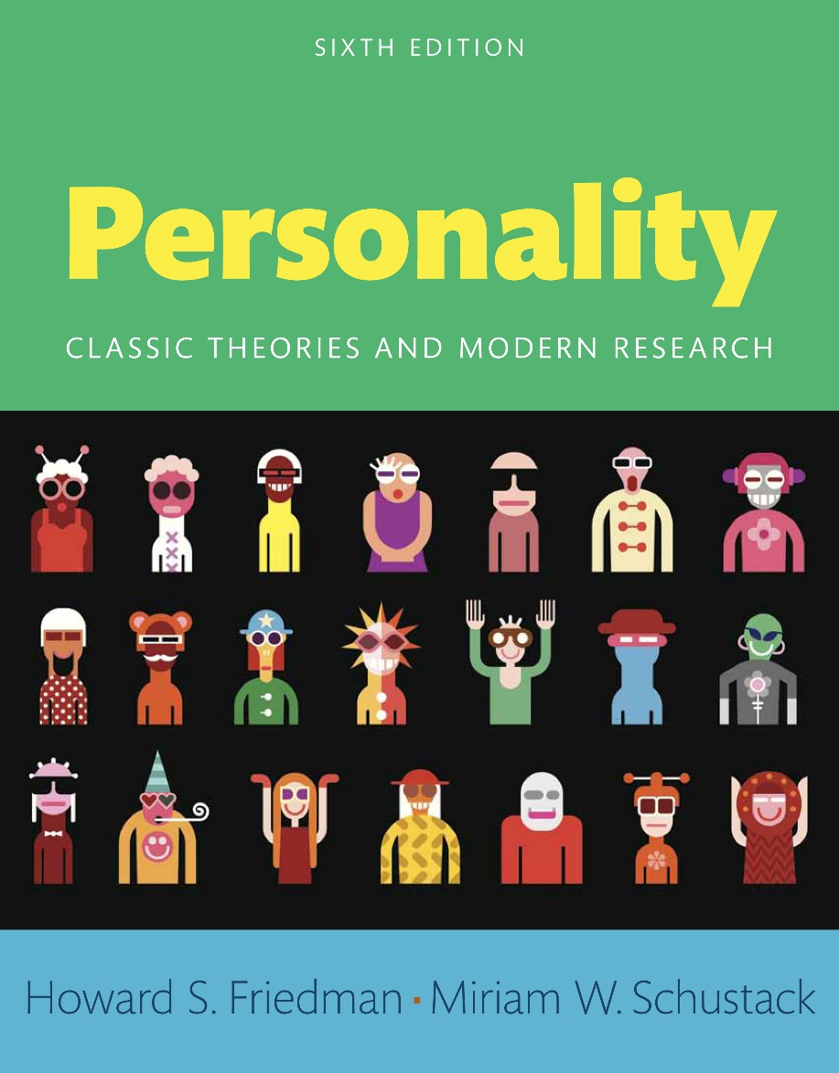
Personality
Sixth edition
Chapter 7
Cognitive and Social-Cognitive Aspects of Personality

Slide 2
Modules (1 of 2)
Introduction: Cognitive and Social-Cognitive Aspects of Personality
7.1: Roots of Cognitive Approaches
7.2: Cognitive and Perceptual Mechanisms
7.3: George Kelly’s Personal Construct Theory
7.4: Social Intelligence
7.5: Explanatory Style as a Personality Variable
7.6: Julian Rotter’s Locus of Control Approach

Slide 3
Modules (2 of 2)
7.7: Albert Bandura’s Social-Cognitive Learning Theory
7.8: Humans as Computers
Conclusion: Cognitive and Social-Cognitive Aspects of Personality

Slide 4
Learning Objectives (1 of 2)
7.1: Investigate different cognitive approaches to personality
7.2: Analyze the mechanisms of expecting, attending, and information processing
7.3: Express George Kelly's personal construct theory
7.4: Investigate how the concept of social, emotional, and multiple intelligence can be used to understand behavior

Slide 5
Learning Objectives (2 of 2)
7.5: Discuss the concept of explanatory style as a cognitive personality variable
7.6: Analyze the work done by Julian Rotter
7.7: Describe Albert Bandura’s theory of social-cognitive learning
7.8: Evaluate the process of the creation of virtual personalities

Slide 6
Introduction: Cognitive and Social-Cognitive Aspects of Personality
Cognitive approaches to personality
Social-cognitive aspects of personality

Slide 7
7.1: Roots of Cognitive Approaches
Objective: Investigate different cognitive approaches to personality
Beginning of cognitive psychology
Influences on thinking
Notes:
Point 1- Beginning of cognitive psychology
Charles Darwin’s theory of evolution
After the human mind came to be seen in biological terms
Point 2- Influences on thinking
Varied circumstances
Shaped by culture

Slide 8
7.1.1: Roots in Gestalt Psychology
Overview
Central tenets
Notes:
Point 1- Overview
An intellectual movement
Became very influential in Germany in the 1920s
Brought to America in the 1930s
Point 2- Central tenets
Human beings seek meaning in their environments
We organize the sensations we receive from the world around us into meaningful perceptions
Complex stimuli are not reducible to the sum of their parts

Slide 9
Figure 7.1: A Typical Gestalt Perceptual Figure
Gestalt theories claim that perception involves a search for meaning and that this meaning can be an emergent property that is not found within any single element. Here, the triangle that most people perceive “emerges” from the juxtaposition of incomplete circles; it exists in the mind of the perceiver, but not in the picture itself.
Notes:
Perception involves a search for meaning
This meaning can be an emergent property that is not found within any single element

Slide 10
7.1.2: Kurt Lewin’s Field Theory
Notion of “field”
Focus
Notes:
Point 1- Notion of “field”
As a field in the mathematical sense of vector forces
As a playing field (a field of life)
Point 2- Focus
Life space—all the internal and external forces that act on an individual
Structural relationships between the person and the environment

Slide 11
7.1.3: Cognitive Style Variables
Field-dependent style
Field-independent style
Notes:
Point 1- Field-dependent style
Very influenced in their problem solving by aspects of the context
Salient, but not directly relevant to the solution
Point 2- Field-independent style
More analytical
Allows for more complex levels of restructuring in problem solving

Slide 12
7.2: Cognitive and Perceptual Mechanisms
Objective: Analyze the mechanisms of expecting, attending, and information processing
Cognitive aspects of personality
Piaget’s contributions
Notes:
Point 1- Cognitive aspects of personality
Mechanisms of expecting
Attending
Information processing
Point 2- Piaget’s contributions
Focused on intellectual development
Had a major impact on cognitive conceptions of the development of personality
Proposed a cognitive-structure explanation of how children develop concepts about the world around them

Slide 13
7.2.1: Schema Theory
Concept of “schemas”
Activation of schema in given situations
Notes:
Point 1- Concept of “schemas”
New cognitive structures
Build on the schemas acquired earlier
Point 2- Activation of schema in given situations
Person’s expectations
Inferences
Actions

Slide 14
7.2.2: Categorization
Overview
Factors
Notes:
Point 1- Overview
Omnipresent
Occurs without conscious intention
Point 2- Factors
Stereotypes
Social categories
Higher-level thought processes
Low-level processing of facial, vocal, bodily cues

Slide 15
7.2.3: Control of Attention
Overview
Variations in people
Notes:
Point 1- Overview
People pick up on a few key features of their current environments
People filter these in light of their current goals
Point 2- Variations in people
Attention to things
A source of stable individual difference

Slide 16
7.2.4: Individual Differences in Attention
Attention-deficit/hyperactivity disorder (ADHD)
Subtypes of ADHD
Notes:
Point 1- Attention-deficit/hyperactivity disorder (ADHD)
Atypical attentional processes
People with or without the hyperactivity component
Point 2- Subtypes of ADHD
Hyperactive/Impulsive type (no inattention)
Inattentive type (no hyperactivity/impulsivity)
Combined type (both inattention and hyperactivity/impulsivity)

Slide 17
7.2.5: Cognitive Influences on Interpersonal Relationships
Influences on people’s interactions
Rejection sensitivity
Notes:
Point 1- Influences on people’s interactions
How people perceive themselves
How people perceive the partner
How people categorize the relationship
The goals people have for the relationship
Point 2- Rejection sensitivity
A personality variable
Captures the extent to which an individual is overly sensitive to cues that he or she is being rejected by another

Slide 18
7.3: George Kelly’s Personal Construct Theory
Objective: Express George Kelly's personal construct theory
Overview
Process
Notes:
Point 1- Overview
Focus on people’s active endeavors to construe the world
People construct their own versions of reality
This approach also called constructivism
Point 2- Process
People change as they reorganize their construct systems
Especially focused on the domain of interpersonal relationships

Slide 19
7.3.1: Individuals as Amateur Personality Theorists
Kelly’s theorizing
Uniqueness of Kelly’s theory
Notes:
Point 1- Kelly’s theorizing
Individuals make up their own “theories”
People use their personal experiences as the “data” that support (or invalidate) the theory
Point 2- Uniqueness of Kelly’s theory
People’s own system of constructs
Each person is more or less a personality theorist

Slide 20
7.3.2: The Role Construct Repertory Test
Overview
Modern social cognition approaches
Notes:
Point 1- Overview
Understanding of personality emerges through the process of making comparisons
Also called the “Rep test”
Point 2- Modern social cognition approaches
Attribution approaches
Social learning theories

Slide 21
7.4: Social Intelligence
Objective: Investigate how the concept of social, emotional, and multiple intelligence can be used to understand behavior
Overview
Emotional intelligence
Notes:
Point 1- Overview
People vary in their abilities to understand and influence other people
Captures the ways in which individuals differ from one another in their interpersonal skills
Point 2- Emotional intelligence
Being self-aware
Controlling anger and anxieties
Being persistent and optimistic in the face of setbacks
Being empathic
Interacting smoothly with others

Slide 22
7.5: Explanatory Style as a Personality Variable
Objective: Discuss the concept of explanatory style as a cognitive personality variable
Explanatory style
Variations in perspective
Notes:
Point 1- Explanatory style
A set of cognitive personality variables
Capture a person’s habitual means of interpreting events in her or his life
Point 2- Variations in perspective
There are a variety of approaches
Central idea of explanatory style

Slide 23
7.5.1: Optimism and Pessimism
Optimistic style
Pessimistic style
Notes:
Point 1- Optimistic style
Tend to interpret events in their lives with an optimistic perspective
Perceive neutral events as positive
See potential or eventual positive outcomes in negative events
Point 2- Pessimistic style
Tend to focus on the negative potential in a situation
Anticipate poorer outcomes

Slide 24
7.5.2: Learned Helplessness and Learned Optimism
Learned helplessness
Learned optimism
Notes:
Point 1- Learned helplessness
Repeated exposure to unavoidable punishment
Leads an organism to accept later punishment even when it is avoidable
Point 2- Learned optimism
Achieved by training people to think differently about themselves
To develop the healthier responses that characterize people who have an optimistic style

Slide 25
7.6: Julian Rotter’s Locus of Control Approach
Objective: Analyze the work done by Julian Rotter
Social-cognitive theory
Rotter’s approach
Notes:
Point 1- Social-cognitive theory
Combination of social learning theories
Important bridge between traditional social learning theories and the most modern ideas
Point 2- Rotter’s approach
Outcome expectancy
Reinforcement value

Slide 26
7.6.1: Generalized versus Specific Expectancies
Specific expectancies
Generalized expectancies
Notes:
Point 1- Specific expectancies
A particular reward will follow a behavior in a particular situation
A person not enjoying his father’s office holiday party
Point 2- Generalized expectancies
Related to a group of situations
A person can enjoy parties in general

Slide 27
7.6.2: The Role of Reinforcements and the Psychological Situation
Rotter’s psychological needs
Psychological situation
Notes:
Point 1- Rotter’s psychological needs
Status
Dominance
Independence
Love and affection
Physical comfort
Point 2- Psychological situation
Represents the individual’s unique combination of potential behaviors and their value to him or her
A person’s expectations and values interact with the situational constraints to exert a powerful influence on behavior

Slide 28
7.6.3: Locus of Control
Locus of control
Dimensions of locus of control
Notes:
Point 1- Locus of control
Internal locus of control
External locus of control
Point 2- Dimensions of locus of control
Internality
Luck or chance
Powerful others

Slide 29
7.7: Albert Bandura’s Social-Cognitive Learning Theory
Objective: Describe Albert Bandura’s theory of social-cognitive learning
Albert Bandura
Bandura’s inspirations
Notes:
Point 1- Albert Bandura
A social-cognitive theorist
His major work addresses the nature of observational learning
Point 2- Bandura’s inspirations
Clark Hull
Edward Tolman

Slide 30
7.7.1: The Self-System
Factors affecting individuals
Bandura’s theory
Notes:
Point 1- Factors affecting individuals
Expectations
Anticipated reinforcement
Thoughts
Plans
Goals
Point 2- Bandura’s theory
Effects of prior reinforcement are internalized
Behavior changes because of changes in the person’s knowledge and expectations

Slide 31
7.7.2: Observational Learning
Overview
Influencing factors
Notes:
Point 1- Overview
Learning without performing the behavior themselves
Learning without being directly rewarded or punished for the behavior
Point 2- Influencing factors
Age
Gender
Similarity to the observer
Status
Competence and power

Slide 32
7.7.3: Self-Efficacy
Overview
Four types of information
Notes:
Point 1- Overview
An expectancy about how competently one will be able to enact a behavior in a particular situation
Differs from the concept of locus of control
Point 2- Four types of information
Our experiences trying to perform the target behavior or similar behavior
Watching others perform that or similar behaviors
Verbal persuasion
How we feel about the behavior (emotional reactions)

Slide 33
7.7.4: Self-Regulation Processes
Process
Relevance
Notes:
Point 1- Process
Setting goals for themselves
Evaluating their success at reaching those goals,
Rewarding themselves for accomplishing those goals
Point 2- Relevance
Applied areas
Health
Education

Slide 34
7.8: Humans as Computers
Objective: Evaluate the process of the creation of virtual personalities
Process
Attributions to machines
Notes:
Point 1- Process
Theoretical constructs are translated into a computer model
“Behavior” of the model is examined under a variety of conditions
Point 2- Attributions to machines
Goals
Beliefs
Mental states

Slide 35
Conclusion: Cognitive and Social-Cognitive Aspects of Personality
Cognitive approaches to personality
Categorization processes
Personal construct theory
Social intelligence
Explanatory style

