Slide 1
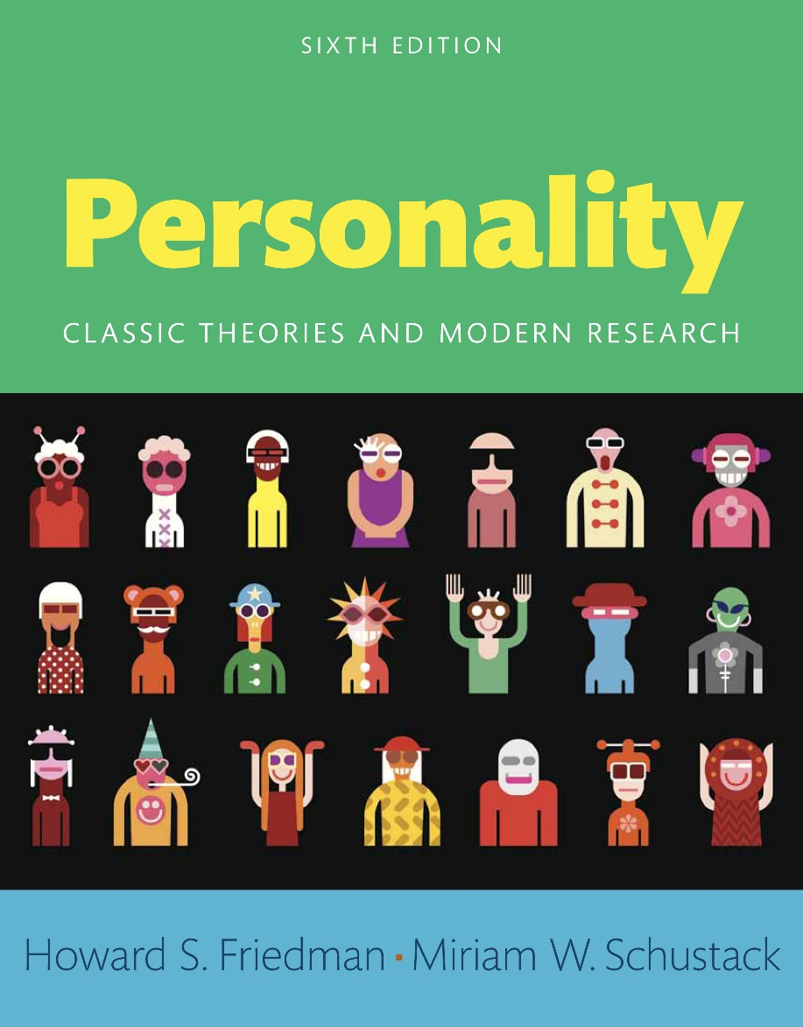
Personality
Sixth edition
Chapter 15
Where Will We Find Personality?

Slide 2
Modules
Introduction: Where Will We Find Personality?
15.1: The Brave New World of Personality
15.2: The Eight Perspectives Revisited
Conclusion: The Brave New World of Personality

Slide 3
Learning Objectives
15.1: Analyze the possibility of controlling individual behavior through social engineering
15.2: Assess the eight basic perspectives of personality

Slide 4
Introduction: Where Will We Find Personality?
Future of personality psychology
Reasons for studying personality psychology

Slide 5
15.1: The Brave New World of Personality
Objective: Analyze the possibility of controlling individual behavior through social engineering
Dramatic scientific developments
Implications
Notes:
Point 1- Dramatic scientific developments
Better understanding of brain biochemistry
More accurate control of environmental contingencies
Social engineering
Better understanding of the human genetic code
Point 2- Implications
Possibility of chemically controlled drug-designed personalities
Improve society’s ability to control individual behavior
Dramatic change in our understanding of and control over behavioral genomics

Slide 6
15.1.1: Drugs and Designer Personalities
Use of psychoactive substances
Social neuroscience
Notes:
Point 1- Use of psychoactive substances
Alcohol
Opium
Peyote
To influence the brain and thereby influence behavior
Point 2- Social neuroscience
To help people suffering from mental illnesses
Freud highly recommended the use of cocaine
Amphetamines to treat depression
Tranquilizers like Valium to treat anxiety

Slide 7
15.1.2: A Utopian World versus Abuse of Reward and Punishment
Skinner’s version of utopia
Less effective means of control
Notes:
Point 1- Skinner’s version of utopia
Convention and coercive societal restrictions eliminated
Reward system shapes people’s desires to fit community’s needs
Society pleasantly manipulates workforce through positive reinforcement
Point 2- Less effective means of control
Coercion
Fear
Punishment

Slide 8
15.1.3: Genetic Superhumans
Behavioral genomics
Human genetic therapy
Notes:
Point 1- Behavioral genomics
Study of how genes affect behavior
Greatest challenge in the brave new world of personality
Point 2- Human genetic therapy
Ultimate goal of the research
Manipulation of the genes
Now commonplace with certain crop plants

Slide 9
15.1.4: Can I Change My Personality?
Modes of dramatic personality change
Process of personality change
Notes:
Point 1- Modes of dramatic personality change
Drugs
Extreme conditioning
Genomics
Point 2- Process of personality change
People learn to change how they think about things
What they do in their daily habits
Their deeper beliefs
People and situations they associate with

Slide 10
15.1.5: Some Applications of Personality Psychology
Personality-based evaluation of employees
Prime motivations of studying personality psychology
Notes:
Point 1- Personality-based evaluation of employees
Structured interviews
Reference letters
Comments by those who know the applicant
Standardized personality tests
Point 2- Prime motivations of studying personality psychology
Love of understanding what makes us individuals
Understanding why we each do what we do

Slide 11
15.2: The Eight Perspectives Revisited
Objective: Assess the eight basic perspectives of personality
Eight aspects of personality
Notes:
Point 1- Eight aspects of personality
Psychoanalytic
Ego
Biological
Behaviorist
Cognitive
Trait
Humanistic
Interactionist

Slide 12
15.2.1: Is There One Correct Perspective?
Overview
Why not have one favorite perspective?
Notes:
Point 1- Overview
They are not scientific theories
Theories that grow out of these perspectives can indeed be tested
Some theories about particular aspects of personality are preferable to others
Point 2- Why not have one favorite perspective?
Expand theoretical potentials
Facilitate discovery of problems with entrenched assumptions

Slide 13
15.2.2: Are There Exactly Eight Perspectives?
Overview
Conclusions
Notes:
Point 1- Overview
Important to understand what each perspective has to offer
Understanding each aspect’s strengths and weaknesses
Point 2- Conclusions
We find something very valuable in each perspective
No single perspective provides the royal road to understanding personality

Slide 14
15.2.3: Can the Perspectives Be Merged?
Overview
Hypothetical merging processes
Notes:
Point 1- Overview
Various perspectives cannot and perhaps should not be merged
It may be that personality is too complex to be understood from any single perspective
Need for different sorts of analyses to understand different sorts of issues
Point 2- Hypothetical merging processes
Integrate biological bases for the Big Five trait approaches
Social learning approaches might be integrated with the cognitive approaches

Slide 15
Conclusion: The Brave New World of Personality
Why would anyone take a course about personality?
New conceptions of personality
Usefulness of personality psychology
Eight basic perspectives of personality

