Slide 1
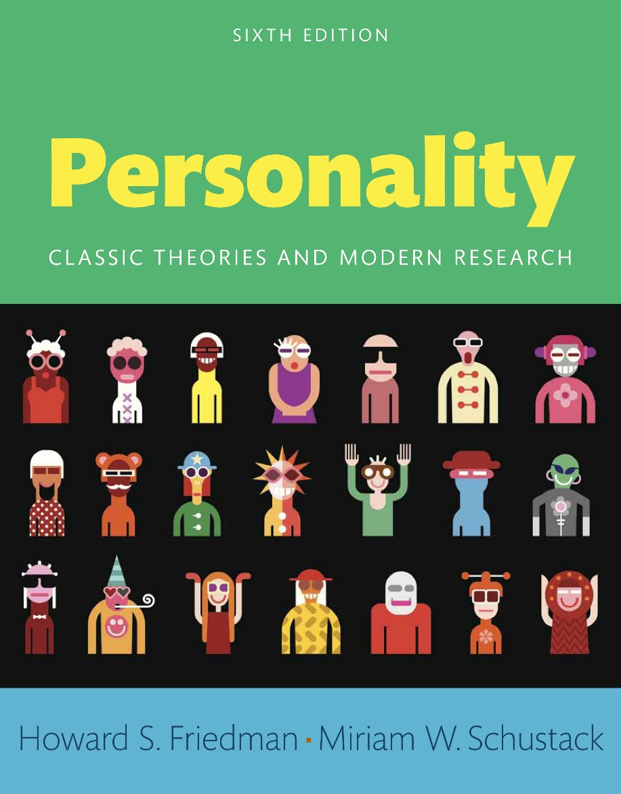
Personality
Sixth edition
Chapter 13
Culture, Religion, and Ethnicity

Slide 2
Modules (1 of 2)
Introduction: Culture, Religion, and Ethnicity
13.1: Group Influence
13.2: History of Research on Personality and Culture
13.3: Collectivist and Individualistic
13.4: Errors of Scientific Inference
13.5: Religion
13.6: Socioeconomic Influences on Personality
13.7: Language as a Cultural Influence
13.8: Culture and Testing

Slide 3
Modules (2 of 2)
13.9: A More General Model of Personality and Culture
13.10: Recent Research Directions
Conclusion: Culture, Religion, and Ethnicity

Slide 4
Learning Objectives (1 of 3)
13.1: Examine the influences of groups, peers, and family on personality development
13.2: Examine the influences of culture on personality development
13.3: Contrast the autonomous individual with the collective
13.4: Evaluate the importance of multiple sources of error in judgments of personality

Slide 5
Learning Objectives (2 of 3)
13.5: Analyze the influence of religion on response
13.6: Describe how socio-economic factors influence personality
13.7: Evaluate the influence of language on personality
13.8: Examine the importance of assumptions while conducting psychological testing
13.9: Report how culture determines personality and behavior

Slide 6
Learning Objectives (3 of 3)
13.10: Appraise the relevance of current research on personality and culture

Slide 7
Introduction: Culture, Religion, and Ethnicity
Influences of groups, peers, and family on personality development
Influences of culture on personality development
Influence of language on personality

Slide 8
13.1: Group Influence
Objective: Examine the influences of groups, peers, and family on personality development
No man is an island
Major influences on personality
Notes:
Point 1- No man is an island
Everyone’s life is related to everyone else
People are embedded in the social structure
Point 2- Major influences on personality
Family
Peers
Groups

Slide 9
13.1.1: Cultural Effects
Direct social influences
Other influences
Notes:
Point 1- Direct social influences
Religious upbringing
Education system
Government
Nationality
Point 2- Other influences
Ethnicity
Class

Slide 10
13.2: History of Research on Personality and Culture
Objective: Examine the influences of culture on personality development
Ethnocentrism
Areas of cultural differences
Notes:
Point 1- Ethnocentrism
Evaluating others from one’s own cultural point of view
Other cultures appear strange
Point 2- Areas of cultural differences
Eating habits
Passing down history
Approach to sex

Slide 11
13.2.1: Contributions from Cultural Anthropology
How culture affects development
Cultural knowledge vs behavior
Notes:
Point 1- How culture affects development
Some cultures see a smooth transition into adolescence
In some cultures children are expected to care for younger siblings; in others, they are expected to explore their potential
In some cultures children are exposed to sexual behavior as normal; in others such behavior is termed sinful
Point 2- Cultural knowledge vs behavior
A child from a hunting tribe would automatically know how to survive a night in the jungle
A child from America would know what a bagel is and how to eat it

Slide 12
13.2.2: Emic versus Etic Approaches
Emic approach
Etic approach
Notes:
Point 1- Emic approach
Culture specific
Studies a culture in isolation
Requires indigenous methods
Point 2- Etic approach
Cross-cultural
Searches for generalities across cultures
Transplants systems from one culture into another

Slide 13
13.3: Collectivist and Individualistic
Objective: Contrast the autonomous individual with the collective
Individualistic
Collectivistic
Notes:
Point 1- Individualistic
Emphasize autonomy
Decontextualized, logic-driven
Point 2- Collectivistic
Group-focused
Relational, interconnected, and context-sensitive

Slide 14
13.4: Errors of Scientific Inference
Objective: Evaluate the importance of multiple sources of error in judgments of personality
Ignorance of social and cultural influences
Examples
Notes:
Point 1- Ignorance of social and cultural influences
Leads to errors of judgment
Not malicious bigots
Point 2- Examples
Galton believed Western males had highest intelligence
Freud described a healthy woman as a good wife and mother, and who is most satisfied by sex with her husband
Yale controlled enrolled Jewish and women students

Slide 15
13.4.1: Race as a Flawed Approach to Grouping People
Grouping by belief
Ethnic groups
Race
Notes:
Point 1- Grouping by belief
Religious groups
Political parties
Can change
Point 2- Ethnic groups
Irish Catholics
Mexicans
Cannot change
Point 3- Race
Skin color
Physical characteristics
Cannot change

Slide 16
13.4.2: The American Dilemma
Racial stereotyping
Common stereotypes
Notes:
Point 1- Racial stereotyping
Modern research shows no support for common stereotypes
Skin color affects personality in complex ways
Point 2- Common stereotypes
English are reserved
Canadians are unemotional
Asians are clannish
Blacks are superstitious

Slide 17
13.5: Religion
Objective: Analyze the influence of religion on response
Effect of religion on personality
Psychoanalysts and religion
Notes:
Point 1- Effect of religion on personality
Two sets of rules to follow–religious and cultural
Relevant to self-regulation, health, and social integration
Point 2- Psychoanalysts and religion
Freud and others were vocally antireligion
Carl Jung very interested in religious symbolism

Slide 18
13.6: Socioeconomic Influences on Personality
Objective: Describe how socio-economic factors influence personality
SES gradient
Social class
Notes:
Point 1- SES gradient
The higher a person’s socioeconomic status, the lower that person’s risk of getting sick and of dying prematurely
This relation has been found in various times and places and income levels
Point 2- Social class
Can have sweeping effects on individuals
Significant effects on usual patterns of psychological reactions

Slide 19
13.6.1: Karl Marx and Alienation
Effects of the economic system on individual behavior
Socioeconomic influences
Notes:
Point 1- Effects of the economic system on individual behavior
Took share in Karl Marx’s work
Concluded that many societal institutions (including religion) served mainly to maintain the economic power of the elite
His ideas led to modern socialism and communism
Point 2- Socioeconomic influences
Key concepts in understanding human behavior
Adopted in many modern analyses
Existential alienation in modern society

Slide 20
13.7: Language as a Cultural Influence
Objective: Evaluate the influence of language on personality
Effects of language
Helps preserve cultural heritage
Notes:
Point 1- Effects of language
Influential feature of any culture
Used in independence struggles
Point 2- Helps preserve cultural heritage
Oral form is pervasive mode for interactions
Central to who we are

Slide 21
13.7.1: Language and Identity
Role of language
Idiolect
Dialects
Notes:
Point 1- Role of language
Keeps out those who do not speak the language
Reinforces ties among those who do
Point 2- Idiolect
Each individual speaks a unique version of his or her native language
Helps identify a writer’s work through this uniqueness
Point 3- Dialects
Regional characteristics
Cultural characteristics

Slide 22
13.7.2: Creating a Culture through Shared Language
Deaf community
Culture of the blind
Notes:
Point 1- Deaf community
Culture of the Deaf
Deafness seriously interferes with the ability of most deaf individuals to communicate with the larger society
Deaf community shares a language within the group
Point 2- Culture of the blind
Also face many extra difficulties in everyday life
But they are not especially impaired in using the common language of the community at large

Slide 23
13.7.3: Language as Politics
“English Only” movement
Anti-“English Only” movement
Notes:
Point 1- “English Only” movement
People who favor limiting all governmental communication to English
They believe it helps immigrants integrate with society
Point 2- Anti-“English Only” movement
Wants the government to continue to offer services in the languages preferred by the recipients
Views the “English Only” movement as racist, exclusivist

Slide 24
13.7.4: Language and Thought
Language for communication
Whorfian hypothesis
Notes:
Point 1- Language for communication
Influences how you communicate
Requirements of a language become part of how the speaker casts an intended communication into words
Point 2- Whorfian hypothesis
Promoted by Benjamin Lee Whorf and Edward Sapir
It claims that our interpretation of the world is, to a large extent, dependent on the linguistic system by which we classify it

Slide 25
13.7.5: Bilingualism
Effects of bilingualism
Examples
Notes:
Point 1- Effects of bilingualism
People behave in line with the language they are speaking at the time
Language triggers certain thoughts and behavior patterns
Point 2- Examples
Bilingual children in Hong Kong responded differently depending on the language used by the interviewer
Series of studies of bilinguals in Spanish and English showed they responded differently depending on the language

Slide 26
13.7.6: Language and Social Interaction
Pecking order
Examples
Notes:
Point 1- Pecking order
Social position defines how you speak
Some languages have different pronouns to indicate position
Point 2- Examples
French – tu, vous
Spanish – tu, usted
German – du, Sie
English - you

Slide 27
13.7.7: Gender and Language
Gender neutrality
Gender neutral third-person
Notes:
Point 1- Gender neutrality
Difficult in English
Common in other languages
Point 2- Gender neutral third-person
Does not exist in English
The pronoun “he” is associated with the male
Challenge to phrase things in gender-neutral form

Slide 28
13.8: Culture and Testing
Objective: Examine the importance of assumptions while conducting psychological testing
Culturally-biased assumptions
Affects test scores
Notes:
Point 1- Culturally-biased assumptions
May not adequately capture some cultural experiences
May view some characteristics as pathological
Point 2- Affects test scores
Motivation
Previous test-taking experience
The qualities of the examiner (test administrator)
Socioeconomic status

Slide 29
13.8.1: Culture-Free and Culture-Fair Tests
Culture-free tests
Culture-fair tests
Solutions
Notes:
Point 1- Culture-free tests
Raven Progressive Matrices test, people analyze geometric figures
Analysis shows that some cultural assumptions creep into every such test
Point 2- Culture-fair tests
Attempt to control for or rule out effects that result from culture
Might test how quickly individuals respond to a stimulus such as a sound or a picture
But this too is affected by culture
Point 3- Solutions
Include some subscales that are known to be culturally biased and other subscales that are thought to be more culture-fair
SOMPA compares individuals within cultural groups, not across

Slide 30
13.8.2: Stereotype Threat
Negative stereotype
Positive stereotype
Notes:
Point 1- Negative stereotype
Poor performance due to stereotype
Performance improves when stereotype is not relevant
Physiological reactions
Point 2- Positive stereotype
Improves performance due to stereotype
People with higher self-esteem perform better

Slide 31
13.9: A More General Model of Personality and Culture
Objective: Report how culture determines personality and behavior
Cultural context
Relationship between Native Americans and U.S. government
Notes:
Point 1- Cultural context
Ideas of personality and predictable behavior are meaningless outside of a cultural context
Issues echo around the world in so many ethnic and religious conflicts
Point 2- Relationship between Native Americans and U.S. government
Broken agreements
Forcing of dominant culture
Made dependent on government for livelihood

Slide 32
13.9.1: Incorporating Culture into Personality Theory
Accept culture as basic element of personality
Example of prejudice
Notes:
Point 1- Accept culture as basic element of personality
Not to try to eliminate culture
Rather, to bring culture into key consideration
Point 2- Example of prejudice
Exists during economic rivalry
Exists during times of social change

Slide 33
13.9.2: Culture and Humanity
Accept culture as basic element of personality
Example of prejudice
Notes:
Point 1- Culture provides basic information
What it means to be a human
Answer may vary
Point 2- Fundamental questions are common across cultures
What does society value and expect of me?
Who is like me, on my side, in my family?
What should a man do versus what should a woman do?
What is mature, rational behavior, and what is childish, impulsive behavior?

Slide 34
13.9.3: Culture and Theory
Culture influences theory
Validity of theories
Notes:
Point 1- Culture influences theory
Type of analysis depends on the researcher’s culture
Adapts ideas of peer group
Point 2- Validity of theories
Human behavior is complex
Different but overlapping theories will emerge
Understand each theory in its context
Be open-minded

Slide 35
13.10: Recent Research Directions
Objective: Appraise the relevance of current research on personality and culture
Cultural views of the self
Western view
Eastern view
Notes:
Point 1- Cultural views of the self
Western view
Eastern view
Point 2- Western view
Idea of the unlimited potential of the divinely inspired free man or woman
It is assumed that each person should strive to be independent and self-reliant
Focus on individual, not social context
Point 3- Eastern view
Success of society over individual
Selflessness
Self-sacrifice

Slide 36
13.10.1: The Situation May Elicit Cultural Differences
Situationally influenced aspects of cultural identity
New directions
Notes:
Point 1- Situationally influenced aspects of cultural identity
Likely to occur in collectivist cultures or subcultures
Globalization and migration have led to diverse college classrooms
Point 2- New directions
Study of traits moving toward understanding behavioral outcomes (like success and achievement)
Cultural personality psychology is becoming more focused on cultural products

Slide 37
13.10.2: Ethnic Socialization
Challenges in diverse societies
Reaction when stereotypic information is disconfirmed
Notes:
Point 1- Challenges in diverse societies
Instilling pride in children without encouraging feelings of superiority
Preparing children for prejudice without instilling anxiety
Point 2- Reaction when stereotypic information is disconfirmed
Depends on one’s implicit theories about traits
People who believe that traits are fixed show greater attention to stereotype-consistent information

Slide 38
Conclusion: Culture, Religion, and Ethnicity (1 of 2)
Understanding cultural influences is important to understanding all eight of the basic aspects of personality
Cultural differences involve the shared behaviors and customs we learn from the institutions in our society
They are an essential component of who we are

Slide 39
Conclusion: Culture, Religion, and Ethnicity (2 of 2)
The effects of social class—social and economic status—on personality can be dramatic
Language is one of the defining features of a person’s identity

