Slide 1
Determine the Difference between Internal and External Cost Reporting
Principles of Cost Analysis and Management

Slide 2
Is it in the interest of the Army that contractors manage cost, not just report it?
Notes:
Introduction
Is it in the interest of the Army that contractors manage cost, not just report it?
Contractors who do business with any branch of the federal government are subject to regulations, and to significant scrutiny to assure compliance with those regulations. The question is, do those regulations guarantee or even promote true cost management?

Slide 3
Terminal Learning Objective
Task: Determine the Difference between internal and external cost reporting
Condition: You are a cost advisor technician with access to all regulations/course handouts, and awareness of Operational Environment (OE)/Contemporary Operational Environment (COE) variables and actors.
Standard: with at least 80% accuracy:
  Describe Defense Contractor issues
Notes:
Introduction
Task: Determine the Difference between internal and external cost reporting
Condition: You are a cost advisor technician with access to all regulations/course handouts, and awareness of Operational Environment (OE)/Contemporary Operational Environment (COE) variables and actors.
Standard: with at least 80% accuracy:
Describe Defense Contractor issues

Slide 4
Regulatory Authorities
FAR – Federal Acquisition Regulations (Title 48 of the U.S. Code of Federal Regulations)
DFARS – Defense FAR supplement
AFARS – Army FAR supplement
CASB – Cost Accounting Standards Board
DCAA – Defense Contract Audit Agency
DCMA – Defense Contract Management Agency
DoD IG – Department of Defense Inspector General
Notes:
Introduction
Contractors who do business with the Army are subject to the following regulations. We’ll look only briefly at a few of these to get the flavor.
FAR – Federal Acquisition Regulations (Title 48 of the U.S. Code of Federal Regulations)
DFARS – Defense FAR supplement – Defense specific regulations
AFARS – Army FAR supplement – Army specific regulations
The following entities govern the reporting of cost by government contractors, and certify compliance with all applicable regulations.
CASB – Cost Accounting Standards Board – the authoritative body for cost accounting standards for federal contractors. The board is authorized by Title 48.
DCAA – Defense Contract Audit Agency – examines contractors for compliance with all applicable regulations and also specific contract provisions for DoD contracts. Reports and makes recommendations to DCMA.
DCMA – Defense Contract Management Agency – manages contracts for DoD. Their job is drawing up the contracts and making sure the provisions of contracts are fulfilled by contractors.
DoD IG – Department of Defense Inspector General – Among other things the Inspector General audits the DCAA to make sure that its recommendations to DCMA are appropriate.
Are these external or internal entities to the contractor? What type of cost measurement focus do you think contractors are likely to have?

Slide 5
Nature of Cost Reporting
Contractors who develop weapons systems for DoD must provide a Contractor Cost Data Report
  Includes the Functional Cost-Hour Report, the Work Breakdown Structure, and the Progress Curve Report
  Requires a 143-page manual of instructions for completing the report
Notes:
Activity Step 1: Describe the nature of cost reporting by defense contractors
All contractors who develop weapons systems for DoD must provide a Contractor Cost Data Report
This report includes the Functional Cost-Hour Report, the Work Breakdown Structure, and the Progress Curve Report
The manual for completing this report is 143 pages long. The manual provides detailed step-by-step instructions that are similar to the instructions for filling out a tax return.

Slide 6
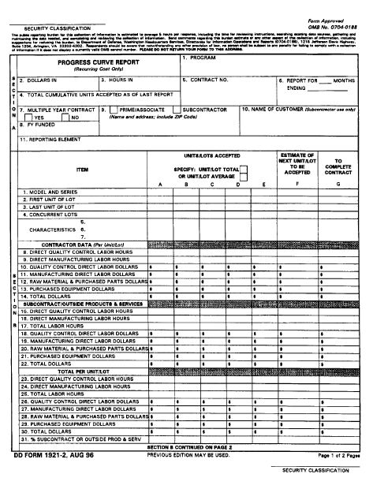
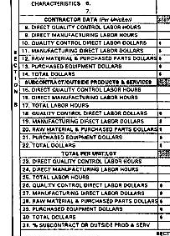
Nature of Cost Reporting
The Progress Curve report is very detailed….13 pages of instructions for this form!
Notes:
Activity Step 1: Describe the nature of cost reporting by defense contractors
The Progress Curve report is very detailed….13 pages of instructions are required just to fill out this form!
You can see in the zoomed portion the level of detail that is required in labor reporting: direct materials and equipment dollars, direct labor hours, direct labor dollars, and various classes of other labor in both hours and dollars.

Slide 7
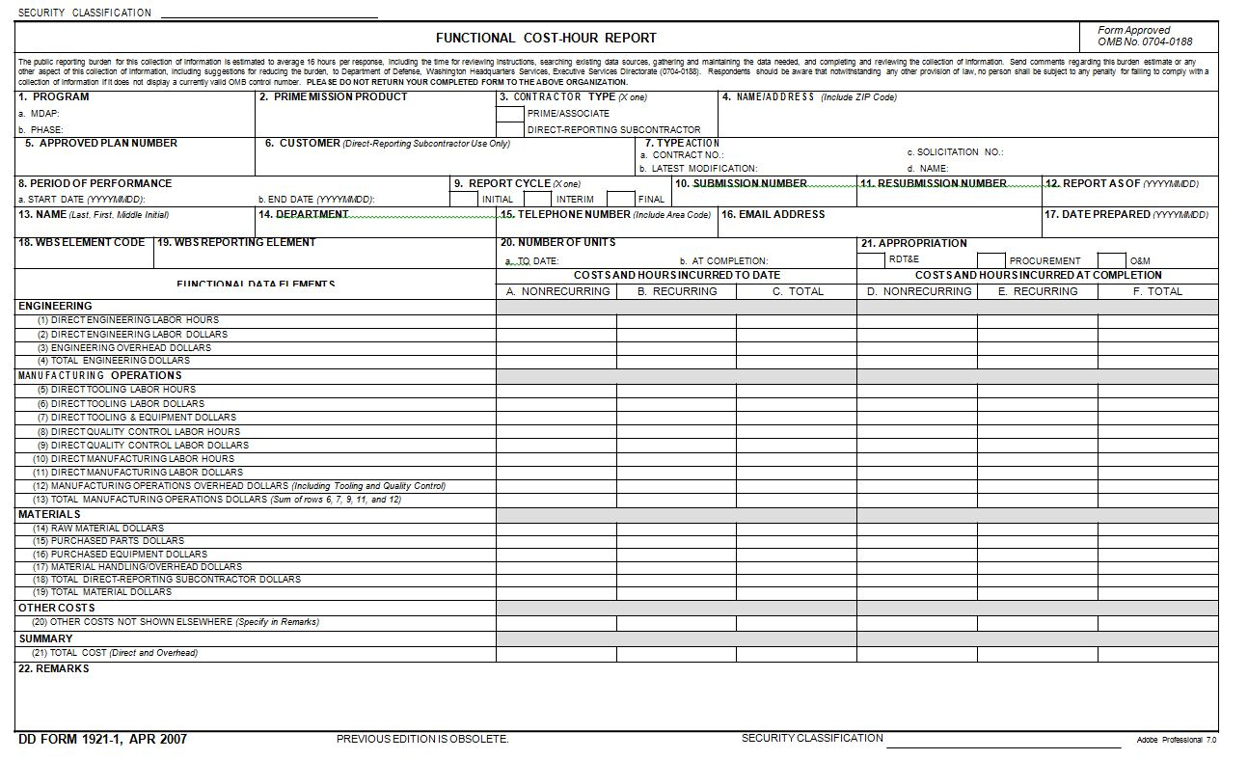
Nature of Cost Reporting
The Functional Cost-Hour Report is highly specified by external users for consistency and comparability
Notes:
Activity Step 1: Describe the nature of cost reporting by defense contractors
The Functional Cost-Hour Report is highly specified by external users for consistency and comparability
Again, in the zoomed portion you can see the level of detail required. Costs in each category must be classified as recurring and non-recurring.

Slide 8
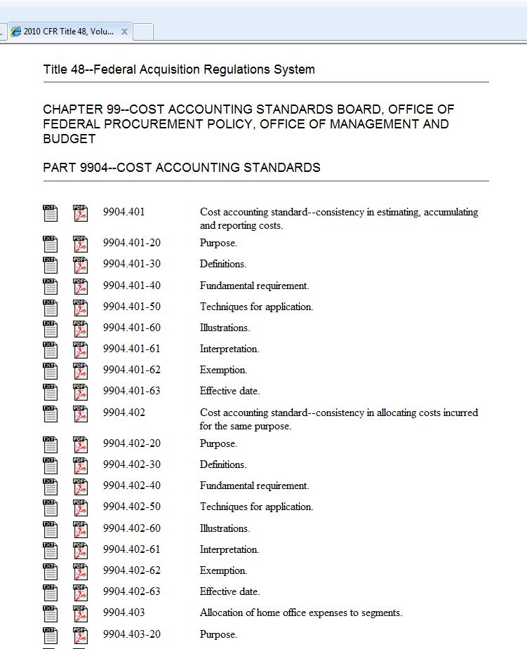
Cost Accounting Standards
Notes:
Activity Step 1: Describe the nature of cost reporting by defense contractors
Federal contractor cost accounting standards, as developed by CASB, are codified in Chapter 99 of Title 48. The overall goal of the cost accounting standard is to make sure that there is consistency in the way a contractor estimates, accumulates and measures costs. The rules and regulations to assure this consistency are lengthy.

Slide 9
The table of contents for the Cost Accounting Standard fills seven pages
Notes:
Activity Step 1: Describe the nature of cost reporting by defense contractors
In fact, the table of contents alone fills seven pages.

Slide 10
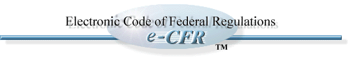
Consistency in estimating, accumulating and reporting costs
Consistency in allocating costs incurred for the same purpose
Allocation of home office expenses to segments
Capitalization of tangible assets
Accounting for unallowable costs
Cost accounting period
Use of standard costs for direct material and direct labor
Accounting for costs of compensated personal absence
Depreciation of tangible capital assets
Allocation of business unit general and administrative expenses to final cost objectives
Accounting for acquisition costs of material
Composition and measurement of pension cost
Adjustment and allocation of pension cost
Cost of money as an element of the cost of facilities capital
Accounting for the cost of deferred compensation
Accounting for insurance costs
Cost of money as an element of the cost of capital assets under construction
Allocation of direct and indirect costs
Accounting for independent research and development costs and bid and proposal costs
Notes:
Activity Step 1: Describe the nature of cost reporting by defense contractors
The main points of the standard are listed here, and may be accessed through the Electronic Code of Federal Regulations.

Slide 11
Consistency in estimating, accumulating and reporting costs
Consistency in allocating costs incurred for the same purpose
Allocation of home office expenses to segments
Capitalization of tangible assets
Accounting for unallowable costs
Cost accounting period
Use of standard costs for direct material and direct labor
Accounting for costs of compensated personal absence
Depreciation of tangible capital assets
Allocation of business unit general and administrative expenses to final cost objectives
Accounting for acquisition costs of material
Composition and measurement of pension cost
Adjustment and allocation of pension cost
Cost of money as an element of the cost of facilities capital
Accounting for the cost of deferred compensation
Accounting for insurance costs
Cost of money as an element of the cost of capital assets under construction
Allocation of direct and indirect costs
Accounting for independent research and development costs and bid and proposal costs
Notes:
Activity Step 1: Describe the nature of cost reporting by defense contractors
Consistency is a major theme.

Slide 12
Consistency in estimating, accumulating and reporting costs
Consistency in allocating costs incurred for the same purpose
Allocation of home office expenses to segments
Capitalization of tangible assets
Accounting for unallowable costs
Cost accounting period
Use of standard costs for direct material and direct labor
Accounting for costs of compensated personal absence
Depreciation of tangible capital assets
Allocation of business unit general and administrative expenses to final cost objectives
Accounting for acquisition costs of material
Composition and measurement of pension cost
Adjustment and allocation of pension cost
Cost of money as an element of the cost of facilities capital
Accounting for the cost of deferred compensation
Accounting for insurance costs
Cost of money as an element of the cost of capital assets under construction
Allocation of direct and indirect costs
Accounting for independent research and development costs and bid and proposal costs
Notes:
Activity Step 1: Describe the nature of cost reporting by defense contractors
Dealing with capital (long lived) assets is another major theme.

Slide 13
Consistency in estimating, accumulating and reporting costs
Consistency in allocating costs incurred for the same purpose
Allocation of home office expenses to segments
Capitalization of tangible assets
Accounting for unallowable costs
Cost accounting period
Use of standard costs for direct material and direct labor
Accounting for costs of compensated personal absence
Depreciation of tangible capital assets
Allocation of business unit general and administrative expenses to final cost objectives
Accounting for acquisition costs of material
Composition and measurement of pension cost
Adjustment and allocation of pension cost
Cost of money as an element of the cost of facilities capital
Accounting for the cost of deferred compensation
Accounting for insurance costs
Cost of money as an element of the cost of capital assets under construction
Allocation of direct and indirect costs
Accounting for independent research and development costs and bid and proposal costs
Notes:
Activity Step 1: Describe the nature of cost reporting by defense contractors
Vacation, sick leave, pensions, insurance, and research and development costs are also addressed. These dictate how these costs (traditionally period costs, not product costs) may be assigned to outputs, including federal contracts.

Slide 14
Consistency in estimating, accumulating and reporting costs
Consistency in allocating costs incurred for the same purpose
Allocation of home office expenses to segments
Capitalization of tangible assets
Accounting for unallowable costs
Cost accounting period
Use of standard costs for direct material and direct labor
Accounting for costs of compensated personal absence
Depreciation of tangible capital assets
Allocation of business unit general and administrative expenses to final cost objectives
Accounting for acquisition costs of material
Composition and measurement of pension cost
Adjustment and allocation of pension cost
Cost of money as an element of the cost of facilities capital
Accounting for the cost of deferred compensation
Accounting for insurance costs
Cost of money as an element of the cost of capital assets under construction
Allocation of direct and indirect costs
Accounting for independent research and development costs and bid and proposal costs
Notes:
Activity Step 1: Describe the nature of cost reporting by defense contractors
Only a few of the standards deal with traditional manufacturing costs.

Slide 15
Consistency in estimating, accumulating and reporting costs
Consistency in allocating costs incurred for the same purpose
Allocation of home office (corporate headquarters) expenses to segments
Capitalization of tangible assets
Accounting for unallowable costs
Cost accounting period
Use of standard costs for direct material and direct labor
Accounting for costs of compensated personal absence
Depreciation of tangible capital assets
Allocation of business unit general and administrative expenses to final cost objectives
Accounting for acquisition costs of material
Composition and measurement of pension cost
Adjustment and allocation of pension cost
Cost of money as an element of the cost of facilities capital
Accounting for the cost of deferred compensation
Accounting for insurance costs
Cost of money as an element of the cost of capital assets under construction
Allocation of direct and indirect costs
Accounting for independent research and development costs and bid and proposal costs
Notes:
Activity Step 1: Describe the nature of cost reporting by defense contractors
One of the standards defines how high level administrative expenses may be assigned to segments, and subsequently to contract outputs. (This is the equivalent of assigning a portion of the Commander in Chief’s cost to your operating unit’s cost.)

Slide 16
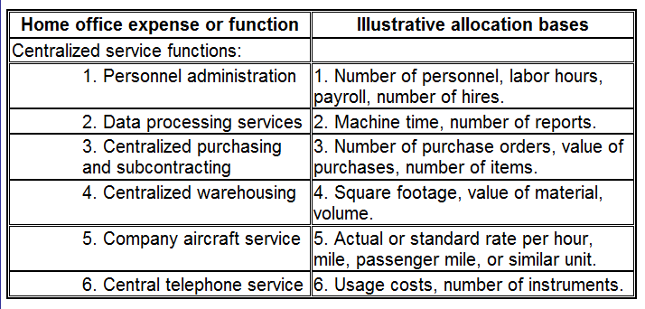
Corporate Headquarters Expenses
Notes:
Activity Step 1: Describe the nature of cost reporting by defense contractors
Home Office or Corporate Headquarters expenses may be assigned in the following ways:
Personnel administration may be assigned on number of personnel, labor hours, payroll dollars, or number of hires.
Data processing services may be assigned by machine time or number of reports
Centralized purchasing and subcontracting may be assigned on number of purchase orders, value of purchases, or number of items.
Centralized warehousing may be assigned on square footage used, value of material, or volume of material.
The list goes on, defining how the cost of company aircraft may be assigned, or the cost of Central telephone service.
The point is, a contractor may be in compliance by using any of these methods, even if they don’t make sense from a cost management standpoint. Think of it this way. How should the President’s costs, or the cost of operating the Pentagon, be assigned to your unit? How would that affect your cost management efforts? If the costs are arbitrarily assigned, it’s likely they will confound cost management efforts. You might be assigned costs of the Pentagon’s or the White House’s telecommunications equipment based on the number of telephones (instruments, in the table above) installed in your organization. While the cost of telecommunications equipment at the Pentagon or White House is likely beyond your unit’s control, having those costs assigned to your unit will make telephones appear very expensive. Even though this method would pass the audit and represent “full cost”, it could stimulate undesired behaviors (a rational cost management behavior under this method of cost assignment would be to reduce or eliminate telephones altogether) and would have little if any impact on the cost of telecommunications equipment incurred at the White House or the Pentagon.

Slide 17
Consistency in estimating, accumulating and reporting costs
Consistency in allocating costs incurred for the same purpose
Allocation of home office expenses to segments
Capitalization of tangible assets
Accounting for unallowable costs
Cost accounting period
Use of standard costs for direct material and direct labor
Accounting for costs of compensated personal absence
Depreciation of tangible capital assets
Allocation of business unit general and administrative expenses to final cost objectives
Accounting for acquisition costs of material
Composition and measurement of pension cost
Adjustment and allocation of pension cost
Cost of money as an element of the cost of facilities capital
Accounting for the cost of deferred compensation
Accounting for insurance costs
Cost of money as an element of the cost of capital assets under construction
Allocation of direct and indirect costs
Accounting for independent research and development costs and bid and proposal costs
Notes:
Activity Step 1: Describe the nature of cost reporting by defense contractors
We’re going to look at just one of the standards, on allocating indirect cost. We already have some experience in this area, from today’s lesson on job order costing.

Slide 18
Allocating Indirect Costs
(d) Allocation measures for an indirect cost pool
  (1) The costs of the management or supervision of activities involving direct labor or direct material costs do not have a direct and definitive relationship to the benefiting cost objectives and cannot be allocated on measures of a specific beneficial or causal relationship. In that circumstance, the base selected to measure the allocation of the pooled costs to cost objectives shall be a base representative of the activity being managed or supervised.
Notes:
Activity Step 1: Describe the nature of cost reporting by defense contractors
Note: read the highlighted words, which give the key points of the standard:
The costs of the management or supervision do not have a direct and definitive relationship to the benefiting cost objectives and cannot be allocated on measures of a specific beneficial or causal relationship. In other words, by definition we can’t identify a specific beneficial relationship between indirect costs and units of output. Therefore we need a method of assigning or allocating those costs.
That method should be a base representative of the activity being managed or supervised. This refers to overhead application similar to what we were doing in the last lesson, Calculate Cost of Goods Sold and Ending Overhead Balance.

Slide 19
Allocating Indirect Costs
(2) The base used to represent the activity being managed or supervised shall be determined by the application of the criteria below. All significant elements of the selected base shall be included.
  (i) A direct labor hour base or direct labor cost base shall be used, whichever in the aggregate is more likely to vary in proportion to the costs included in the cost pool being allocated, except that:
  (ii) A machine-hour base is appropriate if the costs in the cost pool are comprised predominantly of facility-related costs, such as depreciation, maintenance, and utilities; or
  (iii) A units-of-production base is appropriate if there is common production of comparable units; or
  (iv) A material cost base is appropriate if the activity being managed or supervised is a material-related activity.
Notes:
Activity Step 1: Describe the nature of cost reporting by defense contractors
The base used shall be determined by the application of the criteria below.
(i) A direct labor hour base or direct labor cost base
(ii) A machine-hour base
(iii) A units-of-production base
(iv) A material cost base
Again, the key point here is that the contractor can use any of these methods of allocation and be in compliance with the standard.
Notice that the number one choice is direct labor hours or direct labor dollars. This is what we have been doing in the Job order costing module. The other assumption here is that these types of costs are all aggregated into one overhead pool and assigned on the same base, with direct labor hours or direct labor dollars being the preferred method. This is known as a plant-wide application rate.

Slide 20
Allocating Indirect Costs
(3) Indirect cost pools which include material amounts of the costs of management or supervision of activities involving direct labor or direct material costs shall be allocated to:
  (i) Final cost objectives;
  (ii) Goods produced for stock or product inventory;
  (iii) Independent research and development and bid and proposal projects;
  (iv) Cost centers used to accumulate costs identified with a process cost system (i.e., process cost centers);
  (v) Goods or services produced or acquired for other segments of the contractor and for other cost objectives of a business unit; and
  (vi) Self-construction, fabrication, betterment, improvement, or installation of tangible assets
Notes:
Activity Step 1: Describe the nature of cost reporting by defense contractors
Indirect cost pools shall be allocated to:
(i) Final cost objectives;
(ii) Goods;
(iii) projects;
(iv) Cost centers
(v) Goods or services
-or-
(vi) tangible assets
Any of these cost objects may be used. As long as all indirect costs are assigned or allocated to one of these classes of items, the contractor is in compliance with the standard. Again, compliance does not mean that the cost allocation makes sense from a cost management standpoint.

Slide 21
Compliance vs. Cost Management
Cost reporting by contractors is specified in great detail and audited for compliance by multiple agencies
Does compliance with regulations guarantee that contractors manage cost?
Is it in the interest of the Army that contractors manage cost, not just report it?
Notes:
Activity Step 1: Describe the nature of cost reporting by defense contractors
Cost reporting by contractors is specified in great detail and audited for compliance by multiple agencies, as we have already mentioned.
Do regulations guarantee that contractors manage cost? No, regulations cannot guarantee that contractors manage cost. It is not even certain that they can promote cost management. They can only guarantee compliance with the regulation.
Is it in the interest of the Army that contractors manage cost, not just report it? This is the same question asked at the beginning of the lesson. Since the Army wants to manage cost, it would seem to be in the Army’s best interests that its contractors also manage cost.

Slide 22

Conduct Check on Learning
What are the primary goals of cost reporting under the CASB standards?
Notes:
What is the primary goal of cost reporting under the CASB standards?
The primary goals are consistency, comparability, and compliance.

Slide 23

Case Study
“Based on a true story”
DefTech Corporation, a defense contractor, uses a plant-wide rate to assign overhead to products based on direct labor
DefTech specializes in two processes:
  Electron beam welding (EBW)
  Lathe work
Notes:
Activity step 2: Case Study – describe defense contractor reporting issues
“Based on a true story” This case study is based on a true story in the same way a Hollywood film is based on a true story. Artistic license has been employed and names have been changed to protect the innocent. The lessons to be learned from it are real.
DefTech Corporation, a defense contractor uses a plant-wide rate to assign overhead to products based on direct labor
DefTech specializes in two processes:
Electron beam welding (EBW)
Lathe work

Slide 24

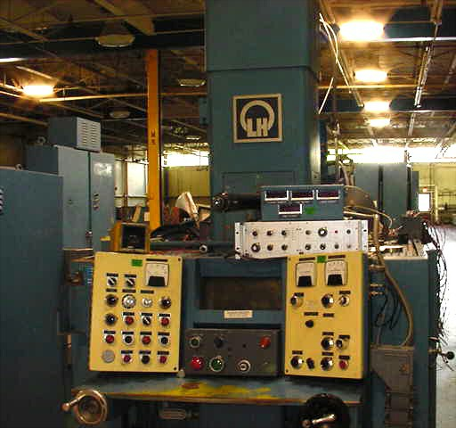
Electron Beam Welding
The EBW process requires high-tech machinery
Notes:
Activity step 2: Case Study – describe defense contractor reporting issues
Electron Beam Welding requires costly, high tech machinery. In most cases EBW is performed inside a vacuum chamber. The upper left photo is taken inside the chamber. The weld is produced using a finely focused stream of electrons.
“As the electrons strike the workpiece, their energy is converted into heat, instantly vaporizing the metal under temperatures near 25,000 °C. The heat penetrates deeply, making it possible to weld much thicker workpieces than is possible with most other welding processes. However, because the electron beam is tightly focused, the total heat input is actually much lower than that of any arc welding process. As a result, the effect of welding on the surrounding material is minimal, and the heat-affected zone is small. Distortion is slight, and the workpiece cools rapidly.” (Wikipedia)
The operator stands outside the machine and, after setting up the job, essentially presses a button to produce the weld.

Slide 25

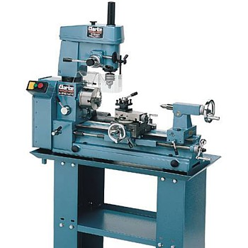
Lathe Work
Lathe work is labor-intense
Notes:
Activity step 2: Case Study – describe defense contractor reporting issues
Lathe work is labor intense. While machinery is required, it is relatively low-tech.

Slide 26
Case Study
DefTech manufactures weapons systems for DoD and uses three self-manufactured components:
 | Component X | Component Y | Component Z
Material per unit | $12,000 | $8,000 | $4,000
Labor per unit | 40 hrs. | 60 hrs. | 100 hrs.
Planned volume | 1000 units | 1000 units | 1000 units
Total material | $12 million | $8 million | $4 million
Total labor | $2 million | $3 million | $5 million
Lathe usage | 0% | 50% | 100%
EBW usage | 100% | 50% | 0%
Notes:
Activity step 2: Case Study – describe defense contractor reporting issues
DefTech manufactures weapons systems for DoD and uses three self-manufactured components:
Component X is heavy in materials cost but light in labor compared to the other two components. It is produced 100% with Electron Beam Welding.
Component Y is medium in both materials and labor. It is produced 50% with EBW and 50% with lathe work.
Component Z is light in materials and heavy in labor. It is produced 100% with lathe work.
If the labor cost for Component X is $2 million and total hours are 40,000, what is the labor cost per hour? $2,000,000/40,000 hrs. = $50 per hour
The same labor cost holds for Y and Z: $3,000,000/60,000 hrs. and $5,000,000/100,000 hrs.

Slide 27
How to Assign Indirect Costs?
Total other costs are estimated at $20 million
According to the CASB standard indirect costs may be assigned by:
  Direct Labor dollars or hours
  Machine hours
  Material dollars
  Units of production
Cost will be assigned to goods, in accordance with the CASB standard
Notes:
Activity step 2: Case Study – describe defense contractor reporting issues
Total other costs are estimated at $20 million
According to the CASB standard indirect costs may be assigned by:
Direct Labor dollars or hours
Machine hours
Material dollars
Units of production
Cost will be assigned to goods, in accordance with the CASB standard

Slide 28
Case Study Additional Info
DefTech uses a plant-wide overhead application rate based on direct labor hours according to CASB standards
What is the overhead application rate per direct labor hour?
What is the cost of one unit of Component X? Component Y? Component Z?
Notes:
Activity step 2: Case Study – describe defense contractor reporting issues
DefTech uses a plant-wide overhead application rate based on direct labor hours
Total other costs are estimated at $20 million
What is the overhead application rate per direct labor hour?
What is the cost of one unit of Component X? Component Y? Component Z?
We will answer these questions on the following slides

Slide 29
Application on Direct Labor Hours
Total OH/Total DL Hours = $20,000,000/20,000 hours = $100 per hr.
$18,000
$19,000
$17,000
Graph represents cost per unit.
Overhead is assigned at $100 per DL hour which is equal to 200% of DL dollars
Notes:
Activity step 2: Case Study – describe defense contractor reporting issues
Component X requires 40 hrs per unit * 1000 units = 40,000 hrs.
Component Y requires 60 hrs per unit * 1000 units = 60,000 hrs.
Component Z requires 100 hrs. per units 1000 units = 100,000 hrs.
Total hours = 40,000 + 60,000 + 100,000 = 200,000 hrs.
$20,000,000/200,000 hrs = $100 per hr.
Overhead for one unit of Component X = 40 hours * $100 per hr = 4000
Overhead for one unit of Component Y = 60 hours * $100 per hr = 6000
Overhead for one unit of Component Z = 100 hrs. * $100 per hr = 10000
Notice that because Component Z uses the most direct labor, it is charged the most overhead.
Assuming machine hours are in direct proportion to labor hours, the allocation would look exactly the same.

Slide 30
Case Study Additional Info
What is the cost of one unit of Component X? Component Y? Component Z?
 | Component X | Component Y | Component Z
Material per unit | $12,000 | $8,000 | $4,000
Labor per unit | 40 hrs. | 60 hrs. | 100 hrs.
Labor $ per hour | $50 | $50 | $50
Labor $ per unit | $2,000 | $3,000 | $5,000
OH @$100 per hr | $4,000 | $6,000 | $10,000
Total $ per unit | $18,000 | $17,000 | $19,000
Notes:
Activity step 2: Case Study – describe defense contractor reporting issues
Note: students will have blank slide

Slide 31
Case Study Additional Info
What is the cost of one unit of Component X? Component Y? Component Z?
 | Component X | Component Y | Component Z
Material per unit | $12,000 | $8,000 | $4,000
Labor per unit | 40 hrs. | 60 hrs. | 100 hrs.
Labor $ per hour | $50 | $50 | $50
Labor $ per unit | $2,000 | $3,000 | $5,000
OH @$100 per hr | $4,000 | $6,000 | $10,000
Total $ per unit | $18,000 | $17,000 | $19,000
Notes:
Activity step 2: Case Study – describe defense contractor reporting issues
Note: students will have blank slide
Cost of a unit = Material + Labor + Overhead
X = 12,000 + 2,000 + 4,000 = 18,000
Labor = 40hrs. * $50/hr
OH = 40 hrs. * $100/hr
Y = 8,000 + 3,000 + 6,000 = 17,000
Labor = 60hrs. * $50/hr
OH = 60 hrs. * $100/hr
Z = 4,000 + 5,000 + 10,000 = 19,000
Labor = 100hrs. * $50/hr
OH = 100 hrs. * $100/hr

Slide 32
Case Study Additional Info
What if DefTech used Materials dollars as a basis for applying overhead, according to CASB standards?
What would be the overhead application rate?
What would be the unit cost of Components X, Y and Z?
Notes:
Activity step 2: Case Study – describe defense contractor reporting issues
What if DefTech used Materials dollars as a basis for applying overhead, according to CASB standards?
What would be the overhead application rate?
What would be the unit cost of Components X, Y and Z?

Slide 33
Application on Materials Dollars
Total OH/Total Materials Cost = $20,000,000/$24,000,000 = 83.3%
$24,000
$17,666
$12,333
Graph represents cost per unit.
Overhead is assigned at 83.3% of Materials dollars
Notes:
Activity step 2: Case Study – describe defense contractor reporting issues
Component X requires $12 million in materials
Component Y requires $8 million in materials
Component Z requires $4 million in materials
Total materials = $12 million + $8 million + $4 million = $24 million
$20,000,000/$24,000,000 = .8333 or 83.3%
Overhead for one unit of Component X = $12,000 * .8333 = 10000
Overhead for one unit of Component Y = $8,000 * .8333 = 6666
Overhead for one unit of Component Z = $4,000 * .8333 = 3333
Notice that, under this method, Component X has the most overhead assigned because it uses the most materials

Slide 34
Case Study Additional Info
What if DefTech used Units of Production as a basis for applying overhead, according to CASB standards?
What would be the overhead application rate?
What would be the unit cost of Components X, Y and Z?
Notes:
Activity step 2: Case Study – describe defense contractor reporting issues
What if DefTech used Units of Production as a basis for applying overhead, according to CASB standards?
What would be the overhead application rate?
What would be the unit cost of Components X, Y and Z?

Slide 35
Application on Units of Production
Total OH/Total Units of Production = $20,000,000/3000 units = $6667 per unit
$20,667
$17,667
$15,667
Graph represents cost per unit.
Overhead is assigned at $6667 per unit
Notes:
Activity step 2: Case Study – describe defense contractor reporting issues
Component X totals 1000 units
Component Y totals 1000 units
Component Z totals 1000 units
Total units = 1000 + 1000 + 1000 = 3000
$20,000,000/3000 units = $6667/unit
OH for one unit of Component X = $6667
OH for one unit of Component Y = $6667
OH for one unit of Component Z = $6667
Notice that all three products are charged the same amount of overhead because ALL UNITS ARE TREATED EQUALLY.

Slide 36
Case Study
Subcontractor A submits a bid to provide 1000 units of Component X at a cost of $23,250 per unit
Subcontractor B submits a bid to provide 1000 units of Component Y at a cost of $16,750 per unit
Subcontractor C submits a bid to provide 1000 units of Component Z at a cost of $14,000 per unit
Notes:
Activity step 2: Case Study – describe defense contractor reporting issues
Subcontractor A submits a bid to provide 1000 units of Component X at a cost of $23,250 per unit
Subcontractor B submits a bid to provide 1000 units of Component Y at a cost of $16,750 per unit
Subcontractor C submits a bid to provide 1000 units of Component Z at a cost of $14,000 per unit

Slide 37
Case Study
DefTech’s management is somewhat surprised by the bids
They conclude that they must be very efficient in the EBW process used to produce Components X and Y
Notes:
Activity step 2: Case Study – describe defense contractor reporting issues
DefTech’s management is somewhat surprised by the bids
They conclude that they must be very efficient in the EBW process used to produce Components X and Y

Slide 38
Comparison – Component X
Component X is 100% Electron Beam Welded.
Is DefTech really more efficient than the subcontractor?
Why or why not?
Should we outsource Component X?
$18,000
$23,250
Notes:
Activity step 2: Case Study – describe defense contractor reporting issues
Component X is 100% Electron Beam Welded.
Is DefTech really more efficient than the subcontractor?
Why or why not?
Assume that the subcontractor bids are based on “true cost”. These subcontractors each only produce one component, so their costs aren’t averaged across multiple components. Assuming their labor and materials costs are equal to DefTech’s, the difference between the reported cost by DefTech and Subcontractor A’s bid is due to overhead.
Their labor and material costs are the same, but DefTech only assigns $4000 of overhead to each unit of Component X ($100/hour) while the subcontractor assigns $9250 ($231.50/hour). Does the subcontractor know something that DefTech doesn’t know about the true cost of EBW?
Should we outsource Component X? Based on our reported cost, no.

Slide 39
Comparison – Component Y
Component Y is 50% lathe work and 50% EBW.
Notice that the costs are very similar. Why might this be?
Should we outsource Component Y?
$17,000
$16,750
Notes:
Activity step 2: Case Study – describe defense contractor reporting issues
Component Y is 50% lathe work and 50% EBW.
Notice that the costs are very similar. Why might this be?
Assuming the subcontractor knows “true cost”, the subcontractor’s overhead composition is very similar to DefTech’s.
Should we outsource Component Y? The cost is competitive. We will see in tomorrow’s lesson that Relevant costs (not all of our costs) would be avoided if we outsource. In other words, the savings of $250 per unit may not be realized if we were to outsource.

Slide 40
Comparison – Component Z
Component Z is 100% lathe work. Is DefTech really less efficient than the subcontractor? Why or why not?
Should we outsource Component Z?
Notes:
Activity step 2: Case Study – describe defense contractor reporting issues
Component Z is 100% lathe work. Is DefTech really less efficient than the subcontractor? Why or why not?
Again, since Subcontractor C only produces one product, its overhead only reflects the cost of lathe work. Subcontractor C’s overhead is $50/hour as opposed to DefTech’s $100/hour. Does the subcontractor know something DefTech doesn’t about the true cost of lathe work?
Should we outsource Component Z? This product is ripe for outsourcing under the current cost reporting method. The single plant-wide rate that mixes the indirect costs of EBW with the indirect cost of lathe work tends to over-report the cost of lathe work and under-report the cost of EBW.

Slide 41
Notes:
Activity step 2: Case Study – describe defense contractor reporting issues
This chart reflects actual data from a real, unnamed defense contractor. In their case overhead was applied to jobs using a plant-wide rate, just like DefTech’s. They experienced similar problems.
Their plant-wide overhead application rate showed that the cost of both Lathe work and EBW was $80/hour. The $80 per hour horizontal line represents the cost reported from the company's cost system.
This $80 per hour rate is the cost against which vendor quotes of $40 and $150 per hour are compared. A $40 per hour vendor quote is less the reported cost and is accepted for lathe work while the $150 per hour vendor quote is higher than the reported and is rejected for electron beam welding.
The $80 reported cost is really made up of two processes with true costs of $40 per hour and $250 per hour. It is now obvious that had the company known the true cost rates it would have compared the vendor quote to the real cost and outsourced the $250 per hour electron beam welding process instead of the $40 per hour lathe work.

Slide 42
Real-World Experience
“We thought we were really good at EB [electron beam] welding. People were coming from all over the world to use our equipment."
Reported "average" overhead rates grossly understated the true economics of EBW:
  Very expensive equipment
  High maintenance cost
  High power consumption
  Uses relatively few direct labor hours
Notes:
Activity step 2: Case Study – describe defense contractor reporting issues
“We thought we were really good at EB [electron beam] welding. People were coming from all over the world to use our equipment."
Reported "average" overhead rates grossly understated the true economics of EBW:
Very expensive equipment – this is reflected in higher depreciation costs for EBW.
High maintenance cost – The high tech machine requires more maintenance
High power consumption
Uses relatively few direct labor hours in relation to lathe work

Slide 43
Need for Advanced Cost Systems
TABLE 1: Data Summary
 | Manufacturing Operations | Program Management | Accounting & Control
Want advanced cost management systems to better manage cost | XXX
Resist cost measurement change due to customer concerns |  | XXX
Resist cost measurement change due to compliance concerns |  |  | XXX
Notes:
Activity step 2: Case Study – describe defense contractor reporting issues
Anecdotal data suggests that managers in manufacturing operations WANT advanced cost management systems to better understand and better manage cost.

Slide 44
Barriers to Advanced Cost Systems
TABLE 1: Data Summary
 | Manufacturing Operations | Program Management | Accounting & Control
Want advanced cost management systems to better manage cost | XXX
Resist cost measurement change due to customer concerns |  | XXX
Resist cost measurement change due to compliance concerns |  |  | XXX
Notes:
Activity step 2: Case Study – describe defense contractor reporting issues
On the other hand, the same research suggests that program management RESISTS cost measurement change due to customer concerns. If cost measurement yields an increase in prices, customers will be unhappy. If cost measurement yields a decrease in prices, customers will still be unhappy because they will believe they were overcharged before.
Accounting management (who you would think would want the most accurate cost measurement possible) also RESISTED cost measurement change due to compliance concerns. If the methods currently in place are satisfying the auditors, why change? Once a federal contractor’s cost measurement system has been approved, changes may not be implemented without further approval.

Slide 45
Conclusion
Defense Contractor reporting is an external reporting exercise
Detailed reporting requirements are the price of doing business with the federal government
Isn’t it in the government’s best interest for contractors to have good managerial cost information?
Notes:
Activity step 2: Case Study – describe defense contractor reporting issues
Defense Contractor reporting is an external reporting exercise
Detailed reporting requirements are the price of doing business with the federal government. Compliance with regulations and reporting requirements is assured through regular audits. But we have seen that it is possible for cost reporting to comply with all federal regulations and cost accounting standards and still fail to adequately support managerial decisions.
Isn’t it in the government’s best interest for contractors to have good managerial cost information?

Slide 46
Conduct Check on Learning
Is it possible for cost reporting to comply with all federal regulations and cost accounting standards and still fail to adequately support managerial decisions?
Notes:
Q. Is it possible for cost reporting to comply with all federal regulations and cost accounting standards and still fail to adequately support managerial decisions?
A: Yes, because external cost reporting goals are consistency, comparability, and compliance.

