Slide 1
Estimate Future Costs Given Planning Factors
Intermediate Cost Analysis
and Management

Slide 2



If Cost is No Object Which Do You Want?
(or if nobody knows the cost)
Notes:
Motivator: If Cost is no Object which do you want?
There will be differences in preference, of course, but I’ll take the Mustang ☺
The point of this is that when cost is unknown, the results tend to be the same as when cost is no object. The choice will be based on features rather than cost and benefits.

Slide 3
Terminal Learning Objective
Task: Estimate Future Costs Given Planning Factors
Condition: You are training to become an ACE with access to ICAM course handouts, readings, and spreadsheet tools and awareness of Operational Environment (OE)/Contemporary Operational Environment (COE) variables and actors
Standard: with at least 80% accuracy
  Demonstrate understanding of Planning Factors concept
  Estimate future costs in constant and current dollars
Notes:
Introduction: TLO
Task: Estimate future costs given planning factors
Condition: You are a cost advisor technician with access to all regulations/course handouts, and awareness of Operational Environment (OE)/Contemporary Operational Environment (COE) variables and actors.
Standard: with at least 80% accuracy:
Demonstrate understanding of Planning Factors concept
Estimate future costs using inflation tables

Slide 4
Cost Input to Decision Making
It is hard to make smart decision without cost information
The next four slides are from the Army’s formal training program on Cost Benefit Analysis to be covered tomorrow
Parts will be highlighted here to give you some prior experience
Notes:
Introduction: Instructional Lead-in: In this section we look at Cost input to decision making.
It is hard to make smart decision without cost information. Incomplete or otherwise inaccurate cost information can be misleading and may be even worse than no cost information.
The next four slides are from the Army’s formal training program on Cost Benefit Analysis to be covered tomorrow. Parts will be highlighted here to give you some prior experience.

Slide 5
Step 4: Develop Cost Estimate for Each Alternative
Cost estimate captures the total cost of each alternative over its relevant life cycle
  Cost perspective vs. POM/budget perspective: Relevant life cycle often extends beyond POM/budget time horizon
Cost estimate includes both one-time and recurring costs
  One-time: Costs of developing the solution and putting it in place
  Recurring: Costs of performing the new process/solution
To ensure apples-to-apples comparison of alternatives:
  Develop robust cost element structure or work breakdown structure (a list of things that cost money) and use same structure for all alternatives
  Don’t change major elements – problem statement, assumptions, scope, etc – from one alternative to another
1. Define the Problem/Opportunity
3. Define Alternatives
4. Develop Cost Estimate for each Alternative
5. Identify Quantifiable and
Non- Quantifiable Benefits
6. Define Alternative
Selection Criteria
7. Compare Alternatives
8. Report Results and Recommendations
2. Define the Scope; Formulate Facts and Assumptions
Notes:
Activity step 1: Explain how planning factors affect CBA (Develop Cost Estimate for each alternative)
Cost estimates are a crucial part of CBA.
2. The cost estimate should:
a. Capture total cost of each alternative course of action.
b. Consider the relevant life cycle of the COA, not just the time year in which budgetary expenditures are made
c. Include both one-time (initial investment) and recurring (operating) costs
d. Develop a Work Breakdown Structure or list of things related to the COA that will cost money. This will assure that your cost estimate has not ignored any relevant cost element.

Slide 6
Guidelines and Tips for Cost Estimating
Begin with clear understanding of how each COA works and what resources are used to carry out the process … process map or flowchart can be very helpful
Use authoritative data sources, to include:
  Personnel costs: Army Military-Civilian Cost System (AMCOS) *
  Contract costs: Contracting office
  Inflation: Known price growth or ASA(FM&C) website *
To help ensure you’ve captured all costs, be sure to consider:
  One-time and recurring costs
  Roles of all relevant stakeholders
  Costs associated with technology, safety, security, etc
Increase level of detail as needed. For example, you might need to segregate costs by
  MDEPs
  Appropriations
  Cost categories (civilian personnel, military personnel, contracts, supplies, etc)
* URLs are in Resources section (slides 58-59)
Notes:
Activity step 1: Explain how planning factors affect CBA (Guidelines and Tips for Cost Estimating)
1. The CBA training emphasizes the importance of using authoritative data sources.
2. The authoritative data source related to personnel costs is the Army Military-Civilian Cost System (AMCOS)

Slide 7
Guidelines and Tips for Cost Estimating (cont’d)
Develop supporting documentation that can stand alone to explain the cost estimate – a critical element for CBARB reviews
Current vs. constant dollars
  Definitions
    Current: Includes inflation … the cost that will be incurred when the money is used. Also referred to as “then-year dollars” and “inflated dollars.”
    Constant: Cost with inflation removed.
  Guidance:
    Develop cost estimate in constant dollars to support decision making. Ensures apples-to apples comparison of costs over time.
    Display cost estimate in current dollars to ensure decision maker is aware of impact on POM and budget.
Notes:
Activity step 1: Explain how planning factors affect CBA (Guidelines and Tips for Cost Estimating continues)
1. CBA guidance requires adjustments for inflation.
2. “Current” dollars refer to payments in the future that have been adjusted to include inflation. They are also called “then-year” or “inflated” dollars
3. “Constant” dollars refers to future payments with the effects of inflation removed. This permits them to be compared with costs in the present period.

Slide 8
CBA Costing Process
Review and Validation
Preparation
Establish Ground Rules and Assumptions
Develop Work Breakdown Structure
Prepare Back-Up Documentation
Develop the Cost Estimate
Review for Accuracy and Reasonableness
Identify Data Requirements and Sources
Obtain or Develop Detailed Process Map
Conduct Sensitivity Analysis and Risk Assessment
If you do all this, you’ll have a good cost estimate
Notes:
Activity step 1: explain how planning factors affect CBA
The cost estimating process has three major steps: (CBA Costing Process)
Preparation:
1. Establish the ground rules and assumptions so you can make apples-to-apples comparisons between all courses of action
2. Develop the Work Breakdown Structure. This is where you identify all of the costs related to the course of action.
3. Identify data requirements and sources. Once you have identified all of the relevant cost elements in the Work Breakdown structure you will need to research and document those cost elements.
4. Finally, obtain or develop detailed process map.
5. Develop the Cost Estimate using the information you prepared in step 1
6.Review and Validation:
7. Prepare backup documentation
8. Review for accuracy and reasonableness
9. Conduct sensitivity analysis and risk assessment

Slide 9

Check on Learning
Which costs are to be included in the CBA?
What is AMCOS?
Notes:
Conduct a Check on Learning:
Q. Which costs are to be included in the CBA? A. “Total Cost” over the “relevant life cycle” including one-time and recurring costs.
Q. What is AMCOS? A. Army Military-Civilian Cost System (AMCOS) - the authoritative data source for Army military and civilian personnel costs.

Slide 10
AMCOS
The cost of personnel is HUGE
The costs of soldiers have frequently been ignored in the past
Access AMCOS with AKO or CAC log in at:
https://www.osmisweb.army.mil/amcos/app/home.aspx
Use AMCOS lite to generate the data on the following slides
Notes:
Activity Step 2 Use spreadsheet tool and AMCOS data to estimate personnel costs (AMCOS-The Army Military-Civilian Cost System)
1. The cost of personnel is HUGE.
2. The costs of soldiers have frequently been ignored in the past
3. There is no excuse for this any longer since the information is now available at the following address with an AKO or CAC login

Slide 11
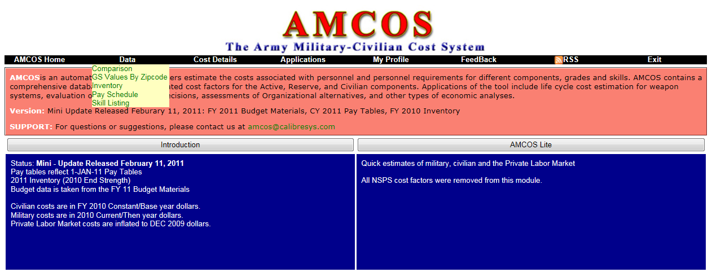
Accessing AMCOS
Notes:
Activity Step 2 Use spreadsheet tool and AMCOS data to estimate personnel costs
1. Screen shot shows the home page for AMCOS and the link to AMCOS Lite

Slide 12
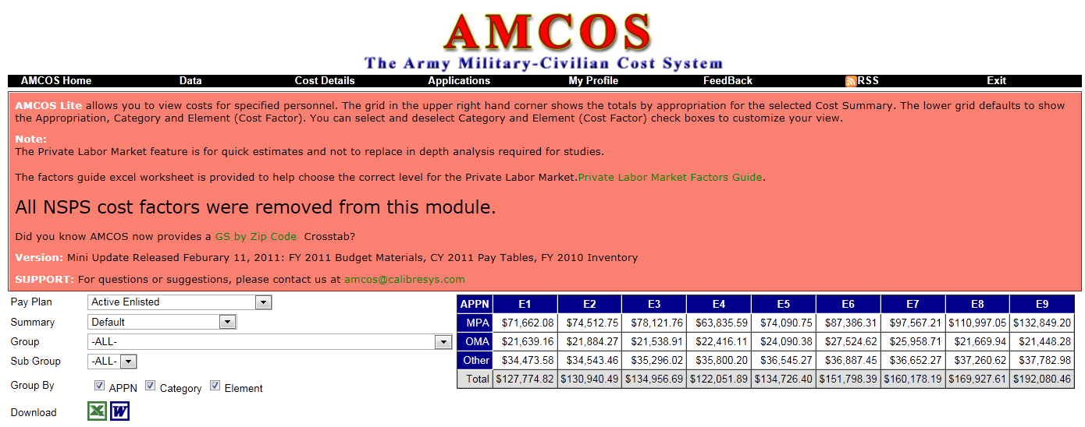
Total Cost
Notes:
Activity Step 2 Use spreadsheet tool and AMCOS data to estimate personnel costs
1. Screen shot shows the data entry selections to generate total cost.
2. Note: the online database is updated regularly and will have the most recent information available. The Excel spreadsheet that comes with the module may not have the most recent information. Problems show in this module were generated using the data in the Excel spreadsheet.

Slide 13
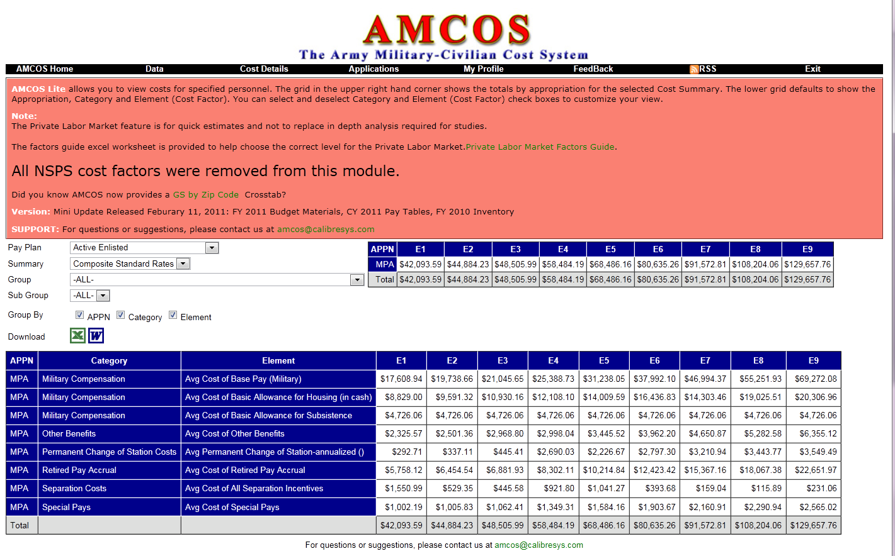
Composite Standard Rate
Notes:
Activity Step 2 Use spreadsheet tool and AMCOS data to estimate personnel costs
1. Screen shot shows the data entry selections to generate Composite Standard rate.
2. Note: the online database is updated regularly and will have the most recent information available. The Excel spreadsheet that comes with the module may not have the most recent information. Problems show in this module were generated using the data in the Excel spreadsheet.

Slide 14
AMCOS Total Cost Data by Rank
 | $K per Year per Soldier | E1 | E2 | E3
Military Compensation | Avg Cost of Base Pay (Military) | 17.6 | 19.7 | 21.0
Military Compensation | Avg Cost of Basic Allowance for Housing (in cash) | 8.8 | 9.6 | 10.9
Military Compensation | Avg Cost of Basic Allowance for Subsistence | 4.7 | 4.7 | 4.7
Other Benefits | Avg Cost of Other Benefits | 2.3 | 2.5 | 3.0
Permanent Change of Station Costs | Avg Permanent Change of Station-annualized () | 0.3 | 0.3 | 0.4
Recruiting Costs | Avg Recruiting Cost for MOS () | 24.1 | 24.1 | 24.2
Retired Pay Accrual | Avg Cost of Retired Pay Accrual | 5.8 | 6.5 | 6.9
Selective Reenlistment Bonus | Avg Cost of Reenlistment Bonus (A and B Amortized) | 0.0 | 0.0 | 0.0
Separation Costs | Avg Cost of All Separation Incentives | 1.6 | 0.5 | 0.4
Special Pays | Avg Cost of Special Pays | 1.0 | 1.0 | 1.1
Training | Avg Cost of Training (Total Amortized) | 6.3 | 6.4 | 6.3
 | Total MPA (AMCOS) | 72.5 | 75.4 | 78.9
MPA
 | $K per Year per Soldier | E1 | E2 | E3
Medical Support Costs | Avg Cost of Medical Support Cost | 6.7 | 6.8 | 6.5
Morale, Welfare and Recreation Costs | Avg Cost of Morale, Welfare and Recreation | 0.3 | 0.3 | 0.3
Recruiting Costs | Avg Recruiting Cost for MOS (Amortized) | 6.3 | 6.4 | 6.4
Training | Avg Cost of Training (Total Amortized) | 9.7 | 9.9 | 9.8
 | Total OMA (AMCOS) | 23.0 | 23.3 | 22.9
OMA
other
 | $K per Year per Soldier | E1 | E2 | E3
New GI Bill Costs | Avg Cost of GI Bill | 30.9 | 30.9 | 30.9
Training | Avg Cost of Training (Total Amortized) | 3.5 | 3.6 | 4.3
 | Total Other (AMCOS) | 34.4 | 34.4 | 35.1
$K per Year per Soldier | E1 | E2 | E3
Total AMCOS | 129.9 | 133.1 | 136.9
Notes:
Activity Step 2 Use spreadsheet tool and AMCOS data to estimate personnel costs
1. Here is some of the data available at the AMCOS site.
2. Total cost of military personnel is:
MPA (Military Pay and Allowances) + OMA (Operations & Maintenance, Army) + Other
3. Is it surprising to find that the cost of an E1 is almost $130K per year?

Slide 15
The Composite Standard Rate is Preferred
 | $K per Year per Soldier | E1 | E2 | E3
Military Compensation | Avg Cost of Base Pay (Military) | 17.6 | 19.7 | 21.0
Military Compensation | Avg Cost of Basic Allowance for Housing (in cash) | 8.8 | 9.6 | 10.9
Military Compensation | Avg Cost of Basic Allowance for Subsistence | 4.7 | 4.7 | 4.7
Other Benefits | Avg Cost of Other Benefits | 2.3 | 2.5 | 3.0
Permanent Change of Station Costs | Avg Permanent Change of Station-annualized () | 0.3 | 0.3 | 0.4
Recruiting Costs | Avg Recruiting Cost for MOS () | 24.1 | 24.1 | 24.2
Retired Pay Accrual | Avg Cost of Retired Pay Accrual | 5.8 | 6.5 | 6.9
Selective Reenlistment Bonus | Avg Cost of Reenlistment Bonus (A and B Amortized) | 0.0 | 0.0 | 0.0
Separation Costs | Avg Cost of All Separation Incentives | 1.6 | 0.5 | 0.4
Special Pays | Avg Cost of Special Pays | 1.0 | 1.0 | 1.1
Training | Avg Cost of Training (Total Amortized) | 6.3 | 6.4 | 6.3
 | Total MPA (AMCOS) | 72.5 | 75.4 | 78.9
Composite Standard
Rates
42.1, 44.9, 48.5
 | $K per Year per Soldier | E1 | E2 | E3
Medical Support Costs | Avg Cost of Medical Support Cost | 6.7 | 6.8 | 6.5
Morale, Welfare and Recreation Costs | Avg Cost of Morale, Welfare and Recreation | 0.3 | 0.3 | 0.3
Recruiting Costs | Avg Recruiting Cost for MOS (Amortized) | 6.3 | 6.4 | 6.4
Training | Avg Cost of Training (Total Amortized) | 9.7 | 9.9 | 9.8
 | Total OMA (AMCOS) | 23.0 | 23.3 | 22.9
OMA
other
 | $K per Year per Soldier | E1 | E2 | E3
New GI Bill Costs | Avg Cost of GI Bill | 30.9 | 30.9 | 30.9
Training | Avg Cost of Training (Total Amortized) | 3.5 | 3.6 | 4.3
 | Total Other (AMCOS) | 34.4 | 34.4 | 35.1
$K per Year per Soldier | E1 | E2 | E3
Total AMCOS | 129.9 | 133.1 | 136.9
Notes:
Activity Step 2 Use spreadsheet tool and AMCOS data to estimate personnel costs
1. Sometimes it might be useful to use the total AMCOS personnel cost. Other times it is more useful to use the Composite Standard rates.
2. The composite standard rate ignores the recruiting cost (which seems to be the allocation of a fixed cost), and the amortized re-enlistment bonus, and training costs. These are one-time costs that are averaged across the time periods of service, and may not meet the definition of a relevant cost (one that will change as the result of a decision).

Slide 16

Practical Exercise
The Garrison Commander wants to be assigned 20 E-4s to hand out towels in the gym. He is under budget pressure and feels he can replace several civilians with these “free” resources.
  What is the total cost to the Army of this request?
  20 E-4s * $123.8K per E-4 = $2,476K
  What is the cost using Composite Standard Rate?
  20 E-4s * $58.5K per E-4 = $1,170K
Notes:
Practical Exercise:
Activity Step 2 Use spreadsheet tool and AMCOS data to estimate personnel costs
The Garrison Commander wants to be assigned 20 E-4s to hand out towels in the gym. He is under budget pressure and feels he can replace several civilians with these “free” resources.
What is the total cost to the Army of this request?
3. What is the cost using Composite Standard Rate?
4. What is the cost expression? Where will you get the data for total cost and Composite Standard Rate?

Slide 17
Practical Exercise
The Garrison Commander wants to be assigned 20 E-4s to hand out towels in the gym. He is under budget pressure and feels he can replace several civilians with these “free” resources.
  What is the total cost to the Army of this request?
  20 E-4s * $123.8K per E-4 = $2,476K
  What is the cost using Composite Standard Rate?
  20 E-4s * $58.5K per E-4 = $1,170K
Notes:
Practical Exercise: Instructor Note (Student do not have this slide in Student VG’s)
Activity Step 2 Use spreadsheet tool and AMCOS data to estimate personnel costs
The Garrison Commander wants to be assigned 20 E-4s to hand out towels in the gym. He is under budget pressure and feels he can replace several civilians with these “free” resources.
What is the total cost to the Army of this request? 20 E-4s * $123.8K per E-4 = $2,476K
$123.8K is rounded from the AMCOS total cost of $123,761
What is the cost using Composite Standard Rate? 20 E-4s * $58.5K per E-4 = $1,170K
This is a classic example of goods that are perceived as free being over consumed. Even at the lower Composite Standard rate, this is a significant expenditure, and undoubtedly greater than the cost of a paying a civilian to hand out towels in the gym.

Slide 18

Spreadsheet Exercise
What is the Total Cost and the Composite Standard Cost of the Non Deployable Soldiers in the nth Brigade?
E-2 | E-3 | E-4 | E-5 | E-6 | E-7 | E-8 | O-2 | O-3 | O-4 | Total
14 | 123 | 153 | 89 | 51 | 28 | 6 | 19 | 12 | 4 | 499
Notes:
Spreadsheet Exercise continues:
Activity Step 2 Use spreadsheet tool and AMCOS data to estimate personnel costs
What is the Total Cost and the Composite Standard Cost of the Non Deployable Soldiers in the nth Brigade?
The list of Non-deployable soldiers for the nth Brigade contains the following:
14 E-2s, 123 E-3s, 153 E-4s, 89 E-5s, 51 E-6s, 28 E-7s, 6 E-8s, 19 O-2s, 12 O-3s, and 4 O-4s for a total of 499 non-deployable soldiers. What is the cost to the Army of these non-deployable soldiers?

Slide 19
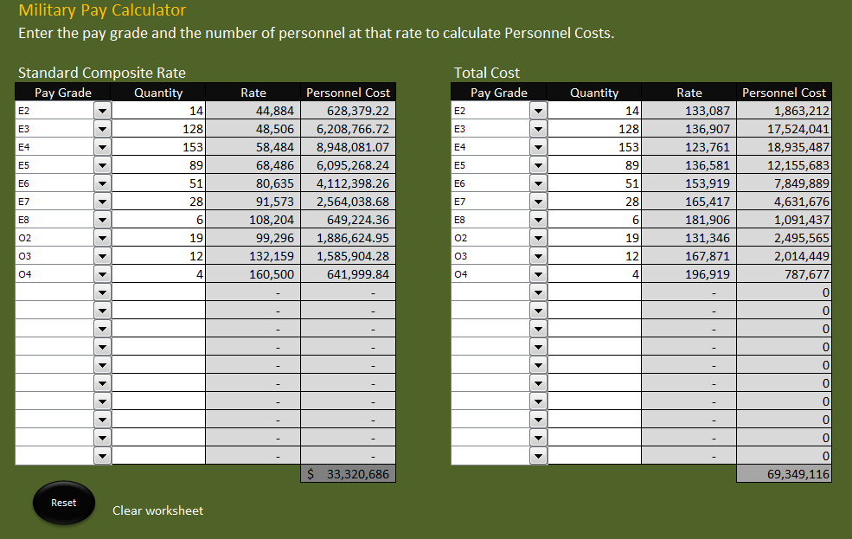
Spreadsheet Exercise
Enter the appropriate data into the spreadsheet to calculate the cost of military personnel at the Standard Composite Rate
Notes:
Spreadsheet Exercise continues:
Activity Step 2 Use spreadsheet tool and AMCOS data to estimate personnel costs
Enter the appropriate data into the spreadsheet to calculate the cost of military personnel at the Standard Composite Rate
Using the lower Standard Composite rate, the total is $33.3 million per year. Is this number surprising?
(The tables in the spreadsheet are static and should be used for example only. For up-to-date personnel cost information be sure to use AMCOS.)

Slide 20
Spreadsheet Exercise
Use the same data to calculate Total Cost of military personnel
Notes:
Spreadsheet Exercise continues:
Activity Step 2 Use spreadsheet tool and AMCOS data to estimate personnel costs
Use the same data to calculate Total Cost of military personnel
Using the Total Cost figures, the cost of non-deployable soldiers jumps to $69.3 million.

Slide 21
Check on Learning
What is the difference between Total Cost and Composite Standard Rate?
Notes:
Conduct a Check on Learning:
Q. What is the difference between Total Cost and Composite Standard Rate? A. The composite standard rate is smaller than total cost. It doesn’t include OMA and some other costs. It also ignores some items from MPA: amortized training cost, retirement accrual cost, and recruitment costs.

Slide 22
Constant versus Current Year Costing
Most cost estimates will be put together using constant dollars
  This means they ignore inflation
  ARMY CBA policy wants decision makers to use this view to improve understanding
However, policy also calls for display of
current year dollars
  This means they include inflation
  Because these are the dollars that must be budgeted in those years
Notes:
Activity Step 3 Estimate future costs in constant and current dollars
Constant versus Current Year Costing:
Most cost estimates will be put together using constant dollars
This means they ignore inflation
ARMY CBA policy wants decision makers to use this view to improve understanding. Similar to the idea of discounting future cash flows to present value, constant dollars can be compared side-by-side with today’s expenditures to gain a better understanding of costs.

Slide 23
Constant versus Current Year Costing
Most cost estimates will be put together using constant dollars
  This means they ignore inflation
  ARMY CBA policy wants decision makers to use this view to improve understanding
However, policy also calls for display of current year dollars
  This means they include inflation
  Because these are the dollars that must be budgeted in those years
Notes:
Activity Step 3 Estimate future costs in constant and current dollars (Instructor Note: Students do not have this VG)
Constant versus Current Year Costing:
However, policy also calls for display of current year dollars. These are also called inflated dollars or “then-year” dollars.
This means they include inflation
Because these are the dollars that must be budgeted in those years. This helps to understand the effect it will have on the budget in future years.

Slide 24
Calculating Constant Cost Growth
Inflation acts exactly like compound interest in a future value calculation:
Cost in nth Year = Constant Cost*(1+rate)^{n}
$100 cost today will be $117 in current year dollars five years from now assuming 4% annual inflation:
Cost in 5th Year = 100*(1+.04)⁵ = 117
Notes:
Activity Step 3 Estimate future costs in constant and current dollars
Calculating Constant Cost Growth:
Inflation acts exactly like compound interest in a future value calculation: Cost in nth Year = Constant Cost*(1+rate)^{n}
$100 cost today will be $117 in current year dollars five years from now assuming 4% annual inflation:
Cost in 5th Year = 100*(1+.04)⁵ = 117

Slide 25
Practical Exercise
The Garrison Commander wants to be assigned 20 E-4s to hand out towels in the gym. He is under budget pressure and feels he can replace several civilians with these “free” resources.
  What is the total cost to the Army of this request in current year dollars three years from now at 5% inflation?
  What is the cost using Composite Standard Rate in current year dollars three years from now at 5% inflation?
Notes:
Practical Exercise:
Activity Step 3 Estimate future costs in constant and current dollars
The Garrison Commander wants to be assigned 20 E-4s to hand out towels in the gym. He is under budget pressure and feels he can replace several civilians with these “free” resources.
What is the total cost to the Army of this request in current year dollars three years from now at 5% inflation?
What is the cost using Composite Standard Rate in current year dollars three years from now at 5% inflation?

Slide 26
Practical Exercise
  What is the total cost to the Army of this request in current year dollars three years from now at 5% inflation?
  The cost expression is:
  20 E-4s * Total Cost per E-4 * (1+rate)^{number of years}
  20*$123.8K * (1.05)³
  $2,476K * (1.05)³
  $2,476K * 1.158
  = $2,867K
Notes:
Practical Exercise continues:
Activity Step 3 Estimate future costs in constant and current dollars
What is the total cost to the Army of this request in current year dollars three years from now at 5% inflation?
Students will have the blank slide. Have them verbalize the cost expression before showing the solution.

Slide 27
Practical Exercise
  What is the total cost to the Army of this request in current year dollars three years from now at 5% inflation?
  The cost expression is
  20 E-4s * Total Cost per E-4 * (1+rate)^{number of years}
  20*$123.8K * (1.05)³
  $2,476K * (1.05)³
  $2,476K * 1.158
  = $2,867K
Notes:
Practical Exercise continues: (INSTRUCTOR NOTE: STUDENT DO NOT HAVE THIS VG)
What is the total cost to the Army of this request in current year dollars three years from now at 5% inflation?
The cost expression is;
a. 20 E-4s * Total Cost per E-4 * (1+rate)^{number of years}
b. 20*$123.8K * (1.05)³
c. $2,476K * (1.05)³
d. $2,476K * 1.158
e. = $2,867K

Slide 28
Practical Exercise
  What is the cost using Composite Standard Rate in current year dollars three years from now at 5% inflation?
  The cost expression is:
  20 E-4s * Comp. Stand. Rate/E-4 * (1+rate)^{number of years}
  20*$58.5K * (1.05)³
  $1,170K * (1.05)³
  $1,170K * 1.158
  = $1,355K
Notes:
Practical Exercise continues:
What is the cost using Composite Standard Rate in current year dollars three years from now at 5% inflation?
Students will have the blank slide. Have them verbalize the cost expression before showing the solution.

Slide 29
Practical Exercise
  What is the cost using Composite Standard Rate in current year dollars three years from now at 5% inflation?
  The cost expression is:
  20 E-4s * Comp Std Rate per E-4 * (1+rate)^{# of years}
  20*$58.5K * (1.05)³
  $1,170K * (1.05)³
  $1,170K * 1.158
  = $1,355K
Notes:
Practical Exercise continues: (INSTRUCTOR NOTE: STUDENT DO NOT HAVE THIS VG)
What is the cost using Composite Standard Rate in current year dollars three years from now at 5% inflation?
The cost expression is:
a. 20 E-4s * Comp Std Rate per E-4 * (1+rate)^{# of years}
b. 20*$58.5K * (1.05)³
c. $1,170K * (1.05)³
d. $1,170K * 1.158
e. = $1,355K

Slide 30
Spreadsheet Exercise
What is the Total Cost and the Composite Standard Cost of the Non Deployable Soldiers in the nth Brigade over the next ten years in current dollars assuming 6% inflation.
E-2 | E-3 | E-4 | E-5 | E-6 | E-7 | E-8 | O-2 | O-3 | O-4 | Total
14 | 123 | 153 | 89 | 51 | 28 | 6 | 19 | 12 | 4 | 499
Notes:
Spreadsheet Exercise continues:
Activity Step 3 Estimate future costs in constant and current dollars
1. What is the Total Cost and the Composite Standard Cost of the Non Deployable Soldiers in the nth Brigade over the next ten years in current dollars assuming 6% inflation.
2. Use Total cost in constant dollars as calculated in the last spreadsheet exercise: $69.3 million
3. Use Composite Standard rate in constant dollars as calculated in the last spreadsheet exercise: $33.3 million

Slide 31
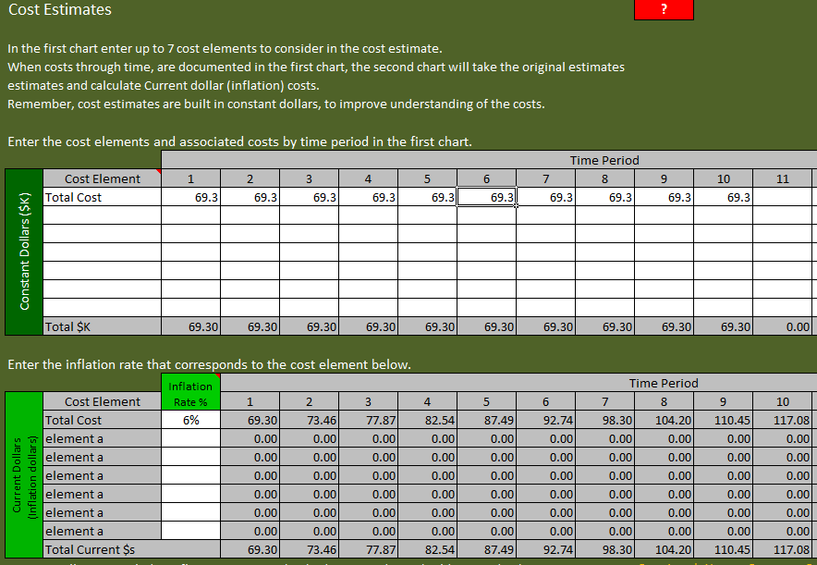
Total Cost
Enter Annual cost and Inflation rate to calculate Current Year dollars
Notes:
Activity Step 3 Estimate future costs in constant and current dollars
Total Cost:
1. Enter Annual cost and Inflation rate to calculate Current Year dollars

Slide 32
Total Cost
Sum of total current year costs of non-deployables over ten years = $913.43 million
Notes:
Activity Step 3 Estimate future costs in constant and current dollars
Total Cost:
1. The sum of the Total Cost, current year dollars, of non-deployable over ten years = $913.43 million

Slide 33
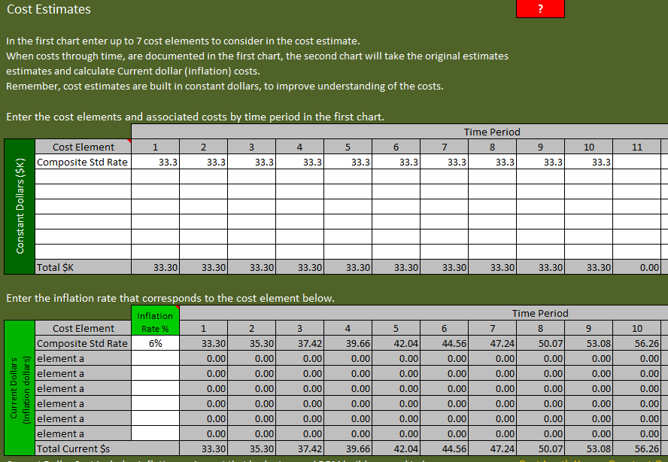
Composite Standard Rate
Sum of Composite Standard Rate current year costs of non-deployables over ten years = $391.89 million
Notes:
Activity Step 3 Estimate future costs in constant and current dollars
Composite Standard Rate:
Enter the annual composite standard rate to calculate the current-year dollars.
The sum of the Composite Standard rate, current year cost of non-deployable over ten years is $391.89 million.

Slide 34
Check on Learning
“Current-year dollars” refers to?
Notes:
Check on Learning:
Q. “Current-year dollars” refers to? A. Inflated or “Then-year” dollars.

