Slide 1
Human Resource Management
Fifteenth Edition
Chapter 7
Interviewing Candidates
Copyright © 2017, 2015, 2013 Pearson Education, Inc. All Rights Reserved
Notes:
Where We Are Now…. Chapter 7 Interviewing Candidates
Chapter 6 focused on the important tools managers use to select employees. Now we’ll turn to one of these tools – what we refer to as the employment interview.
The main topics we’ll cover include types of interviews, things that undermine interviewing’s usefulness, designing and conducting effective selection interviews, using a total selection process to improve employee engagement, and making the offer.

Slide 2
Learning Objectives (1 of 2)
7-1. List and give examples of the main types of selection interviews.
7-2. List and explain the main errors that can undermine an interview’s usefulness.
Notes:
After studying this chapter, you will be able to:
7-1. List and give examples of the main types of selection interviews.
7-2. List and explain the main errors that can undermine an interview’s usefulness.

Slide 3
Learning Objectives (2 of 2)
7-3. Define a structured situational interview and explain how to design and conduct effective selection interviews.
7-4. Discuss how to use employee selection methods to improve employee engagement.
7-5. List the main points to know about developing and extending the actual job offer.
Notes:
After studying this chapter, you will also be able to:
7-3. Define a structured situational interview and explain how to design and conduct effective selection interviews.
7-4. Discuss how to use employee selection methods to improve employee engagement.
7-5. List the main points to know about developing and extending the actual job offer.

Slide 4
I. List and give examples of the main types of selection interviews.
Notes:
An interview is a procedure designed to obtain information from a person through oral responses to oral inquiries. A selection interview (the focus of this chapter) is a selection procedure designed to predict future job performance based on applicants’ oral responses to oral inquiries.

Slide 5
Basic Types of Interviews (1 of 3)
Can be classified according to:
Structure
Content
Administration
Pros & Cons
Notes:
Managers use several interviews at work, such as performance appraisal interviews and exit interviews.
A selection interview (the focus of this chapter) is a selection procedure designed to predict future job performance based on applicants’ oral
responses to oral inquiries. Many techniques in this chapter also apply to appraisal and exit interviews. However, we’ll postpone discussions of those two interviews until later chapters.
There are several ways to conduct selection interviews.
For example, we can classify selection interviews according to the following:
1. How structured they are.
2. Their “content” – the types of questions they contain.
3. How the firm administers the interviews (for instance, one-on-one or via a committee).
Each has pros and cons. We’ll look at each….

Slide 6
Basic Types of Interviews (2 of 3)
Structured vs. Unstructured Interviews
Notes:
In unstructured (or nondirective) interviews, the manager follows no set format.
In structured (or directive) interviews, the employer lists the questions ahead of time. He or she also may even list and score possible answers for appropriateness.
Structured interviews are generally best. In such interviews, all interviewers generally ask all applicants the same questions.
Partly because of this, these interviews tend to be more consistent, reliable, and valid. Having a standardized list of questions can also help even less talented interviewers conduct better interviews. Standardizing the interview also enhances job relatedness.
In a situational interview, you ask the candidate what his or her behavior would be in a given situation. Behavioral interviews ask applicants to describe how they reacted to actual situations in the past. In a job-related interview, the applicants answer questions about relevant past experiences. In stress interviews, the applicant is made uncomfortable by a series of often rude questions. This technique helps identify hypersensitive applicants and those with low or high stress tolerance. Puzzle questions are popular. Recruiters like to use them to see how candidates think under pressure.

Slide 7
Basic Types of Interviews (3 of 3)
Structured vs. Unstructured Interviews
Questions to ask
Situational
Behavioral
Job-related
Stress
Puzzle questions
Notes:
In unstructured (or nondirective) interviews, the manager follows no set format.
In structured (or directive) interviews, the employer lists the questions ahead of time. He or she also may even list and score possible answers for appropriateness.
Structured interviews are generally best. In such interviews, all interviewers generally ask all applicants the same questions.
Partly because of this, these interviews tend to be more consistent, reliable, and valid. Having a standardized list of questions can also help even less talented interviewers conduct better interviews. Standardizing the interview also enhances job relatedness.
In a situational interview, you ask the candidate what his or her behavior would be in a given situation. Behavioral interviews ask applicants to describe how they reacted to actual situations in the past. In a job-related interview, the applicants answer questions about relevant past experiences. In stress interviews, the applicant is made uncomfortable by a series of often rude questions. This technique helps identify hypersensitive applicants and those with low or high stress tolerance. Puzzle questions are popular. Recruiters like to use them to see how candidates think under pressure.

Slide 8
Interview Content What Types of Questions to Ask
Questions to ask
Situational
Behavioral – (S.T.A.R)
Job-related
Stress
Puzzle questions
Notes:
We can also classify interviews based on the “content” or the types of questions interviewers ask. Many interviewers ask relatively unfocused questions, such as “What do you want to be doing in 5 years?” Questions like these generally do not provide much insight into how the person will do on the job. That is why situational, behavioral, and job-related questions are best.
In a situational interview, you ask the candidate what his or her behavior would be in a given situation. For example, ask a supervisory candidate how he or she would act in response to a subordinate coming to work late 3 days in a row.
Situational questions start with phrases such as, “Suppose you were faced with the following situation….
What would you do?”
In behavioral interviews, ask applicants to describe how they reacted to actual situations in the past.
Behavioral questions start with phrases like, “Can you think of a time when…. What did you do?” In one variant, Vanguard uses an interviewing technique it calls STAR. Vanguard managers ask interviewees about a particular situation (S) or task (T) they faced to uncover the actions (A) the candidates took, and the results (R) of their actions. Behavioral interviews are increasingly used.
Other Types of Questions:
Job Related – In a job-related interview, the interviewer asks applicants questions about job-relevant past experiences. The questions here don’t revolve around hypothetical or actual situations or scenarios. Instead, the interviewer asks questions such as, “Which courses did you like best in business school?” The aim is to draw conclusions about, say, the candidate’s ability to handle the financial aspects of the job in question.
In a stress interview – the interviewer seeks to make the applicant uncomfortable with occasionally rude questions. The aim is to supposedly spot sensitive applicants and those with low (or high) stress tolerance.
Puzzle questions are popular. Recruiters like to see how candidates think under pressure. For example, an interviewer at Microsoft asked a tech service applicant this: “Mike and Todd have $21 between them. Mike has $20 more than Todd does. How much money has Mike, and how much money has Todd? (Answer: Mike had $20.50 & Todd has $0.50).

Slide 9
How Should We Conduct the Interview? (1 of 4)
Notes:
Employers administer/conduct interviews in various ways:
One-on-One
Sequential
Panel
Mass
Phone
Computer-based
Web-based Video
Let’s examine them…..

Slide 10
How Should We Conduct the Interview? (2 of 4)
One-on-One
Sequential
Notes:
Most selection interviews are probably still one-on-one and sequential.
In a one-on-one interview, two people meet alone, and one interviews the other by seeking oral responses to oral inquiries. Employers tend to schedule these interviews sequentially.
In a sequential (or serial) interview, several persons interview the applicant, in sequence, one-on-one, and then make their hiring decision.

Slide 11
How Should We Conduct the Interview? (3 of 4)
3. Panel
4. Mass
Notes:
Employers also administer interviews in other ways: Let’s examine them…..
3. Panel
4. Mass
A panel interview, also known as a board interview, is an interview conducted by a team of interviewers (usually two to three), who together question each candidate and then combine their ratings of each candidate’s answers into a final panel score.
The panel format enables interviewers to ask follow-up questions, much as reporters do in press conferences. This may elicit more meaningful responses than a series of one-on-one interviews.
The mass interview – Here a panel interviews several candidates simultaneously. The panel might pose a problem, and then watches to see which candidate takes the lead in formulating an answer.

Slide 12
How Should We Conduct the Interview? (4 of 4)
Phone
Computer-based
Web-based Video
Notes:
Employers also administer interviews in some more ways: Let’s examine them…..
5. Phone
6. Computer-based
7. Web-based Video
Phone Interviews – Employers also conduct interviews via phone. Somewhat counterintuitively, these can actually be more useful than face-to-face interviews for judging one’s conscientiousness, intelligence, and interpersonal skills. Because they needn’t worry about appearance or handshakes, each party can focus on answers. And perhaps candidates—somewhat surprised by an unplanned call from the recruiter—give more spontaneous answers.
Computer-Based Job Interviews – A computerized selection interview is one in which a job candidate’s oral and/or keyed replies are obtained in response to computerized oral, visual, or written questions and/or situations.
Web-Based Video Interviews – With phone and tablet video functionalities and FaceTime™ and Skype™, Web-based “in-person” interview use is widespread; about 18% of candidates took such interviews in one recent year. With the InterviewStream 360 Video Practice Interview System, college career centers and outplacement firms can have students or job seekers record interviews for their own development and for prospective employers.

Slide 13
Online Video Interview Preparation
Look Presentable
Clean Up The Room
Test First
Do A Dry Run
Relax
Notes:
An online video interview requires little special preparation for employers, but Career FAQs (www.careerfaqs.com.au) lists things that interviewees should keep in mind.
● Look presentable. It might seem silly sitting at home wearing a suit, but it could make a difference.
● Clean up the room. Do not let the interviewer see clutter.
● Test first. As Career FAQs says, “Five minutes before the video interview is not a good time to realize that your Internet is down…”
● Do a dry run. Record yourself before the interview to see how you’re “coming across.”
● Relax. The golden rule with such interviews is to treat them like face-to-face meetings. Smile, look confident and enthusiastic, make eye contact, and don’t shout, but do speak clearly.

Slide 14
Trends Shaping HR: Digital and Social Media
Mobile-based Interviews
Let’s take a look…
Notes:
Trends Shaping HR: Digital and Social Media
Today the growing popularity of mobile-based (iPhone or iPad, for instance) interviews is disrupting how job interviewing is done. They enable the interviewee to “do” the interview at his or her leisure from wherever the person wants, and even allow prescreen interviews to occur directly between hiring managers and job applicants, rather than HR.
The HireVue system is an example. As described at http://hirevue.com/mobile/, the free HireVue tool (available as an app for iPhone, iPad, and iPod) enables interviewees to take their HireVue Interviews anytime, anywhere when invited by a potential employer. You can complete your HireVue Digital Interview on your own time, when it works for you, anywhere you have an Internet connection.
The hiring manager can arrange for candidates to first respond to several prescreening questions, and then arrange for a set time for a synchronous online interview. Another HireVue tool uses data analysis to examine what the vendor says is more than 15,000 digital interview attributes to predict which candidates are most likely to be top performers and identify which interviewers make the best hiring decisions.
The Improving Performance feature on the next slide illustrates this.

Slide 15
Improving Performance: The Strategic Context
Urban Outfitters
Let’s talk about it…
Notes:
Improving Performance: The Strategic Context
Urban Outfitters
Urban Outfitters needs store employees who share its core values of community, pride, creativity, and respect. The question is, how does it find and attract such applicants, while controlling hiring costs in the competitive retail industry? Because it receives so many applications, the company first used group interviews for selecting sales associates. Retail managers would interview six to eight candidates at once in a group interview. Store managers didn’t think this was a good fit for Urban Outfitter’s culture, though.
Urban Outfitters switched to HireVue on-demand interviews in its 200 retail stores. The HireVue system enabled applicants to watch videos about Urban Outfitters and the job, and then to respond in writing and by video to Urban’s interview questions and instructions, at their leisure, “on demand.” The hiring managers then reviewed the recorded interviews, usually outside of peak business hours when the stores weren’t as busy. The new system reportedly has been a boon to Urban Outfitters. It reduced screening time by 80%, lets store managers process many more applicants, and is preferred by applicants, 90% of whom can do their interviews after hours. The HireVue system also supports Urban Outfitters’ strategy. As it says, “Moving to digital interviewing has transformed our hiring process into a true reflection of the Urban Outfitters culture. Our value in creativity and community and our nonconformist approach now begins with our candidate experience. No other initiative has impacted our hiring teams like digital recruiting has.”
Talk About it (Discussion): You have to hire dozens of wait staff every year for a new restaurant on Miami Beach. Explain how you would use a HireVue interview, including questions and tasks for candidates.

Slide 16
II. List and explain the main errors that can undermine an interview’s usefulness.
Notes:
One reason selection interviews are often less than useful is that managers make predictable, avoidable errors. We’ll look at these next.

Slide 17
Avoiding Errors That Can Undermine an Interview’s Usefulness (1 of 3)
Use Structure Interviews
Know What to Ask
Avoid the Common Interviewing Errors
Notes:
Interviews hold an ironic place in the hiring process: Everyone uses them, but they’re generally not particularly valid. The knack is to do them properly. If you do, then the interview is generally a good predictor of performance and is comparable with many other selection techniques.
Keep three things in mind—use structured interviews, know what to ask, and avoid the common interviewing errors.
First, structure the interview. Structured interviews (particularly structured interviews using situational questions) are more valid than unstructured interviews for predicting job performance. They are more valid partly because they are more reliable—for example, the same interviewer administers the interview more consistently from candidate to candidate.
Second, Know what to ask. Interviews are better at revealing some things than others, so know what to focus on.
Third, Avoid the Common Interviewing Errors. Whether the interview is in person or online, effective employment interviewers understand and avoid the following common interview errors…

Slide 18
Avoiding Errors That Can Undermine an Interview’s Usefulness (2 of 3)
First Impression (Snap Judgments)
Not Clarifying What the Job Requires
Candidate-Order (Contrast) Error and Pressure to Hire
Notes:
First Impressions (Snap Judgments) – Probably the most widespread error is that interviewers tend to jump to conclusions—make snap judgments—about candidates during the first few minutes of the interview (or even before the interview starts, based on test scores or résumé data).
Not Clarifying What the Job Requires – Interviewers who don’t have an accurate picture of what the job entails and what sort of candidate is best for it usually make their decisions based on incorrect impressions or stereotypes of what a good applicant is. Then they erroneously match interviewees with their incorrect stereotypes. You should clarify what sorts of traits you’re looking for and why, before starting the interview.
Candidate-Order (Contrast) Error and Pressure to Hire – Means that the order in which you see applicants affects how you rate them. In one study, managers had to evaluate a sample candidate who was “just average” after first evaluating several “unfavorable” candidates. They scored the average candidate more favorably than they might otherwise because, in contrast to the unfavorable candidates, the average one looked better than he actually was. Pressure to hire accentuates this problem. Researchers told one group of managers to assume they were behind in their recruiting quota. They told a second group they were ahead. Those “behind” managers rated the same recruits more highly.

Slide 19
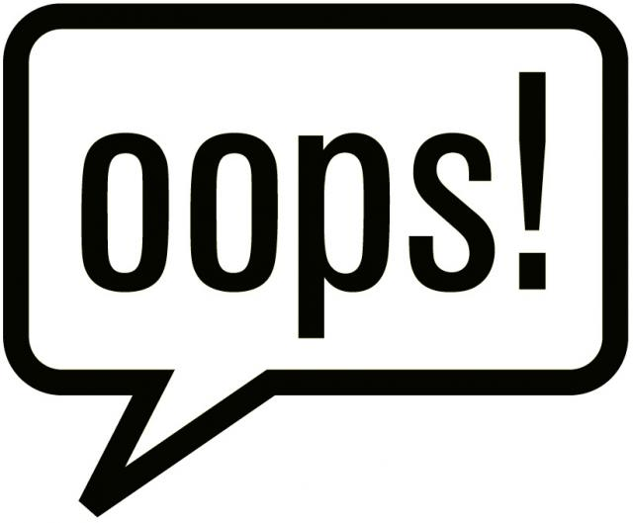
Avoiding Errors That Can Undermine an Interview’s Usefulness (3 of 3)
Nonverbal Behavior and Impression Management
Effect of Personal Characteristics: Attractiveness, Gender, Race
Notes:
The applicant’s nonverbal behavior (smiling, avoiding your gaze, and so on) can also have a surprisingly large impact on his or her rating. Interviewers infer your personality from your nonverbal behaviors in the interview.
Clever candidates capitalize on non-verbal behavior and impression management. One study found that some used ingratiation to persuade interviewers to like them. Psychologists call using techniques like ingratiation and self-promotion “impression management.”
Effect of Personal Characteristics: Attractiveness, Gender, Race – Unfortunately, physical attributes such as applicants’ attractiveness, gender, disability, or race also may distort an interviewer’s assessments.

Slide 20
Diversity Counts
Notes:
Diversity Counts
Applicant Disability and the Employment Interview
Researchers surveyed 40 disabled people from various occupations. The disabled people felt that interviewers tend to avoid directly addressing the disability, and therefore make their decisions without all the facts. What the disabled people prefer is a discussion that lets the employer address his or her concerns and reach a knowledgeable conclusion.
Among the questions they said they would like interviewers to ask were:
Is there any kind of setting or special equipment that will facilitate the interview process for you?
Is there any specific technology that you currently use or have used in previous jobs that assists the way you work?
What other kind of support did you have in previous jobs?
Is there anything that would benefit you?
Discuss a barrier or obstacle, if any, that you have encountered in any of your previous jobs.
How was that addressed? and,
Do you anticipate any transportation or scheduling issues with the work schedule expected of this position?
Remember that under the Americans with Disabilities Act, the interviewer must limit his or her questions to whether the applicant has any physical or mental impairment that may interfere with his or her ability to perform the job’s essential tasks.
In another study, the researchers manipulated the candidates’ appearance, for instance “by placing scar-like marks on the cheeks of some of the applicants for some interviews, but not for others.” Results revealed that managers who interviewed a facially stigmatized applicant (versus a non-stigmatized applicant) “rated the applicant lower [and] recalled less information about the interview” (in part, apparently, because staring at the “scars” distracted the interviewers).
Note that the use of employment discrimination “testers” makes nondiscriminatory interviewing even more important. As defined by the EEOC, testers are “individuals who apply for employment which they do not intend to accept, for the sole purpose of uncovering unlawful discriminatory hiring practices.” Although not really seeking employment, testers have legal standing with the courts and EEOC. One civil rights group sent four university students—two white, two black—to an employment agency, supposedly in pursuit of a job. The civil rights group gave the four “testers” backgrounds and training to make their qualifications appear almost indistinguishable from each other. The white tester/applicants got interviews and job offers. The black tester/applicants got neither interviews nor offers.
The HR Practices feature in the next slide shows why care is required abroad too.

Slide 21
Improving Performance: HR Practice Around the Globe
Selection Practices Abroad
Let’s talk about it…
Notes:
Improving Performance: Hr Practices Around the Globe
Selection Practices Abroad
In choosing selection criteria abroad, the manager in a multinational subsidiary walks a thin line between using the parent company’s selection process and adapting it to local cultural differences. One study focused on Bangladesh. Traditional selection practices there are different from what one might expect in the United States. For example, “age is considered synonymous to wisdom.” Therefore, job advertisements for mid- and senior-level positions often set a minimum age as a selection criteria. But managers of multinational subsidiaries there are slowly implementing their corporate headquarters’ prescribed HRM practices. As a result, the multinationals are affecting local recruitment and selection practices. That said, a manager would still be wise to understand each country’s unique cultural demands before holding an interview there.
Talk About it (Discussion): You are interviewing candidates in Bangladesh and you have a great candidate who unfortunately is 25 years old, when the job calls for someone at least 40. List three interview questions you would ask to see if the person is still qualified.

Slide 22
Interviewer Behavior
Notes:
Finally, the interviewer’s behavior affects interviewee performance and rating.
For example, some interviewers inadvertently telegraph the expected answers, as in: “This job involves a lot of stress. You can handle that, can’t you?” Even subtle cues (like a smile or nod) can telegraph the desired answer. Some interviewers talk so much that applicants have no time to answer questions. At the other extreme, some interviewers let the applicant dominate the interview, and so don’t ask all their questions. When interviewers have favorable pre-interview impressions of the applicant, they tend to act more positively toward that person (smiling more, for instance). Other interviewers play interrogator, forgetting that it’s uncivil to play “gotcha” by gleefully pouncing on inconsistencies. Some interviewers play amateur psychologist, unprofessionally probing for hidden meanings in what the applicant says. Others ask improper questions, forgetting that discriminatory questions “had a significant negative effect on participants’ reactions to the interview and interviewer.” Other interviewers just can’t conduct interviews.

Slide 23
III. Define a structured situational interview and give examples of situational questions, behavioral questions, and background questions that provide structure.
Notes:
There is little doubt that the structured situational interview—a series of job-relevant questions with predetermined answers that interviewers ask of all applicants for the job—produces superior results.
Now we will look into this a bit more.

Slide 24
How to Design and Conduct an Effective Interview
Notes:
You may not have the time or inclination to create a structured situational interview. However, there is still much you can do to make your interviews more systematic and effective.
Ideally, the basics is to (1) write situational (what would you do), behavioral (what did you do), or job knowledge questions, and (2) have job experts (like those supervising the job) also write several answers for each of these questions, rating the answers from good to poor.

Slide 25
Designing the Structured Situational Interview
Analyze the job
Rate the job’s main duties
Create interview questions
Create benchmark answers
Appoint interview panel and conduct interviews
Notes:
The procedure is as follows:
Step 1. Analyze the job. Write a job description with a list of job duties; required knowledge, skills, and abilities; and other worker qualifications.
Step 2. Rate the job’s main duties. Rate each job duty, say from 1 to 5, based on how important it is to doing the job.
Step 3. Create interview questions. Create situational, behavioral, and job knowledge interview questions for each of the job’s duties, with more questions for the important duties. The people who create the questions usually write them as critical incidents. For example, to probe for conscientiousness, the interviewer might ask this situational question:
Your spouse and two teenage children are sick in bed with colds. There are no relatives or friends available to look in on them. Your shift starts in 3 hours. What would you do?
Step 4. Create benchmark answers. Next, for each question, develop ideal (benchmark) answers for good (a 5 rating), marginal (a 3 rating), and poor (a 1 rating) answers.
Step 5. Appoint the interview panel and conduct interviews. Employers generally conduct structured situational interviews using a panel, rather than one-on-one. The panel usually consists of three to six members, preferably the same ones who wrote the questions and answers. It may also include the job’s supervisor
and/or incumbent, and a human resources representative. The same panel interviews all candidates for the job.

Slide 26
Improving Performance: HR Tools For Line Managers and Small Businesses
How to Conduct an Effective Interview
Let’s talk about it…
Notes:
Improving Performance: HR Tools for Line Managers and Small Businesses
How to Conduct an Effective Interview
You may not have the time or inclination to create a structured situational interview. However, there is still much you can do to make your interviews systematic and productive.
Step 1: First, know the job.
Step 2: Structure the interview. Any structuring is better than none. If pressed for time, you can still do several things to ask more consistent and job-relevant questions, without developing a full-blown structured interview.
• Base questions on actual job duties. This will minimize irrelevant questions.
• Use job knowledge, situational, or behavioral questions. Questions that simply ask for opinions and attitudes, goals and aspirations, and self-descriptions and self-evaluations allow candidates to present themselves in an overly favorable manner or avoid revealing weaknesses.
• Use the same questions with all candidates. This improves reliability. It also reduces bias by giving all candidates the same opportunity.
• For each question, if possible, have several ideal answers and a score for each. Then rate each candidate’s answers against this scale.
• List your questions before the interview.
Step 3: Get organized. Hold the interview in a private place to minimize interruptions (including text messages). Prior to the interview, review the candidate’s application and résumé. Note any areas that are vague or that may indicate strengths or weaknesses.
Step 4: Establish rapport. The main reason for the interview is to find out about the applicant. Start by putting the person at ease. Greet the candidate and start the interview by asking a noncontroversial question, perhaps about the weather that day.
Step 5: Ask questions. Try to follow the situational, behavioral, and job knowledge questions you wrote out ahead of time.
Step 6: Take brief, unobtrusive notes during the interview. Doing so may help avoid making a snap decision early in the interview, and may also help jog your memory once the interview is complete. Jot down just the key points of what the interviewee says.
Step 7: Close the interview. Leave time to answer any questions the candidate may have and, if appropriate, to advocate your firm to the candidate. Try to end the interview on a positive note. Tell the applicant whether there is any interest and, if so, what the next step will be. Make rejections diplomatically—“Although your background is impressive, there are other candidates whose experience is closer to our requirements.” Remember, as one recruiter says, “An interview experience should leave a lasting, positive impression of the company, whether the candidate receives and accepts an offer or not.” If the applicant is still under consideration but you can’t reach a decision now, say so.
Step 8: Review the interview. Once the candidate leaves, review your interview notes, score the interview answers (if you used a guide), and make a decision.
In rejecting a candidate, one perennial question is, should you provide an explanation or not? In one study, rejected candidates who received an explanation felt that the rejection process was fairer. Unfortunately, doing so may not be practical. Most employers say little, to avoid pushback and legal problems.
Talk About it (Discussion) : Write a one-paragraph (single-spaced) memo to the people who do your
company’s recruiting on the topic, “The five most important things an interviewer can do to have a useful selection interview.”

Slide 27
Profiles and Employee Interviews (1 of 2)
Use the same job profile (competencies, traits, knowledge, and experience) for creating interview questions as for recruiting
Notes:
Employers using competency models or profiles (which list required skills, knowledge, behaviors, and other competencies) can use the profile for formulating job-related situational, behavioral, and knowledge interview questions.
Table 7-1 summarizes illustrative skill, knowledge, trait, and experience profile items for chemical engineer candidates, with sample interview questions.

Slide 28
Profiles and Employee Interviews (2 of 2)
Table 7-1 Asking Profile-Oriented Interview Questions
Profile Component | Example | Sample Interview Question
Skill | Able to use computer drafting software | Tell me about a time you used CAD Pro computerized design software.
Knowledge | How extreme heat affects Hydrochloric acid (HCl) | Suppose you have an application where HCl is heated to 400 degrees Fahrenheit at 2 atmospheres of pressure; what happens to the HCl?
Trait | Willing to travel abroad at least 4 months per year visiting facilities | Suppose you had a family meeting to attend next week and we informed you that you had to leave for a job abroad immediately. How would you handle that?
Experience | Designed pollution filter for acid-cleaning facility | Tell me about a time when you designed a pollution filter for an acid-cleaning facility. How did it work? What particular problems did you encounter?

Slide 29
IV. Discuss how to use employee selection methods to improve employee engagement.
Notes:
Next we look at how to use employee selection methods to improve employee engagement.

Slide 30
Employee Engagement Guide for Managers
Notes:
Many employers create a total selection program aimed at selecting candidates whose totality of attributes best fits the employer’s total requirements—doing so impacts engagement.

Slide 31
Building Engagement: A Total Selection Program
Notes:
The program Toyota Motor uses to select employees for auto assembly team jobs illustrates the total selection program that is aimed at selecting candidates whose totality of attributes best fits the employer’s total requirements.
Toyota looks for several things in candidates. It wants employees with good interpersonal skills, due to the job’s emphasis on teamwork. Toyota’s emphasis on kaizen—on having the workers improve job processes through worker commitment to top quality—helps explain its emphasis on reasoning and problem-solving skills and on hiring intelligent, educated, and engaged workers.
Quality is a Toyota core value, and so Toyota looks for a history of quality commitment in those it hires. This helps explain why Toyota holds group interviews focusing on accomplishments. By asking candidates about what they are proudest of, Toyota gets a better insight into the person’s values regarding quality and doing things right. Toyota is also looking for employees who have an eagerness to learn, and who are willing to try things Toyota’s way or the team’s way. Toyota’s production system relies on consensus decision making, job rotation, and flexible career paths, and these also require open-minded, flexible team players, not dogmatists.

Slide 32
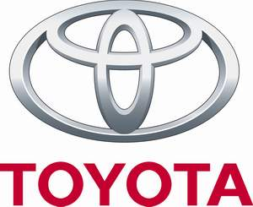
The Toyota Way
Step 1: an in-depth online application (20–30 minutes)
Step 2: a 2–5-hour computer-based assessment
Step 3: a 6–8-hour work simulation assessment
Step 4: a face-to-face interview
Step 5: a background check, drug screen, and medical check
Step 6: job offer
Notes:
Toyota’s hiring process aims to identify such assembler candidates. The process takes about 20 hours and six phases over several days:
Step 1: an in-depth online application (20–30 minutes)
Step 2: a 2–5-hour computer-based assessment
Step 3: a 6–8-hour work simulation assessment
Step 4: a face-to-face interview
Step 5: a background check, drug screen, and medical check
Step 6: job offer

Slide 33
Trends Shaping HR: Science in Talent Management
Google’s Evidence-based Approach to Selection
Let’s take a look…
Notes:
Trends Shaping HR: Science in Talent Management
As another example, Google takes a scientific, evidence-based approach to its selection (and other HR) practices.
In its hiring process, Google starts (as explained in Chapter 4) with strong candidates. Recall that where possible, its internal recruiting group proactively identifies candidates, rather than using job boards to attract unscreened résumés. The main elements in Google’s selection process include work samples, testing, and interviewing. Virtually all of Google’s technical hires take work sample tests, such as actually writing algorithms. Work samples are combined with testing of cognitive ability (similar to IQ tests), and of conscientiousness. Early in its evolution, Google was known for putting candidates through a dozen or more interviews. However, Google’s own analysis showed that after the first four interviews, the amount of useful information it got was not large. Therefore, It now generally makes hiring decisions after the fourth interview.
The interview emphasizes situational and behavioral questions. For specific questions, Google provides (as noted) its interviewers with access to its Qdroid system; this e-mails each interviewer specific questions to ask the candidate for the specific job. Google interviewers were once known for trick questions, but the emphasis today is on using validated questions (from the QDroid system). The questions aim to assess the candidate’s cognitive ability, leadership (particularly willingness to lead projects), “Googleyness” (values such as fun-loving and conscientious), and role-related knowledge (such as in computer science). Who actually does the interviewing? Here Google believes in the “wisdom of crowds”: the interviewing “crowd” includes not just the prospective boss but prospective subordinates and representatives of other unrelated departments. Google then averages all the interviewers’ interview ratings on a candidate to get a score. Finally, the hiring committee reviews the file, as does a Google senior manager, and then the CEO before an offer is made.

Slide 34
V. What are the main points to know about developing and extending the actual job offer?
Notes:
After all the interviews, background checks, and tests, the employer decides to whom to make an offer.

Slide 35
Developing and Extending the Job Offer
Judgmental approach
Statistical approach
Hybrid approach
Notes:
After all the interviews, background checks, and tests, the employer decides to whom to make an offer using one or more approaches.
The judgmental approach subjectively weighs all the evidence about the candidate.
The statistical approach quantifies all the evidence and perhaps uses a formula to predict job success.
The hybrid approach combines statistical results with judgment.
Statistical and hybrid are more defensible; judgmental is better than nothing.

Slide 36
The Job offer Main Parameters
The job offer will include:
Pay rates
Benefits
Actual job duties
There may be some negotiations
When agreement is reached, the employer will extend a written job offer to the candidate
Notes:
When the actual offer is made, for instance the job offer for the candidate’s apparent attractiveness as a prospective employee, the level of the position, and pay rates for similar positions will be reviewed. Next the employer extends an actual job offer to the candidate verbally. Here, the employer’s point person (who might be the person to whom the new employee will report, or the human resource director for instance) discusses the offer’s main parameters. These include, for instance, pay rates, benefits, and actual job duties. There may be some negotiations. Then, once agreement is reached, the employer will extend a written job offer to the candidate.

Slide 37
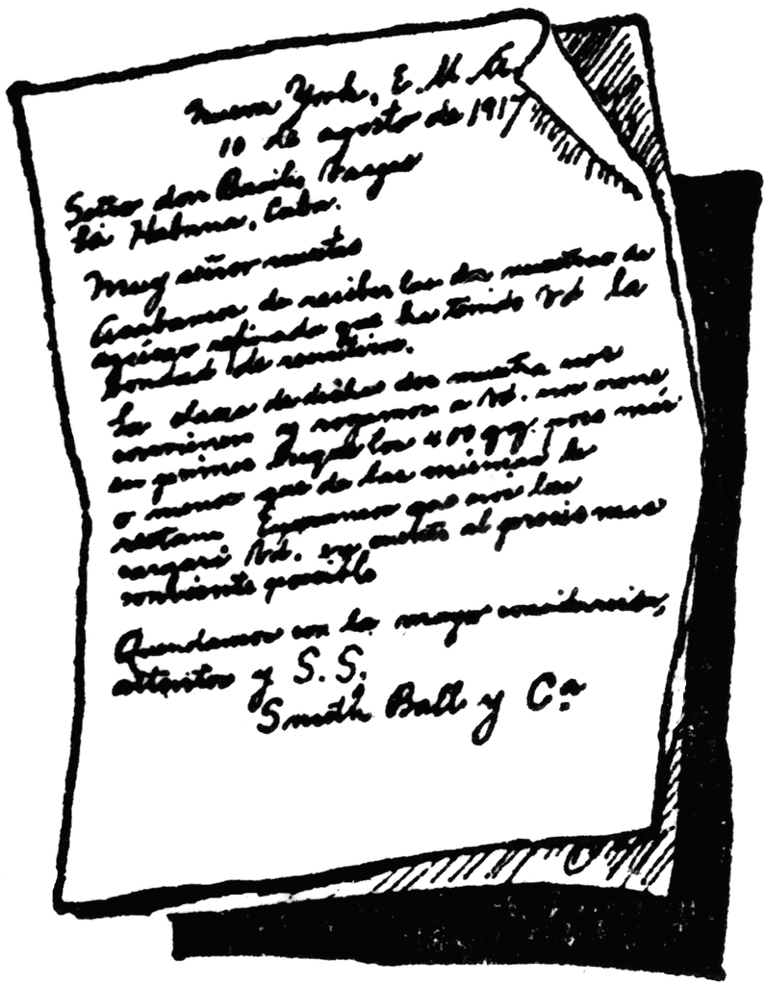
Issues to Consider with the Written Offer
A job offer letter has the:
Welcome sentence
Pay information
Benefits information
Paid leave information
Terms of employment
Notes:
There are several issues to consider with the written offer. Perhaps most important, understand the difference between a job offer letter and a contract. In a job offer letter, the employer lists the offer’s basic information.
This typically starts with a welcome sentence. It then includes job-specific information (such as details on salary and pay), benefits information, paid leave information, and terms of employment (including, for instance, successful completion of job testing and physical exams).
There should be a strong statement that the employment relationship is “at will.” Then there is a closing statement. This again welcomes the employee, mentions who the employer’s point person is if any questions arise, and instructs the candidate to sign the letter of offer if it is acceptable.

Slide 38
The Employment Contract
An employment contract includes:
Duration
Severance provisions
Nondisclosure requirements
Covenants not to compete
Relocation provision
Notes:
For many positions (such as executive) a contract is in order. In contrast to a letter of offer (which should always be “at will”), an employment contract may have a duration (such as 3 years). Therefore, the contract will also describe grounds for termination or resignation, and severance provisions. The contract will almost always also include terms regarding confidentiality, nondisclosure requirements, and covenants not to compete (although some job offer letters for positions such as engineer many include such provisions as well).
See www.shrm.org/ template-tools/toolkits for more information.

Slide 39
Chapter 7 Review
What you should now know….
Notes:
In review of Chapter 7, you should now be able to:
7-1. List and give examples of the main types of selection interviews.
7-2. List and explain the main errors that can undermine an interview’s usefulness.
7-3. Define a structured situational interview and explain how to design and conduct effective selection interviews.
7-4. Discuss how to use employee selection methods to improve employee engagement.
7-5. List the main points to know about developing and extending the actual job offer.

Slide 40
Copyright

