Slide 1
Replacement Decisions
Lecture No. 47
Chapter 14
Contemporary Engineering Economics
Copyright © 2016

Slide 2
Required Assumptions and Decision Frameworks
Planning Horizon (Study Period)
Infinite planning horizon
Finite planning horizon
Technology
No technology improvement is anticipated over the planning horizon.
Technology improvement cannot be ruled out.
Relevant Cash Flow Information
Decision Frameworks

Slide 3
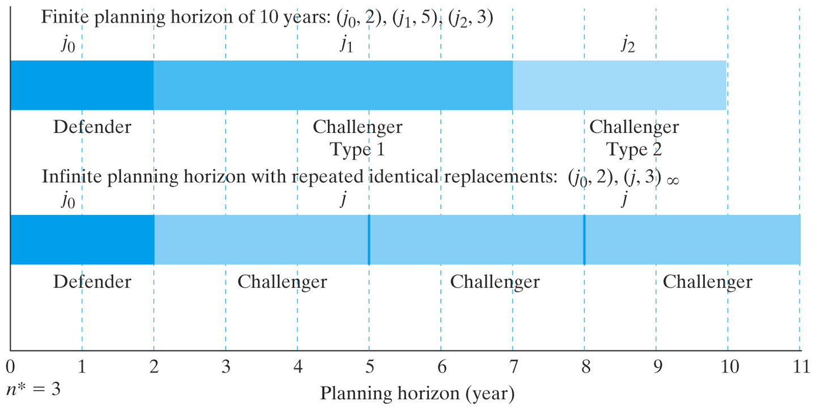
Types of Typical Replacement Decision Frameworks
Notes:
Figure: 14-06

Slide 4
Replacement Strategies under the Infinite Planning Horizon
Decision Rules
Step 1: Compute the AECs for both the defender and challenger at its economic service life, respectively.
Step 2: Compare AEC_{D*} and AEC_{C*.}
If AEC_{D*} > AEC_{C*} , replace the defender now.
If AEC_{D*} < AEC_{C*} , keep the defender at least for the duration of its economic service life if there are no technological changes over that life.
Step 3: If the defender should not be replaced now, conduct marginal analysis to determine when to replace the defender.

Slide 5
Cash Flow Assumptions
Replace the defender now: The cash flows of the challenger estimated today will be used. An identical challenger will be used thereafter if replacement becomes necessary again in the future. This stream of cash flows is equivalent to a cash flow of AEC_{C*} each year for an infinite number of years.
Replace the defender, say, x years later: The cash flows of the defender will be used in the first x years. Starting in year x+1, the cash flows of the challenger will be used indefinitely thereafter.

Slide 6
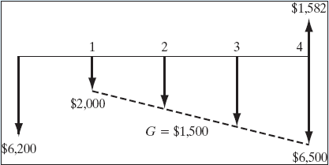
Example 14.4: Replacement Analysis Under an Infinite Planning Horizon
Given:
Defender
Current salvage value = $5,000, decreasing at an annual rate of 25% over the previous year’s value
Required overhaul = $1,200
O&M = $2,000 in year 1, increasing at the rate of $1,500 each year
Challenger
I = $10,000
Salvage value = $6,000 after one year, will decline 15% each year
O&M = $2,200 in the first year, increasing by 20% per year thereafter
Find: (a) Economic service lives for both defender and challenger, (b) when to replace the defender
Cash flow diagram for defender when N = 4 years
Notes:
Figure: 14-07EXM

Slide 7
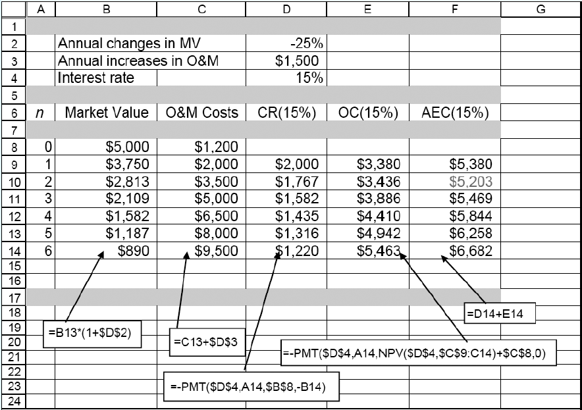
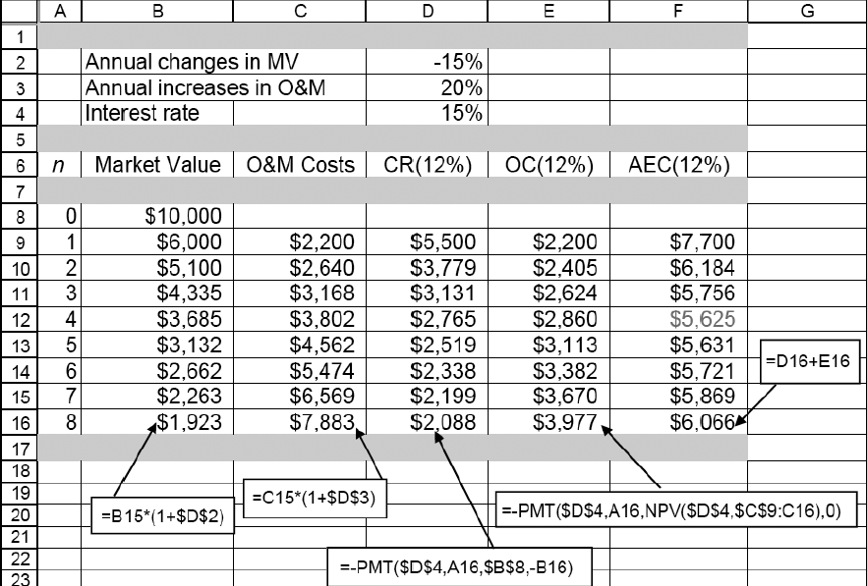
Economic Service Life
Defender
Challenger

Slide 8
Replacement Decisions
Should replace the defender now? No, because AEC_{D*} < AEC_{C*}
If not, when is the best time to replace the defender? Need to conduct the marginal analysis.
N_{C*}= 4 years
AEC_{C*}=$5,625

Slide 9
Marginal Analysis to Determine when the Defender Should Be Replaced
Question: What is the additional (incremental) cost for keeping the defender one more year from the end of its economic service life, from Year 2 to Year 3?
Financial Data
Opportunity cost at the end of year 2: Equal to the market value of $2,813
Operating cost for the 3rd year: $5,000
Salvage value of the defender at the end of year 3: $2,109

Slide 10
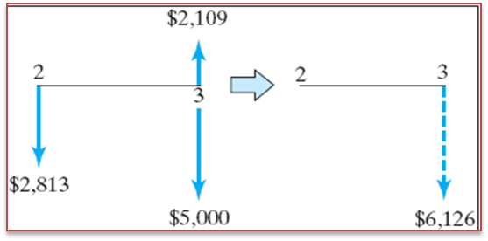
Marginal Analysis
Step 1: Calculate the equivalent cost of retaining the defender one more from the end of its economic service life, say 2 to 3.
$2,813(F/P,15%,1) + $5,000
− $2,109 = $6,126
Step 2: Compare this cost with AEC_{C} = $5,625 of the challenger.
Conclusion: Since keeping the defender for the 3rd year is more expensive than replacing it with the challenger, DO NOT keep the defender beyond its economic service life.

Slide 11
Overall Replacement Strategies Under an Infinite Planning Horizon

Slide 12
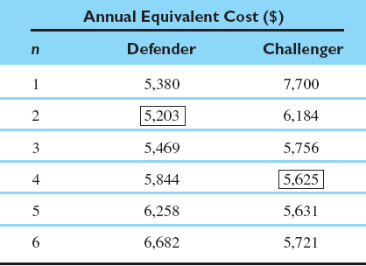
Example 14.5: Replacement Analysis Under the Finite Planning Horizon
Given: Economic service lives for both defender and challenger, planning horizon = 6 years, and i = 15%
Find: the most plausible/economical replacement strategy

Slide 13
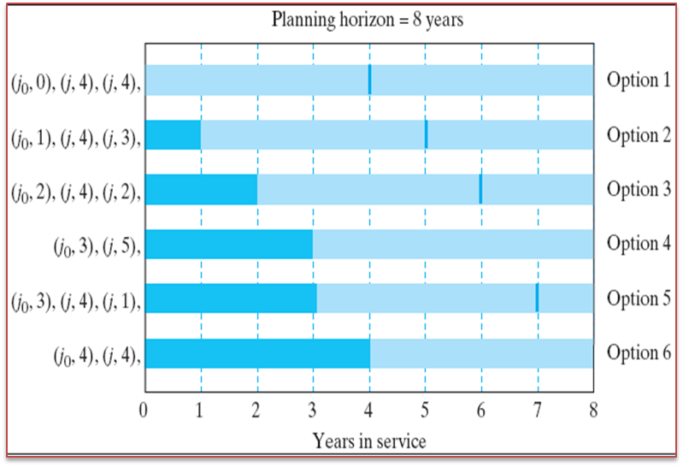
Some Likely Replacement Patterns

Slide 14
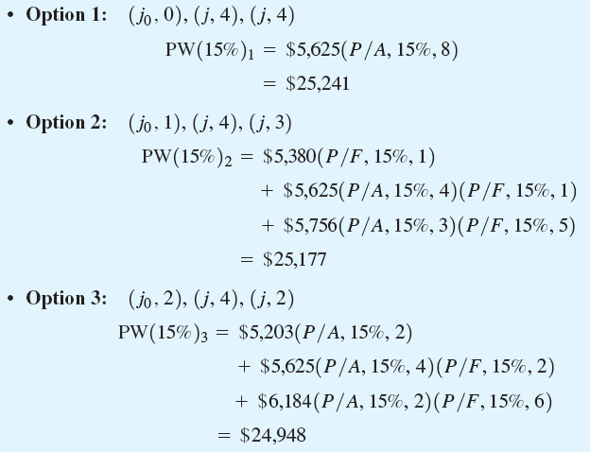
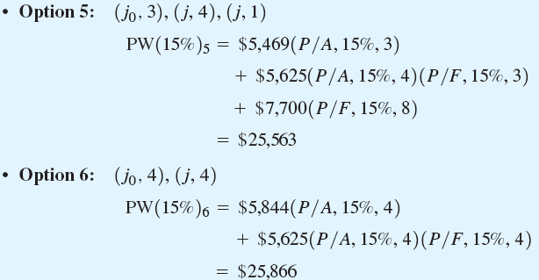
Present Equivalent Cost for Each Option

Slide 15
Graphical Representation of Replacement Strategies Under a Finite Planning Horizon
Optimal Strategy
Notes:
Figure: 14-10EXM

