Slide 1
Estimating Project Volatility
Lecture No. 45
Chapter 13
Contemporary Engineering Economics
Copyright © 2016

Slide 2
Volatility (σ)
Difficult to get a ‘good’ estimate
No historical prices
Volatility in theory should reflect risk and uncertainty
Difficult in practice
Risk represented in the random variable of a cash flow
Uncertainty practically unknown
Unknown investment opportunities, market prices, market demand, etc.

Slide 3
Analytical Approach
Conceptual Idea: Estimating volatility based on the mathematical relationship between the project return volatility (σ) and the parameters (μ_{T} and σ_{T}) of project value distribution, V_{T}

Slide 4
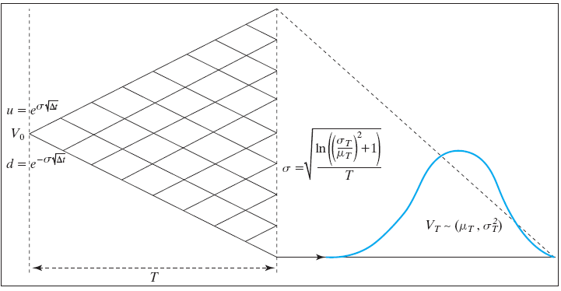
Mathematical Relationship Between σ and σ_{T}

Slide 5
Example
A firm determines the NPV distribution of the project it is evaluating. From inspection, the distribution looks somewhat lognormal (i.e. it is positively skewed). The time to make the investment decision is two-years. The NPV descriptive statistics are:
E(V₂) = 5000
Var(V₂) = 4000²
The volatility estimate is:

Slide 6
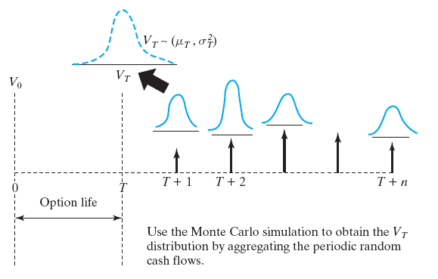
Estimating V_{T} Distribution
Step 1: Estimate the project cash flows over the project life (T + n) if the project is undertaken at the end of option life (T).
Step 2: Obtain the V_{T} distribution by aggregating the project cash flow at each period and then discounting them at a risk-free rate.
Step 3: Compute the mean (μ_{T}) and volatility (σ²_{T})of the V_{T} distribution.
Step 4: Compute σ by using

Slide 7
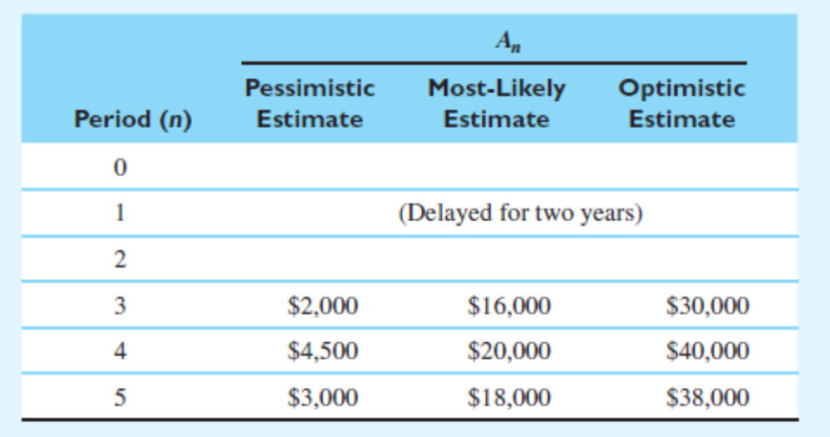
Example 13.14: Estimating the Project Volatility for a Simple Deferral Option
Given:
Two years to defer: T = 2
Required investment: $35M
Risk-adjusted discount rate: 10%
Risk-free rate: 6%
Find: Estimate the volatility.

Slide 8
Analytical Approach to Determine σ
3-point estimates

Slide 9
Estimation of V_{T} Distribution
Project’s Volatility

Slide 10
Option Value Calculation

Slide 12
Summary
Real options analysis provides a new way of managing business risk.
The fundamental difference between the traditional NPV approach and real options analysis is in how they treat managing project risk: The traditional NPV approach is to avoid risk whenever possible, whereas the real options approach is to manage risk.

