Slide 1
Methods of Describing Project Risk
Lecture No. 38
Chapter 12
Contemporary Engineering Economics
Copyright © 2016

Slide 2
Chapter Opening Story
Alcoa has invested $670 million to increase its production capacity to meet demand for aluminum to produce vehicles.
At Issue:
What would be the Alcoa’s financial risk in this expansion project?
How should Alcoa factor the future fluctuation and uncertainty of automobile demand into the analysis?
Notes:
Figure: 12-00UN

Slide 3
Methods of Describing Project Risk
Sensitivity analysis: A procedure of identifying the project variables which, when varied, have the greatest effect on project acceptability
Breakeven analysis: A procedure of identifying the value of a particular project variable that causes the project to exactly break even
Scenario analysis: A procedure of comparing a “base case” to one or more additional scenarios, such as best and worst cases, to identify the extreme and most likely project outcomes

Slide 4
Example 12.1: Transmission-Housing Project by Boston Metal Company
Given: Financial facts
Known with great confidence
Required investment = $125,000
Project Life = 5 years
Income tax rate = 40%
MARR = 15%
Unknown but predictable (most likely values)
Unit variable cost = $15 per unit
Number of units = 2,000 units
Unit Price = $50 per unit
Salvage value = $40,000
Fixed cost = $10,000/yr
Find: Determine the acceptability of the investment.

Slide 5
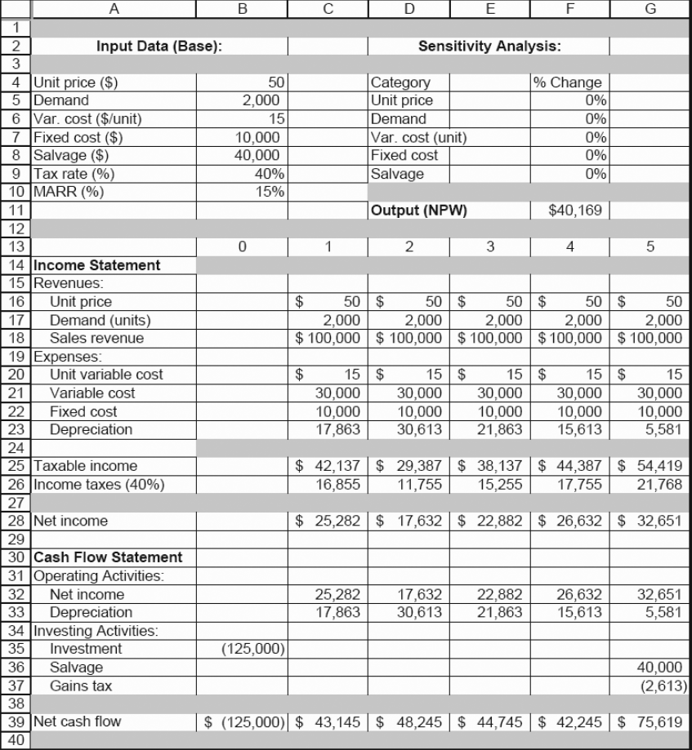
Solution

Slide 6
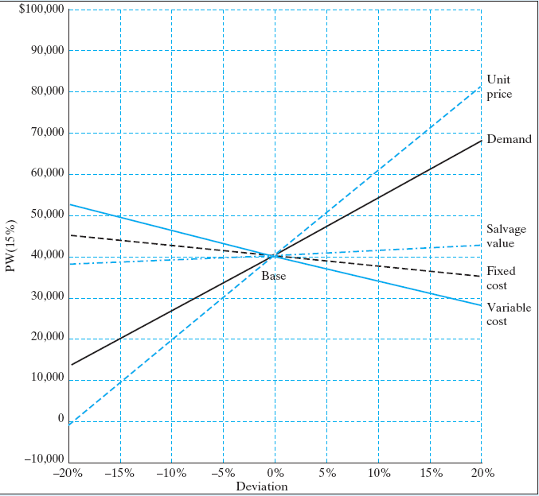
Sensitivity Analysis for Five Key Input Variables
Deviation | −20% | −15% | −10% | −5% | 0% | 5% | 10% | 15% | 20%
Unit price | $57 | $9,999 | $20,055 | $30,111 | $40,169 | $50,225 | $60,281 | $70,337 | $80,393
Demand | 12,010 | 19,049 | 26,088 | 33,130 | 40,169 | 47,208 | 54,247 | 61,286 | 68,325
Variable cost | 52,236 | 49,219 | 46,202 | 43,186 | 40,169 | 37,152 | 34,135 | 31,118 | 28,101
Fixed cost | 44,191 | 43,185 | 42,179 | 41,175 | 40,169 | 39,163 | 38,157 | 37,151 | 36,145
Salvage value | 37,782 | 38,378 | 38,974 | 39,573 | 40,169 | 40,765 | 41,361 | 41,957 | 42,553
Variable most sensitive to NPW: Unit price
Variable least sensitive to NPW: Salvage value

Slide 7
Breakeven Analysis
Breakeven analysis is a tool used to determine when a business will be able to cover all its expenses and begin to make a profit from a project.
Excel using a Goal Seek function
Analytical approach

Slide 8
Using a Goal Seek Function in Excel

Slide 9
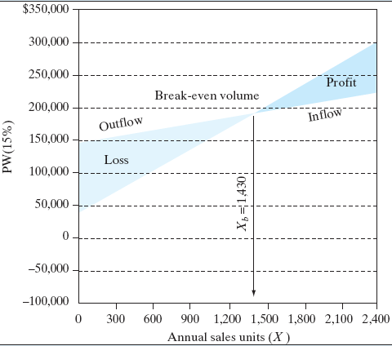
Using a Goal Seek Function in Excel
PW of Inflow: 100.5650X + $44,490
PW of Outflow: 30.1694X + $145,113
NPW = 70.3956X − $100,623

Slide 10
Analytical Approach
● PW of cash inflows
PW(15%)_{Inflow}= (PW of after-tax net revenue)
+ (PW of net salvage value)
+ (PW of tax savings from depreciation
= 30X(P/A, 15%, 5) + $37,389(P/F, 15%, 5)
+ $7,145(P/F, 15%,1)
+ $12,245(P/F, 15%, 2)
+ $8,745(P/F, 15%, 3)
+ $6,245(P/F, 15%, 4)
+ $2,230(P/F, 15%,5)
= 30X(P/A, 15%, 5) + $44,490
= 100.5650X + $44,490
● PW of cash outflows:
PW(15%)_{Outflow} = (PW of capital expenditure
+ (PW) of after-tax expenses
= $125,000 + (9X+$6,000)(P/A, 15%, 5)
= 30.1694X + $145,113
● The NPW:
PW (15%) = 100.5650X
+ $44,490
− (30.1694X
+ $145,113)
=70.3956X −$100,623
● Breakeven volume:
PW (15%)= 70.3956X
−$100,623
= 0
X_{b} =1,430 units.

Slide 11
Scenario Analysis
Scenario analysis is a process of analyzing possible future outcomes by considering alternative possible events (scenarios). The analysis is designed to improve decision-making by allowing more complete consideration of outcomes and their implications.
Source: Wikipedia

Slide 12
Example 12.3: Scenario Analysis
Given: Three plausible scenarios assuming asset of values for key input variables.
Find: Range of NPW

Slide 13
Worst Case Scenario

Slide 14
Best Case Scenario

Slide 15
Summary Outcome

