Slide 1
Corporate Income Taxes
Lecture No. 32
Chapter 9
Contemporary Engineering Economics
Copyright © 2016

Slide 2
Taxable Income and Income Taxes
Item
Gross Income
Expenses
Cost of goods sold (revenues)
Depreciation
Operating expenses
Taxable income
Income taxes
Net income

Slide 3
U.S. Corporate Tax System
For corporations, the U.S. tax system has the following characteristics:
Tax rates are progressive; the more you earn, the more you pay.
Tax rates increase in stair-step fashion; four brackets for corporations and two additional surtax brackets, giving a total of six brackets.
Allowable exemptions and deductions may reduce the overall tax assessment.

Slide 4
U.S. Corporate Tax Rate (2016)
Taxable income
0–$50,000
$50,001–$75,000
$75,001–$100,000
$100,001–$335,000
$335,001–$10,000,000
$10,000,001–$15,000,000
$15,000,001–$18,333,333
$18,333,334 and up
Tax rate
15%
25%
34%
39%
34%
35%
38%
35%
Tax computation
$0 + 0.15(Δ)
$7,500 + 0.25 (Δ)
$13,750 + 0.34(Δ)
$22,250 + 0.39 (Δ)
$113,900 + 0.34 (Δ)
$3,400,000 + 0.35 (Δ)
$5,150,000 + 0.38 (Δ)
$6,416,666 + 0.35 (Δ)
(Δ) denotes the taxable income in excess of the lower bound of each tax bracket

Slide 5
Marginal versus Average Tax Rate
Marginal tax rate is the rate applied to the last dollar of income earned.
Average (effective) tax rate is the ratio of income tax paid to net income.

Slide 6
Marginal and Effective (Average) Tax Rate for a Taxable Income of $16,000,000
Taxable income | Marginal Tax Rate | Amount of Taxes | Cumulative Taxes
First $50,000 | 15% | $7,500 | $7,500
Next $25,000 | 25% | 6,250 | 13,750
Next $25,000 | 34% | 8,500 | 22,250
Next $235,000 | 39% | 91,650 | 113,900
Next $9,665,000 | 34% | 3,286,100 | 3,400,000
Next $5,000,000 | 35% | 1,750,000 | 5,150,000
Remaining $1,000,000 | 38% | 380,000 | $5,530,000

Slide 7
Example 9.13: Corporate Taxes
Given: Financial data
Capital expenditure: $100,000
(Allowed depreciation): $58,000
Gross sales revenue: $1,250,000
Expenses
Cost of goods sold: $840,000
Depreciation: $58,000
Leasing warehouse: $20,000
Find:
Taxable income?
Income taxes?
Average tax rate?
Marginal tax rate?

Slide 8
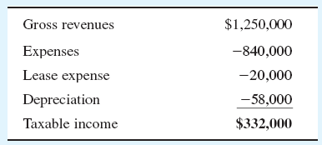
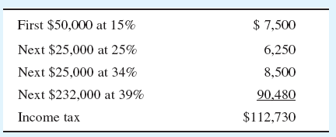
Solution
(a) Taxable income
(b) Income taxes
(c) Average tax rate: $112,730/$332,000 = 33.93%
(d) Marginal tax rate: 39%

Slide 9
Capital Gains and Losses
Capital gains are currently taxed as ordinary income, and the maximum rate is capped at 35%.
Capital losses are deducted from capital gains; net remaining losses may be carried backward (3 years) and forward 15 years for consideration in years other than the current tax year.

Slide 10
Tax Treatment of Gains or Losses on Depreciable Assets
If a MACRS property is disposed of during the recovery period
Personal property: the half-year convention is applied to depreciation amount for the year of disposal.
Real property: the mid-month convention is applied to the month of disposal.

Slide 11
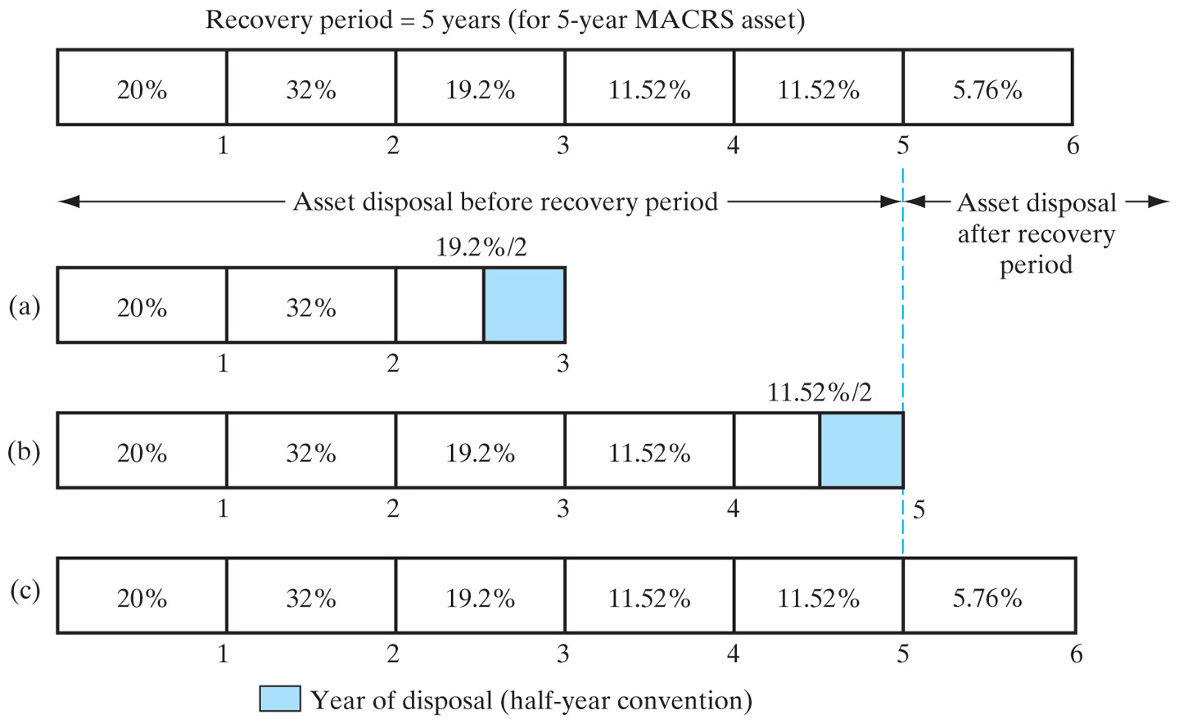
Disposal of a MACRS Property and Its Effect on Depreciation Allowances

Slide 12
Case 1: Salvage Value < Cost Basis
Ordinary gains (losses) = salvage value − book value
These gains, known as depreciation recapture, are taxed as ordinary income.
Any losses (ordinary) can be deducted from the ordinary gains from other assets first and any remaining balance can be deducted from the ordinary taxable income.

Slide 13
Case 2: Salvage Value > Cost Basis
Gains = Salvage value − book value
= (Salvage value − cost basis)
Capital gains
+ (Cost basis − book value)
Ordinary gains
Capital gain is taxed as ordinary income under current tax law.

Slide 14
Example 9.15: Gains or Losses on Depreciable Asset, Case 1
Given:
Cost basis for a drill press: $230,000
Recovery period: 7-year MACRS
Sold the drill press after 3 years at $150,000
Tax rate for capital gains and ordinary gains: 34%
Find:
Taxable gains
Net proceeds from sales

Slide 15
Solution
Depreciation schedule
Total dep. = 230,000(0.1439 + 0.2449 + 0.1749/2) = $109,308
Book value = 230,000 − 109,308 = $120,693
Gains = salvage value − book value = $150,000 − $120,693 = $29,308
Gains tax (34%) = 0.34 ($29,308) = $9,965
Net proceeds from sale = $150,000 − $9,965 = $140,035
0.1439
0.2449
0.1749/2

Slide 16
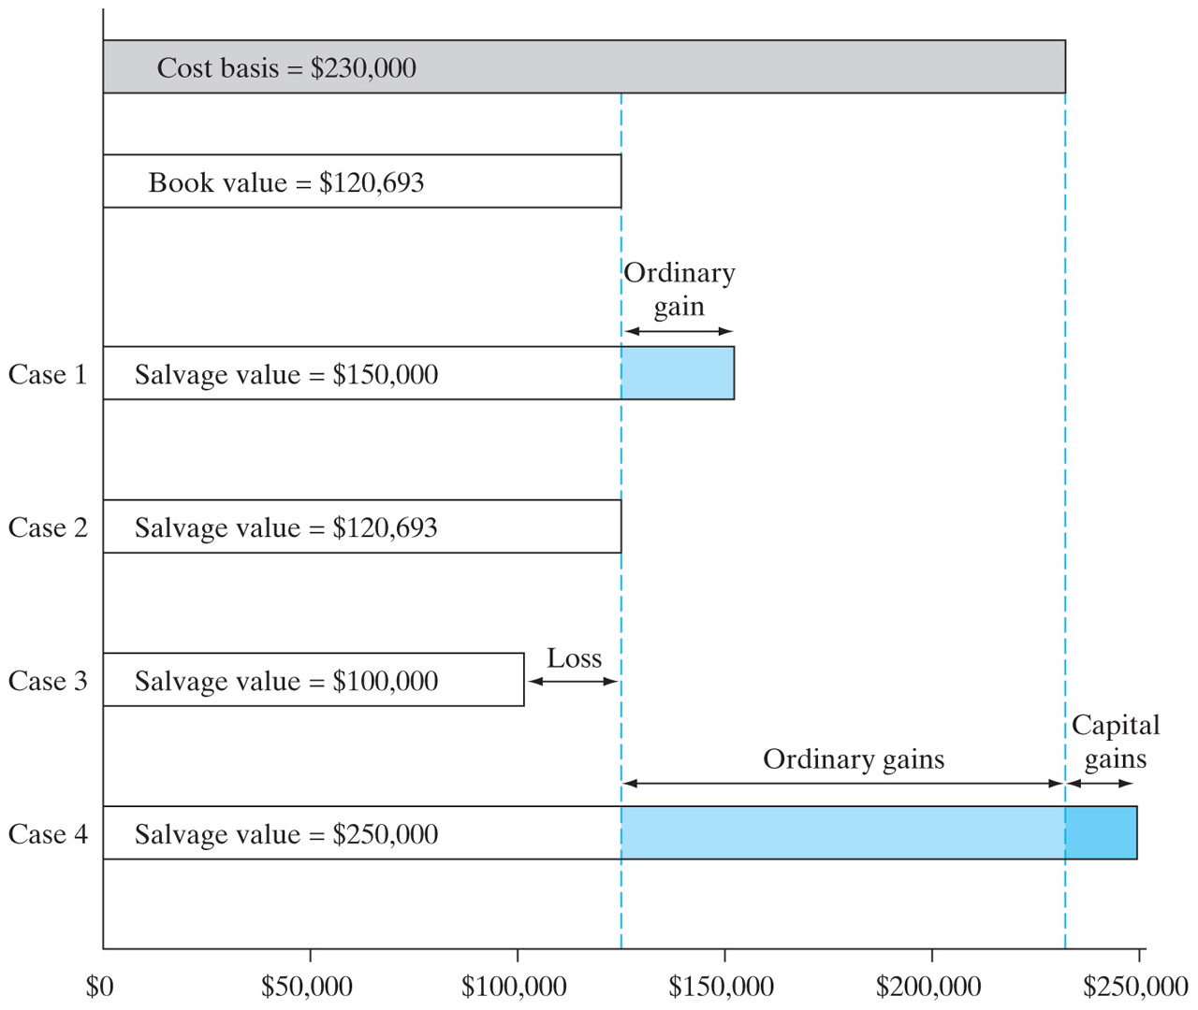
Calculation of Gains or Losses on MACRS Property, Cases 2–4

Slide 17
What Income Tax Rate Should Be Used in Project Analysis?
Incremental tax rate is the average rate applied to the incremental income generated by a new investment project.
Incremental tax rate to be used in
project cash flow analysis

Slide 18
Illustration of Incremental Tax Rate
$20,000 incremental
taxable income due to
undertaking project
0.25($5,000/$20,000) + 0.34($15,000/$20,000) = 31.75%
Regular income from operation
$5,000
at 25%
$15,000
at 34%
Marginal tax rate
15%
25%
34%
$0
$20,000
$40,000
$60,000
$80,000
$100,000

Slide 19
Consideration of State Income Taxes
Example: Given t_{f} = 35% and t_{s} = 7%
Find: t_{m}
Combined tax rate = 0.35 + 0.07 − (0.35)(0.07)
= 39.55%

Slide 20
Example 9.17: Combined State and Federal Income Taxes
Given: Financial Data
Gross revenue = $1,000,000
All expenses = $400,000
t_{f} = 35%, t_{s} = 7%
t_{m} = 0.35 + 0.07 − (0.07)(0.35) = 39.55%
Find: Combined income taxes

Slide 21
Solution
Approach 1
State taxable income = $600,000
State taxes = (0.07)($600,000) = $42,000
Federal taxable income
= $600,000 − $42,000
= $558,000
Federal taxes = (0.35)($558,000)
= $195,300
Approach 2
(0.3955)$600,000 = $195,300

Slide 22
Cash Flow vs. Net Income
Net income: an accounting means of measuring a firm’s profitability based on the matching concept.
Costs become expenses as they are matched against revenue.
The actual timing of cash inflows and outflows are ignored.
Cash flow: Considering the time value of money, it is better to receive cash now than later, because cash can be invested to earn more money. So, cash flows are more relevant data to use in project evaluation.

Slide 23
Example 9.18: Net Income Calculation
Given: Project description
Purchased an equipment costing $28,000
Gross income: $50,000/yr
Cost of goods sold: $20,000/yr
Operating expenses: $6,000/yr
Depreciation method: 7-year MACRS
Income tax rate: 40%
Find: The net income during the first year of operation

Slide 24
Solution
Item | Amount
Gross income (revenue) | $50,000
Expenses: Cost of goods sold Depreciation Operating expenses | 20,000 4,000 6,000
Taxable income | 20,000
Taxes (40%) | 8,000
Net income | $12,000

Slide 25
Capital Expenditure versus Depreciation Expenses
1
2
3
4
5
6
7
8
0
$28,000
Capital expenditure
(actual cash flow)
0
1
2
3
4
7
6
7
8
$1,250
$3,500
$2,500
$2,500
$2,500
$4,000
$4,900
$6,850
Allowed depreciation expenses (not cash flow)

Slide 26
Cash Flow versus Net Income
Item | Income | Cash Flow
Gross income (revenue) | $50,000 | $50,000
Expenses Cost of goods sold Depreciation Operating expenses | 20,000 4,000 6,000 | -20,000 -6,000
Taxable income | 20,000
Taxes (40%) | 8,000 | -8,000
Net income | $12,000
Net cash flow |  | $16,000

Slide 27
Estimating Net Cash Flow from Net Income
Net cash flows = net income + non-cash expense (depreciation)
$50,000
Net
cash flow
Net income
$12,000
$40,000
$16,000
Depreciation
$4,000
$30,000
Income taxes
$8,000
Gross
revenue
Operating expenses
$6,000
$20,000
$10,000
$20,000
Cost of goods sold
$0

Slide 28
Summary
Explicit consideration of taxes is a necessary aspect of any complete economic study of an investment project.
Once we understand that depreciation has a significant influence on the income and cash position of a firm, we will be able to appreciate fully the importance of utilizing depreciation as a means to maximize the value both of engineering projects and of the organization as a whole.

