Slide 1
Cost-Volume-Profit Analysis
Lecture No. 28
Chapter 8
Contemporary Engineering Economics
Copyright © 2016

Slide 2
Illustration of Full Cost Concept

Slide 3
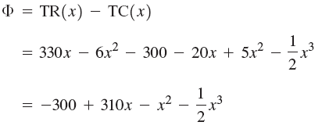
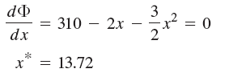
Cost-Volume-Profit Analysis
Profit Maximization for a Short-Run Period
Profit function
Total revenue (TR) and total cost (TC) Functions
Profit Function
Optimum activity level

Slide 4
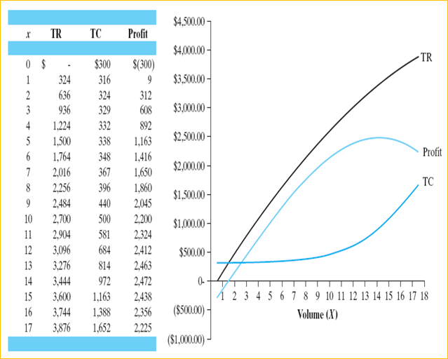
Cost-Volume-Profit Curve (unit: 1,000)

Slide 5
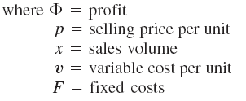
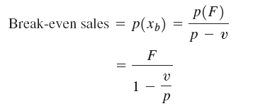
Contribution Margin and Break-Even Sales
Profit Function
Break-Even Volume (units)
Break-Even Sales ($)
marginal contribution
marginal contribution rate

Slide 6
Break-Even Chart
$600
500
400
300
200
100
10 18 20 30 40 50 60
Point of Desired Profit
Desired
Profit
Total Cost Line
Cash Cost Line
Dollars
(in thousands)
(Fixed Manufacturing Overhead)- (Depreciation)
DEPRECIATION
Variable Selling and Admins Expense
Fixed Selling and Admins Expense
Variable Mfg., Overhead
Direct Labor
Direct Material
Units of Product (in thousands)

Slide 7
Useful Break-Even Sales Formulas
Break-Even Formulas
($)
Depreciation
Q_{B}
0
Q_{A}
Q_{C}
Desired profit
Sales Volume
F

Slide 8
Example: Cost Data for Break-Even Chart
Unit Variable Costs
Direct Materials | $2.00
Direct Labor | 1.00
Variable Manufacturing Overhead | 1.00
Variable Selling and Administrative Expenses | 1.00
Total Unit Variable Cost | $5.00
Fixed manufacturing overhead (including depreciation of $10,000) = $70,000
Fixed selling and administrative expenses = $30,000
Selling price/unit = $10
Desired profit before taxes = $100,000

Slide 9
Profit-Volume Graph
$200
Point of Desired Profit
Slope of profit line is
the marginal contribution
Profit Line
PROFITS
($000s)
$100
0
$100 $200 $300 $400 $500 $600
$100
$200
LOSSES
($000s)
Fixed cost
10 20 30 40 50 60
UNITS OF PRODUCT (000s)

Slide 10
Effect of Variable Costs on Sales
The profit/volume graph shows profits (losses) at
different operating levels for the three companies.

Slide 11
Effect of Fixed Costs
Financial Data
Selling price per unit = $6.00
Variable cost per unit = $3.00
Unit marginal contribution = $3.00
Current fixed costs = $600,000
Desired profit level = $150,000
Required sales units = (600,000 + 150,000)/3 = 250,000 units
Fixed costs increase = $60,000
(ex. additional advertising expenditure)
Required sales units to maintain profits
= 810,000/3 = 270,000 units

Slide 12
Price Reduction and Increase in Variable Costs

Slide 13
Example 8.4: Break-Even Analysis
Given: Current Manufacturing Operation
A single shift five-day work week
Reached its maximum production capacity at 24,000 units per week
Fixed cost: $90,000 per week
Avg. variable cost: $30 per unit
Need to produce 4,000 additional units
At Issue: Add overtime (or Saturday operations) or second-shift operation
Option 1: Adding overtime or Saturday operations: 36Q
Option 2: Second-shift operation: $13,000 + 31.50Q
Find: Which option?

Slide 14
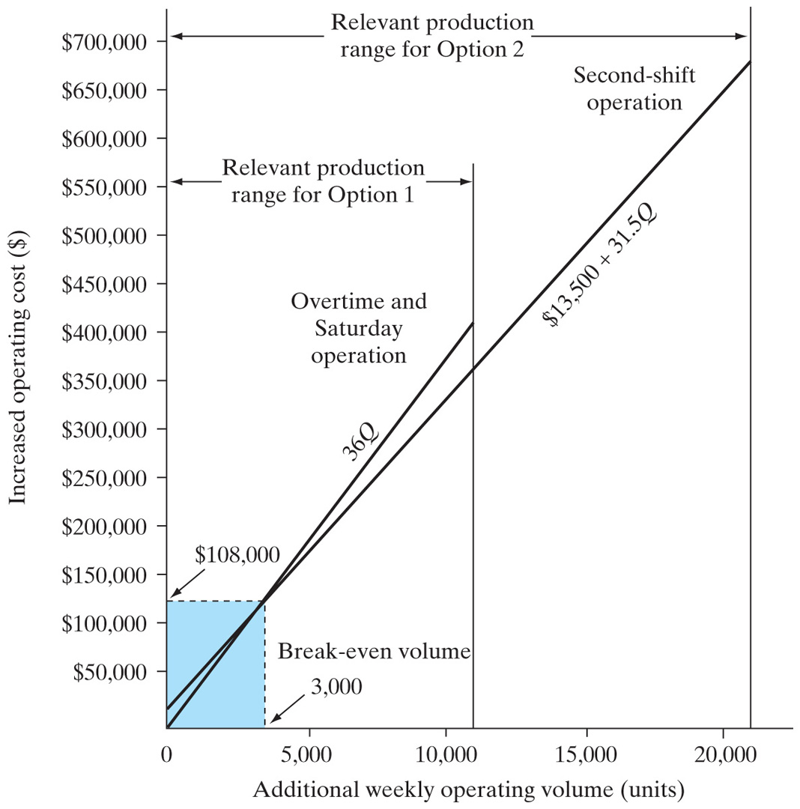
Solution
Break-even volume
36Q = $13,000 + 31.50Q
Q = 3,000 units
Decision
If Q ≤ 3,000, select Option 1.
If Q ≥ 3,000, select Option 2.

Slide 15
Example 8.7: Marginal Analysis
Given:
Financial Data
Daily demand: 1,000 cases
Fixed cost: $5,000 per week
Variable cost
Weekdays: $7 per case
Sundays: $12 per case
Generic aspirin production
Unit price: $10 per case
Brand-name aspirin production
Weekly demand: 1,000 cases per week
Unit price: $30 per case
Find: (1) How to schedule the product mix, and (2) is it worth operating on Sundays?

Slide 16
Solution
Product Mix
Marginal contribution for GA: $10 − $7 = $3 per case
Marginal contribution for BA: $30 − $7 = $23 per case
Schedule the product with the highest MC, i.e., brand-name aspirin
Marginal Analysis on Sunday Operation
Marginal revenue: $10 per case
Marginal cost: $12 per case
Sunday operation not economical
Break-Even Volume

Slide 17
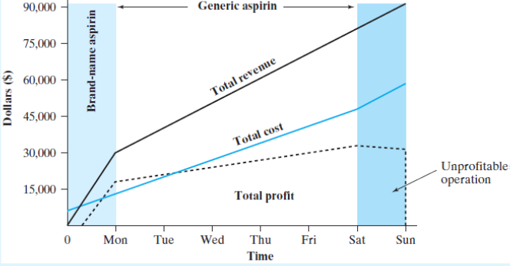
Weekly Profits as a Function of Time
Total Revenue and Cost Functions
Net Profit as a Function of Production Volume
Schedule brand-name aspirin first.
Schedule generic aspirin for five days.
Do not schedule anything on Sundays.

