Slide 1
Design Economics
Lecture No. 22
Chapter 6
Contemporary Engineering Economics
Copyright © 2016

Slide 2
Minimum Cost Analysis
Concept: Total cost is given in terms of a specific design parameter.
Goal: Find the optimal design parameter that will minimize the total cost.
Typical Mathematical Equation
where x is the common design parameter
Analytical Solution

Slide 3
Typical Graphical Relationship
Total Cost
Capital Cost
Cost ($)
O&M Cost
Design Parameter (x)
Optimal Value (x*)

Slide 4
Example 6.11: Optimal Cross-Sectional Area
Decision Problem: A constant electric current of 5,000 amps is to be transmitted a distance of 1,000 feet from a power station to a substation.
Find: The optimal size of a copper conductor
Relevant Physical and Financial Data:
Copper price: $8.25/lb
Resistance: 0.8145x10⁻⁵Ωin²/ft
Cost of energy: $0.05/kWh
Density of copper: 555 lb/ft
Useful life: 25 years
Salvage value: $0.75/lb
Interest rate: 9%
Power Transmission
1,000 ft.
5,000 amps
24 hours
365 days
Cross-sectional area

Slide 5
Operating Cost (Energy Loss)
Energy loss in kilowatt-hours (L)
I = current flow in amperes
R = resistance in ohms
T = number of operating hours
A = cross-sectional area

Slide 6
Material Costs
Material weight in pounds
Material cost (required investment)
Total material cost = 3,854A($8.25)
= 31,797A
Salvage value after 25 years: ($0.75)(31,797A)

Slide 7
Capital Recovery Cost
Given:
Initial cost = $31,797A
Salvage value = $2,890.6A
Project life = 25 years
Interest rate = 9%
Find: CR(9%)
2,890.6 A
0
25
31,797 A

Slide 8
Total Equivalent Annual Cost
Total equivalent annual cost
AEC = Capital cost + Operating cost
= Material cost + Energy loss
Find the minimum annual equivalent cost

Slide 10
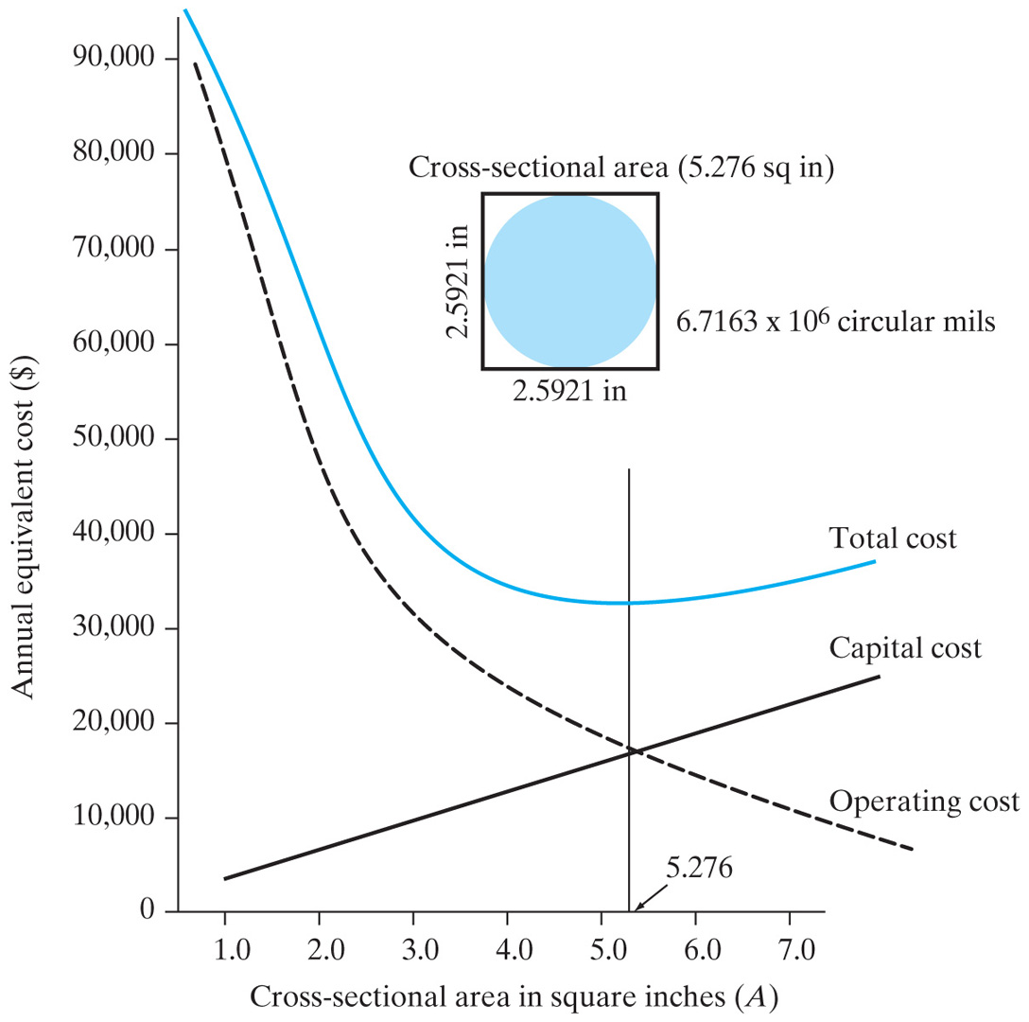
Optimal Cross-Sectional Area
Notes:
Figure: 06-09

Slide 11
Summary
Annual equivalent worth analysis, or AE, is—along with present worth analysis—one of two main analysis techniques based on the concept of equivalence. The equation for AE is:
AE(i) = PW(i)(A/P, i, N)
AE analysis yields the same decision result as PW analysis.
The capital recovery cost factor, or CR(i), is one of the most important applications of AE analysis in that it allows managers to calculate an annual equivalent cost of capital for ease of itemization with annual operating costs.
The equation for CR(i) is:
CR(i)= (I − S)(A/P, i, N) + iS
where I = initial cost and S = salvage value.

Slide 12
AE analysis is recommended over NPW analysis in many key real-world situations for the following reasons:
1. In many financial reports, an annual equivalent value is preferred to a present worth value.
2. Unit costs often must be calculated to determine reasonable pricing for items that are on sale.
3. Calculation of cost per unit of use is required to reimburse employees for business use of personal cars.
4. Make-or-buy decisions usually require the development of unit costs for the various alternatives.
5. Minimum cost analysis is easy to do when based on annual equivalent worth.

