Slide 1
Discounted Cash Flow Analysis
Lecture No.16
Chapter 5
Contemporary Engineering Economics
Copyright © 2016

Slide 2
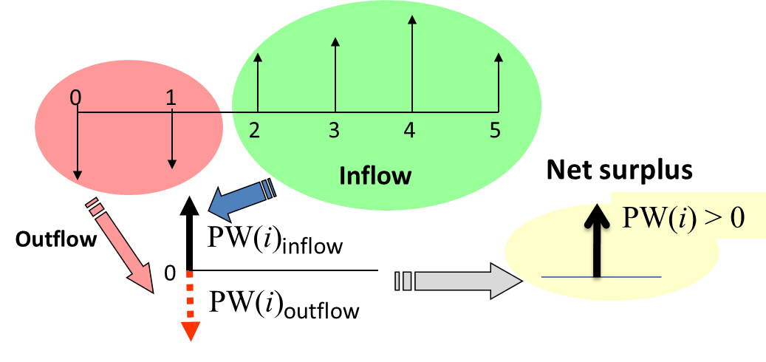
Net Present Worth Measure
Principle: Compute the equivalent net surplus at n = 0 for a given interest rate of i.
For Single Project Evaluation: Accept the project if the net surplus is positive.
For Comparing Multiple Alternatives: Select the alternative with the largest net present worth.

Slide 3
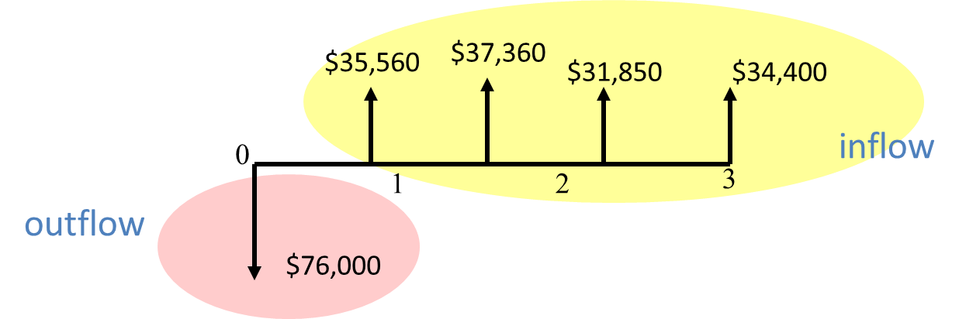
Example 5.5: Tiger Machine Tool Company
Given: Cash flow and i = 15%
Find: Net present worth

Slide 4
Solution
$35,560
$37,360
$31,850
$34,400
0
inflow
1
2
3
outflow
$76,000

Slide 5
Excel Solution
 | A | B | C
1 | Period | Cash Flow
2 | 0 | ($76,000)
3 | 1 | $35,560
4 | 2 | $37,360
5 | 3 | $31,850
6 | 4 | $34,400
7 | PW(12%) | $30,065
=NPV(12%,B3:B6)+B2

Slide 6
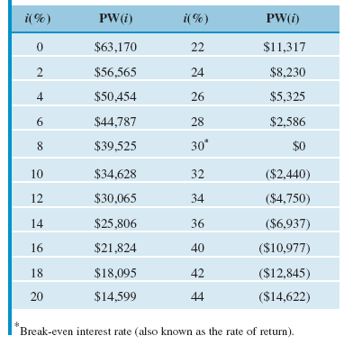
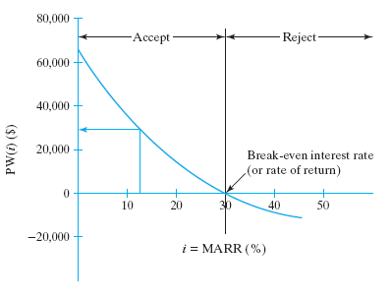
PW at Varying Interest Rates

Slide 7
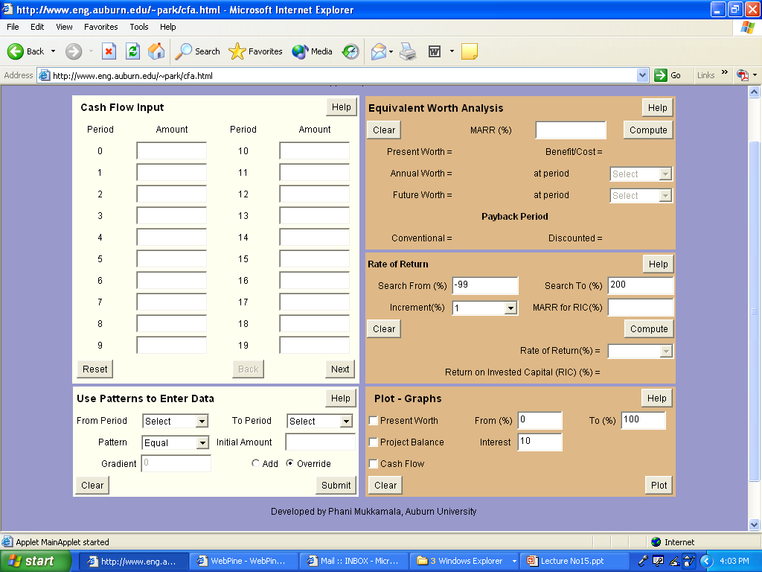
How to Use “Cash Flow Analyzer”
Book Website: http://www.prenhall.com/park

Slide 8
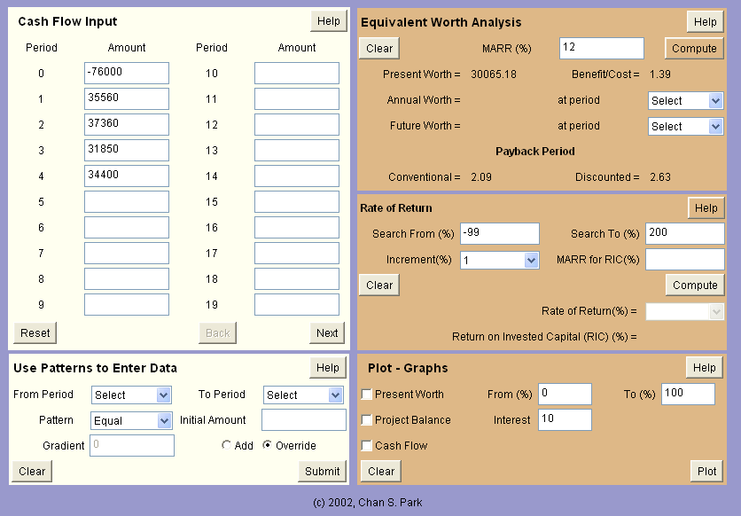
Solving Example 5.3 with Cash Flow Analyzer

Slide 9
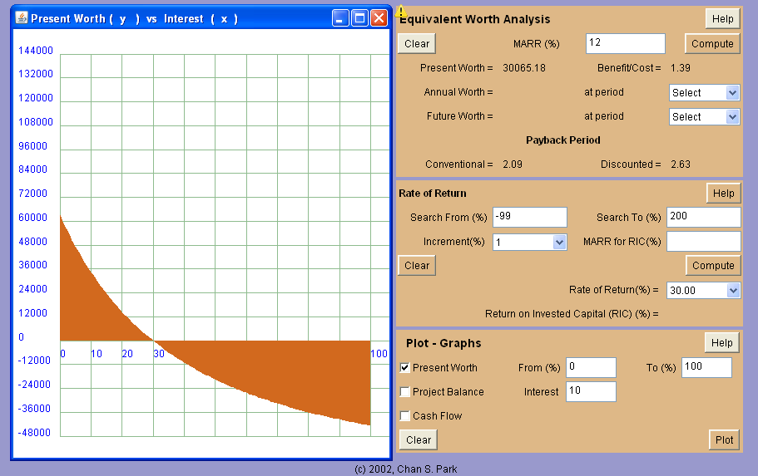
Obtaining a Graphical Plot of NPW

Slide 10
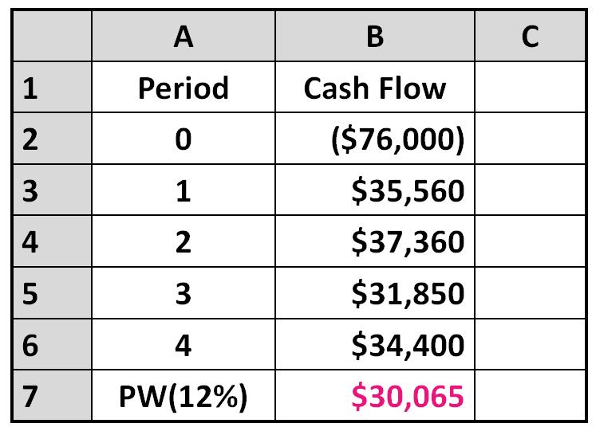
Can You Explain What $30,065 Really Means?
Project Balance Concept
Investment Pool Concept

Slide 11
Project Balance Concept
Suppose that the firm has no internal funds to finance the project, so will borrow the entire investment from a bank at an interest rate of 12%.
Then, any proceeds from the project will be used to pay off the bank loan.
Then, our interest is in seeing how much money would be left over at the end of the project period.

Slide 12
Calculating Project Balances

Slide 13
Project Balance Diagram: Four Pieces of Information
$75,000
Net profit (surplus)
if you kept the
project until its life
$50,000
$25,000
Profit potential
after recovering
the investment
0
1
2
3
4
5
-$25,000
Exposure
to financial risk
Discounted
payback period
-$50,000
-$75,000
-$100,000

Slide 14
Investment Pool Concept
Suppose the company has $76,000. It has two options: (1) take the money out and invest it in the project or (2) leave the money in the pool and continue to earn a 12% interest.
If you take option 1, any proceeds from the project will be returned to the investment pool and earn 12% interest yearly until the end of the project period.
Let’s see what the consequences are for each option.

Slide 15
Option A
If $76,000 were left
in the investment pool
for 4 years
$76,000(F/P,12%,4)
$119,587
Option B
If $76,000 withdrawal
from the investment
pool were invested in
the project
$166,896
Investment Pool
PW(12%) = $47,309(P/F,12%,4) = $30.065
The net benefit of
investing in the project

Slide 16
Selecting an MARR in Project Evaluation
Cost of capital
The required return necessary to make an investment project worthwhile.
Viewed as the rate of return that a firm would receive if it invested its money someplace else with a similar risk
Risk premium
The additional risk associated with the project if you are dealing with a project with higher risk than normal project
Risk
premium
MARR
Cost of capital

Slide 17
Practice Problem
An electrical motor rated at 15HP needs to be purchased for $1,000.
The service life of the motor is known to be 10 years with negligible salvage value.
Its full load efficiency is 85%.
The cost of energy is $0.08 per Kwh.
The intended use of the motor is 4,000 hours per year.
Find the total present worth cost of owning and operating the motor at 10% interest.

Slide 18
Solution

Slide 19
Cash Flow Series Associated with Owning and Operating the Motor
0 1 2 3 4 5 6 7 8 9 10
$1,000
$4,211

