Slide 1
Equivalence Calculations with Effective Interest Rates
Lecture No.11
Chapter 4
Contemporary Engineering Economics
Copyright © 2016

Slide 2
Equivalence Calculations using Effective Interest Rates

Slide 3
Case I: When Payment Period is Equal to Compounding Period

Slide 4
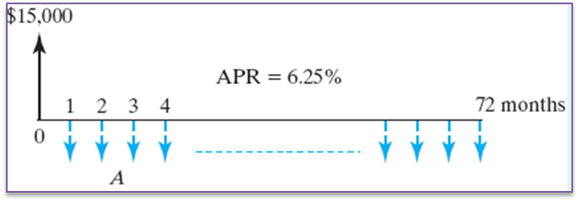
Example 4.4: Calculating Auto Loan Payments
Given:
MSRP = $20,870
Discounts & Rebates = $2,443
Net sale price = $18,427
Down payment = $3,427
Dealer’s interest rate = 6.25% APR
Length of financing = 72 months
Find: the monthly payment (A)

Slide 5
Solution

Slide 6
Dollars Down in the Drain
Suppose you drink a cup of coffee ($3.00 a cup) every morning for 30 years.
If you put the money in the bank for the same period, how much would you have?
Assume that your accounts earns a 5% interest compounded daily.

Slide 7
Solution
Payment period = daily
Compounding period = daily

Slide 8
Case II: When Payment Periods Differ from Compounding Periods
Step 1: Identify the following parameters.
M = No. of compounding periods
K = No. of payment periods per year
C = No. of interest periods per payment period
Step 2: Compute the effective interest rate per payment period.
For discrete compounding
For continuous compounding
Step 3: Find the total no. of payment periods.
N = K (no. of years)
Step 4: Use i and N in the appropriate equivalence formula.

Slide 9
Example 4.5: Compounding Occurs More Frequently than Payments Are Made (Discrete Case)
Given:
A = $1,500 per quarter,
r = 6% per year,
M = 12 compounding periods per year, and
N = 2 years
Find: F
Effective interest rate per quarter
N = 4(2) = 8 Quarters

Slide 10
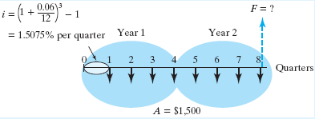
Solution
Cash flow diagram
F = $1,500 (F/A, 1.5075%, 8)
= $14,216.24

Slide 11
Example 4.6: Compounding Is Less Frequent than Payments
Given:
A = $500 per month
M = 4 compounding periods/year
K = 12 payment periods/year
C = 1/3 interest period per quarter
N = 10 years or 120 months
Find: F

Slide 12
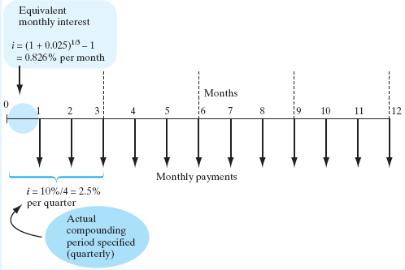
Solution
Cash Flow Diagram
F = $500 (F/A, 0.826%, 120)
= $101,907.89

Slide 13
A Decision Flow Chart on How to Compute the Effective Interest Rate per Payment Period

Slide 14
Key Points
Financial institutions often quote interest rate based on an APR.
In all financial analyses, we need to convert the APR into an appropriate effective interest rate based on a payment period.
When payment period and interest period differ, calculate an effective interest rate that covers the payment period. Then use the appropriate interest formulas to determine the equivalent values.

