Slide 1
Nominal and Effective Interest Rates
Lecture No. 10
Chapter 4
Contemporary Engineering Economics
Copyright © 2016

Slide 2
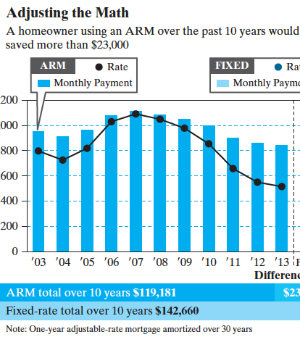
Chapter Opening Story: Financing Home Mortgage
Under what situation, would homeowners benefit from an adjustable rate mortgage over a fixed rate mortgage?

Slide 3
Understanding Money and Its Management: Main Focus
1. If payments occur more frequently than annual, how do you calculate economic equivalence?
If interest period is other than annual, how do you calculate economic equivalence?
How are commercial loans structured?
How would you manage your debt?

Slide 4
Nominal Versus Effective Interest Rates

Slide 5
Financial Jargon
18% Compounded Monthly
Interest
period
Nominal
interest rate
Annual
percentage
rate (APR)

Slide 6
18% Compounded Monthly
What It Really Means?
Interest rate per month (i) = 18%/12 = 1.5%
Number of interest periods per year (N) = 12
In words:
Bank will charge 1.5% interest each month on your unpaid balance, if you borrowed money.
You will earn 1.5% interest each month on your remaining balance, if you deposited money.
Example: Suppose that you invest $1 for 1 year at 18% compounded monthly. How much interest would you earn?

Slide 7
Effective Annual Interest Rate (Yield)
Formula
r = nominal interest rate per year
i_{a} = effective annual interest rate
M = number of interest periods per year
Example
18% compounded monthly
What it really means
1.5% per month for 12 months
19.56% compounded once per year

Slide 8
Practice Problem
Solution
Suppose your savings account pays 9% interest compounded quarterly.
Interest rate per quarter
Annual effective interest rate (i_{a})
If you deposit $10,000 for one year, how much would you have?

Slide 9
Nominal and Effective Interest Rates with Different Compounding Periods
Effective Rates
Nominal Rate | Compounding Annually | Compounding Semi-annually | Compounding Quarterly | Compounding Monthly | Compounding Daily
4% | 4.00% | 4.04% | 4.06% | 4.07% | 4.08%
5 | 5.00 | 5.06 | 5.09 | 5.12 | 5.13
6 | 6.00 | 6.09 | 6.14 | 6.17 | 6.18
7 | 7.00 | 7.12 | 7.19 | 7.23 | 7.25
8 | 8.00 | 8.16 | 8.24 | 8.30 | 8.33
9 | 9.00 | 9.20 | 9.31 | 9.38 | 9.42
10 | 10.00 | 10.25 | 10.38 | 10.47 | 10.52
11 | 11.00 | 11.30 | 11.46 | 11.57 | 11.62
12 | 12.00 | 12.36 | 12.55 | 12.68 | 12.74

Slide 10
Why Do We Need an Effective Interest Rate per Payment Period?
Whenever payment and compounding periods differ from
each other, you need to find the equivalent interest rate so
that both conform to the same unit of time.
Payment period
Interest period
Payment period
Interest period

Slide 11
Effective Interest Rate per Payment Period (i)
C = number of interest periods per payment period
K = number of payment periods per year
CK = total number of interest periods per year, or M
r/K = nominal interest rate per payment period

Slide 12
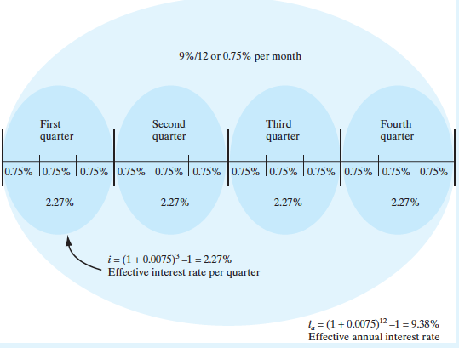
Functional Relationships among r, i, and i_{a}
Payment period = quarter
Interest period = month
APR = 9%where interest

Slide 13
Effective Interest Rate per Payment Period with Continuous Compounding
Formula: With continuous compounding
Example: 12% compounded continuously
(a) effective interest rate per quarter
(b) effective annual interest rate

Slide 14
Case 0: 8% compounded quarterly
Payment Period = Quarter
Interest Period = Quarterly
1st Q
2nd Q
3rd Q
4th Q
1 interest period
Given r = 8%,
K = 4 payments per year
C = 1 interest period per quarter
M = 4 interest periods per year

Slide 15
Case 1: 8% compounded monthly
Payment Period = Quarter
Interest Period = Monthly
1st Q
2nd Q
3rd Q
4th Q
3 interest periods
Given r = 8%,
K = 4 payments per year
C = 3 interest periods per quarter
M = 12 interest periods per year

Slide 16
Case 2: 8% compounded weekly
Payment Period = Quarter
Interest Period = Weekly
1st Q
2nd Q
3rd Q
4th Q
13 interest periods
Given r = 8%,
K = 4 payments per year
C = 13 interest periods per quarter
M = 52 interest periods per year

Slide 17
Case 3: 8% compounded continuously
Payment Period = Quarter
Interest Period = Continuously
1st Q
2nd Q
3rd Q
4th Q
∞ interest periods
Given r = 8%,
K = 4 payments per year

Slide 18
Summary: Effective Interest Rates per Quarter at Varying Compounding Frequencies
Case 0 | Case 1 | Case 2 | Case 3
8% compounded quarterly | 8% compounded monthly | 8% compounded weekly | 8% compounded continuously
Payments occur quarterly | Payments occur quarterly | Payments occur quarterly | Payments occur quarterly
2.000% per quarter | 2.013% per quarter | 2.0186% per quarter | 2.0201% per quarter

