Slide 1
Interest Formulas – Equal Payment Series
Lecture No. 7
Chapter 3
Contemporary Engineering Economics
Copyright © 2016

Slide 2
Equal Payment Series
F
Equivalent Future Worth
0
1
2
N
A
A
A
P
0
1
2
N
Equivalent Present Worth
0
N

Slide 3
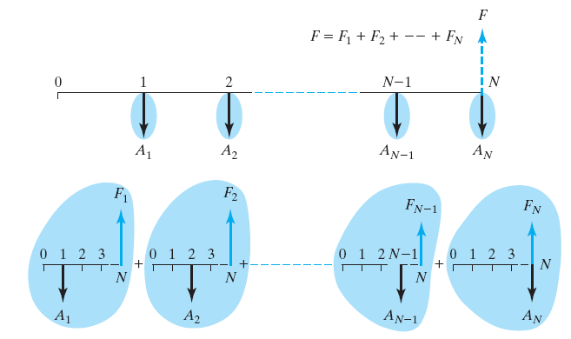
Equal-Payment Series Compound Amount Factor
Formula

Slide 4
An Alternate Way of Calculating the Equivalent Future Worth, F
F
A
A(1+i)^{N-2}
A
A
A
A(1+i)^{N-1}
0
1
2
N
0
1
2
N

Slide 5
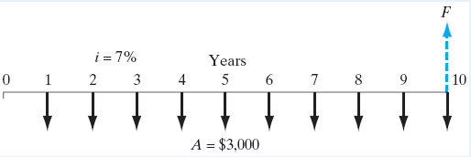
Example 3.11: Uniform Series: Find F, Given i, A, and N
Given: A = $3,000, N = 10 years, and i = 7% per year
Find: F

Slide 6
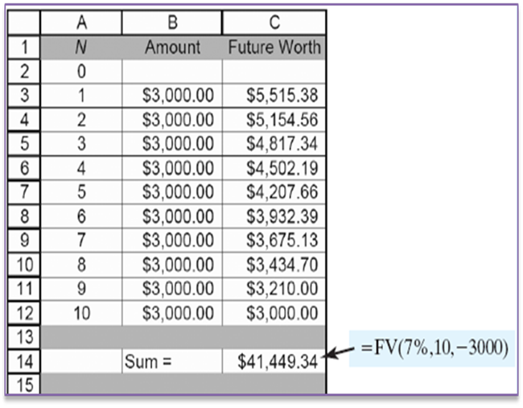
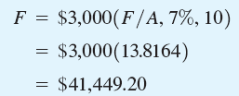
Solution
Excel Solution

Slide 7
Example 3.12: Handling Time Shifts: Find F, Given i, A, and N
Given: A = $3,000, N = 10 years, and i = 7% per year where the first deposit is made at n = 0
Find: F

Slide 8
Solution
Excel Solution:
Each payment has been shifted to one year
earlier, thus each payment would be compounded
for one extra year.

Slide 9
Sinking-Fund Factor: Find A, Given i, A, and F
F
A
A
A
0
1
2
N
1
2
N

Slide 10
Example
Formula to use
Given: F = $5,000, N = 5 years, and i = 7% per year
Find: A
Excel Solution
$5,000
0
1
5
=PMT(7%,5,0,5000)
A

Slide 11
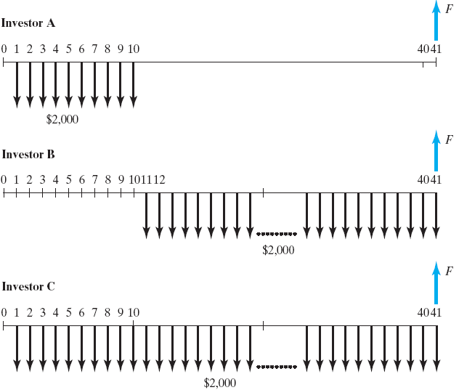
Example 3.14: Comparison of Three Different Retirement Plans
Given: Three investment plans and i = 8%
Find: Balance on 65th birthday

Slide 12
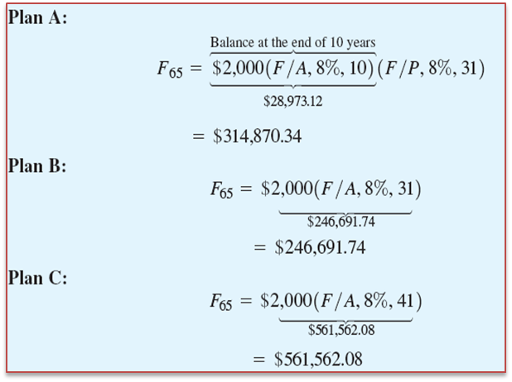
Solution

Slide 13
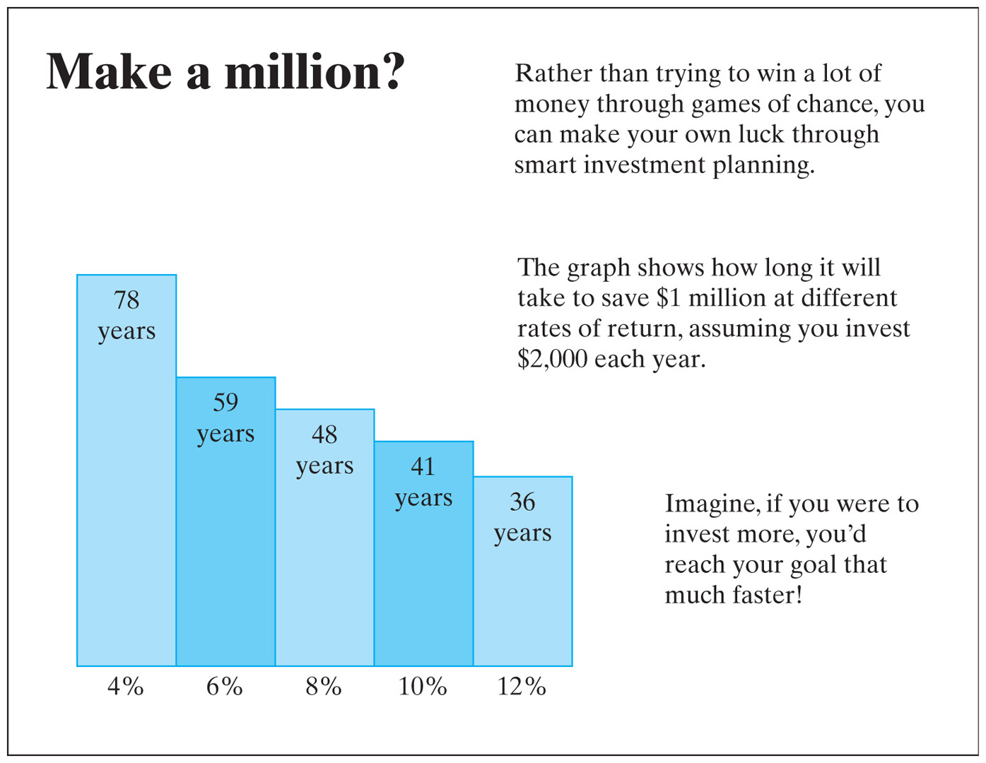
How Long Would It Take to Save $1 Million?

Slide 14
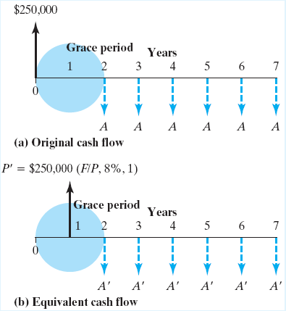
Example 3.16: Deferred Loan Repayment
Given: P = $250,000, N = 6 years, and i = 8% per year, but the first payment occurs at the end of year 2
Find: A

Slide 15
Solution
Step 1. Find the equivalent amount of borrowing at the end of year 1:
Step 2. Use the capital recovery factor to find the size of the annual installment:

Slide 16
Example 3.17: Uniform Series: Find P, Given A, i, and N
Given: A = $9,791,667, N = 30 years, and i = 5% per year
Find: P
Present Worth Factor

Slide 17
Solution
Formula to use:
Excel Solution
Cash Flow Diagram

