Slide 1
Financial Ratio Analysis
Lecture No. 3
Chapter 2
Contemporary Engineering Economics, 6th ed.

Slide 2
Ratio Analysis and What the Numbers Really Mean
Debt Management Ratios
Liquidity Ratios
Asset Management Ratios
Profitability Ratios
Market Trend Ratios
Trends and Graphs to Spot Problems

Slide 3
Key Financial Ratios

Slide 4
Return on Equity: A Composite Ratio
What to measure: A corporation's profitability by revealing how much profit a company generates with the money shareholders have invested
How to calculate: The amount of net income generated as a percentage of shareholders equity

Slide 5
Returns on Equity (ROE): Three Components

Slide 6
Returns on Equity (ROE) and Levels of Performance for Ten Diverse Companies
(As of January 26, 2014)
 | Return on Equity (%) | Profit Margin (%) | Asset Turnover (times) | Financial Leverages (times)
Google (2013) | 16.46 | 21.66 | 0.59 | 1.27
Wells Fargo (2013) | 13.86 | 23.96 | 0.06 | 9.81
Alcoa (2013) | 2.25 | 1.27 | 0.60 | 2.99
Exxon Co. (2013) | 20.35 | 7.7 | 1.30 | 2.05
Kroger (2013) | 35.65 | 1.57 | 3.97 | 5.11
IBM (2013) | 77.90 | 15.92 | 0.87 | 5.93
Nike (2013) | 26.70 | 10.85 | 1.59 | 1.57
Wal-Mart (2013) | 23.35 | 3.62 | 2.28 | 2.86
Southwest Airline (2013) | 8.85 | 3.55 | 0.91 | 2.76
MSFT (2013) | 30.09 | 28.17 | 0.61 | 1.74
Note: ROEs may not match exactly the formula values due to ratios were calculated based on different published data. Source: MSN Finance

Slide 7
Debt Management Analysis
Definition: Ratios that show how a firm uses debt financing and its ability to meet debt repayment obligations

Slide 8
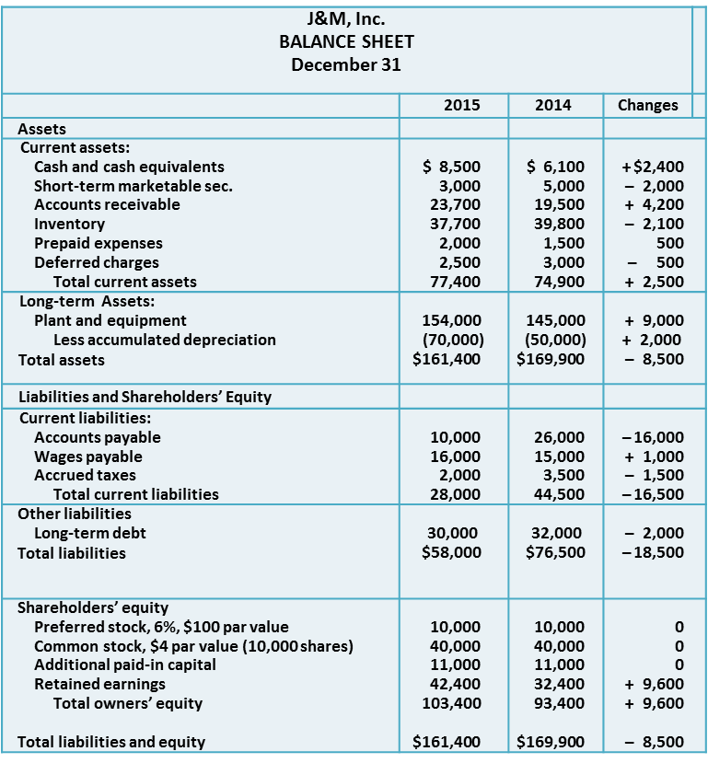
Debt Ratio
Indicates how a firm finances its capital
Formula
A debt ratio of greater than 1 indicates
that a company has more debt than assets,
a measure of a level of risk.

Slide 9
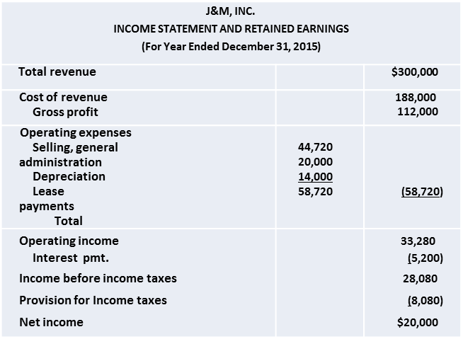
Times Interest
Earned Ratio
Measures the extent to which earnings can decline without defaulting on debt service
Formula
EBIT: Earnings before interest
and taxes

Slide 10
Liquidity Analysis
Definition: Ratios that show the relationship of a firm’s cash and other assets to its current liabilities

Slide 11
Current Ratio
Measures a firm’s short-term solvency
Formula

Slide 12
Quick Ratio
Excludes inventories and prepaid expenses
Formula

Slide 13
Liquidity Ratio
An indication of a firm’s immediate liquidity
Formula

Slide 14
Asset Management Analysis
Definition: A set of ratios which measure how effectively a firm is managing its assets

Slide 15
Inventory Turnover
Ratio
Highlights the rate at which the inventory is being sold
Formula
The typical item sits in inventory almost 1.508 months (12 months/7.96) or 45.24 days before being sold

Slide 16
Days Sales
Outstanding (DSO)
Determines whether receivables are being collected aggressively enough
Formula

Slide 17
Days Sales in Inventory
What It Measures: The amount of inventory (stock) expressed in days of sales. For example, if 2 items are sold and 20 items are held in inventory per day, this represents 10 days' (20/2) worth of sales in inventory.
How To Compute: The ratio computed by dividing average inventory by cost of sales, and multiplied the result by 365

Slide 18
Total Asset
Turnover Ratio
Indicates whether a company is generating a sufficient volume of business for the size of its asset investment
Formula

Slide 19
Profitability Analysis
Definition: A set of ratios which show the combined effects of liquidity, asset management and debt on operating results

Slide 20
Gross Margin
Indicates the profitability of sales
Formula

Slide 21
Net Margin
Illustrates what percentage of each sales dollar is retained in earnings
Formula

Slide 22
Return on Total Assets (ROA)
Measures a company’s success in using its assets to earn a profit.
Formula

Slide 23
Return on Equity (ROE)
Measures the rate of return on the owner’s investment
Formula

Slide 24
Debt-to-Equity Ratio
A measure of a company’s financial leverage, indicating what proportion of equity and debt the company is using to finance its assets
A high debt/equity ratio generally means that a company has been aggressive in financing its growth with debt.

Slide 25
How the Debt to Equity Ratio Impacts Return on Equity
Not have a spectacular ROE because there is so much equity in the company (e.g., well-established DOW 30 stocks)
A highly leveraged company that might have a spectacular ROE because the owners have put so little of their own resources into the company (e.g., high-tech industries)
Liabilities
=
Assets
Equity
=
Liabilities
Assets
Equity

Slide 26
Market Trend Analysis
Definition: A set of ratios that relate the firm’s stock price to its earnings and book value per share

Slide 27
Earnings Per Share (EPS)
Indicates earnings attributable to each share of stock
Widely used indicator of a corporation’s performance

Slide 28
Price to Earnings Ratio
Indicates how many times a corporation is able to multiply its earnings in terms of asking price per share of stock
Share price: $40.50 as of December 28, 2015

Slide 29
How to Use P/E Ratios
P/E Ratios for Selected Stocks
Consider what premium you are paying for a company's earnings today.
Determine if the expected growth warrants the premium.
Compare it to its peers in the industry to see its relative valuation.
Symbol | Price | PE-Ratio | Symbol | Price | PE-Ratio
BIDU | 229.46 | 231.8 | GOOG | 535.21 | 27.10
GE | 24.59 | 16.70 | MSFT | 47.02 | 18.40
HD | 106.36 | 24.10 | LNKD | 226.36 | 676.69
IBM | 156.36 | 10.01 | PCLN | 1,041.86 | 23.50
JNJ | 102.26 | 17.00 | AAPL | 113.10 | 17.53
XOM | 91.76 | 11.50 | FB | 77.50 | 71.95
WMT | 88.63 | 18.50 | KO | 43.00 | 23.90
As of January 26, 2015

Slide 30
Book Value/Share
Indicates what the value of a share of stock is according to the books (financial statements)
As of December 31, 2015, the closing
share price was $40.50. This means
that the share was trading at about
four times higher than its book value.
A higher ratio indicates that investors
are willing to bet a higher return on
their investment.

Slide 31
Market Value/Book Value
Indicates whether you are paying too much for what would be left if the company went bankrupt immediately
A lower ratio would mean that the stock is undervalued.
As of December 31, 2015, the closing
share price was $40.50.

Slide 32
Where Sunset Stands as of January 2015
Category | J&M | Industry | S&P 500
Current Ratio | 2.76 | 1.74 | 1.03
Times-Interest Earned Ratio | 6.40 | 13.3 | 47.7
Return on Equity | 21.95 | 11.35 | 83.36
Return on Assets | 14.31 | 3.5 | 8.0
Inventory Turnover | 7.74 | 35.6 | 11.9
Asset Turnover | 1.86 | 0.6 | 0.8
Gross Margin | 37.73 | 55.45 | 39.36
Net Profit Margin | 6.67 | 4.43 | 12.78
P/E Ratio | 20.87 | 19.4 | 44.1
Book Value | 9.34 | 10.84 | 28.35

Slide 33
Trends and Graphs to Spot Problems
It reveals whether the firm’s ratios are improving or deteriorating over time.

Slide 34
Limitations of Financial Ratios
Analysts should be aware of ever-changing market conditions and make the necessary adjustments.
Difficult to generalize about whether a particular ratio is good or bad
Ratio analysis based on any one year may not represent the true business condition.

