Slide 1
Cost management 101
DASA-CE Training

Slide 2
Mission #2: CM 101 Training
CM 101 Training
Section 1: Cost Management Overview
  What are costs and why is managing costs important?
  Army’s overall objectives
  Change enablers o support Cost Management
  The process of Cost Management and how it differs from Budget Management
Section 2: Cost Model Components
  Defining the various cost objects (which replace APCs/JONOs) within a Cost Model, e.g. organizations, products, services, jobs, etc.
  Understanding decision points of where to capture information
Section 3: Cost Flow Methods
  The difference between cost capturing, allocations, and assignment
Section 4: Cost Model Build
  Reflecting organizational structures
  Replacing APC/Jonos
2
Notes:
2

Slide 3
DASA-CE CM Schedule
(Macro-level)
FY2010
FY2011
FY2012
1
2
3
4
1
2
3
4
1
S
O
N
D
J
F
M
A
M
J
J
A
S
O
N
D
J
F
M
A
M
J
J
A
S
O
N
D
J
COST MANAGEMENT TRAINING
CYCLE
MOCK
CNV
WAVE 2 SE
HQ
DESIGN
CM
TRNG
CM
BUILD
CYCLE
MOCK
CNV
WAVE 3 WE
HQ
DESIGN
CM
TRNG
CM
BUILD
CYCLE
MOCK
CNV
WAVE 4 NE
HQ
DESIGN
CM TRNG & BUILD
CYCLE
MOCK
CNV
WAVE 5 PAC, EUR & AR
HQ
DESIGN
CM TRNG & BUILD
CYCLE
MOCK
CNV
WAVE 6 ARNG
HQ
DESIGN
CM
TRNG
CM
BUILD
CYCLE
MOCK
CNV
WAVE 7 NE (BRAC) & AR
HQ
DESIGN
CM
TRNG
CM
BUILD
CYCLE
MOCK
CNV
WAVE 8 Contingency (All Other)
3
Notes:
3
Deployment strategy involves –
Releases -- refer to functionality in system
Waves –refer to systematic implementation over time
Sites – typically refer to forts or installations that include mission, installation and tenant organizations

Slide 4
DASA-CE CM Schedule
(GFEBS – GCSS-A CC file exchange)
Wave | CYCLE |  | MOCK |  | PROD |  | GFEBS GO-LIVE
 | Provide to GCSS-A | Receive from GCSS - A | Provide to GCSS-A | Receive from GCSS - A | Provide to GCSS-A | Receive from GCSS - A
3 |  |  |  |  | 8/9/10 | 8/20/10 | 10/1/10
4 |  |  | 9/8/10 | 9/21/10 | 11/1/10 | 11/15/10 | 1/1/11
5 | 10/6/10 | 10/20/10 | 11/19/10 | 12/9/10 | 2/7/11 | 2/18/11 | 4/1/11
6 | 1/7/11 | 1/21/11 | 3/8/11 | 3/21/11 | 5/3/11 | 5/16/11 | 7/1/11
7 | 4/6/11 | 4/19/11 | 6/7/11 | 6/20/11 | 8/8/11 | 8/19/11 | 10/1/11
8 | 7/6/11 | 7/19/11 | 8/4/11 | 8/17/11 | 10/3/11 | 10/17/11 | 1/1/12
Last updated 08/11/10
Notes:
4

Slide 5
CM Master Data Build
OUTPUT
VALIDATION
Conversion Team
GFEBS TEAM
CONVERT
DASA-CE / GFEBS
INPUT
VALIDATION
CORRECT
Consolidation Team
DASA-CE CORE TEAM
CONSOLIDATE
DATA
VALIDATION
CORRECT
Team 2
Team 4
CAPTURE TEAMS
CONTROL
Team 1
Team 3
Team 5
DATA
VALIDATION
CORRECT
COMMAND SITE POCS
CREATE
DASA-CE / Army

Slide 6
CM Overview Process
Define
Cost
Centers
Perform
Faces to
Spaces
Cost Center CNV File
Faces to Spaces File
AcType
Rate
CNV File
Walk Thru
APC/JONO
File
DCPS
GFEBS LOA
TOP LOAD
Time Tracking GFEBS LOA
Identify
Internal
Orders
Identify
WBS
Elements
Mapped
APC/JONO File
FMY1
GFEBS LOA For
FCM
LEGEND
DTS
GFEBS LOAs
Tasks
Internal Order
CNV File
WBS Element
CNV File
GFEBS CNV Files
Field Mapping File
AXOL
GFEBS LOAs
Legacy System Updates
6

Slide 7
Master Data: Cost Centers
A Cost Center = Organization; which:
  Incurs costs
  Has a manager who is accountable for those costs
  Has a long life span of more than 1 year (typically years)
  Can be assigned informal budget
A Cost Center accounts for resources:
  People: Ops & Maintenance, DOIM IT Support, etc.
  Facilities: Warehouses, Hospitals, Office Space
  Equipment: IT server farm, Cranes/Trucks
  Blended: mix of resources within a organization, e.g. Vehicles and Mechanics

Slide 8
Cost Center Master Data Elements
Walk through how to determine the starting point for Cost Center; e.g. G3 FMS extract, Wire Charts, etc.
Walk through each data element associated to the Cost Center for determination of values
Understand the difference between the Cost Center Hierarchy and the Funding Distribution flow

Slide 9
APC / JONO Mapping to Cost Objects
The Mission
The APC / JONO
The Mapping
Working Session

Slide 10

The Paradigm Shift
Army has committed to new information technology applications (i.e. ERPs) such as GFEBS, GCSS, LMP, etc.
Within these applications: APCs no longer exist
The core of everything that RM’s currently rely on has now changed.
APC Master File
10
Notes:
The limited cost culture that is present in the Army is embedded into the APC string.
GFEBS is eliminating the APC string but the analytical need still remains. DASA-CE has put together a team to build to cost management perspective, or the cost model to Army.

Slide 11
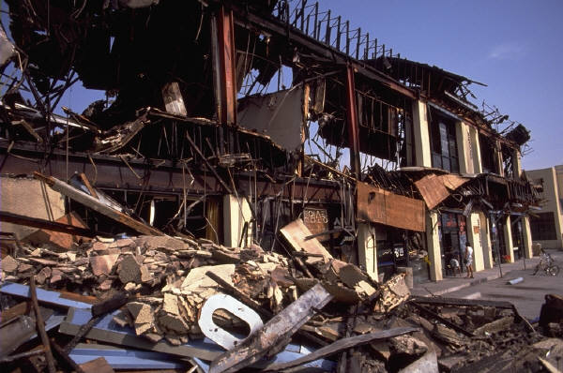

So……What’s Next?
…..chaos, destruction and anarchy?
Or… an opportunity to re-build with a link from legacy to GFEBS with APCs as the rosetta stone?
11
Notes:
Although the world is changing the APC is a key link. This change doesn’t need to leave a wake of destruction but rather should offer an opportunity for change.

Slide 12

Preserving the APC Information – Mapping to GFEBS
Why Map STANFINS APCs/SOMMARDS JONOs to GFEBS Cost Objects?
Allows for retention of budget data
Begins a transition to a Cost Culture
Ensures all cost management master data has been identified
Begins building a dictionary to help translate from “legacy-ese” to “GFEBS-ese” to complete transition taskers.
Provides a crosswalk for merging legacy data with GFEBS data for mid-year go-lives
Supports generation of cheat-sheets for end user to know what to now use as their codes
12
Notes:
WHY MAP:
Going through this process helps RM’s to understand How APC’s are replaced within GFEBS by multiple different Budget & Cost Objects.
Having Legacy APC codes mapped to GFEBS objects provides a crosswalk table that can be utilized by organizations to combine STANFINS data with GFEBS data when executions in both financial systems for the same fiscal year.
Ensures all cost management master data has been identified to be created within the GFEBS conversion load sheets the capture teams generate.

Slide 13
Mapping Process
The APC Master File will go through the following process:
  APC File is pulled for the ASN’s represented at each site
  GFEBS Budget Data elements are added
  File is manipulated to include information for each command
  Additional fields added for GFEBS required taskers (e.g. DTS, AXOL, FCM, etc.)
  Different GFEBS cost objects columns are added which will replace the APC codes are put next to each APC
  Indicator representing that APC has been Mapped,
  Comments column is utilized to capture information between resources
13
Notes:
6. Allows the file can be filtered throughout the process to focus on APCs for specific scenarios

Slide 14
APCs: Used to Reflect
Create/Control Budget Authority
DFAS/STANFINS Journal Vouchers
Types of expense, i.e. EORs
Reimbursable customers
Organizations/units
Events, e.g. mobilizations, chaplains retreat, hurricane, etc. & Other Items
14

Slide 15
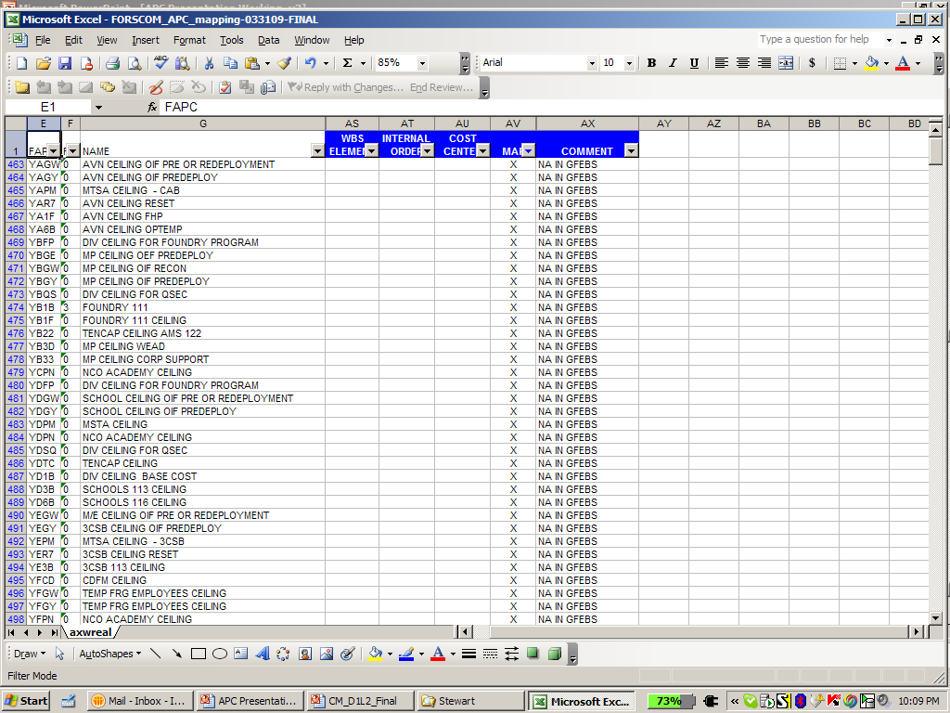
Scenario #1: Budget LOA
STANFINS
GFEBS
Create Budget Address APC and push obligating authority to address
Distribute Budget from top down and where end generates Budget Address
Enter “X”
in MAP column
Enter “NA IN GFEBS”
in COMMENT column
15
Notes:
Many of the APC’s are generated to create the funding lines of accounting budget LOA’s.
Sometimes they are listed as FAC “0’s” but more likely are FAC “3’s” with some logic in the APC code which indicates it is a funding LOA.

Slide 16
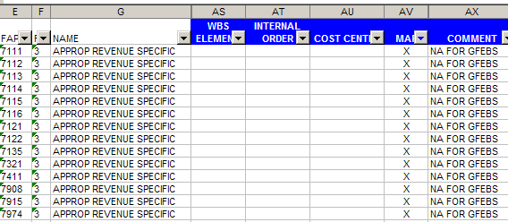
Scenario #2: DFAS/STANFINS
Revenue Collection APC’s
APC’s for Unfunded Leave Journal Vouchers
APC’s for Unmatched Disbursements
Enter “NA IN GFEBS”
in COMMENT column
Enter “X”
in MAP column
16

Slide 17
Scenario #3: Organizational view
Many of the FAC ‘3’ APCs are utilized to represent an Organizational view
These will be mapped to the Cost Center Code
DIV
MSE
Civilian
Employees
CIV
HR
APC | DESCRIP | COST CENTER | INTERNAL ORDER | WBS | MAP | COMMENTS
RYBP | 88TH BSB PREDEPLOYMENT | WJN4AA | F1201 PRE |  | X | UNIT CC
RYBR | CEILING USE ONLY |  |  |  | X | NA IN GFEBS
RYBS | 88TH BSB HHD | WC27T0 |  |  | X | UNIT CC
RYBT | 88TH BSB | WC27AA |  |  | X | UNIT CC
RYBU | 88TH BSB DISTRO | 40002435 |  |  | X | UNIT CC
RYBV | 88TH BSB MAINT CO | 40002440 |  |  | X | UNIT CC
RYCS | HHC 1ST CSB | 40002243 |  |  | X | UNIT CC
TCG1 | G1 RETENTION | W6DHAA |  |  | X | G1 CC
3BCT
2BCT
1BCT
BN
BN
BN
DASA-CE CM Team
Updates CC #
once created in GFEBS
Enter Temporary CC Code
in column
Enter “X”
in MAP column
17
Notes:
Organizations:
APC codes often did not go to the lowest level of the organization however within GFEBS there will be a code
Some organizations are generating DTS LOA’s per cost centers (For TDA Orgs)
Many APC typically map to a single cost center since organizations usually spend more than one budget LOA

Slide 18
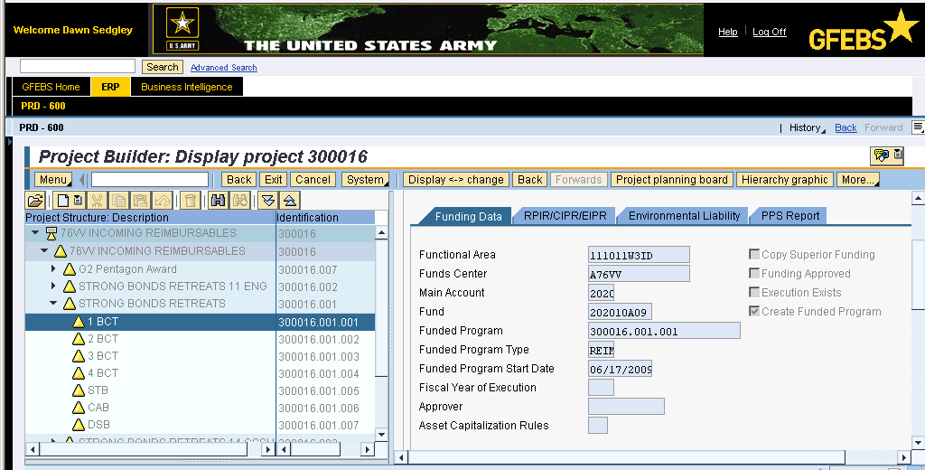
Scenario #4: Customers
APCs representing customers are listed as FAC ‘8’
Reimbursables are supported using WBS Elements within GFEBS
18

Slide 19
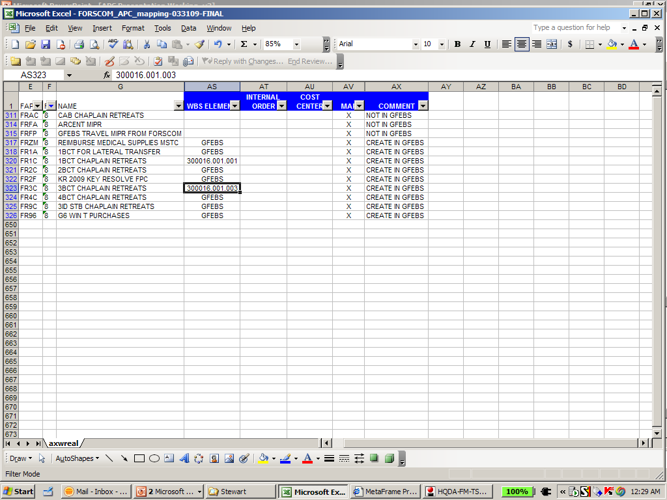
Scenario #4: Customers
Reimbursables require the WBS Element to be associated with a Sales Order which generates the Authority
Not Master Data created by DASA-CE Cost Master Data Team
  Created by users at field level
Once manually created within GFEBS – the corresponding WBS Element code can be associated with the APC code within the APC Mapping
Enter WBS Element
in column
once created
Enter “GFEBS”
in column
until created
Enter “X”
in MAP column
Enter “CREATE IN GFEBS”
in COMMENT column
19
Notes:
19

Slide 20
Scenario #5: EORs
EOR data is captured and reportable currently without an APC and will not be mapped for GFEBS
APCs often created for CIV PAY – these will not need to be mapped since replaced with the faces-to-spaces exercise
20

Slide 21
Scenario #6: Products/Services and Events
Some FAC ‘3’ APC codes represent Products/Services Produced by the command (e.g. TRADOC Courses, IMCOM SSP’s, FORSCOM: Mobilizations, etc.)
Mapped to Internal Orders if not Project-based
  Short lived – not perpetual in nature like an organization (e.g. Conference, Hurricane, Training Event)
  Can be informational only (called statistical orders) in which case usually an org/cost center is posted to as well
  Typically only consume one budget LOA but can cross multiple if necessary
  Often for types of travel
Mapped to WBS Elements if Project-based (e.g. IMCOM DPW SSPs, Exercises, PEO Projects, etc.)
21

Slide 22
GFEBS: Internal Order Example
APC | DESCPT | Cost Center | IO | WBS | MAPPED | COMMENTS*
DB6E | PROVIDE CAC/ID CARD SERVICES |  | 10003473 |  | X | TOP LOAD IO
DB8T | PROVIDE CASUALTY OPERATIONS SVCS |  | NEW IO |  | X
DB7E | PROVIDE DEPLOYMENT CYCLE SERVICES |  | NEW IO |  | X
DB8U | PROVIDE PERSONNELL PROCESSING SERVICES |  | 10003476 |  | X | TOP LOAD IO
DB8V | PROVIDE MILPAY SERVICES |  | 10003477 |  | X | TOP LOAD IO
DB8W | PROVIDE PRE-TRANSITION SERVICES |  | 10003478 |  | X | TOP LOAD IO
DB8F | PROCESS INDIV PERS ACTION & MIL SERV |  | 10003479 |  | X | TOP LOAD IO
DB7A | PROVIDE POST-TRANSITION SERVICES |  | 10003482 |  | X | TOP LOAD IO
DB9K | PROVIDE HUMAN CAPITAL SYSTEM AUTOMATION SER |  | 10003482 |  | X | TOP LOAD IO
DASA-CE CM Team
updates IO #
once created in GFEBS
Enter NEW IO
INTERNAL ORDER
column
Enter “X”
in MAP column
* Example is IMCOM SSP – Comments are command specific
22

Slide 23
APCs: Next Steps
Review kinds of money for funding structures
Walk through APC file by scenarios
Identify additional scenarios if applicable
Document issues which need to be resolved
23
Notes:
23

