Slide 1
Training Agenda/Objectives
Day 1: Cost Management Overview
  Understanding of why managing costs are important, Army’s overall objectives, the process of Cost Management, how it differs from Budget, and key cost terms
Day 2: Cost Object Definition
  Understanding of an ERP, how to build a Cost Model, and the various cost objects within a Cost Model (e.g. organization, products, job orders, etc.)
Day 3: Assignment of Costs
  Understanding of cost allocations/assignments, how to chose which to utilize when, how to valuate the results of the assignments (Std. vs Actual), and rate creation
Day 4: Analysis and Reporting
  Understanding of the results of the Cost Model and how various types of analysis and decisions are supported
D2L1_p1

Slide 2
Day 2 Objective & Agenda
Day 2: Cost Object Definition
Understanding of an ERP, how to create a cost model and each of the cost objects supported within the cost model
Lesson 1: ERP Enabler
Lesson 2: Costing Conceptual Design
Lesson 3: Cost Centers
Lesson 4: Activity Types
Lesson 5: Cost Elements
Lesson 6: WBS Elements
Lesson 7: Orders
Lesson 8: Business Processes
Lesson 9: Statistical Key Figures
Lesson 10: Capturing Costs
D2L1_p2

Slide 3
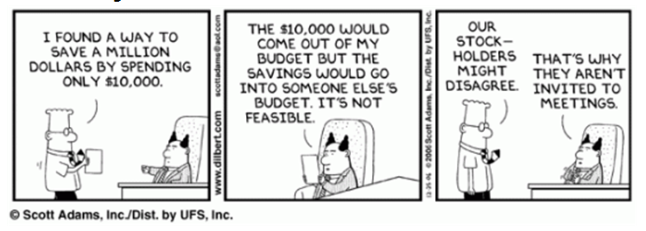
I FOUND A WAY TO SAVE A MILLION DOLLARS BY SPENDING ONLY $10,000.
THE $10,000 WOULD COME OUT OF MY BUDGET BUT THE SAVING WOULD GO INTO SOMEONE ELSE’S BUDGET. IT’S NOT
THE CHIEF OF STAFF MIGHT NOT AGREE.
THAT’S WHY HE IS NOT INVITED TO THE MEETINGS.
FEASIBLE.
(Modified)
D2L1_p3

Slide 4
Lesson 1: ERP Enabler
Objective(s):
To understand what “ERP” stands for and how it can support the Army’s Cost Management culture
D2L1_p4

Slide 5

Enhanced Ability to Capture Cost
Cost Objects
Organizational
Real Property /
Program / Project
Task / Activity
Special Event or
Entities
Equipment
Initiative
GFEBS (SAP)
Cost Centers
Assets / Real
Project / WBS
Business Process
Internal Order
Cost Collectors
Estate Objects
• Installation
• Acquisition
• Service Support
• BRAC
• Brigade
• Building
• RDTE Project
Program (SSP)
• Training Event
Army Examples
• School
• Training Range
• MILCON Project
• Instructional Course
• Mandatory
• Directorate
• Weapon System
• System Test
• Repair Process
Training
• Lab
• Test Run
• Support to
Olympics
Cost assigned Directly or Indirectly
Customer / Product
Brigade
Tenant
Command
Weapon System
PEO / PM
Course
D2L1_p5

Slide 6
Many ways to Measure Cost
Methodology vs System
Army’s Purpose is to Provide Operational Managers with Relevant “True” Cost Information to Make Sound Economic Decisions
Methodologies to Measure Cost (FASAB #4)
  Activity Based Costing
  Job Order (Event) costing
  Project (with WBS) costing
  Std. (Product) costing
  Others
Requires a System to Gather Cost Data and Provide Analytical Information
Army
Ad
Hoc
Financial
Reports
Independent
Cost Models
Integrated
Cost Management
D2L1_p6
Notes:
Three Modules in an ABC Model
-Resources
-Activities
-Outputs
Resource costs are consumed by activities. The consumption is based resources drivers (hours, % of time) the resources.
Activity costs are consumed by outputs and determined by activity drivers (frequency or intensity of demand for activity).

Slide 7
Enterprise Resource Planning (ERP)
ERP Benefits
ERPs Help to Streamline & Integrate the Processes & Systems Providing the Following Benefits:
  Increases Productivity Across Organizations
  Improves Standardization & Efficiency of Processes
  Increases Access, Consistency & Transparency of Data
  Provides Collaboration Across Business Domains
  Provides IT Economies of Scale
  Enhances Analytics & Improves Accuracy of Data
D2L1_p7

Slide 8
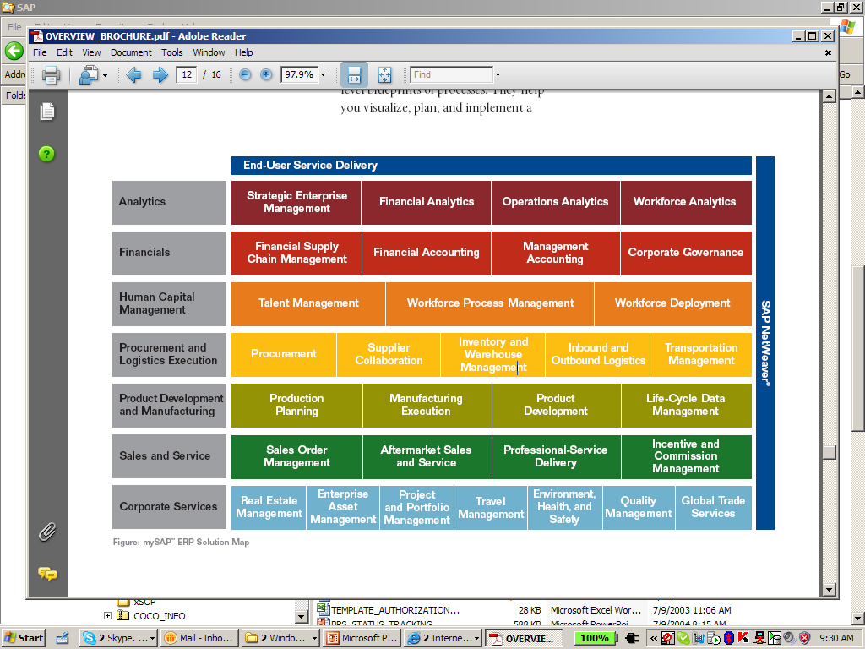
Enterprise Resource Planning (ERP)
Commercial Off the Self System that Integrates All Facets of the Business
End User Presentation Layer
GFEBS
Data Warehousing Analytics
D2L1_p8

Slide 9
Enterprise Resource Planning (ERP)
ERP Functionality Integrates Management Accounting (Cost Management) with the Financial & Budget Accounting
End User Presentation Layer
Cost Management
Integrated with Finance & Budget Accounting
Data Warehousing Analytics
End User Presentation Layer
Public Sector
Budget Accounting
D2L1_p9

Slide 10
Enterprise Resource Planning (ERP)
Cost
Accounting
ERPs (e.g. GFEBS) Enable
The Cost Management Process
Cost
Planning
Cost
Management
Process
Cost
Analysis
Cost
Controlling
Cost Management
Integrated with Finance & Budget Accounting
End User Presentation Layer
Public Sector
Budget Accounting
D2L1_p10

Slide 11
GFEBS System Components
ECC – Enterprise Central Component
BI – Business Intelligence
FI – Financial Acct. & Mgmt.
Cost By
Report
FM – Funds Acct. & Mgmt.
CO – Cost Acct. & Mgmt.
Unit Cost
Report
MM – Materials Mgmt.
and Procurement
PPE – Property, Plant &
Equipment [PM, PS, RE, AA]
Detailed
Labor
Report
SD – Sales & Reimbursables
Optimized for Data Input
Transaction Processing
Real-time; recon analysis
Structured reporting
Optimized for Data Extraction
Analytical Processing
Near real-time; trending analysis
Slice-n-dice reporting (pivot)
D2L1_p11

Slide 12
Simultaneous Update
ECC – Enterprise Central Component
FI - None
FM - Commitment
CO - None
FI - None
FM - Obligation
CO - None
FI – Financial Acct. & Mgmt.
FM – Funds Acct. & Mgmt.
PR
PO
CO – Cost Acct. & Mgmt.
MM – Materials Mgmt.
and Procurement
Pay
GR
PPE – Property, Plant &
Equipment [PM, PS, RE, AA]
SD – Sales & Reimbursables
FI - AP/Cash
FM - Disbursement
CO - None
FI - Expense/AP
FM - Expenditure
CO - Expense
Optimized for Data Input
Transaction Processing
Real-time; recon analysis
Structured reporting
D2L1_p12

Slide 13
Lesson 1: Wrap-Up
An ERP is an enabler to Cost Management “Culture” by providing the technology necessary
The Army Cost Model is being designed into GFEBS which utilizes the SAP ERP application
The ERP application has a transactional component and an analytical component
The transactional component has real-time integration for the various value streams/modules
D2L1_p13

Slide 14
Lesson 2: Costing Conceptual Design
Objective(s):
To understand the approach to developing the costing conceptual design to support the Cost Management Process using the GFEBS ERP application.
D2L2_p1

Slide 15
Costing Conceptual Design
Full Cost
Organizations
Full Cost
Product/Services
Full Cost
Customers
Director of
Logistics)
SSPA: Manage
OCIE Inventory
Brigade
XXX
Military
Labor
SSPB: Issue
OCIE to Soldier
What/Why information is entered, stored, used, and presented
Central Issue facility
SSPC: Issue
Clothing to Initial
Training Soldier
TRADOC
YYY
Depreciation
CIVHR
SSPD: Accept
OCI Turn-Ins
Civilian
Employees
Contractors
CNTHR
SSPE: Receive
& Process
Shipments
Brigade ZZZ
Military
Labor
MILHR
SSPF: Manage
Chemical Defense
Equipment
. . Etc.
Cost
Accounting
Cost
Planning
Cost
Analysis
How the information is entered, stored, used, and presented
Cost
Management
Process
Cost
Controlling
End User Presentation Layer
Where the information is entered, stored, used, and presented
Public Sector
D2L2_p2
Budget Accounting

Slide 16
What is the Costing Conceptual Design?
The translation of the business objectives, needs, and requirements into a management decision support model (Cost Model)
A monetary valuation of the economic goods and services of the organization – full burden cost flows
“The Continuum” – maturation over years (ex. from Ft. Jackson go-live through all roll-outs and beyond, increased accuracy of cost flows through better data)
The CCD influences/defines the set-up of tools providing cost management information, e.g. GFEBS, GCSS, Data Warehouses, etc.
D2L2_p3

Slide 17
What Influences the CCD Developed?
Management information requirements – What type of decisions to support, when, for who, etc. (e.g. Insource/Outsource, Contract/OT, etc.)
Cost objectives necessary to support the informational needs (SSP Focused, Brigade, etc.)
The Cost Objects – What does it cost to/for/if….?
Cost Object Relationships – flows of goods and services from/to/between
Various Techniques for reflecting the relationships - % based, quantity (Plan/Actual, such as ATAAPS Hrs), variances, etc.
D2L2_p4

Slide 18
CCD – Cost Model
Full Cost
Organizations
Full Cost
Product/Services
Full Cost
Customers
Director of
Logistics)
SSPs Provided
Cost Center
SSPA: Manage
OCIE Inventory
Brigade XXX
The translation of the business objectives, needs, and requirements into a management decision support model (Cost Model)
SSPB: Issue
OCIE to Soldier
Military
Labor
Cost Center/Resource Pool
Central Issue facility
TRADOC YYY
SSPC: Issue
Clothing to Initial
Training Soldier
Depreciation
CIV
HR
Civilian
Employees
SSPD: Accept
OCI Turn-Ins
Brigade ZZZ
CNT
HR
SSPE: Receive
& Process
Shipments
Contractors
Military
MIL
HR
SSPF: Manage
Chemical Defense
Equipment
. . Etc.
D2L2_p5

Slide 19
CCD – Cost Model
Full Cost
Organizations
Full Cost
Product/Services
Full Cost
Customers
Director of
Logistics)
SSPs Provided
Cost Center
SSPA: Manage
OCIE Inventory
Brigade XXX
A monetary valuation of the economic goods and services of the organization – full burden cost flows
SSPB: Issue
OCIE to Soldier
Military
Labor
Cost Center/Resource Pool
Central Issue facility
TRADOC YYY
SSPC: Issue
Clothing to Initial
Training Soldier
Depreciation
CIV
HR
Civilian
Employees
SSPD: Accept
OCI Turn-Ins
Brigade ZZZ
CNT
HR
SSPE: Receive
& Process
Shipments
Contractors
Military
MIL
HR
SSPF: Manage
Chemical Defense
Equipment
. . Etc.
maturation over years
D2L2_p6

Slide 20
Army Cost Model Concept
Cost Center
Asset / Equipment
Project / Program
Internal Order
WBS / Work Order
Organization - Labor, Materials, Supplies
Resources
Plant, Property & Equipment
Building Project, Weapon System
Outputs
Services, Events (SSP, Course)
Job (Set of Tasks) – Maint & Repair
D2L2_p7

Slide 21
Cost Object Types
Resource Centric
  Cost Centers [Orgs]
  Resource Pools/Activity Types [Types of Labor, Machine, SQFT]
  Cost Elements [Labor, Travel, Etc.
  Business Process [Services]
Product/Service Centric
  Projects/Events (ex. Minor Construction…)
  Orders (ex. Work, Maintenance, Service, Production, Customers….)
Results Centric
  Results Segments (Customers of your products/services)
P&L
PROJ
PROD
CC
(ex. Dir/Div…)
SERV
RP
IO
CE
BPR
D2L2_p8

Slide 22
How is the CCD Developed?
Identification of Subject Matter Experts from each of the core business providers
Schedule meetings with each area’s key stakeholder(s) and SME representatives
Conduct Analysis workshops
Gather Results and Evaluate
Translate the business objectives, needs, and requirements into a management decision support model, i.e. the CCD
Feed information to system supporting management model (e.g. GFEBS)
D2L2_p8

Slide 23
How is the CCD Developed for IMCOM?
Review of IMCOM stated objectives on web site and already identified products/services (CLS)
IMCOM HQ Interviews of CLS representatives
Select and visit bases and conduct analysis workshops [Ft. Jackson, Ft. Lewis, Ft. Polk, Aberdeen Proving Grounds]
Gather and review org charts, TDA, etc.
Work with Installation RM representative to collect information required
Recognize all installations are different
D2L2_p9

Slide 24
Analysis Workshops
Inputs into the Analysis
  Organizational Structure
  List of Locations
  List of Data Feeds and Input
  List of Operational Systems
  Current Cost Reports
Analysis Outputs
  Organization
    Revamp Org Structure
    Conceptual Design
  Process
    Organizational Business Process
    Management Accounting Processes
  Technology
    Interface Inventory
    Reports and Forms
    Customizations
D2L2_p10

Slide 25
CCD – Cost Model
Full Cost
Organizations
Full Cost
Product/Services
Full Cost
Customers
Director of
Logistics)
SSPs Provided
Cost Center
SSPA: Manage
OCIE Inventory
Brigade XXX
SSPB: Issue
OCIE to Soldier
Military
Labor
Cost Center/Resource Pool
Central Issue facility
TRADOC YYY
SSPC: Issue
Clothing to Initial
Training Soldier
Depreciation
CIV
HR
Civilian
Employees
SSPD: Accept
OCI Turn-Ins
Brigade ZZZ
Results of the Analysis Workshops are aggregated and utilized to generate the Cost Model
CNT
HR
SSPE: Receive
& Process
Shipments
Contractors
Military
MIL
HR
SSPF: Manage
Chemical Defense
Equipment
. . Etc.
D2L2_p11

Slide 26
Lesson 2: Wrap-Up
GFEBs is the technology to support Cost Management and where the information is captured, stored, used, and displayed. The Cost Management Process defines how Cost Management is supported. The CCD (Cost Model) is what cost Management information will be provided to support management decisions
The CCD is the translation of management objectives, with the valuation of the goods and services, and matures in scope and accuracy over time.
The output of the CCD and Analysis Workshop findings is a Cost Model to be built into GFEBS
D2L2_p12

Slide 27
Question # 1
What are some of the benefits of an ERP?
ERPs Help to Streamline & Integrate the Processes & Systems Providing the Following Benefits:
  Increases Productivity Across Organizations
  Improves Standardization & Efficiency of Processes
  Increases Access, Consistency & Transparency of Data
  Provides Collaboration Across Business Domains
  Provides IT Economies of Scale
  Enhances Analytics & Improves Accuracy of Data
D2L2_p13

Slide 28
Question #2: What are the three Components of a Costing Conceptual Design
Full Cost
Organizations
Full Cost
Product/Services
Full Cost
Customers
Director of
Logistics)
SSPA: Manage
OCIE Inventory
Brigade
XXX
Military
Labor
SSPB: Issue
OCIE to Soldier
What/Why information is entered, stored, used, and presented
Central Issue facility
SSPC: Issue
Clothing to Initial
Training Soldier
TRADOC
YYY
Depreciation
Civilian
Employees
CIVHR
SSPD: Accept
OCI Turn-Ins
Contractors
CNTHR
SSPE: Receive
& Process
Shipments
Brigade ZZZ
Military
Labor
MILHR
SSPF: Manage
Chemical Defense
Equipment
. . Etc.
Cost
Accounting
Cost
Planning
Cost
Analysis
How the information is entered, stored, used, and presented
Cost
Management
Process
Cost
Controlling
End User Presentation Layer
Where the information is entered, stored, used, and presented
Public Sector
Budget Accounting
D2L2_p14

Slide 29
Lesson 3: Cost Centers
Objective(s):
To understand what the Cost Center cost object represents, key definition criteria (guiding principles), uses, and how defined for the Cost Model
D2L3_p1

Slide 30
Costing Starts with Cost Centers
Fund Center = ASN
Cmdr. Ofs.
Special Staff
Ch, DOL
Ch, DPW
Ch, RM
Ch, MWR
Performs Funds
Management
Cost Centers
Cost Center Groups
D2L3_p2

Slide 31
SAFM-CE Army Cost Model
Cost Center Definition
Cost Center Definition:
A cost center is a responsibility center that incurs costs and has a manager who is accountable for those costs.
This definition lends itself to multiple varied utilizations of the cost center object to reflect the costs of an organization
Further criteria/principles along with the Cost Center’s purpose must be utilized to better indicate when a Cost Center is appropriate
The purpose of the Cost Center object is to serve as the base for the management optimization model – the model utilized to reflect the business, it’s inputs, conversions, and outputs in order to support management decisions
The Cost Center is the first cost object to be defined for the Cost Model
To support the appropriate definition of a Cost Center within an entity, Guiding Principles should be considered
D2L3_p3

Slide 32
SAFM-CE Army Cost Model
Guiding Principles for Cost Centers
Principle #1: Materiality | cost center costs needs to be significant in relation to all costs to be captured seemingly insignificant costs could be represented within its own cost center if required by external regulations
Principle #2: Life Span | The life span of a Cost Center crosses multiple years short term life spans indicate a project or event versus a Cost Center
Principle #3: Control | there must be a manager who is responsible for controlling the cost of the Cost Center and the cost management processes: planning, performing, decisions support and corrective actions, measurement of efficiency/ effectiveness of the outputs of the Cost Center
Principle #4: # Employees (if Labor Related) | ideally 5 to12 employees based on industrial psychology research sensitive personal information may be apparent for cost centers with only one employee, such as payroll. To date, within the government, display of payroll related information has not been highly guarded. However with the introduction of Pay Banding, it will eventually become necessary to protect salary information. a cost center could have tens to hundreds of employees if the costs represented a small portion of total costs unless aggregated, employees performed the same type of work, follow-on cost assignments accuracy is not impacted by the aggregation, and management transparency at a sub-level is not required for corrective actions
Principle #5: Contains at least 1 Resource Pool | a Resource Pool provides quantitative output of the Cost Center and has an assignment unit of measurement, e.g a Citrix Farm Cost Center has a Resource Pool of machines providing CPU Minutes (CPUMINs), the Human Resource Cost Center provides Labor Hours (LABHRs), etc.
D2L3_p4

Slide 33



SAFM-CE Army Cost Model
Cost Centers Uses
RMO
People Related: e.g. RMO office
Facilities Related: e.g. Warehouses, Hospitals, Office Space
Equipment Related: e.g. Citrix farm accessing GFEBS, Cranes/Trucks
Blended: e.g. mix of resources within a organization, e.g. Vehicles and Mechanics
Building 1
Hospital 1
Network Admin
Equipment
Motor Pool
D2L3_p5

Slide 34
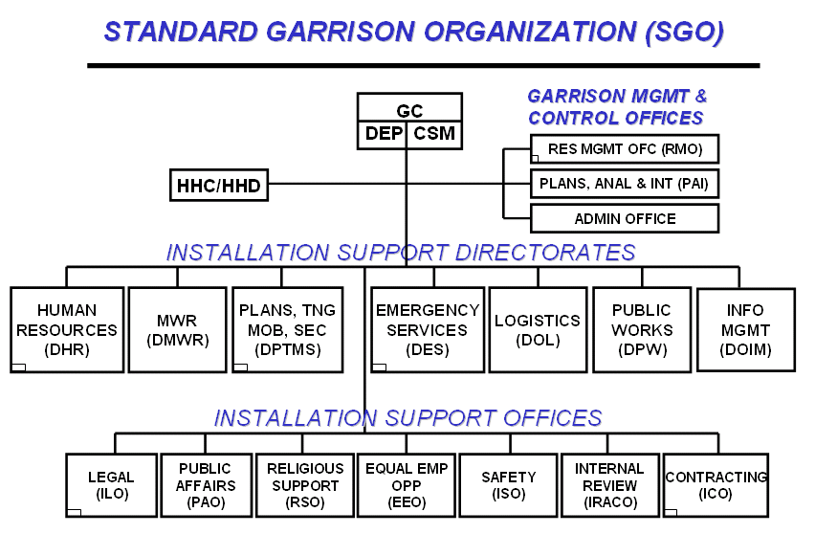
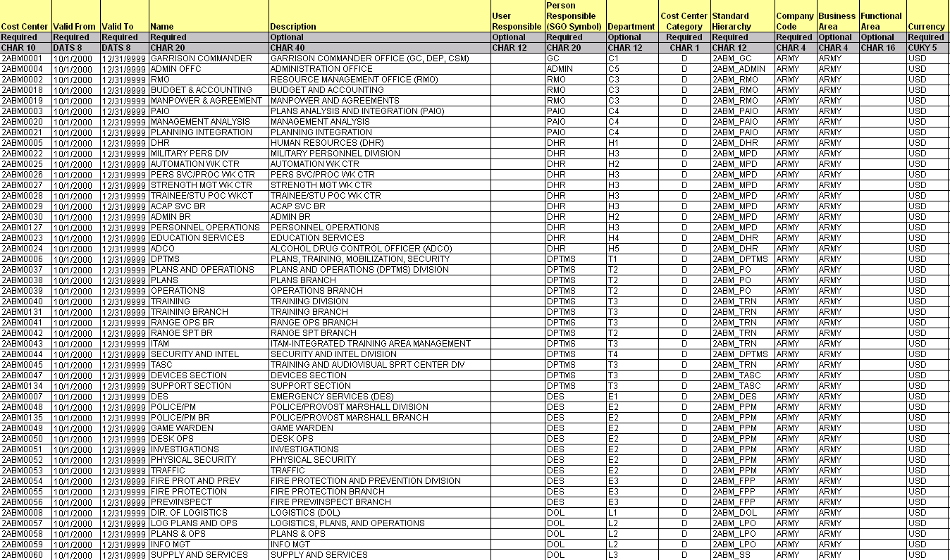
Cost Center Creation
SGO used as start for defining Cost Centers per Installation
Review of TDA and interviews at each base reveal branches and sections that are also added to the list of Cost Centers
Tenant organizations and RPAs (e.g. buildings) are also defined as Cost Centers to develop the final Cost Center list to be loaded to GFEBS
Building 1….N
from
ASCIPS
D2L3_p6

Slide 35
Cost Center Information
GFEBS Cost Center Attributes
Cost Center | Country
Valid From / To | Jurisdiction
Name | PO Box
Description | Postal Code
User Responsible | PO Box Postal Code
Person Responsible (SGO Symbol) | Region
Department (PD Major/Minor) | Language Key
Cost Center Category | Telephone 1
Standard Hierarchy | Telephone 2
Company Code | Telebox Number
Business Area | Telex Number
Functional Area | Fax Number
Title | Teletex Number
Name 1 | Printer Destination
Name 2 | Data Communication Line Number
Name 3 | UIC Code
Name 4 | OUID
House Number and Street | DMIS ID
Location City | TDA Paragraph
District | FDC (Function Designator Code)
D2L3_p7

Slide 36
SAFM-CE Army Cost Model
Cost Center Hierarchy
In addition to defining the Cost Centers and the attribute information for each individual Cost Center, the Cost Centers need to be identified on a standard hierarchy
There is a single standard hierarchy which every Cost Center will reside on to ensure that all costs can be reported from a single hierarchy
Alternative hierarchies can be defined as needed to meet management objectives
D2L3_p8

Slide 37
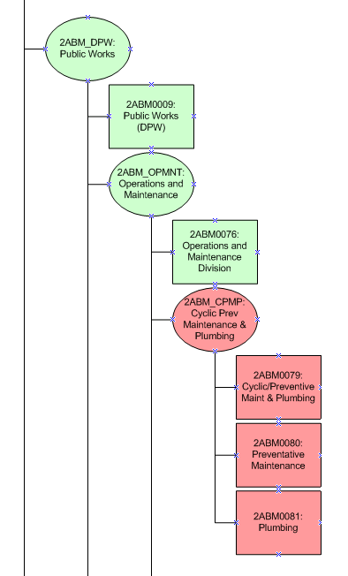
Cost Center Hierarchy Creation
Start with SGO structure
Expand to accommodate lower levels identified specific to the installation
D2L3_p9

Slide 38
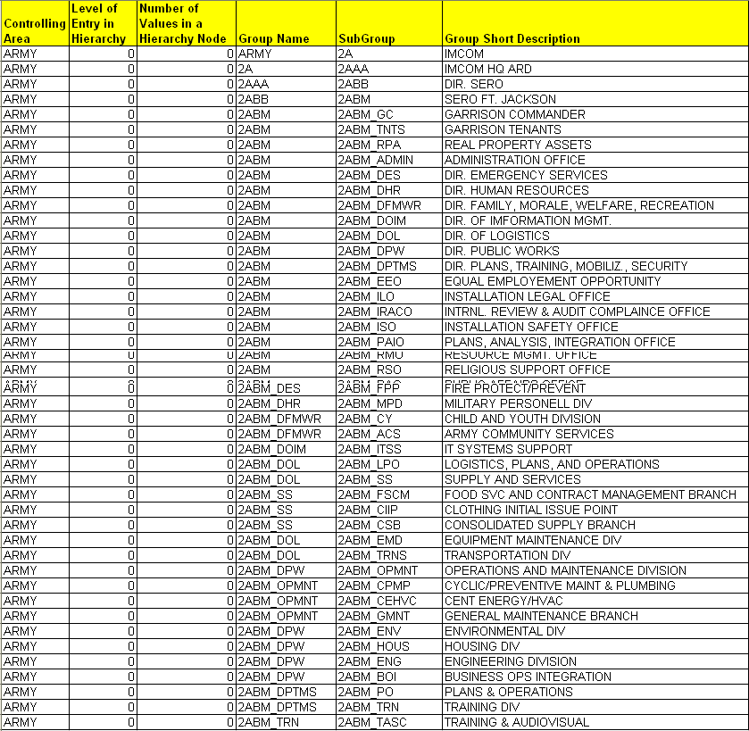
Cost Center Hierarchy
Complete lower level hierarchy and generate into GFEBS load sheet
D2L3_p10

Slide 39
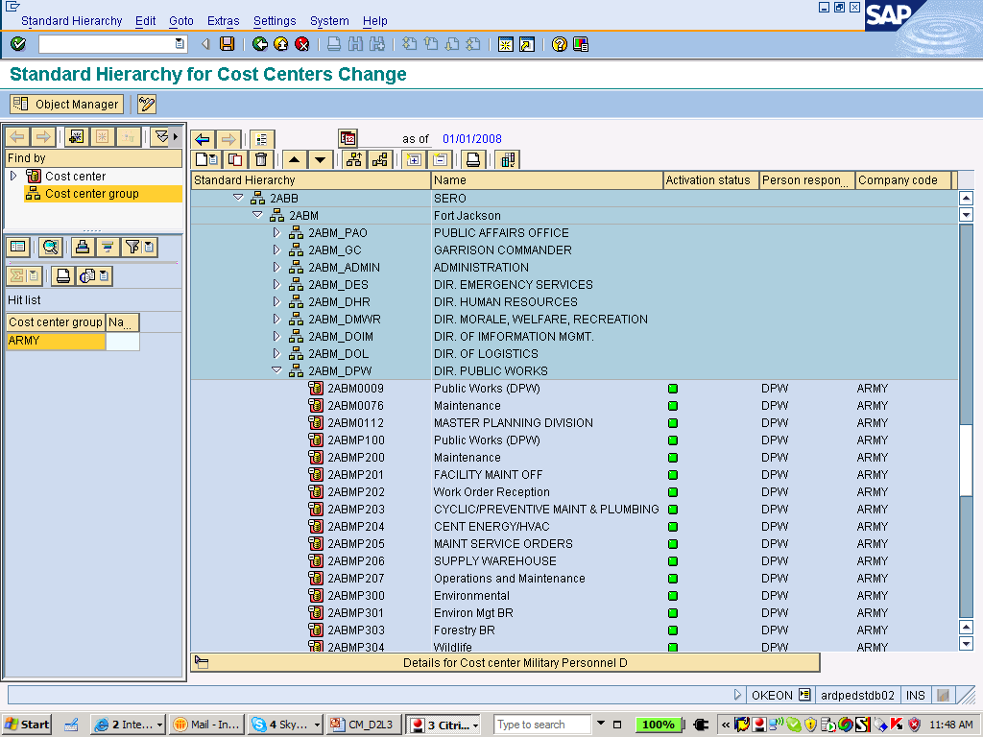
Cost Center Hierarchy
D2L3_p11

Slide 40
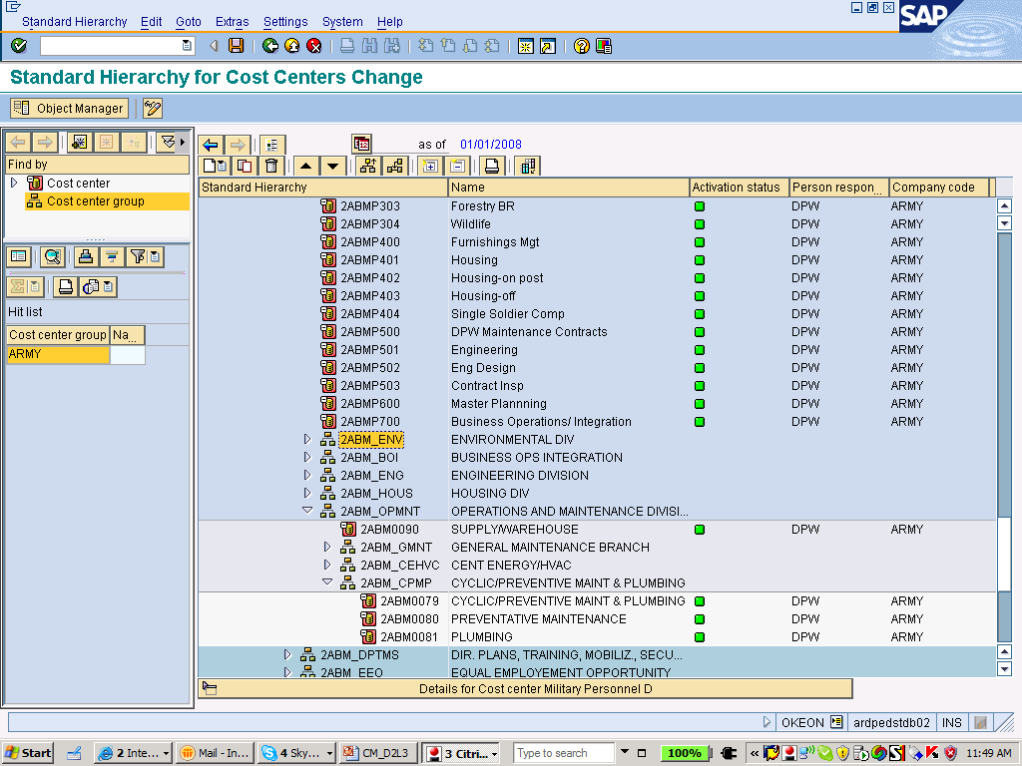
Cost Center Hierarchy
D2L3_p12

Slide 41
Lesson 3: Wrap-Up
A cost center is a responsibility center that incurs costs and has a manager who is accountable for those costs
Costs of the cost center are material in nature (worth capturing vs the cost of capturing)
A cost center has a long life span of more than 1 year (typically years) and has a manager responsible for the resources consumed and the outputs produced by the cost center
Every cost center resides on the standard cost center hierarchy
Alternative cost center hierarchies can exist as well
D2L3_p13

Slide 42
Questions:
A cost center is a cost object used to capture any costs?
  True
  False
X
A cost center is utilized to capture the revenues generated by the outputs of an organization
  True
  False
X
D2L3_p14

Slide 43
Questions:
A cost center can be assigned to more than 1 standard hierarchy?
  True
  False
X
There is a cost center for every fund center (ASN)
  True
  False
X
D2L3_p15

Slide 44
Lesson 4: Activity Types
Objective(s):
To understand what the Activity Type cost object represents, key definition criteria (guiding principles), uses, and how defined for the Cost Model
D2L4_p1

Slide 45
SAFM-CE Army Cost Model
Activity Type Definition
Activity Type Definition:
An Activity Type is a cost object that represents a group of resources within a Cost Center. These resource groups have capacity and a unit of measure such as: labor hours, machine hours, square footage, etc. Activity Types are consumed and utilized to the produce the products and services of the organization.
The term activity type is often confused with an activity, of the Activity-Based Costing approach – however it does not represent an activity. Activities are generally identified with a verb, e.g. Pick Items, Pack Box, Ship Pallet
A more appropriate translation is Resource Pool, e.g. groups of like kind resources within an organization that perform an activity such as TECH HR, SUPV HR, MACHR
Activity Types have a rate/output associated are the utilization of capacity to perform “work” to generate a product/service, e.g. TECH HR @ $10/Hr
D2L4_p2

Slide 46
SAFM-CE Army Cost Model
Activity Type Uses
Cost Center
Activity Type
RMO
People e.g. RMO
  Manager & Analyst
ANLY HR
MGR HR
Motor Pool
Blended e.g. Motor Pool
  Mechanic & Vehicle
MECH HR
VEHC HR
D2L4_p3

Slide 47
SAFM-CE Army Cost Model
Guiding Principles for Activity Types
Principle #1: Interchangeability | Meets the interchangeability criterion which requires that the attributes of two or more resources be such that they can be substituted for each other without impacting the cost and ability to produce the output
Principle #2: Similar | be of a similar technology
Principle #3: Responsibility | the responsibility of one manager or team
Principle #4: Homogeneous | their costs must conform with the homogeneity principle, e.g. be similar in the resources they consume
Principle #5:Planable | outputs and related costs are able to be planned
Principle #6: Captured | actual information (quantities and costs) can be collected or imputed
Principle #7:Co-located | they must not be geographically dispersed
D2L4_p4

Slide 48

SAFM-CE Army Cost Model
Activity Type Uses
Capture Capacity or Planned Output, e.g. grandma works 2088 Hrs or machine runs 3500 Hrs (10 Hrs/Day for 350 days)
Holds the rate for the output of the resource pool, e.g. $2 Hr, $5 Hr, $20 Hr
Assigns capacity consumed by products/ services, e.g. Hrs/min worked per dress, which then valuates based on the rate
$20/Dress
Interchangeable
Not Similar Technology
Not Homogenous – needs resources (input cost structure) of food versus laborer versus electricity
D2L4_p5

Slide 49
Capacity Management
Activity Types facilitate capacity management and there are various types of capacity (e.g. Productive, Non-Productive, Idle/Excess, etc.)
Activity Types provide the capacity information required to optimize the conversion of inputs to generate the most outputs – meeting the “Efficiently” portion of the Cost Management definition
Activity Types are defined as master data, however they exist only in conjunction with a Cost Center
  Activity Type = MACHR is assigned to Cost Center 1 and Cost Center 2 resulting in CC1/MACHR and CC2/MACHR each of which holds their own rate, their planned output, captures actuals, etc.
D2L4_p6
Notes:
People are pretty clear on capability, it involves some judgement.
Cost structure will be explored in some detail in a few minutes.
Let’s look at Capacity? How is capacity defined? 17 different models in IMA SMA.
Productive – clearly valuable
NonProductive – time for maintenance, training, set up, process R & D, ship/acft – PR, etc.
Idle/Excess – by regulation, union rule, ethical/moral choice, etc.
More Capacity questions? Does idle Capacity have a cost? Ship inport for crew rest? Cube only used for one shift? Rent and power paid for 24 hr period. How valuable is you having a personal desk space?
Who is responsible for idle & Excess capacity? A factory manager’s goal is to be efficient – create excess & idle time – marketing and sales needs to create the demand.
What happens if you make the Factory manager responsible for the excess & idle costs? Produce inventory that piles up & ages.

Slide 50
SAFM-CE Army Cost Model
How Activity Types are Defined
The project and production related areas are familiar with the concepts of labor and equipment rates and often have std. rates for charging level of effort for like kind resources to work on an order, e.g. IFS
IFS shop rates are reviewed and then grouped/expanded upon into like kind resources
Equipment Activity Types are defined based on a review and grouping of equipment, e.g. Dump Truck 6T
Vehicle Activity Types are defined based on GSA classification into groupings
D2L4_p7

Slide 51
Activity Types
Non-Labor Examples
D2L4_p8

Slide 52
SAFM-CE Army Cost Model
How Activity Types are Defined
Current Labor definitions from OPM, DOL, NSPS are reviewed (e.g. GS, WG, NSPS)
Labor series/categories, bands (e.g. 1 – 4 depending on labor classification), and type of work (e.g. regular versus overtime) generate starting point for labor activity types
Controlling Area | Activity Type | Valid-From Date | Valid To Date | General Name | Description | Activity Unit
Army | 10032 | 10/1/2000 | 12/31/9999 | ACC & BUDGET GRP RG1 | Accounting And Budget Group RG1 | HR
Army | 10033 | 10/1/2000 | 12/31/9999 | ACC & BUDGET GRP RG2 | Accounting And Budget Group RG2 | HR
Army | 10034 | 10/1/2000 | 12/31/9999 | ACC & BUDGET GRP RG3 | Accounting And Budget Group RG3 | HR
Army | 10035 | 10/1/2000 | 12/31/9999 | ACC & BUDGET GRP RG4 | Accounting And Budget Group RG4 | HR
Army | 10036 | 10/1/2000 | 12/31/9999 | ACC & BUDGET GRP OT1 | Accounting And Budget Group OT1 | HR
Army | 10037 | 10/1/2000 | 12/31/9999 | ACC & BUDGET GRP OT2 | Accounting And Budget Group OT2 | HR
Army | 10038 | 10/1/2000 | 12/31/9999 | ACC & BUDGET GRP OT3 | Accounting And Budget Group OT3 | HR
Army | 10039 | 10/1/2000 | 12/31/9999 | ACC & BUDGET GRP OT4 | Accounting And Budget Group OT4 | HR
D2L4_p9

Slide 53
Faces to Spaces to
Activity Types
The Cost Center and Activity Type will be updated on the DCPS accounting information as the default Cost Center/Activity Type for an employee
To determine the Activity Type for each person an exercise of mapping people (Faces) to cost centers (Spaces) occurred, and then an Activity Type is assigned
The Activity Type is associated with the ATAAPS entry for time tracking or via the work order confirmation process (confirmations associate labor and non-labor activity types to the work order supported
D2L4_p10

Slide 54
Lesson 4: Wrap-Up
An Activity Type is a cost object that represents a group of resources within a Cost Center. These resource groups have capacity and a unit of measure such as: labor hours, machine hours, square footage, etc. Activity Types are consumed and utilized to the produce the products and services of the organization.
There are several guiding principles for the definition of an Activity Type which should be considered
The Activity Type is the cost object which supports capacity management
Each person will be assigned their default activity type based on NSPS, WG, GS, cost center assigned, etc.
D2L4_p11

Slide 55
Question:
Resources within Activity Types
(Check All that Apply) are:
similar technology
homogeneous
able to be planned for $s and qtys
interchangeable
tracked in actual or imputed
the responsibility of one manager/team
what provide the capacity for “work” to be performed
✓
Principle #1: Interchangeability | Meets the interchangeability criterion which requires that the attributes of two or more resources be such that they can be substituted for each other without impacting the cost and ability to produce the output
Principle #2: Similar | be of a similar technology
Principle #3: Responsibility | the responsibility of one manager or team
Principle #4: Homogeneous | their costs must conform with the homogeneity principle, e.g. be similar in the resources they consume
Principle #5:Planable | outputs and related costs are able to be planned
Principle #6: Captured | actual information (quantities and costs) can be collected or imputed
Principle #7:Co-located | they must not be geographically dispersed
✓
✓
✓
✓
✓
✓
D2L4_p12

Slide 56
Lesson 5: Cost Elements
Objective(s):
To understand what the Cost Element cost object represents, key definition criteria (guiding principles), uses, and how defined for the Cost Model
D2L5_p1

Slide 57
SAFM-CE Army Cost Model
Cost Element Definition
Cost Element Definition:
A Cost Element is the lowest level component for classifying costs and revenues (as negative costs) of a resource and indicates the category/type associated with a posting (e.g. allocation type, revenue, expense)
GFEBS replaces the concept of EORs with GL Accounts in Financials (FI), Commitment Items in Budgeting (FM) and Cost Elements in Cost Management (CO)
For every P&L related GL Account there is a corresponding Cost Element; revenue accounts are reflected as negative cost elements
D2L5_p2

Slide 58


SAFM-CE Army Cost Model
Guiding Principles for Cost Elements
Principle #1: External Alignment | Alignment to support external reporting requirements for financial reporting of P/L items.
Principle #2: Transparency | Provide the lowest level of transparency necessary for managing revenues/expenses not already supported within another data element
Manage Travel
by Cost Center
OMB Object
Class 21 - Travel
Individual Transactions
Flight
Hotel
Travel
Travel
Meal
D2L5_p3

Slide 59
SAFM-CE Army Cost Model
Cost Element Uses
Capture actual Costs (expenditures, imputed costs, allocations, etc.)
Plan Cost by resources (Employee #1), groups of resources (TECH Hr Activity Type), organizations (Cost Centers), or products/services
Reporting of individual expense categories or grouped together to support internal (management) and external (OMB/SFIS) reports
Move costs from one org/location to another: e.g. similar to some “cost transfers” currently performed
Primary (consumed from outside) versus Secondary (consumed from inside)
Maintain debit/credit integrity for expense related postings within the Controlling component of GFEBS
D2L5_p4

Slide 60
Primary Cost Elements
Expenditures externally sourced, such as most of today’s EORs (excluding the 2700s)
Typically (but not necessarily e.g., depreciation) indicative of cash out flows
Start with the USGL indicator, such as 6100 or 6400 for expenses
Are a 1:1 match with the General Ledger Account utilized for Financial Accounting
Director of
Logistics (DOL)
Cost Center: CIF
DOL Support $$$
Labor $$$
Material $$$
Military
Labor
Contracts $$$
Travel $$$
Military Labor $$$
Facilities $$$
CIV
HR
Examples:
6100.11B1 Civilian Base Pay - Full-time Permanent
6100.11B3 Civilian Base Pay - Other than Full-time Permanent
6100.21T0 TDY Travel
6100.252A Information Technology Services – Processing
6400.13H0 VSIP TAX -15% Remittance to CSRDF
MIL
HR
D2L5_p5

Slide 61
Secondary Cost Elements
Assigned/service fees to an object for consuming products/services providing by another object. (e.g. 2714 Shop Stock)
Non-cash outlays (would have occurred with the Primary Cost Element posting
Start with a 9 series preface to indicate that they are not associated with the General Ledger, e.g. internal only
There are multiple types of secondary cost elements to support allocations, charge outs, overhead surcharges, etc.
Director of
Logistics (DOL)
Cost Center: CIF
DOL Support $$$
Labor $$$
Material $$$
Military
Labor
Contracts $$$
Travel $$$
Military Labor $$$
Facilities $$$
CIV
HR
Examples:
9000.2714 MATERIAL SHOP STOCK
9300.0100 LABOR CHARGE - REG
9300.01OT LABOR CHARGE - OT
9400.0150 MILITARY LABOR CHARGE
MIL
HR
D2L5_p6

Slide 62
Cost Elements Example
Director of
Logistics (DOL)
Cost Center: CIF
9200.0100 Support Allocation $$$
6100.11B1 Full-Time Perm $$$
6100.26XX Material $$$
Military
Labor
6100.25YY Contracts $$$
6100.21T0 Travel $$$
9700.0150 Mil Labor Imputed $$$
9400.SQFT Facilities $$$
Total $$$$$
9300.0100 Labor Charge Reg - $$$
9400.0150 Mil Labor Charge - $$$
CIV
HR
Total - $$$$
Over/Under Absorption $$$$
MIL
HR
D2L5_p7

Slide 63
SAFM-CE Army Cost Model
How Cost Elements are Defined
For Primary Cost Elements:
  Started with EORs for both pay and non-pay
  Evaluated information embedded in code/EOR
  Determined if another GFEBS data element could hold that info and collapsed where possible (e.g. C-Type, Vendor, Type of Interest Payment)
  Reviewed external reporting requirements such as OMB Object Classes, USGL, SFIS mappings
  When a GL Account it determined a Primary Cost Element is also created with the exact same code
  Once live, new Primary Cost Elements are typically rarely added and as needed to support external reporting
D2L5_p8

Slide 64
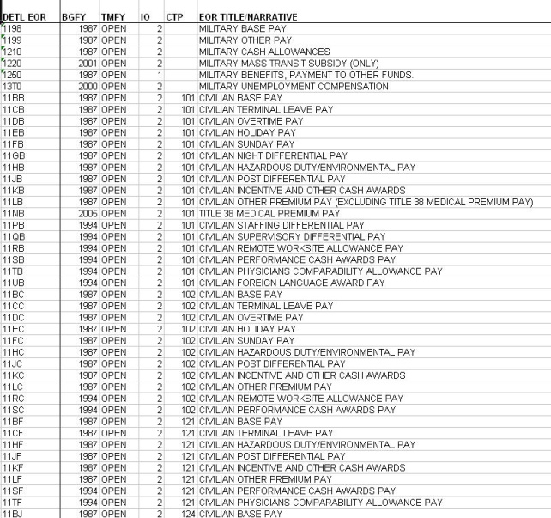
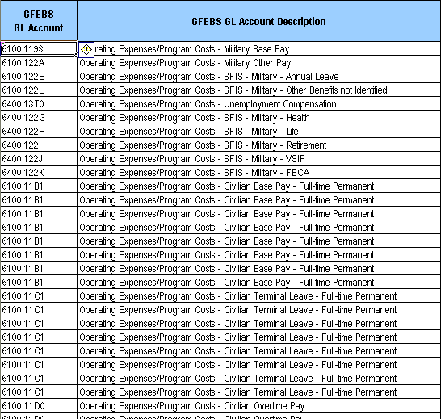
EOR crosswalk to GL Discussion
EORs will no longer be used in GFEBS; yet, the same information previously maintained through EORs will be supported via different methods
C-type is removed from Accounts in GFEBs and reported via BI Labor Report
500+
37-100
Labor EORs
60+ in GFEBS as:
FI GL Accounts
Primary Cost Elements
Commitment Items
Labor
Report by
C-Type
GFEBS BI
D2L5_p9

Slide 65
SAFM-CE Army Cost Model
How Cost Elements are Defined
For Secondary Cost Elements:
  Determined types of cost allocations/ assignments to be supported (assumed all possible in GFEBS)
  Determine internal management reporting detail needs, continues to expand with maturity
  Identified impacts for budget/non-budget relevant in funds management
  Secondary Cost Elements are constantly being added as assignments/allocations are updated/changed in order to provide transparency for management reporting
D2L5_p10

Slide 66
Cost Element Groups
Cost Elements can be grouped together to support
  Reporting: e.g. all labor related primary cost elements into a group called Payroll Labor
  Reconciliation: e.g. the primary cost element used to procure shop stock with the secondary cost element used to allocate shop stock to manage the under/over absorption
  Allocations: e.g. allocating a combination of cost elements to multiple receivers
  Hierarchies: e.g. by creating cost element groups within cost element groups a hierarchy is generated which can be utilized to meet OMB Object Class and SFIS reporting requirements
OMB OCs
11
11.1
11.3
11.5
11.7
12
13
21
…
D2L5_p11

Slide 67
Lesson 5: Wrap-Up
A Cost Element is the lowest level component for classifying costs and revenues (as negative costs) and indicates the category/type associated with a posting (e.g. allocation type, revenue, expense)
There are two types of Cost Elements: Primary and Secondary
Primary Cost Elements represent those obtained from the external market
Secondary Cost Elements represent costs incurred from within the Army
EORs and the EOR information will be supported via GFEBS through GL Accounts, Commitment Items, and Primary Cost Elements
Cost Elements can be grouped together to support internal and external reporting including to generate hierarchies such as OMB Object Class
D2L5_p12

Slide 68
Questions
A serviced received from another Army command will be represented by a secondary cost element?
  True
  False
✓
Labor costs are always primary?
  True
  False
X
A cost element groups can be grouped to generate a hierarchy?
  True
  False
✓

Slide 69
Lesson 6: WBS Elements
Objective(s):
To understand what the Project WBS Element cost object represents, uses, and how defined for the Cost Model
D2L6_p1

Slide 70
SAFM-CE Army Cost Model
Project & WBS Element Definition
Project Definition:
An object used to plan, collect, monitor and control costs for large scale time-based events in Project Systems, when extensive scheduling and resource management capabilities are required. Projects have a definite start and end.
Work Breakdown Structure (WBS) Definition:
WBS elements are activities in the Project used for planning and updating cost data. Some examples of WBS Elements are: Tasks, Partial tasks that are further subdivided, and work packages.
D2L6_p2

Slide 71
SAFM-CE Army Cost Model
WBS Element Uses
Projects and WBS Elements are master data elements of the Project System (PS) will be utilized to support project oriented areas such as environmental, maintenance, R&D, RDT&E, etc
PS will be utilized to replace the IFS functionality and will utilize Projects/ WBS Elements as cost objects for tracking the costs associated with repairs
Even though WBS Elements are master data for the PS module of GFEBS they are cost objects for the Cost Model and fully integrated within the Controlling module
Since the DPW area will already be working with the WBS Element cost object to support maintenance planning and orders, the CLS SSPs for the DPW related Services will be represented as WBS Elements
Each DPW related CLS SSP will have a WBS Element for capturing costs
New WBS Elements will be generated to support above-CLS level SSPs
D2L6_p3

Slide 72
Sample WBS
Elements Defined
FY09 CLS for DPW related Services will be reviewed and transferred into the appropriate GFEBS load format necessary for WBS Elements to be created
Description Contains SSP value
D2L6_p6

Slide 73
Lesson 6: Wrap-Up
Work Breakdown Structure (WBS) Element is a cost object defined and maintained within a Project residing in the Project Systems (PS) module
WBS Elements are cost objects and therefore fully integrated within the Controlling module for use within the Cost Model
WBS Elements will be utilize to support IFS like functionality
DPW related CLS SSPs will be generated as WBS Elements
Above-Level CLS for reimbursables will be created as a WBS Element to facilitate the billing process
D2L6_p7

Slide 74
Questions
A WBS Element is (check all that apply)?
  master data of the controlling module
  a component of a Project
  utilized to support DPW related SSPs
  support reimbursables
✓
✓
✓
D2L6_p9

Slide 75
Lesson 7: Orders
Objective(s):
To understand what the Order cost object represents, key definition criteria (guiding principles), uses, and how defined for the Cost Model
D2L7_p1

Slide 76
SAFM-CE Army Cost Model
Order Definition
Order Definition:
Orders are cost objects used to plan, collect, monitor, and settle the costs of specific jobs and tasks. Orders are used to monitor the costs of short term projects and event/job costing.
D2L7_p2

Slide 77
SAFM-CE Army Cost Model
Order Types
There are various Order Types which are utilized to distinguish the purpose of the Order; such as,
  Sales Orders (located within the Sales and Distribution module) and used for revenue/reimbursables
  Production Orders (located in Production Planning module) and used for manufacturing (e.g. uniforms, ammo)
  Maintenance Orders (located in Plant Maintenance module) and used for maintenance (e.g. IFS/Maximo related functionality)
  Internal Orders (located in the Controlling module) and used for event costing such as marketing/recruiting campaigns, Katrina, Special Olympics, projects not requiring the rigor of a Project Structure
All Orders are cost objects and included in the Cost Model regardless of which GFEBS module creates the Order
D2L7_p3

Slide 78
SAFM-CE Army Cost Model
Guiding Principles for Internal Orders
Principle #1: Time Frame | Orders are short term in nature
Principle #2: Lot Size | Internal Order have a lot size of 1; therefore intended to represent a single event not multiple occurrences
Principle #3: Revenues | Main revenue collection cost object within the controlling module when CO-PA is not utilized
Principle #4: Collectors | Internal orders are not intended to replace the rigor of the Project/WBS Element structure, e.g. collectors versus project management objects
D2L7_p4

Slide 79
SAFM-CE Army Cost Model
Internal Order Uses
Collect revenues which are not associated with Sales Orders. Order Type ZFIN has been created to capture miscellaneous revenues such as gains, interest, etc.
Capture one-time events which management wants to have visibility into, e.g. hurricane Katrina, the annual IMI conference, presidential visit to an installation, Special Olympic support, etc.
Manage small projects not requiring formal Project Management controls such as planning/scheduling, pert and gant charts, etc.
Represent products/services such as SSPs, Training Classes, etc.
Facilitate cost assignments/transfers within the Cost Model, e.g. internal bill between organizations
D2L7_p5

Slide 80
Cost Centers vs Internal Orders
 | Cost Centers | Internal Orders
Cost Collection | Ongoing Operations | Discrete, Time Based Events
Time Period | Indefinite/ Long Term | Definitive Beginning and End
Ownership of Resources | Maintains responsibility of the people/equipment; i.e. people are always assigned to a cost center/organization | People can be assigned to work on but are not assigned to an Internal Order
Status (Real/Statistical) | Always real, but can receive statistical postings (information only – can not be further allocated) | Can be defined as Real or Statistical. Statistical Orders receive informational postings only for cost reporting but cannot further allocate
Grouping Options | Standard Hierarchy and can be grouped | Can be grouped; no Standard Hierarchy requirement
TN
JAVA
Org 1
Recruiting
SC 1
System
SC 2
ABAP
Org 2
D2L7_p6

Slide 81
Internal Orders vs WBS Elements
 | Internal Orders | Project/WBS Elements
Cost Collection | Discrete, Time Based Events | Same
Time Period | Definitive Beginning and End | Same
Ownership of Resources | People can be assigned to work on but are not assigned to an Internal Order | Same
Status (Real/Statistical) | Can be defined as Real or Statistical. Statistical Orders receive informational postings only for cost reporting but cannot further allocate | Same
Grouping Options | Can be grouped; no Standard Hierarchy requirement | Project/WBS Elements is a structured hierarchy
Networks | Not Applicable | Provides how the work is performed (routing)
Controlling | Limited status management | Advanced status management, project reporting and controlling
Financial Controls | Collector | Budgeting and Controlling
D2L7_p7

Slide 82
SAFM-CE Army Cost Model
How Internal Orders are defined
Evaluate Job/Event Costing related Products/Services and determine which will be supported by an operational module and exclude those (e.g. maintenance orders)
Review remaining products/services to determine how to be grouped for identifying Internal Order Types
ZSSP Internal Order type was created and an Internal Orders for each non-DPW area CLS-SSP
ZSSP Internal Order numbers are auto-generated on creation
The SSP value is stored in a field on the Internal Order to support reporting by SSP
D2L7_p8

Slide 83
Example Internal Orders
D2L7_p9

Slide 84
Lesson 7: Wrap-Up
Orders are cost objects used to plan, collect, monitor, and settle the costs of specific jobs and tasks. Orders are used to monitor the costs of short term projects and event/job costing.
There are multiple order types which are used for various focused purposes; e.g. Sales Orders, Maintenance Orders, Internal Orders, etc.
Internal Order Type ZSSP will include all non-DPW CLS-SSPs
Internal Orders provided a sub-view of the costs within a Cost Center or a cross Cost Center view
D2L7_p12

Slide 85
Questions
An Internal Order is interchangeable with Cost Center?
  True
  False
X
Like a Cost Center, Internal Orders can capture costs only?
  True
  False
X
Internal Orders can be identified as statistical (informational only) or real (capture and transfer costs)?
  True
  False
✓
D2L7_p13

Slide 86
Lesson 8: Business Process
Objective(s):
To understand what the Business Process cost object represents, key definition criteria (guiding principles), uses, and how defined for the Cost Model
D2L8_p1

Slide 87
SAFM-CE Army Cost Model
Business Process Definition
Business Process Definition:
A business process is a cost object used to capture costs of cross-functional (cost center) activities.
Business Processes are the “work” being performed by the Cost Center/Activity Types
Typically related to an action such as a “verb”, e.g. Pick Items, Pack Boxes, Ship Pallet
Are an expression of the capacity utilized; but do not hold capacity themselves
D2L8_p2

Slide 88
SAFM-CE Army Cost Model
Guiding Principles for Business Process
Principle #1: Analytical | Utilized when management needs more insight into “what” the resource pools are doing in order to make process improvement decisions
Principle #2: Detail | Defined in areas where further detail is necessary to support cost-to-serving a customer
Principle #3: Billing | Mechanism for making cross-functional (cost center) charging of a single rate
Principle #4: Capacity | Utilized to represent the consumption of capacity, not the capacity itself (e.g. no “Idle” activity/business processes)
Pick
Cust
1
Cust
1
DC 1
DC 3
Hr
Pack
Cust
2
Hr
Cust
2
Ship
Pick
Cust
1
DC 1
DC 2
Pick
Cust
1
DC 2
Pick
Pick
Hr
Pack
Hr
Cust
2
Hr
Pack
Pack
Pack
Cust
2
Ship
Ship
Ship
Ship
D2L8_p3

Slide 89
Activity Types vs
Business Processes
 | Activity Types | Business Processes (Activities)
Scope | The resource pool performing the work | The work being performed
Relationship to Cost Center | Can never stand alone without a cost center | Multiple Cost Centers can provide resources to the process
Capacity | Is the capacity provided to perform the work | Is the utilization of capacity while performing the work
Rates | Always has a rate associated | Can have a rate associated
Grouping Options | Can be grouped for reporting (e.g. All labor related) | Standard Hierarchy required and can be grouped into alternate hierarchies
D2L8_p4

Slide 90
SAFM-CE Army Cost Model
Business Process Uses
Used to support activity-based costing initiatives
For utilization of a single consolidated rate of a similar activity performed across several cost centers
Represent repetitive services that are not Order based (e.g. Process Help Desk Ticket)
D2L8_p5

Slide 91
SAFM-CE Army Cost Model
How Business Processes are defined
Most of IMCOMs SSPs would typically be Business Processes, however since processes should not receive a primary posting, these were created as WBS Elements and Internal Orders
When desired to charge a rate/per, to the receiving customer/tenant, a business process was identified; e.g. SBC 25 – Central Issue Facility and SBC 23 – Ammunition Supply Services based on #Issues/Returns
D2L8_p6

Slide 92
SAFM-CE Army Cost Model
Business Processes Std. Hierarchy
There is a Business Process Std. Hierarchy to which all business processes must be assigned when created.
The currently defined Business Process Hierarchy groups processes into Services, this will be augmented as other commands are included into the Cost Model
Additionally, alternative hierarchies can be generated as needed
Groups of processes can also be generated to support ad-hoc reporting or cost allocations
D2L8_p7

Slide 93
Lesson 8: Wrap-Up
A business process is a cost object used to capture costs of cross-functional (cost center) activities
Reflect the utilization of capacity of a resource pool (activity type)
Can have a rate associated supporting a $/per occurrence of the process being charged to the receiver
Must be assigned to the Business Process Std. Hierarchy but can also be assigned to alternative groups for reporting
D2L8_p8

Slide 94
Questions
A Business Process is (check all that apply)?
  The “work” being performed
  Consumes output of the resource pools/activity types
  Must have a rate associated
  Are for one-time occurrences
  Support benchmarking
✓
✓
✓
A Business Process is interchangeable with an Activity Type
  True
  False
X
D2L8_p9

Slide 95
Lesson 9: Statistical Key Figures
Objective(s):
To understand what the Statistical Key Figure represents, uses, and how defined for the Cost Model
D2L9_p1

Slide 96
SAFM-CE Army Cost Model
Statistical Key Figure (SKF) Definition
Statistical Key Figure Definition:
A Statistical Key Figure is a piece of information about the cost object it is assigned to, e.g. # FTE for a cost center, # telephones, etc.
There are two types of statistical key figures:
  Fixed value - Fixed values are carried forward from the period posted to all subsequent posting periods for the year
  Total value - Total values exist only for the period posted
P1 P2 P3 P4 P5 ….
12 12 24 24 24 24
1 1 1.5 2
CC #1000
# Headcount
# FTE
D2L9_p2

Slide 97
SAFM-CE Army Cost Model
Statistical Key Figure Uses
As a basis (cost driver) for cost assignments, e.g. # telephones to allocate out the phone bill
To measure performance, e.g. # surveys SKF can be planned for the year and then actuals captured to report progress
To calculate a unit cost rate in unit cost report. This report is designed specifically for the Army and allows for some or all of the costs on the cost object selected to be divided by the SKF on that cost object to calculate a Unit Cost rate of the SKF, e.g. $/meal
D2L9_p3

Slide 98
SAFM-CE Army Cost Model
How SKFs are defined
Evaluated the CLS
Determined the “work load” measure within CLS is an appropriate representation of SKF
SKFs have to be associated with a cost object and the information must then be captured and maintained (directly or via ISR or some other system feed)
D2L9_p4

Slide 99
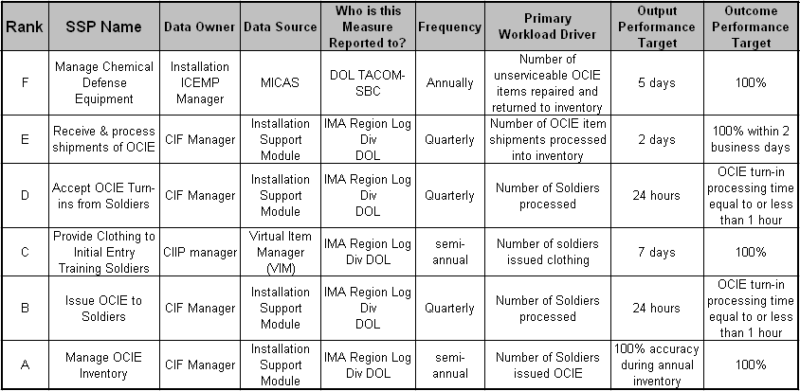

SSP Workload Example
CLS SBC 25 - CIF
GFEBS
D2L9_p5

Slide 100
Lesson 9: Wrap-Up
A Statistical Key Figure is a piece of information about the cost object it is assigned to, e.g. # FTE for a cost center, # telephones, etc.
There are two types of SKFs; Fixed which pre-populates the same data for each period until changed and Total which represents the total value of that SKF for that period only
Utilized as cost drivers/basis for cost allocations and performance reporting
Must be assigned to a cost object
D2L9_p6

Slide 101
Questions
  _______ statistical key figure varies each period.
  _______ statistical key figure is static from the period of entry through to the end of the year.
There is a limited number of SKFs that can be assigned to a Cost Object?
  True
  False
X
D2L9_p7

Slide 102
Lesson 10: Capturing Costs
Objective(s):
To understand how actual costs will be captured against the cost objects defined within the Cost Model
D2L10_p1

Slide 103
GFEBS Cost Objects vs Legacy Data Elements
Legacy Data Element | Purpose | GFEBS Cost Objects
Elements of Resource (EOR) - 6000 Series | Expenses & Revenues | Primary Cost Elements
Cost Transfers (e.g. EOR 2700) | Cost Movement (Budgetary and non-Budgetary) | Secondary Cost Elements
Command, Directorate, Branch, Unit | Organizational Entity | Cost Centers
Civilian / Military Pay (e.g. C-Type, Rank) | Resource Pool (e.g. Labor, Equip) | Activity Types
Point Accounts, Functional Cost Accounts, Account Processing Codes (APCs) (e.g. Installation Services, Facility Codes, Job Orders, orders, projects, etc.) | Internal Orders | Internal Orders
 | Processes/activities | Business Processes
 | Projects / WBS Elements | Projects / WBS Elements
 | Infrastructure (e.g. Facility, Roads) | Real Estate Objects
Legacy Data Element | Purpose | FM Master Data
Program Element, MDEP, Acquisition / RDTE Programs | Budget / Program Level Mgmt | Functional Area
Mandates, Earmarks, Con-Ops | Special Projects | Funded Program
D2L10_p2

Slide 104
Cost Model Cost Objects
Full Cost
Organizations
Full Cost
Product/Services
Full Cost
Customers
Director of
Logistics)
SSPs Provided
Cost Center
The initial cost recognition is the primary posting (primary cost element)
Costs flow through the Cost Objects of the model (e.g. secondary cost elements) using various cost assignments/allocations
SSPA: Manage
OCIE Inventory
Brigade XXX
SSPB: Issue
OCIE to Soldier
Military
Labor
Cost Center/Resource Pool
Central Issue facility
SSPC: Issue
Clothing to Initial
Training Soldier
TRADOC YYY
Depreciation
CIV
HR
Civilian
Employees
SSPD: Accept
OCI Turn-Ins
Brigade ZZZ
CNT
HR
SSPE: Receive
& Process
Shipments
Contractors
Military
MIL
HR
SSPF: Manage
Chemical Defense
Equipment
. . Etc.
D2L10_p3

Slide 105
Process for Capturing Cost
Expense Elements
Organizations
Products & Services
DCPS
ATAAPS
WMT
DIMHRS
Payroll
Business
Process
Cost
Center
Material
WAWF
FCM
PCard
Orders
(Internal,
Sales,
Maint.)
Supplies
Activity Types:
Labor Pools
Equipment usage
Facility usage
LMP
GCSS-A
Equipment
Project WBS
Element
DTS
Travel
Operational Systems:
SKF Cost Driver #1
SKF Cost Driver #2
GFEBS Fixed Assets
Depreciation
D2L10_p4

Slide 106
GFEBS Interfaces R1.3
DCPS
Cost Center
ATAAPS
WMT
Activity Types:
Labor Pool usage
Equipment usage
Facility usage
WAWF
Project WBS
Element
Credit Cards
Orders
(Internal, Job
Work)
DTS
D2L10_p5

Slide 107
Cost Example
2ABM0065 Ammo Supply Point
Name | Cost Element | Actuals | Quantity
2ABM0065 Ammo Supply Point
Name | Cost Element | Actuals | Quantity
Perm | 6100.11B1 | $10,000 | 80 hrs
Overtime | 6100.11D0 | $3,000 | 20 hrs
Civ PCS | 6100.12A3 | $1,000
2ABM0065 Ammo Supply Point
Name | Cost Element | Actuals | Quantity
Perm | 6100.11B1 | $10,000 | 80 hrs
Overtime | 6100.11D0 | $3,000 | 20 hrs
Civ PCS | 6100.12A3 | $1,000
Travel | 6100.12T0 | $800
2ABM0065 Ammo Supply Point
Name | Cost Element | Actuals | Quantity
Perm | 6100.11B1 | $10,000 | 80 hrs
Overtime | 6100.11D0 | $3,000 | 20 hrs
Civ PCS | 6100.12A3 | $1,000
Travel | 6100.12T0 | $800
Contracts | 6100.252G | $2,000
2ABM0065 Ammo Supply Point
Name | Cost Element | Actuals | Quantity
Perm | 6100.11B1 | $10,000 | 80 hrs
Overtime | 6100.11D0 | $3,000 | 20 hrs
Civ PCS | 6100.12A3 | $1,000
Travel | 6100.12T0 | $800
Contracts | 6100.252G | $2,000
Purchase Cards | 6100.262B | $1,500
2ABM0065 Ammo Supply Point
Name | Cost Element | Actuals | Quantity
Perm | 6100.11B1 | $10,000 | 80 hrs
Overtime | 6100.11D0 | $3,000 | 20 hrs
Civ PCS | 6100.12A3 | $1,000
Travel | 6100.12T0 | $800
Contracts | 6100.252G | $2,000
Purchase Cards | 6100.262B | $1,500
DOL Support | 9100.0000 | $2,000
Allocation | 9400.SQFT | $1000 | 300ft
2ABM0065 Ammo Supply Point
Name | Cost Element | Actuals | Quantity
Perm | 6100.11B1 | $10,000 | 80 hrs
Overtime | 6100.11D0 | $3,000 | 20 hrs
Civ PCS | 6100.12A3 | $1,000
Travel | 6100.12T0 | $800
Contracts | 6100.252G | $2,000
Purchase Cards | 6100.262B | $1,500
DOL Support | 9100.0000 | $2,000
Allocation | 9400.SQFT | $1000 | 300ft
Labor Charge | 9300.0100 | ($2,000)
DCPS
2ABM0065 Ammo Supply Point
Name | Cost Element | Actuals | Quantity
Perm | 6100.11B1 | $10,000 | 80 hrs
Overtime | 6100.11D0 | $3,000 | 20 hrs
Civ PCS | 6100.12A3 | $1,000
Travel | 6100.12T0 | $800
Contracts | 6100.252G | $2,000
Purchase Cards | 6100.262B | $1,500
DOL Support | 9100.0000 | $2,000
Allocation | 9400.SQFT | $1000 | 300ft
Labor Charge | 9300.0100 | ($2,000)
Ammo | 9400.AMMO | ($500)
ATAAPS
10145 Quality Assurance,
Inspect & Grading RG2
$X/Hr
DTS
ADKINS, SYLVIA R
10153 Supply RG2
$Y/Hr
WAWF
BERRY, MALLIE H
Purchase
Cards
10369 Amm Explosives &
Toxic Material Work RG2
$Z/Hr
GUINTHER, JOHN S
MCEADY, SAMUEL E
OWENS, ROBERT E
YOUNG, ERNEST W
BENSON, JAMES E
WARS
$XX/
issue
SBC 23 Workload Drivers
# of Requests
# of Inspections
AMMO
D2L10_p6

Slide 108
Lesson 10: Wrap-Up
The cost objects define the structure of where the actual costs are posted against
Actual costs are reflected first as the primary cost element postings in the Cost Model, then as secondaries as they are assigned/allocated through the cost model
Many interfaces to legacy applications will exist to generate the primary postings into the model
As GFEBS releases occur, more and more interfaces will be accommodated for capturing both dollars and non-financial operational measures
D2L10_p7

Slide 109
Question
You survived Day 2? – Congratulations!
D2L10_p8

