Slide 1
19
Analysis of Variance and Experimental Design

Slide 2
Introduction (slide 1 of 3)
The procedure for analyzing the difference between more than two population means is commonly called analysis of variance, or ANOVA.
There are two typical situations where ANOVA is used:
When there are several distinct populations
In randomized experiments; in this case, a single population is treated in one of several ways.
In an observational study, we analyze data already available to us.
The disadvantage is that it is difficult or impossible to rule out factors over which we have no control for the effects we observe.
In a designed experiment, we control for various factors such as age, gender, or socioeconomic status so that we can learn more precisely what is responsible for the effects we observe.
In a carefully designed experiment, we can be fairly sure that any differences across groups are due to the variables that we purposely manipulate.
This ability to infer causal relationships is never possible with observational studies.

Slide 3
Introduction (slide 2 of 3)
Experimental design is the science (and art) of setting up an experiment so that the most information can be obtained for the time and money involved.
Unfortunately, managers do not always have the luxury of being able to design a controlled experiment for obtaining data, but often have to rely on whatever data are available (that is, observational data).
Some terminology:
The variable of primary interest that we wish to measure is called the dependent variable (or sometimes the response or criterion variable).
This is the variable we measure to detect differences among groups.
The groups themselves are determined by one or more factors (sometimes called independent or explanatory variables) each varied at several treatment levels (often shortened to levels).
It is best to think of a factor as a categorical variable, with the possible categories being its levels.
The entities measured at each treatment level (or combination of levels) are called experimental units.

Slide 4
Introduction (slide 3 of 3)
The number of factors determines the type of ANOVA.
In one-way ANOVA, a single dependent variable is measured at various levels of a single factor.
Each experimental unit is assigned to one of these levels.
In two-way ANOVA, a single dependent variable is measured at various combinations of the levels of two factors.
Each experimental unit is assigned to one of these combinations of levels.
In three-way ANOVA, there are three factors.
In balanced design, an equal number of experimental units is assigned to each combination of treatment levels.

Slide 5
One-Way ANOVA
The simplest design to analyze is the one-factor design.
There are basically two situations:
The data could be observational data, in which case the levels of the single factor might best be considered as “subpopulations” of an overall population.
The data could be generated from a designed experiment, where a single population of experimental units is treated in different ways.
The data analysis is basically the same in either case.
First, we ask: Are there any significant differences in the mean of the dependent variable across the different groups?
If the answer is “yes,” we ask the second question: Which of the groups differs significantly from which others?

Slide 6
The Equal-Means Test (slide 1 of 4)
Set up the first question as a hypothesis test.
The null hypothesis is that there are no differences in population means across treatment levels:
The alternative is the opposite: that at least one pair of μ’s (population means) are not equal.
If we can reject the null hypothesis at some typical level of significance, then we hunt further to see which means are different from which others.
To do this, calculate confidence intervals for differences between pairs of means and see which of these confidence intervals do not include zero.

Slide 7
The Equal-Means Test (slide 2 of 4)
This is the essence of the ANOVA procedure:
Compare variation within the individual treatment levels to variation between the sample means.
Only if the between variation is large relative to the within variation can we conclude with any assurance that there are differences across population means—and reject the equal-means hypothesis.
The test itself is based on two assumptions:
The population variances are all equal to some common variance σ².
The populations are normally distributed.
To run the test:
Let Y_{j}, s²_{j}, and n_{j} be the sample mean, sample variance, and sample size from treatment level j.
Also let n and Y be the combined number of observations and the sample mean of all n observations.
Y is called the grand mean.

Slide 8
The Equal-Means Test (slide 3 of 4)
Then a measure of the between variance is MSB (mean square between), as shown in the equation below:
A measure of the within variance is MSW (mean square within), as shown in this equation:
MSW is large if the individual sample variances are large.
The numerators of both equations are called sums of squares (often labeled SSB and SSW), and the denominators are called degrees of freedom (often labeled dfB and dfW).
They are always reported in ANOVA output.

Slide 9
The Equal-Means Test (slide 4 of 4)
The ratio of the mean squares is the test statistic we use, the F-ratio in the equation below:
Under the null hypothesis of equal population means, this test statistic has an F distribution with dfB and dfW degrees of freedom.
If the null hypothesis is not true, then we would expect MSB to be large relative to MSW.
The p-value for the test is found by finding the probability to the right of the F-ratio in the F distribution with dfB and dfW degrees of freedom.
The elements of this test are usually presented in an ANOVA table.
The bottom line in this table is the p-value for the F-ratio.
If the p-value is sufficiently small, we can conclude that the population means are not all equal.
Otherwise, we cannot reject the equal-means hypothesis.

Slide 10
Confidence Intervals for Differences between Means
If we can reject the equal-means hypothesis, then it is customary to form confidence intervals for the differences between pairs of population means.
The confidence interval for any difference μ₁ − μ_{j} is of the form shown in the expression below:
There are several possibilities for the appropriate multiplier in this expression.
Regardless of the multiplier, we are always looking for confidence intervals that do not include 0.
If the confidence interval for μ₁ − μ_{j} is all positive, then we can conclude with high confidence that these two means are not equal and that μ₁ is larger than μ_{j.}

Slide 11
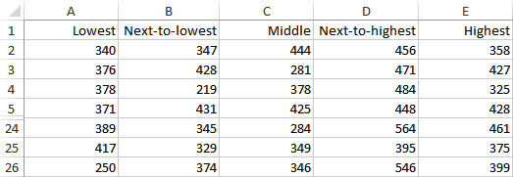
Example 19.1: Cereal Sales.xlsx (slide 1 of 3)
Objective: To use one-way ANOVA to see whether shelf height makes any difference in mean sales of Brand X, and if so, to discover which shelf heights outperform the others.
Solution: For this experiment, Midway supermarket chain selects 125 of its stores to be as alike as possible. Each store stocks cereal on five-shelf displays.
The stores are divided into five randomly selected groups, and each group of 25 stores places Brand X of cereal on a specific shelf for a month.
The number of boxes of Brand X sold is recorded at each of the stores for the last two weeks of the experiment.
The resulting data are shown below, where the column headings indicate the shelf heights.

Slide 12
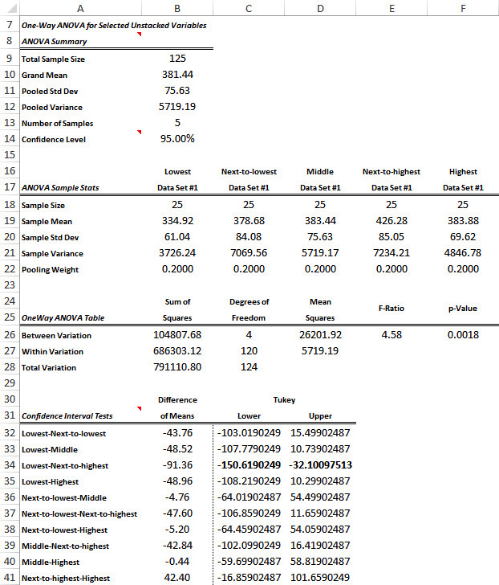
Example 19.1: Cereal Sales.xlsx (slide 2 of 3)
To analyze the data, select One-Way ANOVA from the StatTools Statistical Inference group, and fill in the resulting dialog box.
Click the Format button, and select the Unstacked option, all five variables, and the Tukey Correction option.
The resulting one-way ANOVA output is shown to the right.

Slide 13
Example 19.1: Cereal Sales.xlsx (slide 3 of 3)
From the summary statistics, it appears that mean sales differ for different shelf heights, but are the differences significant?
The test of equal means in rows 26-28 answers this question.
The p-value is nearly zero, which leaves practically no doubt that the five population means are not all equal.
Shelf height evidently does make a significant difference in sales.
The 95% confidence intervals for ANOVA in rows 32-41 indicate which shelf heights differ significantly from which others.
Only one difference (the one in boldface) does not include 0. This is the only difference that is statistically significant.
We can conclude that customers tend to purchase fewer boxes when they are placed on the lowest shelf, and they tend to purchase more when they are placed on the next-to-highest shelf.

Slide 14
Using a Logarithmic Transformation
Inferences based on the ANOVA procedure rely on two assumptions: equal variances across treatment levels and normally distributed data.
Often a look at side-by-side box plots can indicate whether there are serious violations of these assumptions.
If the assumptions are seriously violated, you should not blindly report the ANOVA results.
In some cases, a transformation of the data will help, as shown in the next example.

Slide 15
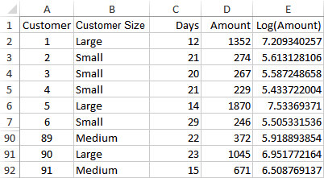
Example 19.2: Rebco Payments.xlsx (slide 1 of 4)
Objective: To see how a logarithm transformation can be used to ensure the validity of the ANOVA assumptions, and to see how the resulting output should be interpreted.
Solution: The data file contains data on the most recent payment from 91 of Rebco’s customers. A subset of the data is shown below.
The customers are categorized as small, medium, and large.
For each customer, the number of days it took the customer to pay and the amount of the payment are given.

Slide 16
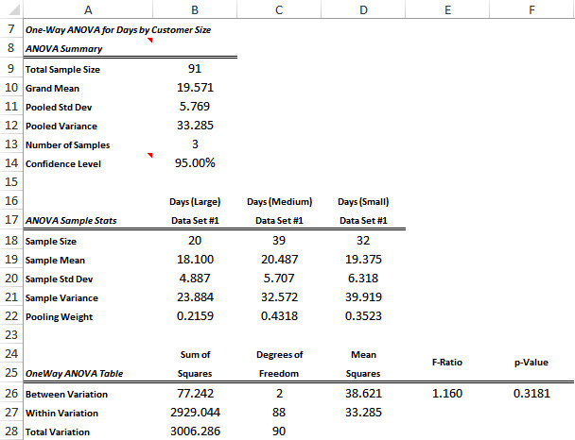
Example 19.2: Rebco Payments.xlsx (slide 2 of 4)
This is a one-factor observational study, where the single factor is customer size at three levels: small, medium, and large.
The experimental units are the bills for the orders, and there are two dependent variables, days until payment and payment amount.
Focusing first on days until payment, the summary statistics and the ANOVA table (to the right) show that the differences between the sample means are not even close to being statistically significant.
Rebco cannot reject the null hypothesis that customers of all sizes take, on average, the same number of days to pay.

Slide 17
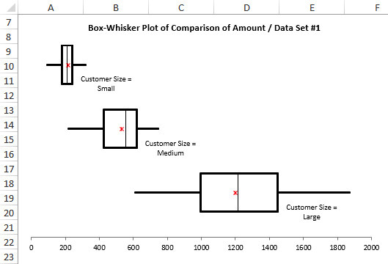
Example 19.2: Rebco Payments.xlsx (slide 3 of 4)
The analysis of the amounts these customers pay is quite different. This is immediately evident from the side-by-side box plots shown below.
Small customers tend to have lower bills than medium-size customers, who in turn tend to have lower bills than large customers.
However, the equal-variance assumption is grossly violated: There is very little variation in payment amount from small customers and a large amount of variation from large customers.
This situation should be remedied before running any formal ANOVA.

Slide 18
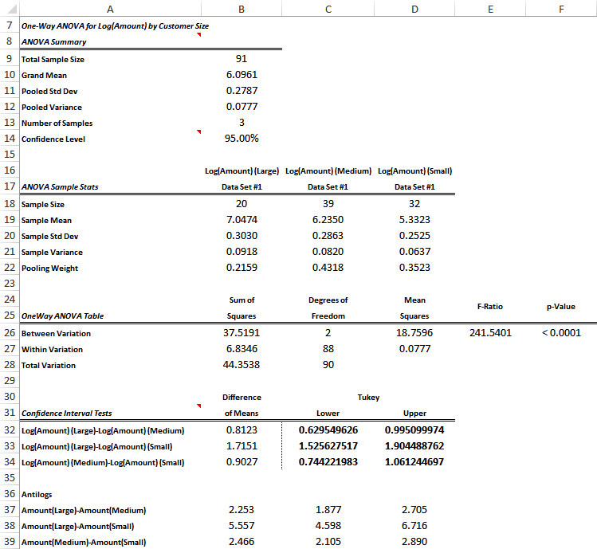
Example 19.2: Rebco Payments.xlsx (slide 4 of 4)
To equalize variances, take logarithms of the dependent variables and then use the transformed variable as the new dependent variable.
This log transformation tends to spread apart small values and compress together large values.
The resulting ANOVA on the log variable appears to the right.
The bottom line is that Rebco’s large customers have bills that are typically over twice as large as those for medium-sized customers, which in turn are typically over twice as large as those for small customers.

Slide 19
Using Regression to Perform ANOVA
Most of the same ANOVA results obtained by traditional ANOVA can be obtained by multiple regression analysis.
The advantage of using regression is that many people understand regression better than the formulas used in traditional ANOVA.
The disadvantage is that some of the traditional ANOVA output can be obtained with regression only with some difficulty.
To perform ANOVA with regression, we run a regression with the same dependent variable as in ANOVA and use dummy variables for the treatment levels as the only explanatory variables.
In the resulting regression output, the ANOVA table will be exactly the same as the ANOVA table we obtain from traditional ANOVA, and the coefficients of the dummy variables will be estimates of the mean differences between the corresponding treatment levels and the reference level.
The regression output also provides an R² value, the percentage of the variation of the dependent variable explained by the various treatment levels of the single factor. This R² value is not part of the traditional ANOVA output.
However, we do not automatically obtain confidence intervals for some mean differences, and the confidence intervals we do obtain are not of “Tukey” type we obtain with ANOVA.

Slide 20
Example 19.1 (Continued): Cereal Sales.xlsx (slide 1 of 3)
Objective: To see how Midway can analyze its data with regression, using only dummy variables for the treatment levels.
Solution: Midway supermarket chain ran a study on 125 stores to see whether shelf height, set at five different levels, has any effect on sales.
To run a regression, the data must be in stacked form.
In StatTools, check all five variables, and specify Shelf Height as the Category Name and Sales as the Value Name.
Next, create a new StatTools data set for the stacked data, and then use StatTools to create dummies for the different shelf heights, based on the Shelf Height variable.
The results for a few stores are shown below.

Slide 21
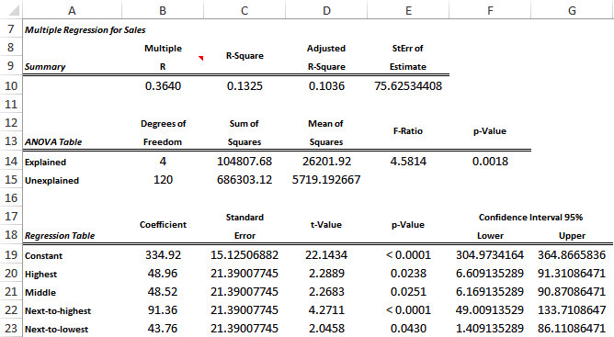
Example 19.1 (Continued): Cereal Sales.xlsx (slide 2 of 3)
Now run a multiple regression with the Sales variable as the dependent variable and the Shelf Height dummies as the explanatory variables.
The regression output is shown below.

Slide 22
Example 19.1 (Continued): Cereal Sales.xlsx (slide 3 of 3)
The ANOVA table from the regression output is identical to the ANOVA table from traditional ANOVA.
However, the confidence intervals in the range F20:G23 of the regression output are somewhat different from the corresponding confidence intervals for the traditional ANOVA output.
The confidence interval from regression, although centered around the same mean difference, is much narrower.
In fact, it is entirely positive, leading us to conclude that this mean difference is significant, whereas the ANOVA output led us to the opposite conclusion.
This is basically because the Tukey intervals quoted in the ANOVA output are more “conservative” and typically lead to fewer significant differences.
Based on the R² value, differences in the shelf height account for 13.25% of the variation in sales.
This means that although shelf height has some effect on sales, there is a lot of “random” variation in sales across stores that cannot be accounted for by shelf height.

Slide 23
The Multiple Comparison Problem (slide 1 of 3)
In many statistical analyses, including ANOVA studies, we want to make statements about multiple unknown parameters.
Any time we make such a statement, there is a chance that we will be wrong; that is, there is a chance that the true population value will not be inside the confidence interval.
For example, if we create a 95% confidence interval, then the error probability is 0.05.
However, in statistical terms, if we run each confidence interval at the 95% level, the overall confidence level (of having all statements correct) is much less than 95%. This is called the multiple comparison problem.
It says that if we make a lot of statements, each at a given confidence level such as 95%, then the chance of making at least one wrong statement is much greater than 5%.

Slide 24
The Multiple Comparison Problem (slide 2 of 3)
The question is how to get the overall confidence level equal to the desired value, such as 95%
The answer is that we need to correct the individual confidence intervals.
StatTools includes three of the most popular correction methods in its one-way ANOVA procedure:
Bonferroni method
Tukey method
Scheffé method
All of the correction methods use a multiplier that is larger than the multiplier used for the “no correction” method.
By using a larger multiplier, we get a wider confidence interval, which decreases the chance that the confidence interval will fail to include the true mean difference.
Scheffé’s and Bonferroni’s methods tend to be most conservative (where “conservative” means wider intervals), whereas Tukey’s method strikes a balance between too conservative and not conservative enough.

Slide 25
The Multiple Comparison Problem (slide 3 of 3)
The reason there are so many methods has to do with the purpose of the study.
When a researcher who initiates a study has a particular interest in a few specific differences, the differences of interest are called planned comparisons.
If there are only a few differences of interest, the no-correction method is usually acceptable.
If there are more than a few planned comparisons, then it is better to report Bonferroni intervals.
When the analyst initiates the study just to see what differences there are and does not specify which differences to focus on before collecting the data, the differences are called unplanned comparisons.
In the case of unplanned comparisons, the Tukey method is usually the preferred method.
The Scheffé method can be used for planned or unplanned comparisons.
It tends to produce the widest intervals because it is intended not only for differences between means but also for more general contrasts—where a contrast is the difference between weighted averages of means.

Slide 26
Two-Way ANOVA
In two-way ANOVA, we allow two factors, each at several levels.
Some of the ideas from one-way ANOVA carry over to two-way ANOVA.
However, there are differences in the data setup, the analysis itself, and perhaps most important, the types of questions we ask.

Slide 27
Example 19.3: Golf Ball.xlsx (slide 1 of 5)
Objective: To use two-way ANOVA to analyze the effects of golf ball brands and temperature on driving distances.
Solution: Assume that there are five major brands of golf balls, labeled A through E.
A consumer testing service runs an experiment where 60 balls of each brand are driven under three temperature conditions—cool (about 40 degrees), mild (about 65 degrees), and warm (about 90 degrees)—to see whether some brands differ significantly, on average, from other brands and what effect temperature has on mean differences between brands.
This is a controlled experiment where the experimental units are the individual golf balls and the dependent variable is the length (in yards) of each drive.
There are two factors: brand and temperature. The brand factor has five treatment levels, A through E, and temperature has three levels: cool, mild, and warm.
This is called a full factorial two-way design because the golf balls are tested at each of the 15 possible treatment level combinations.
If one or more brands were not tested at a particular temperature, this would be called an incomplete design.

Slide 28
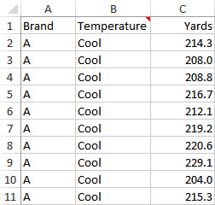
Example 19.3: Golf Ball.xlsx (slide 2 of 5)
Once the details of the experiment have been decided and the golf balls have been hit, there will be 300 observations (yardages) at various conditions.
The usual way to enter the data in Excel®—and the only way the StatTools Two-Way ANOVA procedure will accept it—is in the stacked form shown to the right.
There must be two categorical variables that represent the levels of the two factors (Brand and Temperature) and a measurement variable that represents the dependent variable (Yards).
Although many rows are hidden in this figure, there are actually 300 rows of data, 20 for each of the 15 combinations of Brand and Temperature.

Slide 29
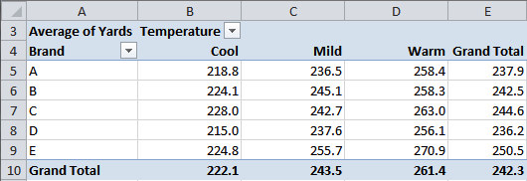
Example 19.3: Golf Ball.xlsx (slide 3 of 5)
To see what we can learn from the data, look at the table of sample means shown below.
Some questions we might ask:
Looking at column E, do any brands average significantly more yards than others?
Looking at row 10, do average yardages differ significantly across temperatures?
Looking at the columns in the range B5:D9, do differences among averages of brands depend on temperature?
Looking at the rows in the range B5:D9, do differences among averages of temperatures depend on brand?

Slide 30
Example 19.3: Golf Ball.xlsx (slide 4 of 5)
Question 1 is asking about the main effect of the brand factor, and Question 2 is asking about the main effect of the temperature factor.
Main effects indicate whether there are different means for treatment levels of one factor when averaged over the levels of the other factor.
Questions 3 and 4 are asking about interactions between the two factors.
Interactions indicate patterns of differences in means that could not be guessed from the main effects alone.
They exist when the effect of one factor on the dependent variable depends on the level of the other factor.
The concept of interactions is much easier to understand by looking at graphs. The more nonparallel they are, the stronger the interactions are.
Check first for interactions in a two-way design.
If there are significant interactions, then the main effects might not be as interesting.
However, if there are no significant interactions, then main effects generally become more important.

Slide 31
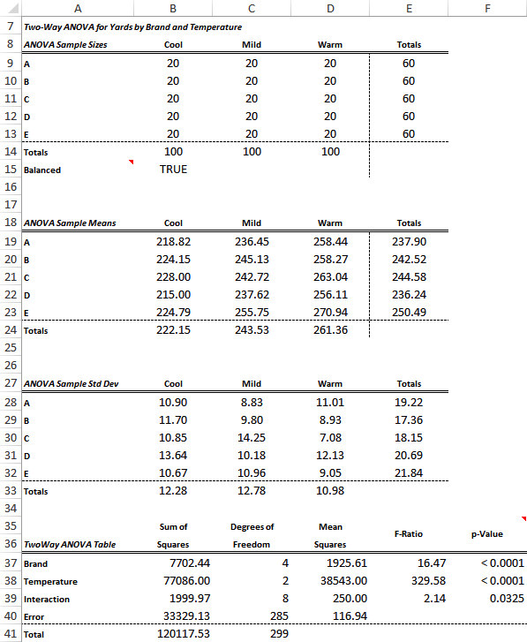
Example 19.3: Golf Ball.xlsx (slide 5 of 5)
The next question is whether the main effects and interactions in a table of sample means are statistically significant.
As in one-way ANOVA, two-way ANOVA collects the information about the different sources of variation in an ANOVA table, as shown to the right.
However, instead of just two sources of variation, there are now four sources of variation: one for the main effect of each factor, one for interactions, and one for variation within treatment level combinations.
Test whether main effects or interactions are statistically significant by examining p-values.

Slide 32
Confidence Intervals for Contrasts
A contrast is any difference between weighted averages of means.
It is any linear combination of means (sum of coefficients multiplied by means) such that the sum of the coefficients is 0.
It is typically used to compare one weighted average of means to another.
Once StatTools has been used to run a two-way ANOVA, you can then form confidence intervals for any contrasts of interest.
The general form of the confidence interval is given by the expression below.
The multiplier in the confidence interval can be chosen in several ways to handle the multiple comparison problem appropriately.
The StatTools Two-Way ANOVA procedure finds MSW for this formula. However, you must calculate the other ingredients with Excel formulas.

Slide 33
Example 19.3 (Continued): Golf Ball.xlsx (slide 1 of 2)
Objective: To form and test contrasts for the golf ball data, and to interpret the results.
Solution: One golf ball retail shop would like to test the claims that (1) brand C beats the average of the other four brands in cool weather and (2) brand E beats the average of the other four brands when it is not cool.
Let μ_{C,W} be the mean yardage for brand C balls hit in warm weather, and define similar means for the other brands and temperatures.
Then the first claim concerns the contrast
and the second claim concerns the contrast

Slide 34
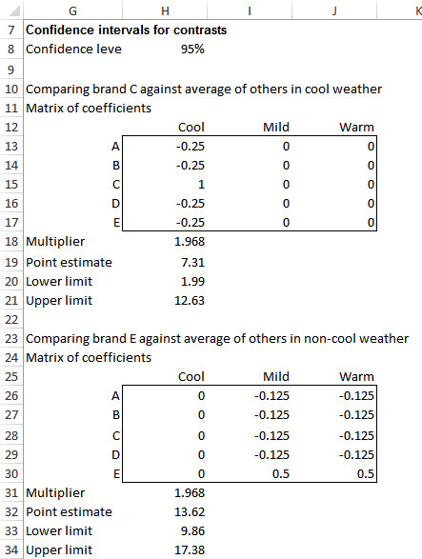
Example 19.3 (Continued): Golf Ball.xlsx (slide 2 of 2)
A good way to handle the calculations in Excel is illustrated by the figure to the right.
Both claims are supported.
Brand C beats the average of the competition by at least 1.99 yards in cool weather.
Brand E beats the average of the competition by at least 9.86 yards in weather that is not cool.
To examine a lot of contrasts, use one of the other confidence interval methods—the two preferred methods being the Bonferroni and Scheffé methods.

Slide 35
Assumptions of Two-Way ANOVA
The assumptions for the two-way ANOVA procedure are basically the same as for one-way ANOVA.
If we focus on any particular combination of factor levels, we assume that
the distribution of values for this combination is normal, and
the variance of values at this combination is the same as at any other combination.
It is always wise to check for at least gross violations of these assumptions, especially the equal-variance assumption.
The StatTools output provides an informal check by providing a table of standard deviations for the factor level combinations, as shown in the table below.

Slide 36
More About Experimental Design
We can break up the topic of experimental design into two parts:
The actual design of the experiment
The analysis of the resulting data
Experimental design has to do with the selection of factors, the choice of the treatment levels, the way experimental units are assigned to the treatment level combinations, and the conditions under which the experiment is run.
These decisions must be made before the experiment is performed, and they should be made very carefully.
Experiments are typically costly and time-consuming, so the experiment should be designed (and performed) in a way that will provide the most useful information possible.

Slide 37
Randomization
The purpose of most experiments is to see which of several factors have an effect on a dependent variable.
The factors in question are chosen as those that are controllable and most likely to have some effect.
Often, however, there are “nuisance” factors that cannot be controlled, at least not directly.
One important method for dealing with such nuisance factors is randomization—the process of randomly assigning experimental units so that nuisance factors are spread uniformly across treatment levels.

Slide 38
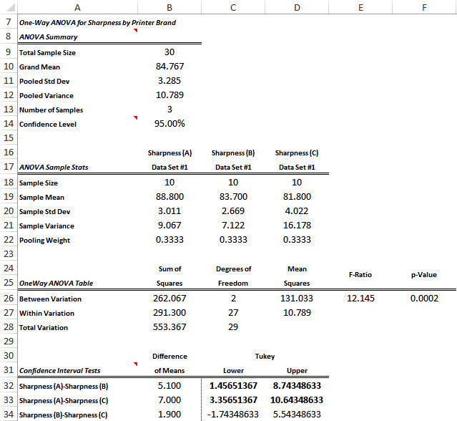
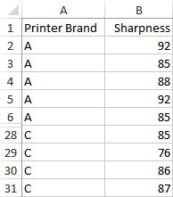
Example 19.4: Printers.xlsx (slide 1 of 2)
Objective: To use randomization of paper types to see whether differences in sharpness are really due to different brands of printers.
Solution: A computer magazine would like to test sharpness of printed images across three popular brands of inkjet printers.
It purchases one printer of each brand, prints several pages on each printer, and measures the sharpness of image on a 0-100 scale for each page.
A subset of the data and the analysis are shown below and to the right.

Slide 39
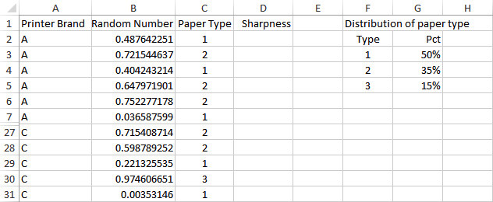
Example 19.4: Printers.xlsx (slide 2 of 2)
The data and analysis indicate that printer A is best on average and printer C is worst.
Suppose, however, that there is another factor, type of paper, that is not the primary focus of the study but might affect the sharpness of the image.
Suppose further that all type 1 paper is used in printer A, all type 2 paper is used in printer B, and all type 3 paper is used in printer C.
It is possible that type 1 paper tends to produce the sharpest image, regardless of the printer used.
The solution is to randomize over paper type, as shown in the figure below.
For each sheet to be printed by any printer, randomly select a paper type.
This will tend to even out the paper types across the printers, and we can be more confident that any differences are due to the printers themselves.

Slide 40
Blocking
Another method for dealing with nuisance factors is blocking.
There are many forms of blocking designs.
The simplest is the randomized block design, in which the experimental units are divided into several “similar” blocks.
Then each experimental unit within a given block is randomly assigned a different treatment level.

Slide 41
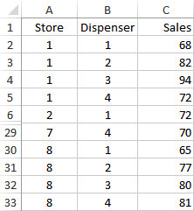
Example 19.5: Soap Sales.xlsx (slide 1 of 3)
Objective: To use a blocking design with store as the blocking variable to see whether type of dispenser makes a difference in sales of liquid soap.
Solution: SoftSoap Company is introducing a new liquid hand soap into the market, and four types of dispensers are being considered.
It chooses eight supermarkets that have carried its products, and it asks each supermarket to stock all four versions of its new product for a 2-week test period.
It records the number of items purchased at each store during this period, as shown below.

Slide 42
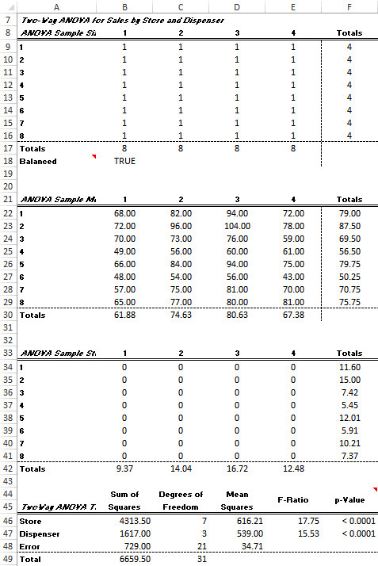
Example 19.5: Soap Sales.xlsx (slide 2 of 3)
In this experiment, there is a single factor, dispenser type, varied at four levels, and there are eight observations at each level.
However, it is very possible that the dependent variable, number of sales, is correlated with store.
Therefore, we treat each store as a block, so that the experimental design appears as shown to the right.
Each treatment level (dispenser type) is assigned exactly once to each block (store).
To obtain this output, use the StatTools Two-Way ANOVA procedure, with Store and Dispenser as the two categorical variables.

Slide 43
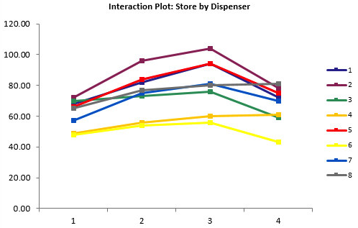
Example 19.5: Soap Sales.xlsx (slide 3 of 3)
Because there is only one observation per store/dispenser combination, the ANOVA table has no Interaction row.
However, it still provides interaction charts, one of which is shown below, to check for the no-interaction assumption.
The F-value and corresponding p-value in row 47 of the ANOVA table are for the main effect of dispenser type.
Because the p-value is essentially 0, there are significant differences across dispenser types.
If SoftSoap had to market only one dispenser type, it would almost certainly select type 3.

Slide 44
Incomplete Designs (slide 1 of 3)
In a full factorial design, one or more observations are obtained for each combination of treatment levels.
This is the preferred way to run an experiment from a statistical point of view, but it can be very expensive, or even infeasible, if there are more than a few factors.
As a result, statisticians have devised incomplete, or fractional factorial, designs that test only a fraction of the possible treatment level combinations.
Obviously, something is lost by not gaining information from all of the possible combinations.
Specifically, different effects are confounded, which means that they cannot be estimated independently.

Slide 45
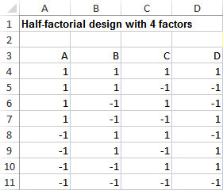
Incomplete Designs (slide 2 of 3)
A “half-fractional” design with four factors, each at two levels, is shown below.
If this were a full factorial design, there would be 2⁴ = 16 combinations of treatment levels.
The “half-fractional” design means that only half, or eight, of these are used.
When using only two levels for each factor, it is customary to label the lower level with a -1 and the higher level with a +1.
Each row in the figure represents one of eight combinations of the factor levels.

Slide 46
Incomplete Designs (slide 3 of 3)
To see how the confounding works, it is useful to create new columns by multiplying the appropriate original A-D columns. The results appear below.
There is now a column for each possible two-way and three-way interaction, and the columns come in pairs (e.g, AB is the same as CD).
When two columns are identical, we say that one is the alias of the other.
If two effects are aliases of one another, it is impossible to estimate their separate effects.
Therefore, we try to design the experiment so that only one of these is likely to be important and the other is likely to be insignificant.

