Slide 1
17
Data Mining

Slide 2
Introduction (slide 1 of 2)
Data mining attempts to discover patterns, trends, and relationships among data, especially nonobvious and unexpected patterns.
The place to start is with a data warehouse—a huge database that is designed specifically to study patterns in data.
It is not the same as the databases companies use for their day-to-day operations. Instead, it should:
Combine data from multiple sources to discover relationships.
Contain accurate and consistent data.
Be structured to enable quick and accurate responses to a variety of queries.
Allow follow-up responses to specific relevant questions.
A data mart is a scaled-down data warehouse, or part of an overall data warehouse, that is structured specifically for one part of an organization, such as sales.

Slide 3
Introduction (slide 2 of 2)
Once a data warehouse is in place, analysts can begin to mine the data with a collection of methodologies:
Classification analysis—attempts to find variables that are related to a categorical (often binary) variable.
Prediction—tries to find variables that help explain a continuous variable, rather than a categorical variable.
Cluster analysis—tries to group observations into clusters so that observations within a cluster are alike, and observations in different clusters are not alike.
Market basket analysis—tries to find products that customers purchase together in the same “market basket.”
Forecasting—is used to predict values of a time series variable by extrapolating patterns seen in historical data into the future.
Numerous software packages are available that perform various data mining procedures.

Slide 4
Data Exploration and Visualization
Data mining is a relatively new field and not everyone agrees with its definition.
Data mining includes advanced algorithms that can be used to find useful information and patterns in data sets.
It also includes relatively simple methods for exploring and visualizing data.
Advances in software allow large data sets to be analyzed quickly and easily.

Slide 5
Online Analytical Processing (OLAP) (slide 1 of 4)
One type of pivot table methodology is called online analytical processing, or OLAP.
This name is used to distinguish this type of data analysis from online transactional processing, or OLTP, which is used to answer specific day-to-day questions.
OLAP is used to answer broader questions.
The best database structure for answering OLAP questions is a star schema, which includes:
At least one Facts table of data that has many rows and only a few columns
A dimension table for each item in the Facts table, which contains multiple pieces of information about that particular item

Slide 6
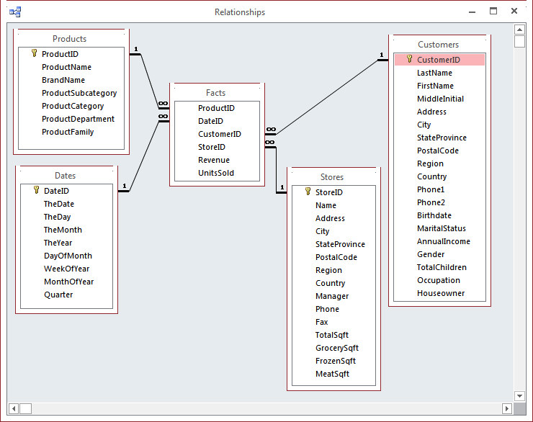
Online Analytical Processing (OLAP) (slide 2 of 4)
One particular star schema is shown below.
The Facts table in the middle contains only two “facts” about each line item purchased: Revenue and UnitsSold.
The other columns in the Facts table are foreign keys that let you look up information about the product, the date, the store, and the customer in the respective dimension tables.

Slide 7
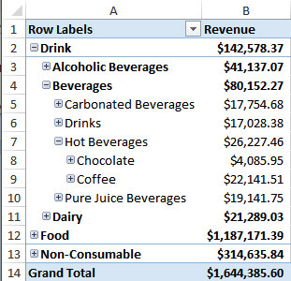
Online Analytical Processing (OLAP) (slide 3 of 4)
The OLAP methodology and corresponding pivot tables have the following features that distinguish them from standard Excel® pivot tables:
The OLAP methodology does not belong to Microsoft or any other software company, but has been implemented in a variety of software packages.
In OLAP pivot tables, you aren’t allowed to drag any field to any area of the pivot table, as you can in Excel.
Some dimensions have natural hierarchies, and OLAP lets you specify such hierarchies.
Then when you create a pivot table, you can drag a hierarchy to an area and “drill down” through it.
The figure to the right shows what a resulting pivot table might look like.

Slide 8
Online Analytical Processing (OLAP) (slide 4 of 4)
OLAP databases are typically huge, so it can take a while to get the results for a particular pivot table.
For this reason, the data are often “preprocessed” in such a way that the results for any desired breakdown are already available and can be obtained immediately.
The data are preprocessed into files that are referred to as OLAP cubes.
To build cubes, you need Analysis Services in SQL Server (or some other company’s software).
The PowerPivot tool included in Excel 2013 can also be used to implement much of the OLAP cube functionality.

Slide 9
Example 17.1: Foodmart.cub (slide 1 of 2)
Objective: To learn how an offline cube file can be used as the source for an Excel pivot table.
Solution: Starting with a blank workbook in Excel, click PivotTable from the Insert ribbon.
In the Create PivotTable dialog box, choose the Use an external data source option, and click the Choose Connection button.
In the resulting Existing Connections dialog box, click the Browse for More button and search for the Foodmart.cub file.
Click Open to return to the Create PivotTable dialog box.
Click OK to see a blank pivot table.
The only items that can be placed in the Values area of the pivot table are Facts Count (a count of records) or a sum of Revenue or Units Sold.
The dimensions you can break down by are limited to those chosen when the cube was first built.
If a given dimension isn’t built into the cube in the first place, it can’t be used in a pivot table later on.

Slide 10
Example 17.1: Foodmart.cub (slide 2 of 2)
One possible pivot table is shown below.
Each value is a sum of revenues.
The Rows area contains a Store dimension hierarchy, where a drill-down to the cities in Oregon is shown.
The Columns area contains the Date dimension hierarchy, where a drill-down to the months in the second quarter of 1998 is shown.

Slide 11
PowerPivot and Power View in Excel 2013 (slide 1 of 4)
Two new Microsoft tools of the pivot table variety, PowerPivot and Power View, were introduced in Excel 2013.
The PowerPivot add-in allows you to:
Import millions of rows from multiple data sources.
Create relationships between data from different sources, and between multiple tables in a pivot table.
Create implicit calculated fields (previously called measures)—calculations created automatically when you add a numeric field to the Values area of the Field List.
Manage data connections.
In its discussion of PowerPivot, Microsoft refers to building a data model—a collection of tables and their relationships that reflects the real-world relationships between business functions and processes.
This is essentially the definition of a relational database.
The difference is that the data model is now contained entirely in Excel, not in Access or some other relational database package.

Slide 12
PowerPivot and Power View in Excel 2013 (slide 2 of 4)
The Power View add-in for Excel 2013 is used to create various types of reports, including insightful data visualizations.
It provides an interactive data exploration, visualization, and presentation experience, where you can pull your data together in tables, matrices, maps, and a variety of charts in an interactive view.
The data set for the tutorial on PowerPivot and Power View is stored in four separate, currently unrelated, files:
Two Access files, ContosoSales.accdb and ProductCategories.accdb
Two Excel files, each of which contains a single table of data that will eventually be related to the ContosoSales data:
Stores.xlsx—contains data about the stores where the products are sold.
Geography.xlsx—has information about the locations of the stores.

Slide 13
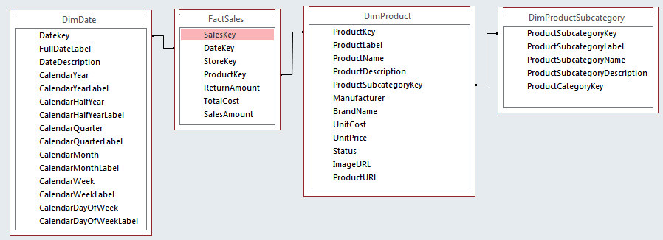
PowerPivot and Power View in Excel 2013 (slide 3 of 4)
The ContosoSales database has four related tables, DimDate, DimProduct, DimProductSubcategory, and FactSales.
Each fact is a sale of some product on some date.
The four tables are related through primary and foreign keys, as shown below.

Slide 14
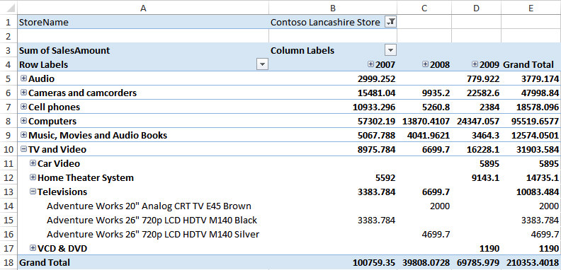
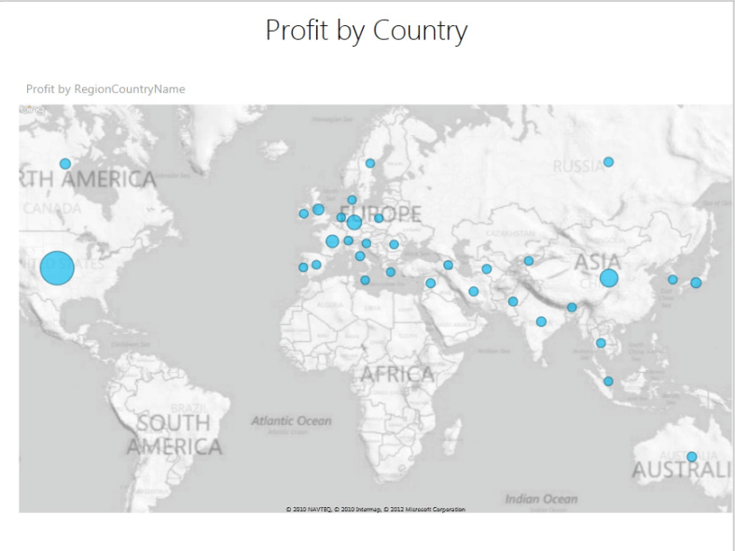
PowerPivot and Power View in Excel 2013 (slide 4 of 4)
Here is an overview of the entire process:
Enter the data from the four sources into four worksheets of a single Excel workbook.
Use PowerPivot to create relationships between the sources.
Modify the data model to enable useful pivot tables.
Use Power View to create a map report of sales.
One possible pivot table and a map of profit by country are shown below.

Slide 15
Visualization Software
As the Power View tool illustrates, you can gain a lot of insight by using charts to view your data in imaginative ways.
This trend toward powerful charting software for data visualization is the wave of the future and will certainly continue.
Besides Microsoft’s Excel, many other companies are developing visualization software.
The purpose of charting software is to portray the data graphically so that otherwise hidden trends or patterns can emerge clearly.

Slide 16
Microsoft Data Mining Add-Ins for Excel
To many analysts, data mining refers only to data mining algorithms.
These include algorithms for classification and for clustering, but there are many other types of algorithms.
Microsoft data mining add-ins for Excel illustrate other data mining methods.
These add-ins are free and easy to use.
However, they are really only front ends—client tools—for the Microsoft engine that actually performs the data mining algorithms.
This engine is called Analysis Services and is part of Microsoft’s SQL Server database package. (SQL Server Analysis Services is abbreviated SSAS.)
To use Excel data mining add-ins, you must have a connection to an SSAS server.
The number crunching is performed on the SSAS server, but the data and results are in Excel.

Slide 17
Classification Methods
One of the most important problems studied in data mining is the classification problem.
This is basically the same problem attacked by regression analysis, but now the dependent variable is categorical.
Each of the classification methods has the same objective: to use data from the explanatory variables to classify each record (person, company, or whatever) into one of the known categories.
Data partitioning plays an important role in classification.
The data set is partitioned into two or even three distinct subsets before algorithms are applied.
The first subset, usually with about 70% to 80% of the records, is called the training set. The algorithm is trained with data in the training set.
The second subset, called the testing set, usually contains the rest of the data. The model from the training set is tested on the testing set.
Some software packages might also let you specify a third subset, often called a prediction set, where the values of the dependent variables are unknown. Then you can use the model to classify these unknown values.

Slide 18
Logistic Regression (slide 1 of 3)
Logistic regression is a popular method for classifying individuals, given the values of a set of explanatory variables.
It estimates the probability that an individual is in a particular category.
It uses a nonlinear function of the explanatory variables for classification.
It is essentially regression with a dummy (0-1) dependent variable.
For the two-category problem, the dummy variable indicates whether an observation is in category 0 or category 1.

Slide 19
Logistic Regression (slide 2 of 3)
The logistic regression model uses a nonlinear function to estimate the probability than an observation is in category 1.
If p is the probability of being in category 1, the following model is estimated:
This equation can be manipulated algebraically to obtain an equivalent form:
This equation says that the natural logarithm of p/(1− p) is a linear function of the explanatory variables.
The ratio p/(1− p) is called the odds ratio.
The logarithm of the odds ratio, the quantity on the left side of the above equation, is called the logit (or log odds).
The logical regression model states that the logit is a linear function of the explanatory variables.

Slide 20
Logistic Regression (slide 3 of 3)
The goal is to interpret the regression coefficients correctly.
If a coefficient b is positive, then if its X increases, the log odds increases, so the probability of being in category 1 increases.
The opposite is true for a negative b.
Just by looking at the signs of the coefficients, you can see which Xs are positively correlated with being in category 1 (the positive bs) and which are positively correlated with being in group 0 (the negative bs).
In many situations, the primary objective of logistic regression is to “score” members, given their Xs.
Those members who score highest are most likely to be in category 1; those who score lowest are most likely to be in category 0.
Scores can also be used to classify members, using a cutoff probability. All members who score below the cutoff are classified as 0s, and the rest are classified as 1s.

Slide 21
Example 17.2: Lasagna Triers Logistic Regression.xlsx (slide 1 of 4)
Objective: To use the StatTools Logistic Regression procedure to classify users as triers or nontriers, and to interpret the resulting output.
Solution: The data file contains the same data set from Chapter 3 on 856 people who have either tried or not tried a company’s new frozen lasagna product.
The categorical dependent variable, Have Tried, and several of the potential explanatory variables contain text, as shown below.
Because StatTools requires all numeric variables, the StatTools Dummy utility was used to create dummy variables for all text variables.

Slide 22
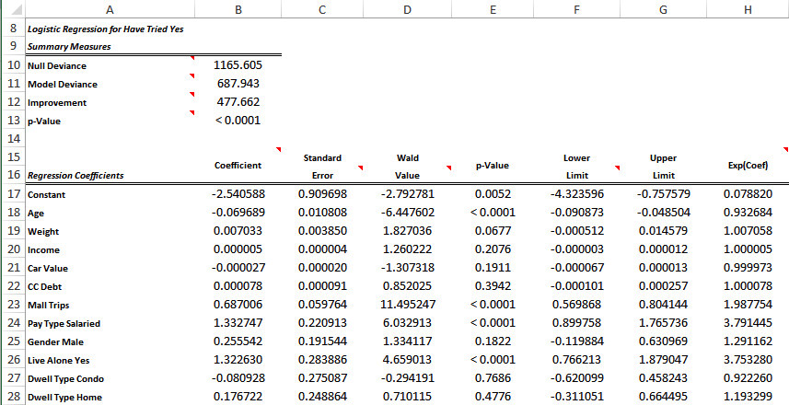
Example 17.2: Lasagna Triers Logistic Regression.xlsx (slide 2 of 4)
To run the logistic regression, select Logistic Regression from the StatTools Regression and Classification dropdown list and fill out the dialog box.
The first part of the logistic regression output is shown below.

Slide 23
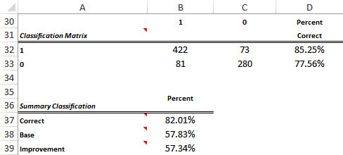
Example 17.2: Lasagna Triers Logistic Regression.xlsx (slide 3 of 4)
Below the coefficient output is the classification summary, shown below.
To create these results, the explanatory variables in each row are plugged into the logistic regression equation, which results in an estimate of the probability that the person is a trier.
If this probability is greater than 0.5, the person is classified as a trier; if it is less than 0.5, the person is classified as a nontrier.

Slide 24
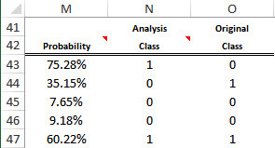
Example 17.2: Lasagna Triers Logistic Regression.xlsx (slide 4 of 4)
The last part of the logistic regression output lists all of the original data and the scores.
A small part of this output is shown below.
Explanatory variables for new people, those whose trier status is unknown, could be fed into the logistic regression equation to score them.
Logistic regression is then being used as a tool to identify the people most likely to be triers.

Slide 25
Discriminant Analysis
StatTools includes another classification procedure called discriminant analysis.
This is a classical technique developed many decades ago that is still in use.
It is somewhat similar to logistic regression and has the same basic goals.
However, it is not as prominent in data mining discussions as logistic regression.

Slide 26
Neural Networks (slide 1 of 2)
The neural network (or neural net) methodology is an attempt to model the complex behavior of the human brain.
It sends inputs (the values of explanatory variables) through a complex nonlinear network to produce one or more outputs (the values of the dependent variable).
It can be used to predict a categorical dependent variable or a numeric dependent variable.
The biggest advantage of neural nets is that they often provide more accurate predictions than any other methodology, especially when relationships are highly nonlinear.
However, neural nets do not provide easily interpretable equations where you can see the contributions of the individual explanatory variables.

Slide 27
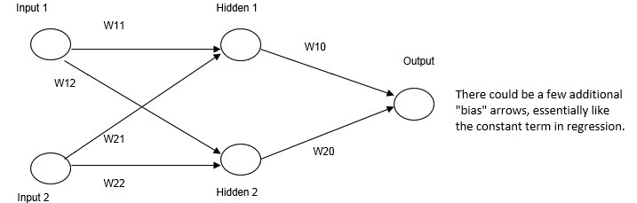
Neural Networks (slide 2 of 2)
Each neural net has an associated network diagram, like the one shown below.
This figure assumes two inputs and one output.
The network also includes a “hidden layer” in the middle with two hidden nodes.
Scaled values of the inputs enter the network at the left, they are weighted by the W values and summed, and these sums are sent to the hidden nodes.
At the hidden nodes, the sums are “squished” by an S-shaped logistic-type function.
These squished values are then weighted and summed, and the sum is sent to the output node, where it is squished again and rescaled.
The neural net is “trained” by sending many sets of inputs—even the same inputs multiple times—through the network and comparing the outputs from the net with the known output values.
StatTools does not implement neural nets, but the NeuralTools add-in does.

Slide 28
Example 17.2 (Continued): Lasagna Triers NeuralTools.xlsx (slide 1 of 3)
Objective: To learn how the NeuralTools add-in works, and to compare its results to those from logistic regression.
Solution: This data file is different from the file used for logistic regression in two ways:
No dummy variables are necessary. The NeuralTools add-in is capable of dealing directly with text variables.
There is a Prediction Data sheet with a second data set of size 250 to be used for prediction. Its values of the dependent Have Tried variable are unknown.
The first step is to create two data sets, called Lasagna Data and Prediction Data, with Have Tried as Dependent Categorical, Person as Unused, and the other variables Independent Numeric or Independent Categorical as appropriate.
To train the data in the Lasagna Data set, activate the Data sheet, click Train on the NeuralTools ribbon, and fill in the tabs on the Training dialog box.
Click the Train button on the model setup summary page to start the algorithm.

Slide 29
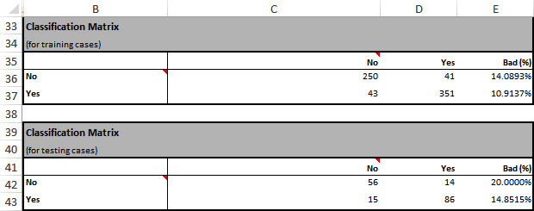
Example 17.2 (Continued): Lasagna Triers NeuralTools.xlsx (slide 2 of 3)
The results appear on a new sheet, the most important of which are shown below.
These results are slightly better than those from logistic regression, where about 18% of the classifications were incorrect.

Slide 30
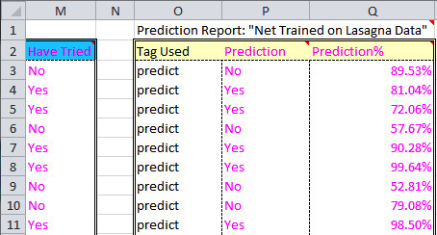
Example 17.2 (Continued): Lasagna Triers NeuralTools.xlsx (slide 3 of 3)
Once the model has been trained, it can be used to predict the unknown values of the dependent variable in the Prediction Data set.
Activate the Prediction Data sheet, click Predict on the NeuralTools ribbon, and then fill out the resulting dialog box.
Click the Predict button on the Prediction setup page.
NeuralTools runs each of the cases in the Prediction Data sheet through the trained net and displays the results, a few of which are shown below.
Each percentage shown here is the probability that the prediction is correct, not the probability that the person is a trier or a nontrier.

Slide 31
Classification Trees (slide 1 of 2)
Classification trees (sometimes called decision trees) is another method that is also capable of discovering nonlinear relationships.
It is much more intuitive than logistic regression and neural networks.
It is available in the free Microsoft Data Mining Add-Ins.
The basic idea of classification trees is to split a box of observations into two or more boxes so that each box is more “pure” than the original box, meaning that each box is more nearly Yes than No, or vice versa.
Each of these boxes can be split on another variable (or even the same variable) to make them purer.
This split continues until the boxes are either sufficiently pure or they contain very few cases.
The attractive aspect of this method is that the final result is a set of simple rules for classification.

Slide 32
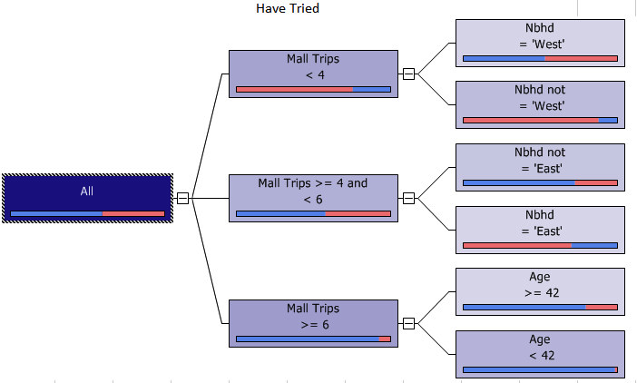
Classification Trees (slide 2 of 2)
The final tree might look like the one below.
Each box has a bar that shows the purity of the corresponding box, where blue corresponds to Yes values and red corresponds to No values.

Slide 33
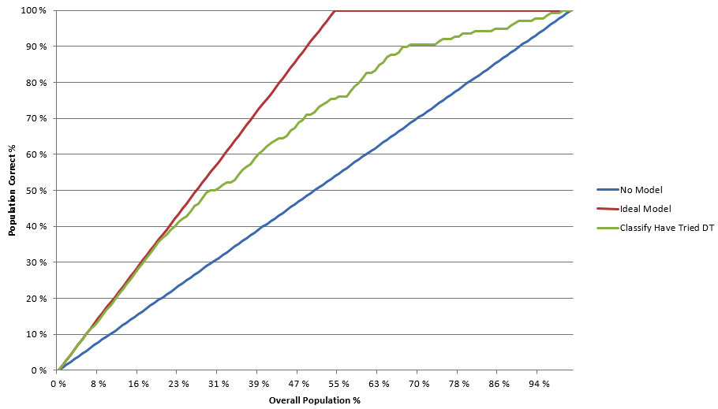
Classification and Lift
One concept that often accompanies discussions of classification is lift.
Lift is loosely defined as the increase in results obtained by using a classification method to score people, as compared to the results obtained by simple random sampling.
Many software packages illustrate lift with a lift chart.
A lift chart for the lasagna data is shown below.

Slide 34
Classification with Rare Events
Classification methods are often used on data sets with rare events.
Most packages, including NeuralTools, accompany predictions of new observations with probabilities that the predictions are correct.
Even if all of these probabilities are above 50%, you can still sort on the probability column to see the predictions that are least likely to be correct.
Then if you are forced to choose some observations, you can choose the ones with the lowest probabilities of being classified as No.

Slide 35
Clustering (slide 1 of 2)
In supervised data mining techniques, there is a dependent variable the method is trying to predict.
The classification methods discussed so far are supervised data mining techniques.
In unsupervised data mining techniques, there is no dependent variable.
Instead, these techniques search for patterns and structure among all of the variables.
One popular unsupervised method is market basket analysis (also called association analysis), where patterns of customer purchases are examined to see which items customers tend to purchase together, in the same “market basket.”

Slide 36
Clustering (slide 2 of 2)
Probably the most common unsupervised method is clustering, known in marketing circles as segmentation.
It tries to group entities (customers, companies, cities, etc.) into similar clusters, based on the values of their variables.
There are no fixed groups like the triers and nontriers in classification.
Instead, the purpose of clustering is to discover the number of groups and their characteristics, based entirely on the data.
The key to all clustering methods is the development of a dissimilarity measure.
Once a dissimilarity measure is developed, a clustering algorithm attempts to find clusters of rows so that rows within a cluster are similar and rows in different clusters are dissimilar.
Once an algorithm has discovered the clusters, the clusters must be understood (and possibly named).
This is done by exploring the distributions of variables in different clusters.

