Slide 1
15
Introduction to Simulation Modeling

Slide 2
Introduction (slide 1 of 2)
A simulation model is a computer model that imitates a real-life situation.
It is like other mathematical models, but it explicitly incorporates uncertainty in one or more input variables.
The fundamental advantage of this model is that it provides an entire distribution of results, not simply a single bottom-line result.
Each different set of values for the uncertain quantities is a scenario.
Simulation allows a company to generate many scenarios, each leading to a particular outcome.
This approach is illustrated in the figure below.

Slide 3
Introduction (slide 2 of 2)
Simulation models are also useful for determining how sensitive a system is to changes in operating conditions.
A huge benefit of computer simulation is that it enables managers to answer what-if questions without actually changing (or building) a physical system.
The main difference between simulation modeling and other modeling applications is that simulation uses random numbers to drive the whole process.
Each time the spreadsheet recalculates, all of the random numbers change.
By collecting the data from these different scenarios, the most likely values of the outputs and the best-case and worse-case values of the outputs can be seen.

Slide 4
Probability Distributions for Input Variables
Probability distributions for input variables are the building blocks of spreadsheet simulation models.
The primary difference between other spreadsheet models and simulation models is that at least one of the input variable cells in a simulation contains random numbers.
Each time the spreadsheet recalculates, the random numbers change, and the new random values of the inputs produce new values of the outputs.
Technically speaking, input cells do not contain random numbers; they contain probability distributions.
A probability distribution indicates the possible values of a variable and the probabilities of those values.
There are many probability distributions to choose from, so it is important to choose an appropriate distribution for each specific problem.

Slide 5
Types of Probability Distributions
General characteristics of probability distributions:
Discrete versus continuous
Symmetric versus skewed
Bounded versus unbounded
Nonnegative versus unrestricted

Slide 6
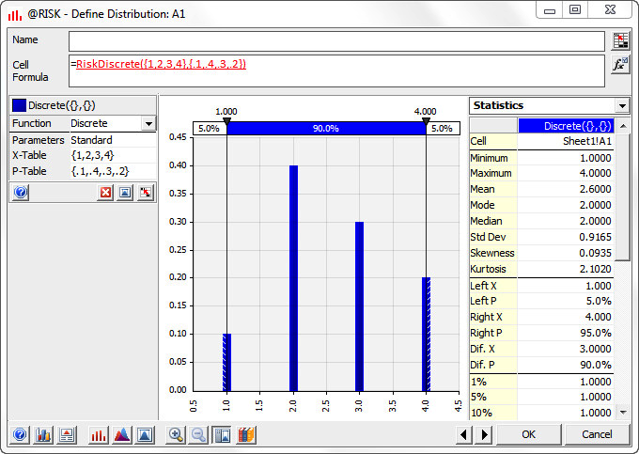
Discrete Versus Continuous (slide 1 of 2)
A probability distribution is discrete if it has a finite number of possible values.
Example: Sum of the faces of two dice
The graph of a discrete distribution is a series of spikes, as shown below.
The height of each spike is the probability of the corresponding value.

Slide 7
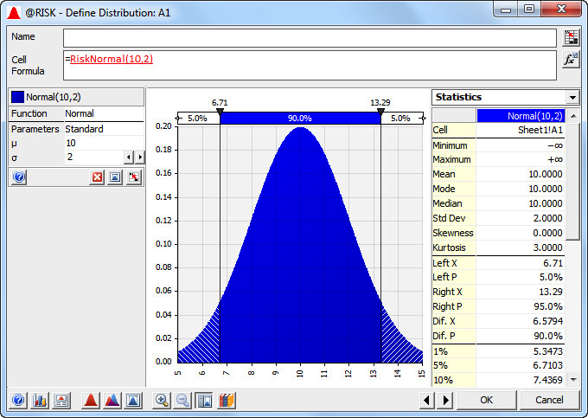
Discrete Versus Continuous (slide 2 of 2)
A probability distribution is continuous if its possible values are essentially a continuum.
Example: Amount of rain that falls during a month
A continuous distribution is characterized by a density function, a smooth curve as shown in the figure below.
The height of the density function above any value indicates the relative likelihood of that value.
Probabilities can be calculated as areas under the curve.

Slide 8
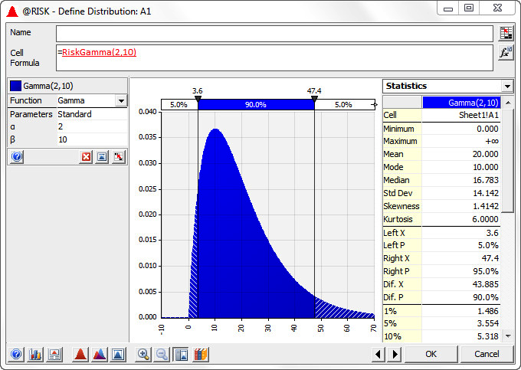
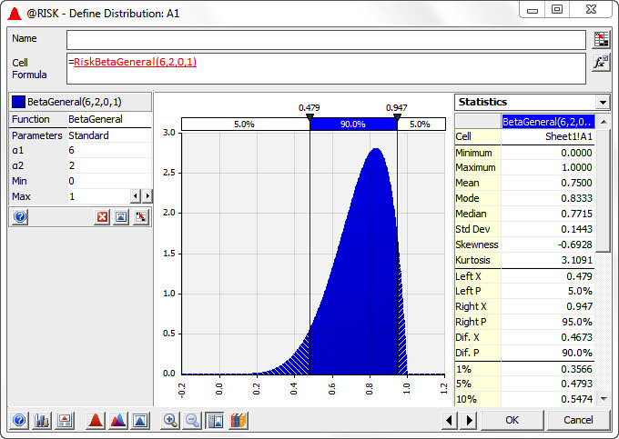
Symmetric Versus Skewed
A probability distribution can either be symmetric or skewed to the left or right.
Choose between a symmetric and skewed distribution on the basis of realism.
Positively skewed distribution Negatively skewed distribution

Slide 9
Bounded Versus Unbounded
A probability distribution is bounded if there are values A and B such that no possible value can be less than A or greater than B.
The value A is the minimum possible value.
The value B is the maximum possible value.
The distribution is unbounded if there are no such bounds.
It is possible for a distribution to be bounded in one direction but not the other.

Slide 10
Nonnegative Versus Unrestricted
One special case of bounded distributions is when the only possible values are nonnegative.
In such cases, model the randomness with a probability distribution that is bounded below by 0.
This rules out negative values that make no practical sense.

Slide 11
Common Probability Distributions
Each sheet in the file Probability Distributions.xlsx illustrates a particular probability distribution.
It describes the general characteristics of the distribution.
It indicates how to generate random numbers from the distribution either with Excel’s® built-in functions or with @RISK functions.
It includes histograms of these distributions from simulated data to illustrate their shapes.
It is important to realize that each of the distributions is really a family of distributions.
Each member of the family is specified by one or more parameters.
For example, there is not a single normal distribution; there is a normal distribution for each possible mean and standard deviation.

Slide 12
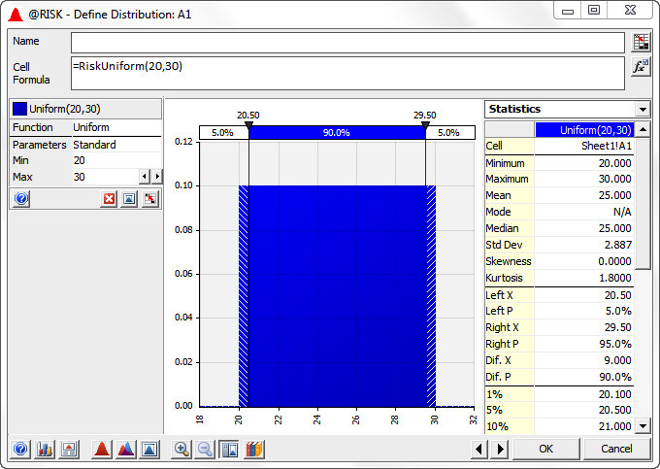
Uniform Distribution
The uniform distribution is the “flat” distribution illustrated below.
It is bounded by a minimum and a maximum, and all values between these two extremes are equally likely.
Think of this as the “I have no idea” distribution.

Slide 13
Excel’s RAND Function
To generate a random number equally likely to be anywhere between 0 and 1, enter the formula =RAND() into any cell.
Press the F9 key to make it change randomly.
The numbers created by this function have two properties of random numbers:
Uniform property: All numbers between 0 and 1 have the same chance of occurring.
Independence property: Different random numbers generated by RAND formulas are probabilistically independent.
A number generated previously has no effect on the values of any other random numbers generated in the spreadsheet.

Slide 14
Freezing Random Numbers
The automatic recalculation of random numbers can be useful sometimes and annoying at other times.
There are situations when you want the random number to stay fixed—that is, you want to freeze random numbers at their current values.
There are three steps to do this:
Select the range that you want to freeze.
Press Ctrl + c to copy this range.
With the same range still selected, select the Paste Values option from the Paste dropdown menu.
This pastes a copy of the range onto itself, but the entries are now numbers, not formulas.

Slide 15
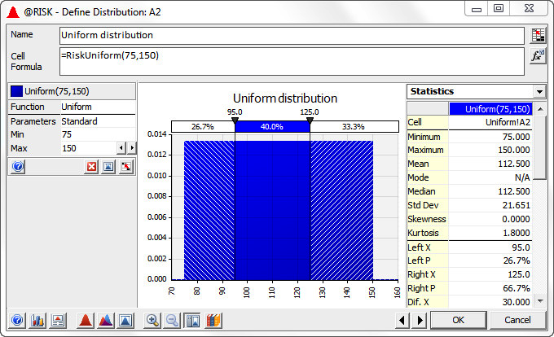
Using @RISK to Explore Probability Distributions
Palisade’s @RISK add-in allows you to experiment with probability distributions with its @RISK random functions.
It allows you to see the shapes of various distributions and to calculate probabilities for them.
A uniform distribution from @RISK is shown below.

Slide 16
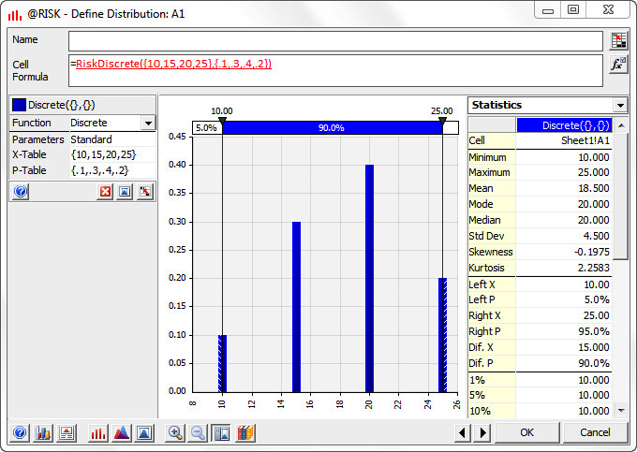
Discrete Distribution
A discrete distribution is useful for many situations, either:
When the uncertain quantity is not really continuous, or
When you want a discrete approximation to a continuous variable.
All you need to specify are the possible values and their probabilities, making sure that the probabilities sum to 1.
Because of this flexibility in specifying values and probabilities, discrete distributions can have practically any shape.
An example is shown here.

Slide 17
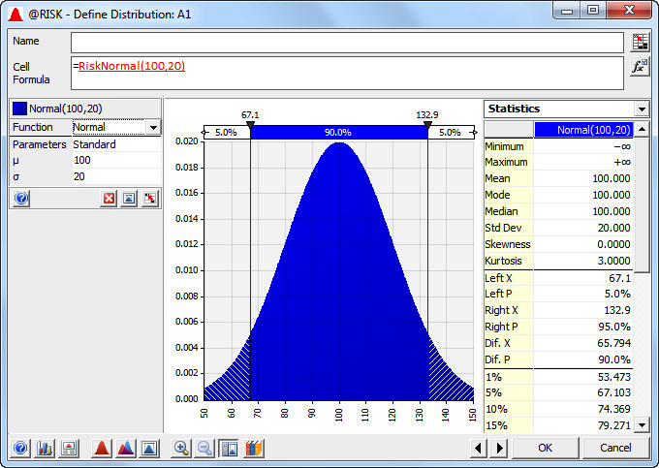
Normal Distribution
The normal distribution is the familiar bell-shaped curve.
It is useful in simulation modeling as a continuous input distribution.
It is not always the most appropriate distribution, because it is symmetric. Skewed distributions may be more realistic.
It allows negative values, which are not appropriate in many situations.

Slide 18
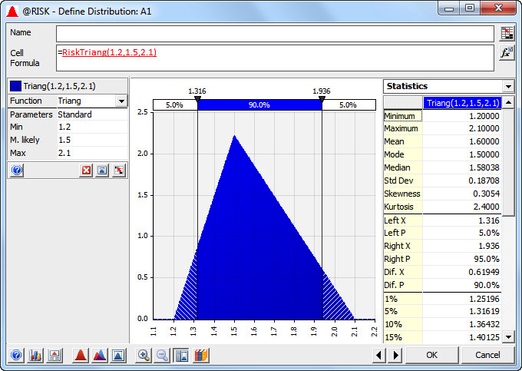
Triangular Distribution
The triangular distribution is somewhat similar to the normal distribution in that its density function rises to some point and then falls, but it is more flexible and intuitive than the normal distribution.
It is an excellent candidate for many continuous input variables.
It is specified by easy-to-understand parameters: the minimum possible value, the most likely value, and the maximum possible value.
The shape of a triangular density function is literally a triangle, as shown below.
The high point of the triangle is above the most likely value.

Slide 19
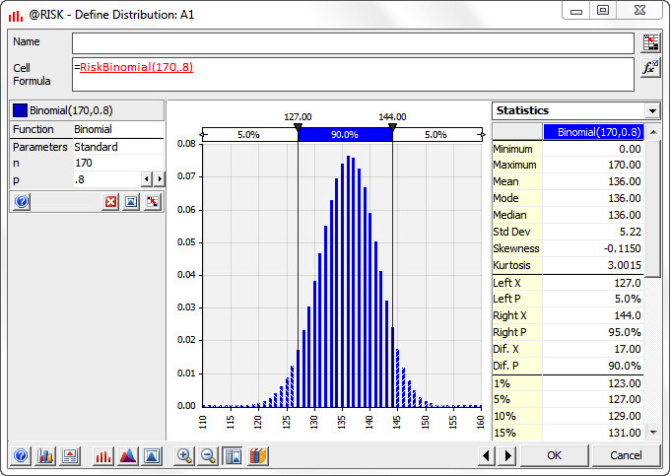
Binomial Distribution
The binomial distribution is a discrete distribution that applies to a very specific situation: when a number of independent and identical trials occur, and each trial results in a success or a failure.
The binomial random number is the number of successes in these trials.
The two parameters, n and p, are the number of trials and the probability of success on each trial.

Slide 20
Simulation and the Flaw of Averages
A pitfall called the “flaw of averages” should be avoided.
If a model contains uncertain inputs, it can be very misleading to build a deterministic model by using the means of the inputs to predict an output.
The resulting output value can be considerably different—lower or higher—than the mean of the output values obtained from running a simulation with uncertainty incorporated explicitly.
The following example illustrates this pitfall.

Slide 21
Example 15.1: Walton Bookstore 1.xlsx (slide 1 of 3)
Objective: To illustrate the difference between a deterministic model with a best guess for uncertain inputs and a simulation model that incorporates uncertainty explicitly.
Solution: In August, Walton Bookstore must decide how many of next year’s nature calendars to order.
Each calendar costs the bookstore $7.50 and sells for $10.
After January 1, all unsold calendars will be returned to the publisher for a refund of $2.50 per calendar.
Walton believes that the number of calendars it can sell by January 1 follows some probability distribution with mean 200.
Walton believes that ordering to the average demand, that is, ordering 200 calendars, is a good decision. Is it?

Slide 22
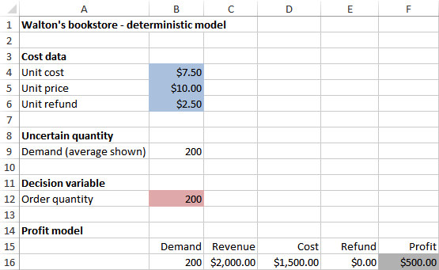
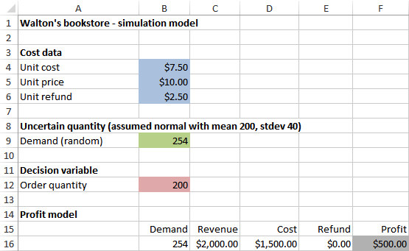
Example 15.1: Walton Bookstore 1.xlsx (slide 2 of 3)
The deterministic model is shown on the bottom left.
Contrast it with the simulation model on the bottom right.

Slide 23
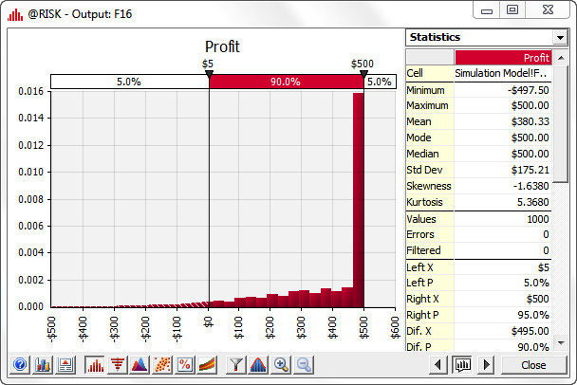
Example 15.1: Walton Bookstore 1.xlsx (slide 3 of 3)
Running @RISK with 1000 iterations results in the histogram of 1000 simulated profits shown below.
The mean profit, the average of the 1000 simulated profits, is only about $380, well less than the $500 suggested by the deterministic model.

Slide 24
Simulation with Built-In Excel Tools
Spreadsheet simulation models can be developed and analyzed with Excel’s built-in tools without using add-ins.
However, there are two problems with this approach:
Only Excel’s RAND function and transformations of it can be used to generate random numbers from various probability distributions.
There is no quick way to keep track of the output values and summarize them.
This bookkeeping feature is the real strength of a simulation add-in such as @RISK.

Slide 25
Example 15.2: Walton Bookstore 2.xlsx (slide 1 of 2)
Objective: To use built-in Excel tools—including the RAND function and data tables, but no add-ins—to simulate profit for several order quantities and ultimately choose the “best” order quantity.
Solution: This is a continuation of the calendar problem from Example 15.1.
In this version, assume that demand for calendars (at the full price) is given by the probability distribution shown in the table below.
First, develop a simulation model for any fixed order quantity.
Then run this simulation model with various order quantities to see which one appears to be best.

Slide 26
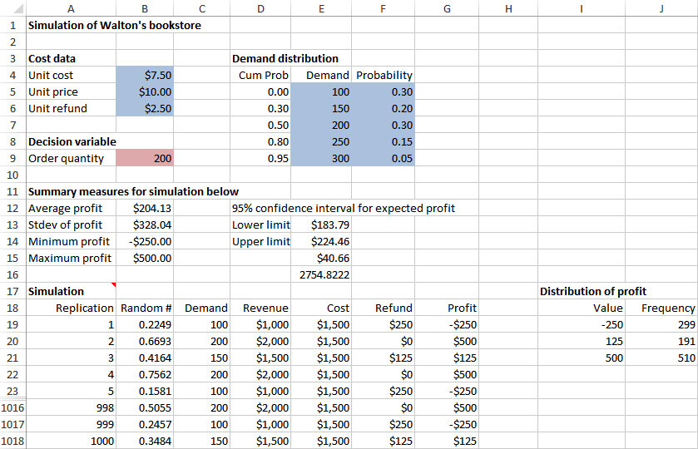
Example 15.2: Walton Bookstore 2.xlsx (slide 2 of 2)
The figure below illustrates the results obtained by simulating 1000 independent replications for an order of 200 calendars.

Slide 27
Checking Logic with Deterministic Inputs
It can be difficult to check whether the logic in the model is correct, because of the random numbers.
You usually get different output values, depending on the particular random numbers generated.
It is sometimes useful to enter well-chosen fixed values for the random inputs, just to see whether the logic is correct.
These are called deterministic checks.
Fix any logical errors before reentering the random numbers and running the simulation.

Slide 28
Notes about Confidence Intervals (slide 1 of 2)
It is common in computer simulations to estimate the mean of some distribution by the average of the simulated observations.
The usual practice is then to calculate a confidence interval, which indicates the accuracy of the estimate.
If the estimated mean is X, the confidence interval is given by the following formula:
The standard error of X is the standard deviation of the observations divided by the square root of n, the number of observations:
The approximate 95% confidence interval for the mean is then:

Slide 29
Notes about Confidence Intervals (slide 2 of 2)
Analysts often plan a simulation so that the confidence interval for the mean of some important output will be sufficiently narrow.
The reasoning is that narrow confidence intervals imply more precision about the estimated mean of the output variable.
If the confidence level is fixed at some value such as 95%, the only way to narrow the confidence interval is to simulate more replications.
Assuming that the confidence level is 95%, the following value of n is required to ensure that the resulting confidence interval will have a half-length approximately equal to some specified value B:

Slide 30
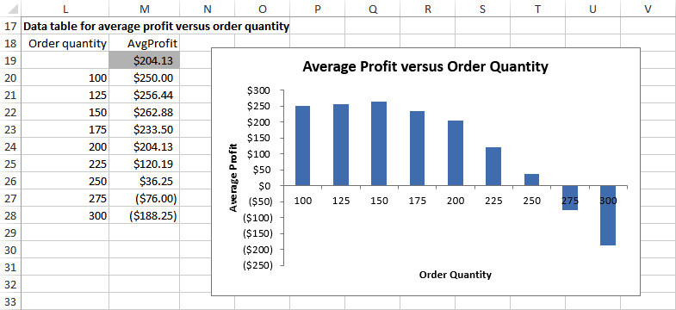
Finding the Best Order Quantity
To find the best order quantity, use a data table to rerun the simulation for other order quantities.
This data table and a corresponding chart are shown in the figure below.

Slide 31
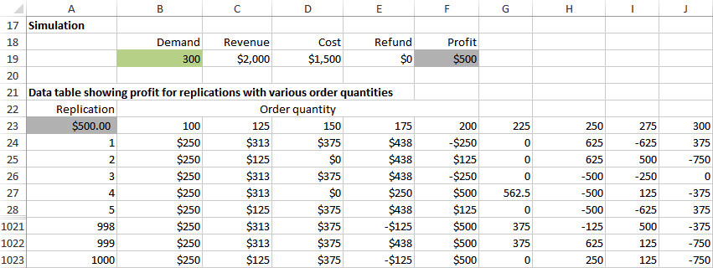
Using a Two-Way Data Table
To see how the profit depends on the order quantity, use a two-way data table with the replication number along the side and possible order quantities along the top.
Each cell in the body of the data table shows a simulated profit for a particular replication and a particular order quantity, and each is based on a different random demand.
By averaging the numbers in each column of the data table, you can see which is the best order quantity.

Slide 32
Introduction to the @RISK
Much of the reason for the popularity of spreadsheet simulation modeling is due to simulation add-ins such as @RISK.
There are two primary advantages to using such an add-in:
It gives easy access to many probability distributions you might want to use in your simulation models.
It allows you to perform simulations much more easily than is possible with Excel alone.

Slide 33
@RISK Features
@RISK contains a number of functions such as RISKNORMAL and RISKDISCRETE that make it easy to generate observations from a wide variety of probability distributions.
You can designate any cell or range of cells in your simulation model as output cells.
@RISK automatically keeps summary measures from the values generated in these output cells across the replications.
It also creates graphs such as histograms based on these values.
@RISK has a special function, RISKSIMTABLE, that allows you to run the same simulation several times, using a different value of some key input variable each time.

Slide 34
@RISK Models with a Single Random Input Variable
The development of a simulation model is basically a two-step procedure:
First, build the model itself.
This step requires you to enter all of the logic that transforms inputs into outputs.
@RISK cannot do this for you.
Once this logic has been incorporated, @RISK replicates your model with different random numbers on each replication.
It also reports any summary measures that you request in tabular or graphical form.

Slide 35
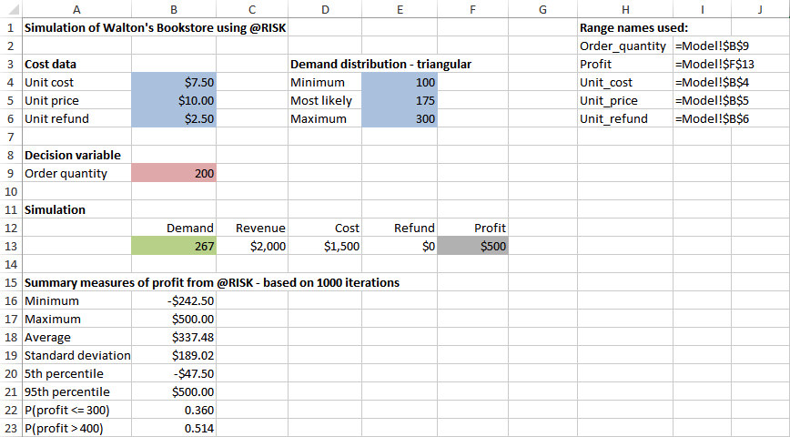
Example 15.3: Walton Bookstore 5.xlsx (slide 1 of 2)
Objective: To learn about @RISK’s basic functionality by revisiting the Walton Bookstore problem.
Solution: This is a continuation of the calendar problem from Examples 15.1 and 15.2.
Assume now that Walton estimates a triangular probability distribution for demand, where the minimum, most likely, and maximum values of demand are 100, 175, and 300, respectively.
The company wants to use this probability distribution, together with @RISK, to simulate the profit for any particular order quantity, with the ultimate goal of finding the best order quantity.
The spreadsheet model for profit (as shown to the right) is essentially the same model developed previously without @RISK.

Slide 36
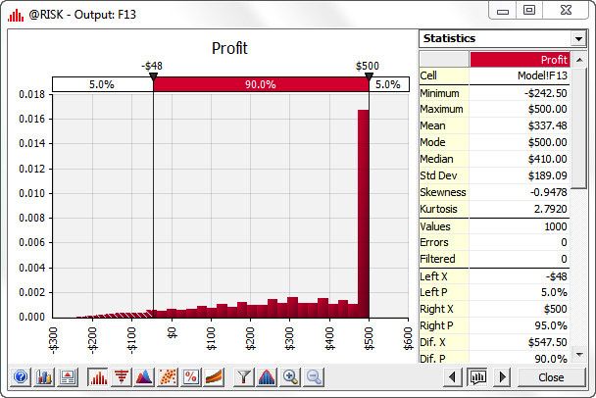
Example 15.3: Walton Bookstore 5.xlsx (slide 2 of 2)
After you develop the model, the procedure is always the same:
Specify simulation settings.
Run the simulation.
Examine the results.
The quickest way to get results is to select an input or output cell and then click the Browse Results button in the Results group on the @RISK ribbon.
This provides an interactive histogram of the selected value, as shown to the right.

Slide 37
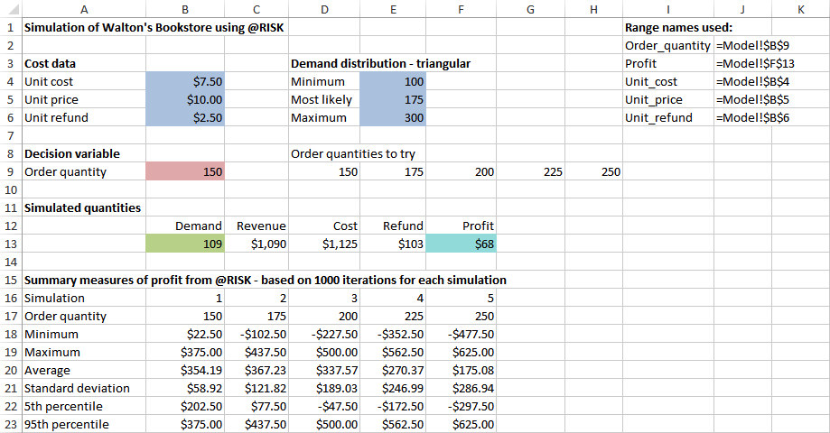
Using RISKSIMTABLE
The ultimate goal is to choose an order quantity that provides a large average profit.
You could rerun the simulation model several times, each time with a different order quantity and compare the results.
However, each time you run the simulation, you get a different set of random demands.
For a fairer comparison, it is best to test each order quantity on the same set of random demands.
The RISKSIMTABLE function in @RISK enables you to obtain a fair comparison quickly and easily, as illustrated below.

Slide 38
Some Limitations of @RISK
The simulation model must be contained in a single workbook with at most four worksheets, and each worksheet is limited to 300 rows and 100 columns.
The number of @RISK input probability distribution functions is limited to 100.
The number of unattended iterations is limited to 1000. (You can request more than 1000, but you have to click a button after each 1000 iterations.)
All @RISK graphs contain a watermark.
The Distribution Fitting tool can handle only 150 observations.

Slide 39
Example 15.4: Walton Bookstore 7.xlsx (slide 1 of 3)
Objective: To develop and analyze a simulation model with multiple sources of uncertainty using @RISK, and to introduce @RISK’s sensitivity analysis features.
Solution: This is a continuation of the calendar problem in Example 15.3, but there are now two other sources of uncertainty.
First, the maximum number of calendars Walton’s supplier can supply is uncertain and is modeled with a triangular distribution. Its parameters are 125 (minimum), 200 (most likely), and 250 (maximum).
Once Walton places the order, the supplier will charge $7.50 per calendar if he can supply the entire order. Otherwise, he will charge $7.25 per calendar.
Second, unsold calendars can no longer be returned to the supplier for a refund. Instead, Walton will put them on sale for $50 apiece after Jan. 1.
At that price, Walton believes the demand for leftover calendars is triangularly distributed with parameters 0, 50, and 75.
Any calendars still left over after March 1 will be thrown away.
Walton wants to use simulation to analyze the resulting profit for various order quantities.

Slide 40
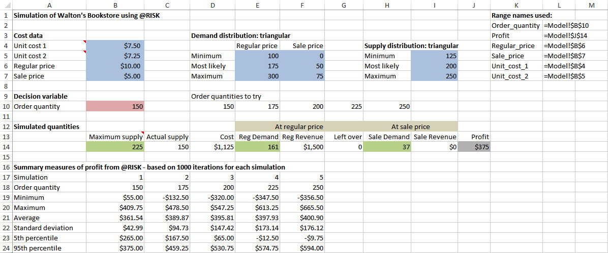
Example 15.4: Walton Bookstore 7.xlsx (slide 2 of 3)
The first step is to develop the model. The completed model is shown below.
The next steps are to specify the simulation settings (in this case, 1000 iterations and 5 simulations), and run the simulation. Selected results are also shown below (at the bottom).

Slide 41
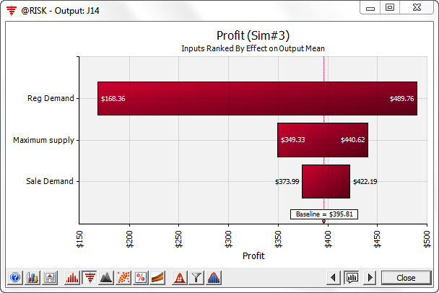
Example 15.4: Walton Bookstore 7.xlsx (slide 3 of 3)
One feature of @RISK is particularly useful when there are several random input cells. It lets you see which of these inputs has the most effect on an output cell.
Select the profit cell, and click the Browse Results button. You will see a histogram of profit with a number of buttons at the bottom.
Click the red button with the pound sign to select a simulation.
Then click the “tornado” button (the fifth button from the left) and choose Change in Output Mean. This produces the chart below.
This figure shows graphically and numerically how each of the random inputs affects profit: the longer the bar, the stronger the relationship between that input and profit.

Slide 42
The Effects of Input Distributions on Results
The randomness in input variables causes the variability in the output variables.
Some models are more sensitive to changes in the shape or parameters of input distributions than others.
There are two types of sensitivity analysis:
Check whether the shape of the input distribution matters.
Check whether the independence of input variables is crucial to the output results.
Many random quantities in real situations are not independent; they are positively or negatively correlated.
@RISK enables you to build correlation into a model.

Slide 43
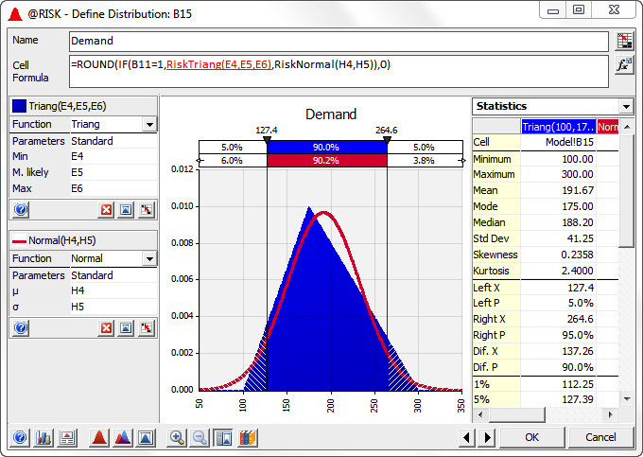
Example 15.5: Walton Bookstore 8.xlsx (slide 1 of 3)
Objective: To see whether a triangular distribution with some skewness gives the same profit distribution as a normal distribution for demand.
Solution: Keep the same unit cost, unit price, and unit refund for leftovers as in Example 15.3, but assume a normal distribution of demand.
For a fair comparison, use the same mean and standard deviation that the triangular distribution has, taking advantage of @RISK’s Define Distributions tool.
@RISK allows you to see a comparison of these two distributions, as shown below.

Slide 44
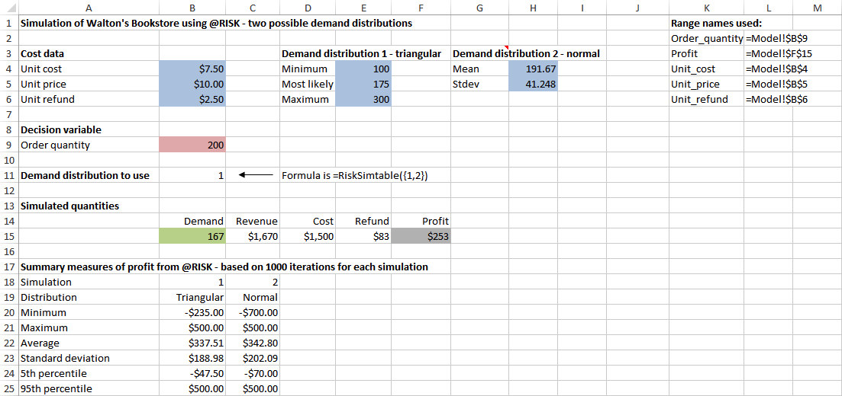
Example 15.5: Walton Bookstore 8.xlsx (slide 2 of 3)
A clever use of the RISKSIMTABLE function allows you to run two simulations at once, one for the triangular distribution and one for the corresponding normal distribution.

Slide 45
Example 15.5: Walton Bookstore 8.xlsx (slide 3 of 3)
The comparison is shown numerically and graphically below.

Slide 46
Effect of Correlated Input Variables
Until now, all of the random numbers generated with @ RISK functions have been probabilistically independent.
Sometimes, however, independence is unrealistic.
In such cases, correlated inputs are more appropriate.
If they are positively correlated, then large numbers will tend to go with large numbers, and small with small.
If they are negatively correlated, then large numbers will tend to go with small numbers, and small with large.
You can create correlated inputs in @RISK with the RISKCORRMAT function.

Slide 47
Example 15.6: Walton Bookstore 9.xlsx (slide 1 of 3)
Objective: To see how @RISK enables us to simulate correlated demands, and to see the effect of correlated demands on profit.
Solution: Suppose that Walton Bookstore must order two different calendars. Assume that the calendars have the same unit cost, unit selling price, and unit refund value as in previous examples.
Also assume that each has a triangularly distributed demand with parameters 100, 175, and 300.
Now assume they are “substitute” products, so that their demands are negatively correlated. Specifically, assume a correlation of -0.9 between the two demands.
How do these correlated inputs affect the distribution of profit, as compared to the situation where the demands are uncorrelated (correlation 0) or very positively correlated (correlation 0.9)?

Slide 48
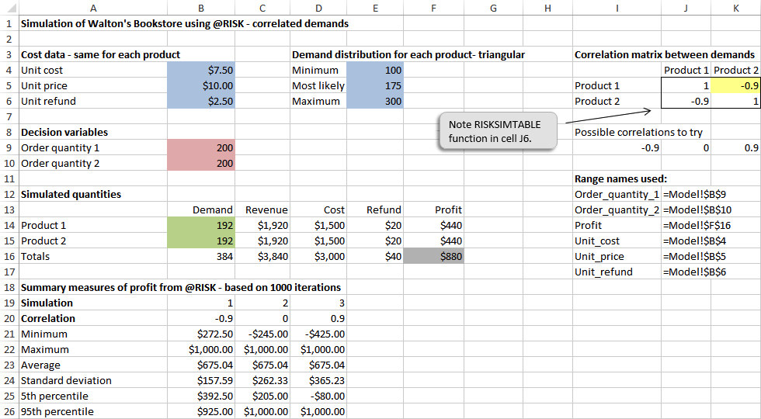
Example 15.6: Walton Bookstore 9.xlsx (slide 2 of 3)
The key to building in correlation is @RISK’s RISKFORMAT (correlation matrix) function.
To use this function, you must include a correlation matrix in the model, as shown in the range J5:K6 of the figure below.

Slide 49
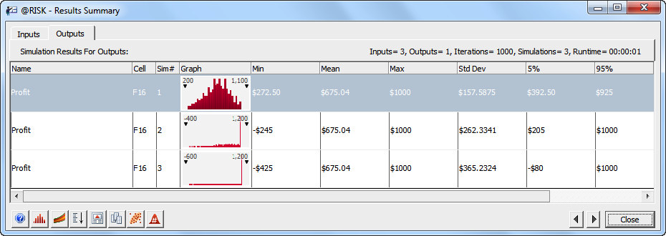
Example 15.6: Walton Bookstore 9.xlsx (slide 3 of 3)
Set up and run @RISK exactly as before. Set the number of iterations to 1000 and the number of simulations to 3 (because three different correlations are being tested).
Selected numerical and graphical results are shown below.

