Slide 1
13
Introduction to Optimization Modeling

Slide 2
Introduction
Spreadsheet optimization is one of the most powerful and flexible methods of quantitative analysis.
One specific type of optimization, linear programming (LP), is used in all types of organizations to solve a wide variety of problems.

Slide 3
Introduction to Optimization (slide 1 of 3)
All optimization problems have several common elements:
Decision variables—the variables whose values the decision maker is allowed to choose
Objective function (objective for short) to be optimized—maximized or minimized
Constraints that must be satisfied—physical, logical, or economic restrictions, depending on the nature of the problem
Excel® uses its own terminology for optimization:
Changing cells—contain values of the decision variables.
Objective cell—contains the objective to be minimized or maximized.
Constraints—impose restrictions on the values in the changing cells.
Nonnegativity constraints—imply that changing cells must contain nonnegative numbers.

Slide 4
Introduction to Optimization (slide 2 of 3)
Steps in solving an optimization problem:
Model development—decide on the decision variables, the objective, the constraints, and how everything fits together.
Algebraic model: Derive correct algebraic expressions.
Spreadsheet model: Relate all variables with appropriate cell formulas.
Optimize—systematically choose the values of the decision variables that make the objective as large (for maximization) or small (for minimization) as possible and cause all constraints to be satisfied.
A feasible solution is a solution that satisfies all of the constraints.
The feasible region is the set of all feasible solutions.
An infeasible solution violates at least one of the constraints and is disallowed.
The optimal solution is the feasible solution that optimizes the objective.

Slide 5
Introduction to Optimization (slide 3 of 3)
Algorithms have been devised for searching through the feasible region to find the optimal solution.
The simplex method is an algorithm used for linear models.
Other more complex algorithms are used for other types of models.
Excel’s Solver add-in finds the best feasible solution with the appropriate algorithm.
Sensitivity analysis—follow up the optimization step with what-if questions related to the input variables.
Good software allows you to obtain answers to various what-if questions quickly and easily.

Slide 6
A Two-Variable Product Mix Model
In a product mix problem, a company must decide its product mix (how much of each of its potential products to produce) to maximize its net profit.
Possible approaches:
Model the problem algebraically.
Model it in Excel.
Find its optimal solution with Solver.
Solve it graphically.
Ask a number of what-if questions about the completed model.

Slide 7
Example 13.1: Product Mix 1.xlsx (slide 1 of 7)
Objective: To use LP to find the best mix of computer models that stays within the company’s labor availability and maximum sales constraints.
Solution: PC Tech company must decide how many of each of two models, Basic and XP, to produce to maximize its net profit.
The most it can sell are 600 Basics and 1200 XPs.
Each Basic sells for $300 and each XP for $450.
The cost of component parts for a Basic is $150 and for an XP is $225.
There are at most 10,000 assembly hours and 3000 testing hours available.
Each Basic requires five hours for assembling and one hour for testing, and each XP requires six hours for assembling and two hours for testing.
Each labor hour for assembling costs $11 and for testing costs $15.
A summary of the variables, the objective, and the constraints is shown below:

Slide 8
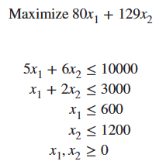
Example 13.1: Product Mix 1.xlsx (slide 2 of 7)
Algebraic Model:
Identify the decision variables (number of computers to produce) and label these x₁ and x₂.
Write expressions for the total net profit and the constraints in terms of the xs.
Add explicit constraints to ensure that all the xs are nonnegative.
The resulting algebraic model is:

Slide 9
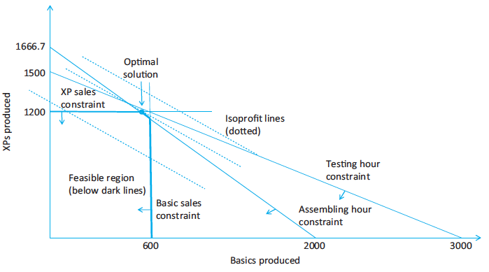
Example 13.1: Product Mix 1.xlsx (slide 3 of 7)
Graphical Solution:
Express the constraints and the objective in terms of x₁ and x₂.
Graph the constraints to find the feasible region.
Move the objective through the feasible region until it is optimized.
This graphical solution approach is not practical in most realistic optimization models, where there are more than two decision variables.

Slide 10
Example 13.1: Product Mix 1.xlsx (slide 4 of 7)
Spreadsheet Model:
There are many ways to develop an LP spreadsheet model.
Common elements include:
Inputs: All numerical inputs—that is, all numeric data given in the statement of the problem—should appear somewhere in the spreadsheet.
Changing cells: Instead of using variable names, such as x, use a set of designated cells for the decision variables. The values in these changing cells can be changed to optimize the objective.
Objective cell: One cell, called the objective cell, contains the value of the objective. Solver systematically varies the values in the changing cells to optimize the value in the objective cell. The cell must be linked to the changing cells by formulas.
Constraints: Excel does not show the constraints directly on the spreadsheet. Instead, they are specified in a Solver dialog box.
Nonnegativity: Normally, the decision variables—that is, the values in the changing cells—must be nonnegative. Check the appropriate option in the Solver dialog box.

Slide 11
Example 13.1: Product Mix 1.xlsx (slide 5 of 7)
Overview of the Solution Process:
Model development stage: Enter all of the inputs, trial values for the changing cells, and formulas relating these in a spreadsheet.
The spreadsheet must include a formula that relates the objective to the changing cells.
It must also include formulas for the various constraints that are related to the changing cells.
Invoking Solver: Designate the objective cell, the changing cells, the constraints, and selected options, and tell Solver to find the optimal solution.
Sensitivity analysis: See how the optimal solution changes (if at all) as selected inputs are varied.

Slide 12
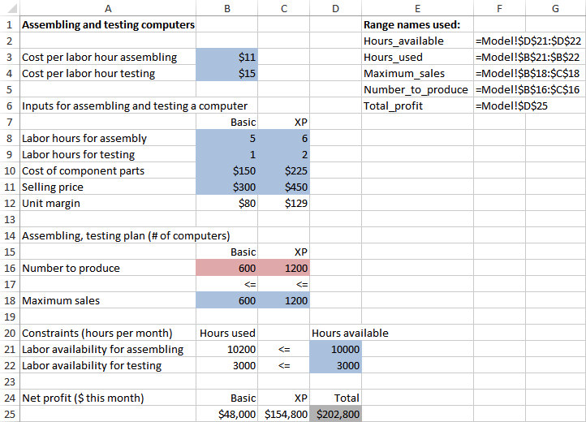
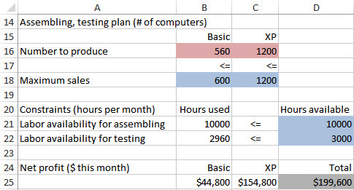
Example 13.1: Product Mix 1.xlsx (slide 6 of 7)
Two-Variable Product Mix Model with an Infeasible Solution
Two-Variable Product Mix Model with the Optimal Solution

Slide 13
Example 13.1: Product Mix 1.xlsx (slide 7 of 7)
Discussion of the Solution:
Of all the inequality constraints, some are satisfied exactly and others are not.
The XP maximum sales and assembling labor constraints are met exactly. Each of these is called a binding constraint.
Binding constraints represent the bottlenecks that keep the objective from being improved.
The Basic maximum sales and testing labor constraint do not hold as equalities. Each of these is called a nonbinding constraint.
An inequality is binding if the solution makes it an equality. Otherwise, it is nonbinding.

Slide 14
Sensitivity Analysis
In real LP applications, the solution to a single model is hardly ever the end of the analysis.
It is almost always useful to perform a sensitivity analysis to see how (or if) the optimal solution changes as one or more inputs vary.
Two approaches to performing sensitivity analysis:
An optional sensitivity report that Solver offers
An add-in called SolverTable

Slide 15
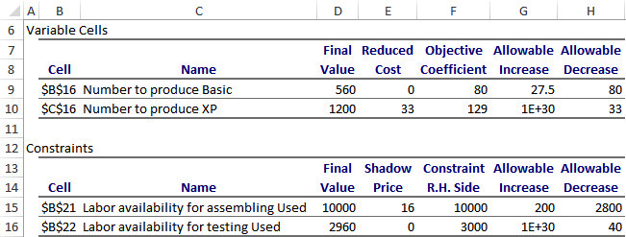
Solver’s Sensitivity Report (slide 1 of 2)
Solver’s sensitivity report performs two types of sensitivity analysis:
On the coefficients of the objective
On the right sides of the constraints
A sensitivity report is requested in Solver’s final dialog box. It appears on a new worksheet, as shown below.
The top section of the report is for sensitivity to changes in the two coefficients of the decision variables in the objective.
The bottom section of the report is for sensitivity to changes in the right sides of the labor constraints.

Slide 16
Solver’s Sensitivity Report (slide 2 of 2)
The reduced cost for any decision variable with value 0 in the optimal solution indicates how much better that coefficient must be before that variable enters at a positive level.
The reduced cost for any decision variable at its upper bound in the optimal solution indicates how much worse its coefficient must be before it will decrease from its upper bound.
The reduced cost for any variable between 0 and its upper bound in the optimal solution is irrelevant.
The term shadow price indicates the change in the optimal value of the objective when the right side of some constraint changes by one unit.
If a resource constraint is binding in the optimal solution, the company is willing to pay up to some amount, the shadow price, to obtain more of the resource.

Slide 17
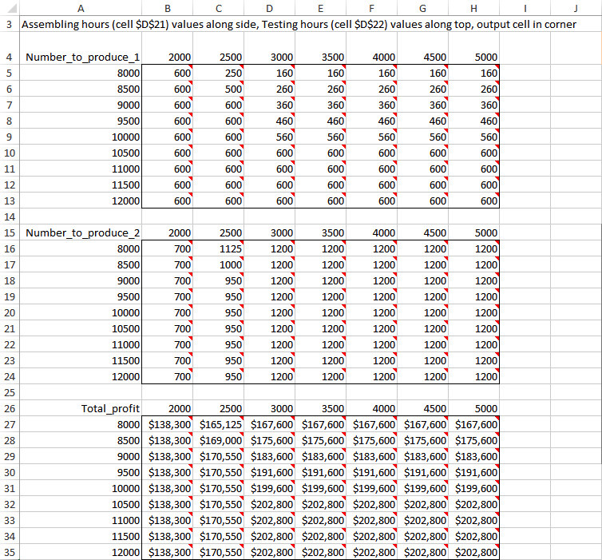
SolverTable Add-In
SolverTable allows you to ask sensitivity questions about any of the input variables, not just coefficients of the objective and right sides of constraints.
Two-way SolverTable results for two labor availabilities are shown below.

Slide 18
Comparison of Solver’s Sensitivity Report and SolverTable
Solver’s Sensitivity Report
SolverTable
Focuses only on the coefficients of the objective and the right sides of the constraints.
Provides useful information through its reduced costs, shadow prices, and allowable increases and decreases.
Based on changing only one objective coefficient or one right side at a time.
Outputs can be difficult to understand if you lack the necessary background.
Not available for integer-constrained models, and its interpretation is more difficult for nonlinear models.
Comes with Excel.
Allows you to vary any of the inputs.
Provides the same information, but requires a bit more work and some experimentation with the appropriate input ranges.
Is much more flexible in this respect.
Outputs are straightforward. You can vary inputs and see directly how the optimal solution changes.
Outputs have the same interpretation for any type of optimization model.
Is a separate add-in, but is freely available.

Slide 19
Properties of Linear Models
Linear programming is a subset of a larger class of models called mathematical programming models.
All of these models select the levels of various activities that can be performed, subject to a set of constraints, to maximize or minimize an objective, such as total profit or total cost.
In terms of the general setup, LP models possess three important properties that distinguish them from general mathematical programming models:
Proportionality—means that if the level of any activity is multiplied by a constant factor, the contribution of this activity to the objective, or to any of the constraints in which the activity is involved, is multiplied by the same factor.
Additivity—implies that the sum of the contributions from the various activities to a particular constraint equals the total contribution to that constraint. Also, the value of the objective is the sum of the contributions from the various activities.
Divisibility—means that both integer and noninteger levels of the activities are allowed.

Slide 20
Discussion of Linear Properties
It is easy to recognize whether a model satisfies proportionality and additivity if the model is described algebraically. The objective must be of the form:
a₁x₁ + a₂x₂ + … + a_{n}x_{n}, where n is the number of decision variables, as are constants, and xs are decision variables
This expression is called a linear combination of the xs.
Each constraint must be equivalent to a form where the left side is a linear combination of the xs and the right side is a constant.
It is usually easier to recognize when a model is not linear:
When there are products or quotients of expressions involving changing cells
When there are nonlinear functions, such as squares, square roots, or logarithms, that involve changing cells
Real-life problems are almost never exactly linear, but linear approximations often yield very useful results.

Slide 21
Linear Models and Scaling
In a well-scaled model, all of the numbers are roughly of the same magnitude.
If the model is poorly scaled, with some very large and some very small numbers, the roundoff error is far more likely to be an issue.
There are three possible remedies for poorly scaled models:
Check the Use Automatic Scaling option in Solver.
Redefine the units in which the various quantities are defined.
Change the Precision setting in Solver’s Options dialog box to a larger number.

Slide 22
Infeasibility and Unboundedness
A solution is feasible if it satisfies all of the constraints.
However, it is possible that there are no feasible solutions to the model. This could happen when:
There is a mistake in the model (an input was entered incorrectly).
The problem has been so constrained that there are no solutions left.
Careful checking and rethinking are required to remedy a problem of infeasibility.
Another problem is unboundedness—the model has been formulated in such a way that the objective is unbounded—that is, it can be made as large or as small as you like.
If this occurs, you have probably entered a wrong input or forgotten some constraints.
It is quite possible for a reasonable model to have no feasible solutions, but there is no way a realistic model can have an unbounded solution.

Slide 23
Example 13.2: Product Mix 2.xlsx (slide 1 of 3)
Objective: To use LP to find a mix of computer models that maximizes total net profit and stays within the labor hour availability and maximum sales constraints.
Solution: PC Tech now has eight available models, not just two, and there are now two lines for testing.
The first line tends to test faster, but its labor costs are slightly higher, and each line has a certain number of hours available for testing.
PC Tech must decide not only how many of each model to produce, but also how many of each model to test on each line.
The table below lists the variables and constraints for this model.

Slide 24
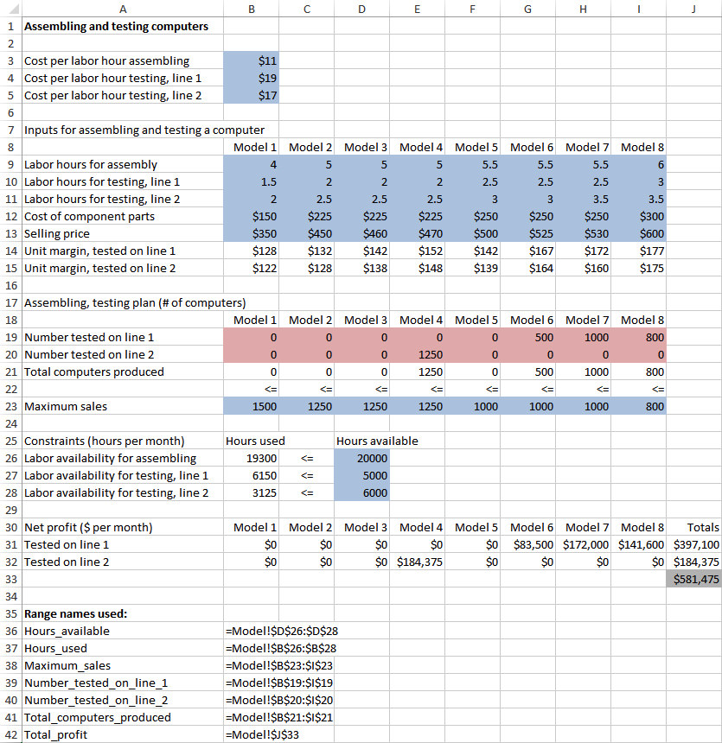
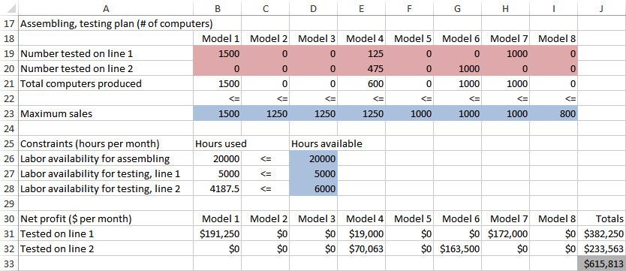
Example 13.2: Product Mix 2.xlsx (slide 2 of 3)
Larger Product Mix Model with Infeasible Solution
Optimal Solution to Larger Product Mix Model

Slide 25
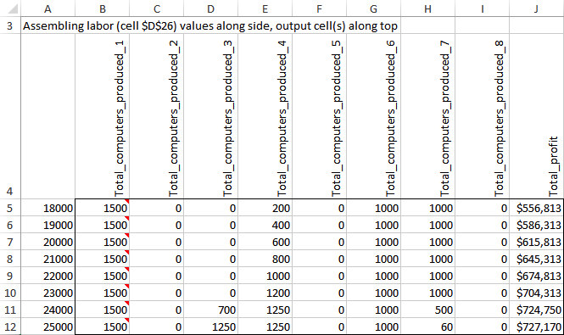
Example 13.2: Product Mix 2.xlsx (slide 3 of 3)
You can also use SolverTable to perform a sensitivity analysis where the number of available assembling labor hours is allowed to vary from 18,000 to 25,000 in increments of 1000, and the numbers of computers produced and profit are designated as outputs.

Slide 26
A Multiperiod Production Model
The distinguishing feature of a multiperiod production model is that it relates decisions made during several time periods.
This type of problem occurs when a company must make a decision now that will have ramifications in the future.
The company does not want to focus completely on the short run and forget about the long run.

Slide 27
Example 13.3: Production Scheduling.xlsx (slide 1 of 5)
Objective: To use LP to find the production schedule that meets demand on time and minimizes total production and inventory holding costs.
Solution: Pigskin Company must decide how many footballs to produce each month. The company has decided to use a 6-month planning horizon.
Pigskin has 5000 footballs in inventory, and forecasted monthly demands for the next six months are 10,000, 15,000, 30,000, 35,000, 25,000, and 10,000.
During each month, there is enough capacity to produce up to 30,000 footballs, and there is enough storage capacity to store up to 10,000 footballs at the end of the month, after demand has occurred.
The forecasted production costs per football for the next six months are $12.50, $12.55, $12.70, $12.80, $12.85, and $12.95, respectively.
The holding cost per football held in inventory at the end of any month is figured at 5% of the production cost for that month.

Slide 28
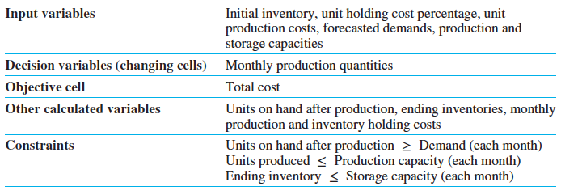
Example 13.3: Production Scheduling.xlsx (slide 2 of 5)
The variables and constraints for this model are listed in the table below.
To simplify the model, assume that:
All production occurs at the beginning of the month.
All demand occurs after production, so that all units produced in a month can be used to satisfy that month’s demand.
The storage constraint and the holding cost are based on ending inventory in a given month.

Slide 29
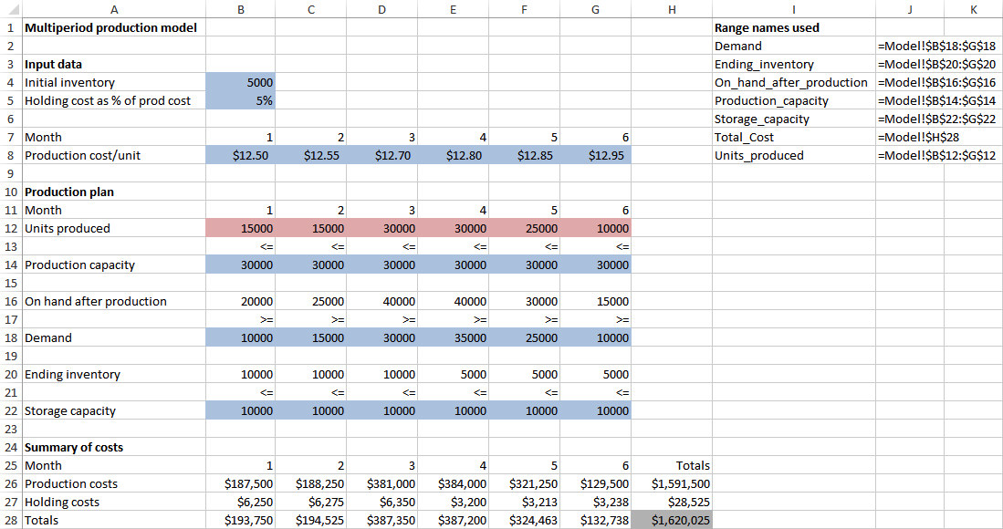
Example 13.3: Production Scheduling.xlsx (slide 3 of 5)
The spreadsheet model of Pigskin’s production problem is shown below.
The main feature that distinguishes this model from the product mix model is that balance constraints are built into the spreadsheet itself by means of formulas.

Slide 30
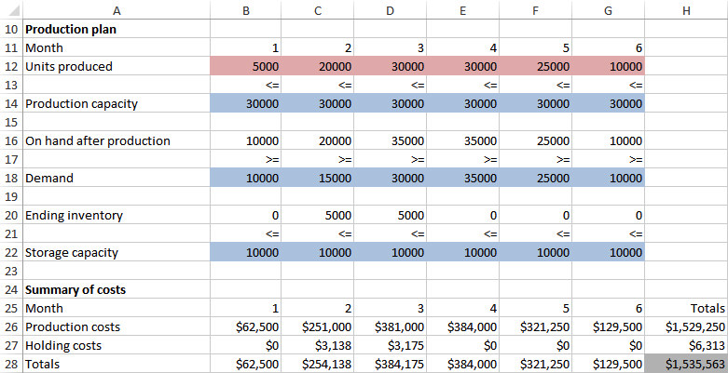
Example 13.3: Production Scheduling.xlsx (slide 4 of 5)
The optimal solution from Solver is shown below.

Slide 31
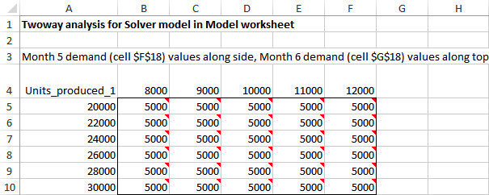
Example 13.3: Production Scheduling.xlsx (slide 5 of 5)
In reality, Pigskin would probably implement the model’s recommendation only for the first month.
Then at the beginning of the second month, it would gather new forecasts for the next six months, solve a new six-month model, and again implement the model’s recommendation for the first of these months, month 2.
If the company continues in this manner, it is following a six-month rolling planning horizon.
The Solver table below shows how the optimal month 1 production quantity varies with the forecasted demands in months 5 and 6.

Slide 32
A Comparison of Algebraic and Spreadsheet Models
For product mix models, algebraic models are quite straightforward, and spreadsheet models are almost direct translations into Excel of the algebraic models.
For multiperiod production models, algebraic models have two sets of variables, while spreadsheet models have only one.
Algebraic models for multiple periods must be related algebraically through a series of balance equations.
This extra level of abstraction makes algebraic models much more difficult for typical users to develop and comprehend.

Slide 33
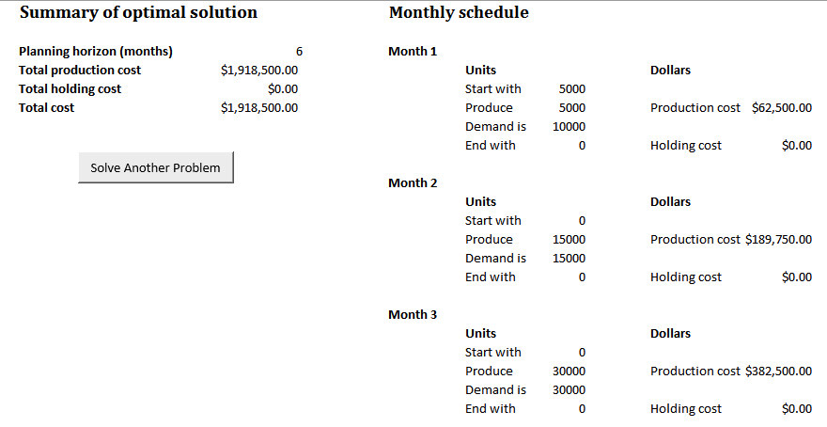
A Decision Support System
A decision support system (DSS) can help users solve problems without having to worry about technical details of LP.
A spreadsheet-based DSS contains a spreadsheet model of a problem, but the user will probably never even see this model.
Instead, the user will see a front end (which allows the user to select input variables) and a back end (which will produce a report that explains the solution in nontechnical terms).
Part of one optimal solution report is shown below.

