Slide 1
9
Hypothesis Testing

Slide 2
Introduction
In hypothesis testing, an analyst collects sample data and checks whether the data provide enough evidence to support a theory, or hypothesis.
The hypothesis that an analyst is attempting to prove is called the alternative hypothesis.
It is also frequently called the research hypothesis.
The opposite of the alternative hypothesis is called the null hypothesis.
It usually represents the current thinking or status quo.
That is, it is usually the accepted theory that the analyst is trying to disprove.
The burden of proof is on the alternative hypothesis.

Slide 3
Concepts in Hypothesis Testing
There are a number of concepts behind hypothesis testing, all of which lead to the key concept of significance testing.
Example 9.1 provides context for the discussion of these concepts.

Slide 4
Example 9.1: Pizza Ratings.xlsx
The manager of Pepperoni Pizza Restaurant has recently begun experimenting with a new method of baking pizzas.
He would like to base the decision whether to switch from the old method to the new method on customer reactions, so he performs an experiment.
For 100 randomly selected customers who order a pepperoni pizza for home delivery, he includes both an old-style and a free new-style pizza.
He asks the customers to rate the difference between the pizzas on a -10 to +10 scale, where -10 means that they strongly favor the old style, +10 means they strongly favor the new style, and 0 means they are indifferent between the two styles.
How might he proceed by using hypothesis testing?

Slide 5
Null and Alternative Hypotheses
The manager would like to prove that the new method provides better-tasting pizza, so this becomes the alternative hypothesis.
The opposite, that the old-style pizzas are at least as good as the new-style pizzas, becomes the null hypothesis.
He judges which of these are true on the basis of the mean rating over the entire customer population, labeled μ.
If it turns out that μ≤ 0, the null hypothesis is true.
If μ> 0, the alternative hypothesis is true.
Usually, the null hypothesis is labeled H_{0,}, and the alternative hypothesis is labeled H_{a}.
In our example, they can be specified as H₀:μ≤ 0 and H_{a}:μ> 0.
The null and alternative hypotheses divide all possibilities into two nonoverlapping sets, exactly one of which must be true.

Slide 6
One-Tailed versus Two-Tailed Tests
A one-tailed alternative is one that is supported only by evidence in a single direction.
A two-tailed alternative is one that is supported by evidence in either of two directions.
Once hypotheses are set up, it is easy to detect whether the test is one-tailed or two-tailed.
One-tailed alternatives are phrased in terms of “<“ or “>”.
Two-tailed alternatives are phrased in terms of “≠“.
The pizza manager’s alternative hypothesis is one-tailed because he is trying to prove that the new-style pizza is better than the old-style pizza.

Slide 7
Types of Errors
Regardless of whether the manager decides to accept or reject the null hypothesis, it might be the wrong decision.
He might incorrectly reject the null hypothesis when it is true, or he might incorrectly accept the null hypothesis when it is false.
These two types of errors are called type I and type II errors.
You commit a type I error when you incorrectly reject a null hypothesis that is true.
You commit a type II error when you incorrectly accept a null hypothesis that is false.
Type I errors are usually considered more costly, although this can lead to conservative decision making.

Slide 8
Significance Level and Rejection Region
To decide how strong the evidence in favor of the alternative hypothesis must be to reject the null hypothesis, one approach is to prescribe the probability of a type I error that you are willing to tolerate.
This type I error probability is usually denoted by α and is most commonly set equal to 0.05.
The value of α is called the significance level of the test.
The rejection region is the set of sample data that leads to the rejection of the null hypothesis.
The significance level, α, determines the size of the rejection region.
Sample results in the rejection region are called statistically significant at the α level.
It is important to understand the effect of varying α:
If α is small, such as 0.01, the probability of a type I error is small, and a lot of sample evidence in favor of the alternative hypothesis is required before the null hypothesis can be rejected
When α is larger, such as 0.10, the rejection region is larger, and it is easier to reject the null hypothesis.

Slide 9
Significance from p-values
A second approach is to avoid the use of a significance level and instead simply report how significant the sample evidence is.
This approach is currently more popular.
It is done by means of a p-value.
The p-value is the probability of seeing a random sample at least as extreme as the observed sample, given that the null hypothesis is true.
The smaller the p-value, the more evidence there is in favor of the alternative hypothesis.
Sample evidence is statistically significant at the α level only if the p-value is less than α.
The advantage of the p-value approach is that you don’t have to choose a significance value α ahead of time, and p-values are included in virtually all statistical software output.

Slide 10
Type II Errors and Power
A type II error occurs when the alternative hypothesis is true but there isn’t enough evidence in the sample to reject the null hypothesis.
This type of error is traditionally considered less important than a type I error, but it can lead to serious consequences in real situations.
The power of a test is 1 minus the probability of a type II error.
It is the probability of rejecting the null hypothesis when the alternative hypothesis is true.
There are several ways to achieve high power, the most obvious of which is to increase sample size.

Slide 11
Hypothesis Tests and Confidence Intervals
The results of hypothesis tests are often accompanied by confidence intervals.
This provides two complementary ways to interpret the data.
There is also a more formal connection between the two, at least for two-tailed tests.
When using a confidence interval to perform a two-tailed hypothesis test, reject the null hypothesis if and only if the hypothesized value does not lie inside a confidence interval for the parameter.

Slide 12
Practical versus Statistical Significance
Statistically significant results are those that produce sufficiently small p-values.
In other words, statistically significant results are those that provide strong evidence in support of the alternative hypothesis.
Such results are not necessarily significant in terms of importance. They might be significant only in the statistical sense.
There is always a possibility of statistical significance but not practical significance with large sample sizes.
By contrast, with small samples, results may not be statistically significant even if they would be of practical significance.

Slide 13
Hypothesis Tests for a Population Mean
As with confidence intervals, the key to the analysis is the sampling distribution of the sample mean.
If you subtract the true mean from the sample mean and divide the difference by the standard error, the result has a t distribution with n – 1 degrees of freedom.
In a hypothesis-testing context, the true mean to use is the null hypothesis, specifically, the borderline value between the null and alternative hypotheses.
This value is usually labeled μ₀.
To run the test, referred to as the t test for a population mean, you calculate the test statistic as shown below:

Slide 14
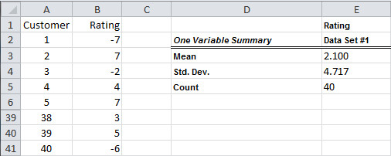
Example 9.1 (continued): Pizza Ratings.xlsx (slide 1 of 2)
Objective: To use a one-sample t test to see whether consumers prefer the new-style pizza to the old style.
Solution: The ratings for the 40 randomly selected customers and several summary statistics are shown below.
To run the test, calculate the test statistic:

Slide 15
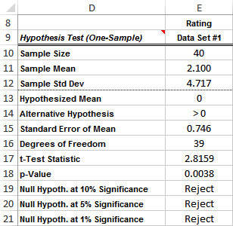
Example 9.1 (continued): Pizza Ratings.xlsx (slide 2 of 2)
Use the StatTools One-Sample Hypothesis Test procedure to perform this analysis easily, with the results shown below.

Slide 16
Example 9.2: Textbook Ratings.xlsx (slide 1 of 2)
Objective: To use a one-sample t test, with a two-tailed alternative, to see whether students like the new textbook any more or less than the old textbook.
Solution: The chemistry faculty at State University have decided to experiment with a new textbook.
The old textbook has been rated over the years, and the average rating has been stable at about 5.2.
50 randomly selected students were asked to rate the new textbook on a scale of 1 to 10. The results appear in column B on the next slide.
Set this up as a two-tailed test—that is, the alternative hypothesis is that the mean rating of the new textbook is either less than or greater than the mean rating of the previous textbook.
The test is run using the StatTools One-Sample Hypothesis Test procedure almost exactly as with a one-tailed test.

Slide 17
Example 9.2: Textbook Ratings.xlsx (slide 2 of 2)

Slide 18
Hypothesis Tests for Other Parameters
Just as we developed confidence intervals for a variety of parameters, we can develop hypothesis tests for other parameters.
In each case, the sample data are used to calculate a test statistic that has a well-known sampling distribution.
Then a corresponding p-value measures the support for the alternative hypothesis.

Slide 19
Hypothesis Tests for a Population Proportion
To test a population proportion p, recall that the sample proportion has a sampling distribution that is approximately normal when the sample size is reasonably large.
Specifically, the distribution of the standardized value
is approximately normal with mean 0 and standard deviation 1.
This leads to the following z test for a population proportion.
Let p₀ be the borderline value of p between the null and alternative hypotheses.
Then p₀ is substituted for p to obtain the test statistic below:

Slide 20
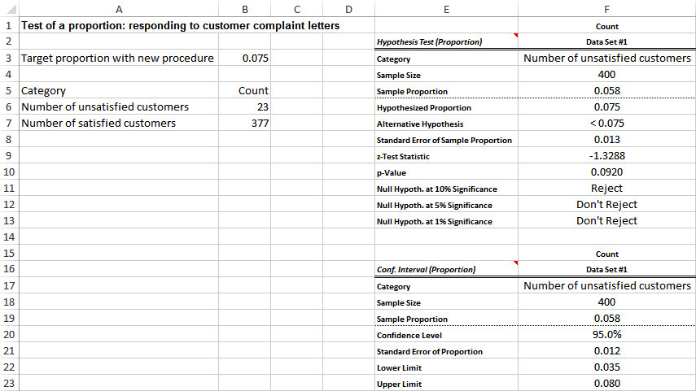
Example 9.3: Customer Complaints.xlsx
Objective: To use a test for a proportion to see whether a new process of responding to complaint letters results in an acceptably low proportion of unsatisfied customers.
Solution: The manager’s goal is to reduce the proportion of unsatisfied customers after 30 days from 0.15 to 0.075 or less.
With the new process in place, the manager has tracked 400 letter writers and has found that 23 of them are “unsatisfied” after 30 days.
Arrange the data in one of the three formats for a StatTools proportions analysis. Then run the test with StatTools, as shown below.

Slide 21
Hypothesis Tests for Differences between Population Means
The comparison problem, where the difference between two population means is tested, is one of the most important problems analyzed with statistical methods.
The form of the analysis depends on whether the two samples are independent or paired.
If the samples are paired, then the test is referred to as the t test for difference between means from paired samples.
Test statistic for paired samples test of difference between means:
If the samples are independent, the test is referred to as the t test for difference between means from independent samples.
Test statistic for independent samples test of difference between means:

Slide 22
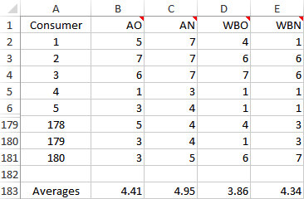
Example 9.4: Soft-Drink Cans.xlsx (slide 1 of 2)
Objective: To use paired-sample t tests for differences between means to see whether consumers rate the attractiveness, and their likelihood to purchase, higher for a new-style can than for the traditional-style can.
Solution: Randomly selected customers are asked to rate each of the following on a scale of 1 to 7:
The attractiveness of the traditional-style can (AO)
The attractiveness of the new-style can (AN)
The likelihood that you would buy the product with the traditional-style can (WBO)
The likelihood that you would buy the product with the new-style can (WBN)

Slide 23
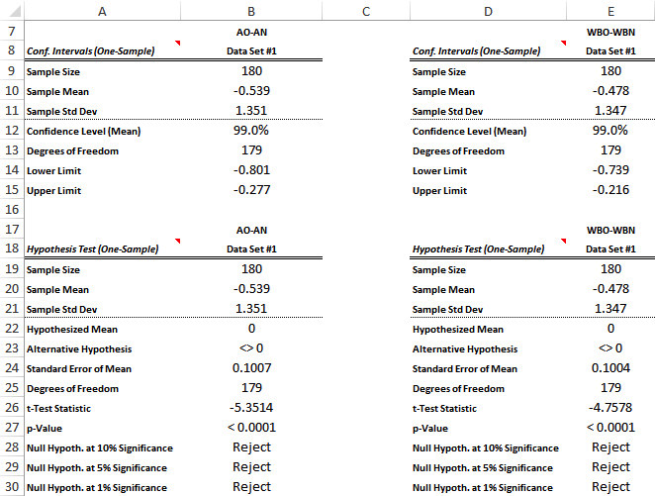
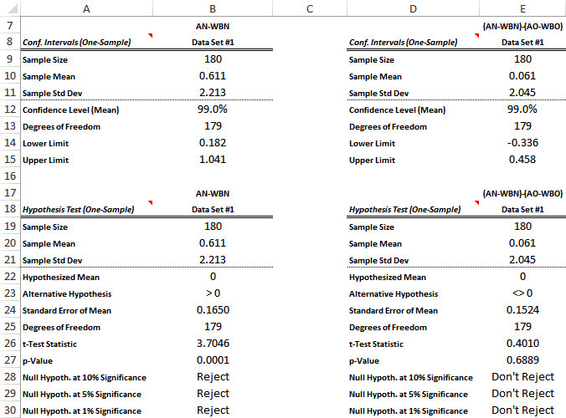
Example 9.4: Soft-Drink Cans.xlsx (slide 2 of 2)
The results from four tests for four difference variables are shown below.

Slide 24
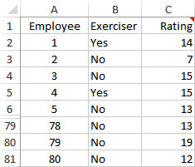
Example 9.5: Exercise & Productivity.xlsx (slide 1 of 2)
Objective: To use a two-sample t test for the difference between means to see whether regular exercise increases worker productivity.
Solution: Informatrix Software Company installed exercise equipment on site a year ago and wants to know if it has had an effect on productivity.
The company gathered data on a sample of 80 randomly chosen employees: 23 used the exercise facility regularly, 6 exercised regularly elsewhere, and 51 admitted to being nonexercisers.
The 51 nonexercisers were compared to the 29 exercisers based on the employees’ productivity over the year, as rated by their supervisors on a scale of 1 to 25, 25 being the best.
The data appear to the right.

Slide 25
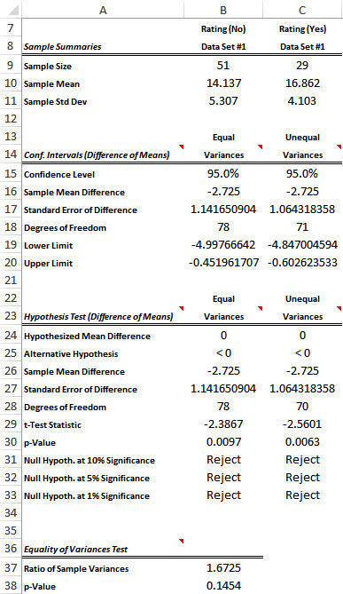
Example 9.5: Exercise & Productivity.xlsx (slide 2 of 2)
The output for this test, along with a 95% confidence interval for μ₁ − μ₂, where μ₁ and μ₂ are the mean ratings for the nonexerciser and exerciser populations, is shown to the right.

Slide 26
Hypothesis Test for Equal Population Variances
The two-sample procedure for a difference between population means depends on whether population variances are equal.
Therefore, it is natural to test first for equal variances.
This test is referred to as the F test for equality of two variances.
The test statistic for this test is the ratio of sample variances:
The null hypothesis is that this ratio is 1 (equal variances), whereas the alternative is that it is not 1 (unequal variances).
Assuming that the population variances are equal, this test statistic has an F distribution with n₁ – 1 and n₂ – 1 degrees of freedom.

Slide 27
Hypothesis Tests for Differences between Population Proportions
One of the most common uses of hypothesis testing is to test whether two population proportions are equal.
The following z test for difference between proportions can then be used.
As usual, the test on the difference between the two values requires a standard error.
Standard error for difference between sample proportions:
Resulting test statistic for difference between proportions:

Slide 28
Example 9.6: Empowerment 1.xlsx (slide 1 of 2)
Objective: To use a test for the difference between proportions to see whether a program of accepting employee suggestions is appreciated by employees.
Solution: ArmCo Company initiated a number of policies to respond to employee suggestions at its Midwest plant.
No such initiatives were taken at its other plants.
To check whether the initiatives had a lasting effect, 100 randomly selected employees at the Midwest plant and 300 employees from the other plants were asked to fill out a questionnaire six months after implementation of the new policies at the Midwest plant.
Two specific items on the questionnaire were:
Management at this plant is generally responsive to employee suggestions for improvements in the manufacturing process.
Management at this plant is more responsive to employee suggestions now than it used to be.

Slide 29
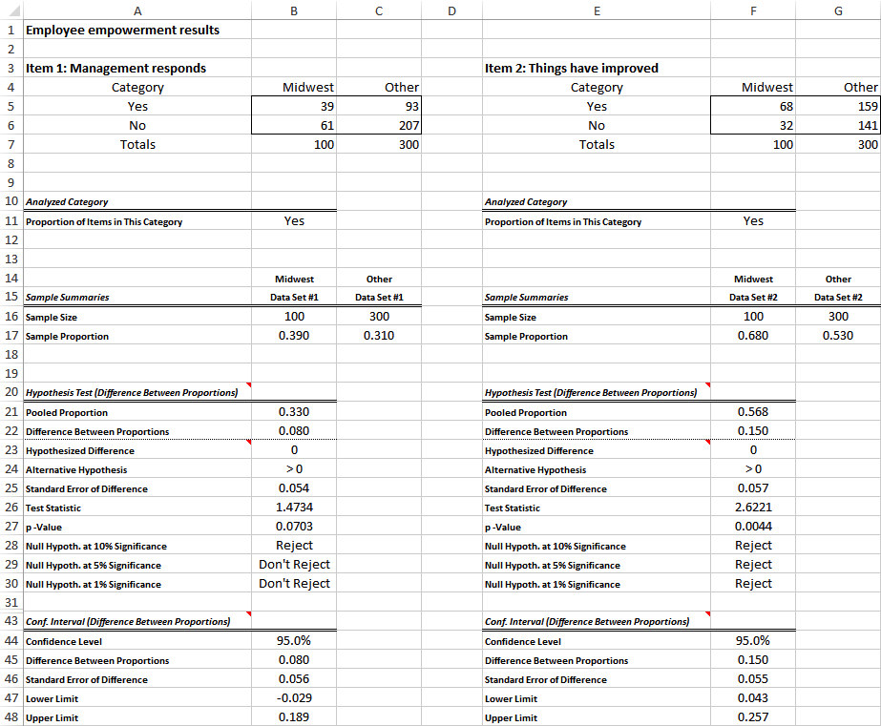
Example 9.6: Empowerment 1.xlsx (slide 2 of 2)
The results of the questionnaire for these two items appear in rows 5 and 6 below.
Using the counts in rows 5 and 6, StatTools can run the test for differences between proportions.

Slide 30
Tests for Normality
Many statistical procedures are based on the assumption that population data are normally distributed.
The tests that allow you to test this assumption are called tests for normality.
The first test is called a chi-square goodness-of-fit test.
A histogram of the sample data is compared to the expected bell-shaped histogram that would be observed if the data were normally distributed with the same mean and standard deviation as in the sample.
If the two histograms are sufficiently similar, the null hypothesis of normality is accepted.
The goodness-of-fit measure in the equation below is used as a test statistic.

Slide 31
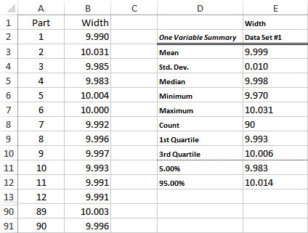
Example 9.7: Testing Normality.xlsx (slide 1 of 5)
Objective: To use the chi-square goodness-of-fit test to see whether a normal distribution of the metal strip widths is reasonable.
Solution: A company manufactures strips of metal that are supposed to have width of 10 centimeters.
For purposes of quality control, the manager plans to run some statistical tests on these strips.
Realizing that these statistical procedures assume normally distributed widths, he first tests this normality assumption on 90 randomly sampled strips.
The sample data appear below.

Slide 32
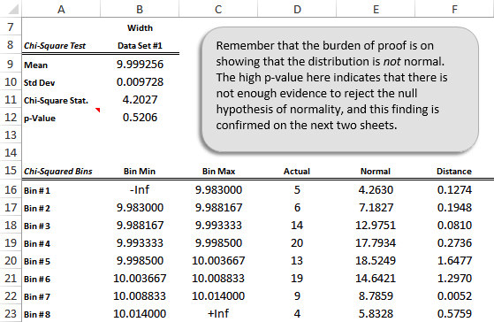
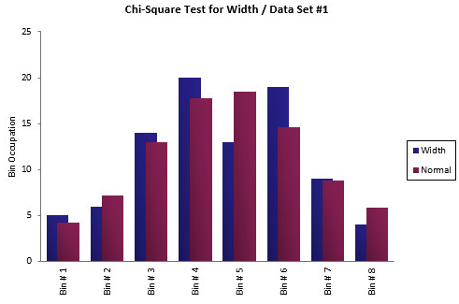
Example 9.7: Testing Normality.xlsx (slide 2 of 5)
To run the test, select Chi-Square Test from StatTools Normality Tests dropdown list.
Both the output and histograms below confirm that the normal fit to the data appears to be quite good.

Slide 33
Example 9.7: Testing Normality.xlsx (slide 3 of 5)
A more powerful test than the chi-square test of normality is the Lilliefors test.
This test is based on the cumulative distribution function (cdf), which shows the probability of being less than or equal to any particular value.
Specifically, the Lilliefors test compares two cdfs: the cdf from a normal distribution and the cdf corresponding to the given data.
This latter cdf, called the empirical cdf, shows the fraction of observations less than or equal to any particular value.
If the maximum vertical distance between the two cdfs is sufficiently large, the null hypothesis of normality can be rejected.

Slide 34
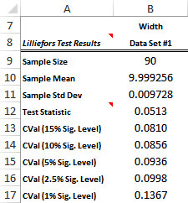
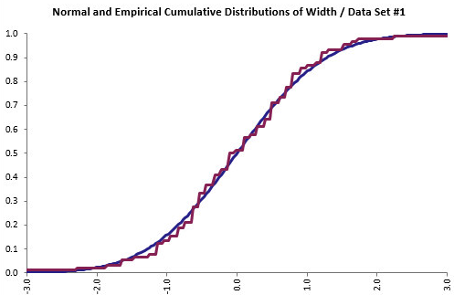
Example 9.7: Testing Normality.xlsx (slide 4 of 5)
To run the Lilliefors test for the Width variable in Example 9.7, select Lilliefors Test from the StatTools Normality Tests dropdown list.
StatTools then shows the numerical outputs and the graph of the normal and empirical cdfs.

Slide 35
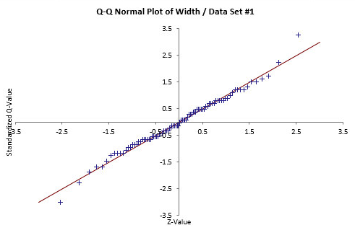
Example 9.7: Testing Normality.xlsx (slide 5 of 5)
A popular, but informal, test of normality is the quantile-quantile (Q-Q) plot.
It is basically a scatterplot of the standardized values from the data set versus the values that would be expected if the data were perfectly normally distributed.
The Q-Q plot for the Width data in Example 9.7 appears below.

Slide 36
Chi-Square Test for Independence
The chi-square test for independence is used in situations where a population is categorized in two different ways.
For example, people might be characterized by their smoking habits and their drinking habits. The question then is whether these two attributes are independent in a probabilistic sense.
They are independent if information on a person’s drinking habits is of no use in predicting the person’s smoking habits (and vice versa).
The null hypothesis for this test is that the two attributes are independent.
This test is based on the counts in a contingency (or cross-tabs) table.
It tests whether the row variable is probabilistically independent of the column variable.

Slide 37
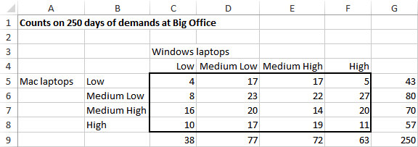
Example 9.8: Laptop Demand.xlsx (slide 1 of 2)
Objective: To use the chi-square test of independence to test whether demand for Windows laptops is independent of demand for Mac laptops.
Solution: Big Office wants to know whether the demands for Windows and Mac laptops are related in any way.
Big Office has daily information on categories of demand for 250 days, with each day’s demand for each type of computer categorized as Low, Medium Low, Medium High, or High.

Slide 38
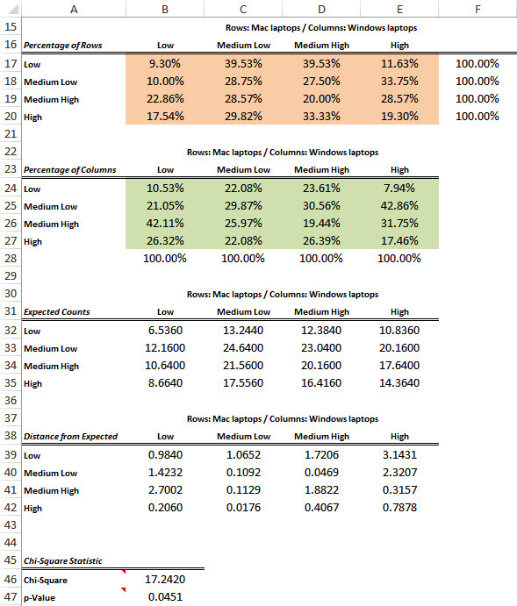
Example 9.8: Laptop Demand.xlsx (slide 2 of 2)
Test statistic for chi-square test for independence:
Expected counts assuming row and column independence:
Perform the calculations for the test by selecting Chi-Square Independence Test from the StatTools Statistical Inference dropdown list.
The output is shown to the right.

