Slide 1
8
Confidence Interval Estimation

Slide 2
Introduction
Statistical inferences are always based on an underlying probability model, which means that some type of random mechanism must generate the data.
Two random mechanisms are generally used:
Random sampling from a larger population
Randomized experiments
Generally, statistical inferences are of two types:
Confidence interval estimation—uses the data to obtain a point estimate and a confidence interval around this point estimate.
Hypothesis testing—determines whether the observed data provide support for a particular hypothesis.

Slide 3
Sampling Distributions
Most confidence intervals are of the form:
In general, whenever you make inferences about one or more population parameters, you always base this inference on the sampling distribution of a point estimate, such as the sample mean.
An equivalent statement to the central limit theorem is that the standardized quantity Z, as defined below, is approximately normal with mean 0 and standard deviation 1:
However, the population standard deviation σ is rarely known, so it is replaced by its sample estimate s in the formula for Z.
When the replacement is made, a new source of variability is introduced, and the sampling distribution is no longer normal. Instead, it is called the t distribution.

Slide 4
The t Distribution (slide 1 of 2)
If we are interested in estimating a population mean μ with a sample of size n, we assume the population distribution is normal with unknown standard deviation σ.
σ is replaced by the sample standard deviation s, as shown in this equation:
Then the standardized value in the equation has a t distribution with n – 1 degrees of freedom.
The degrees of freedom is a numerical parameter of the t distribution that defines the precise shape of the distribution.
The t-value in this equation is very much like a typical Z-value.
That is, the t-value indicates the number of standard errors by which the sample mean differs from the population mean.

Slide 5
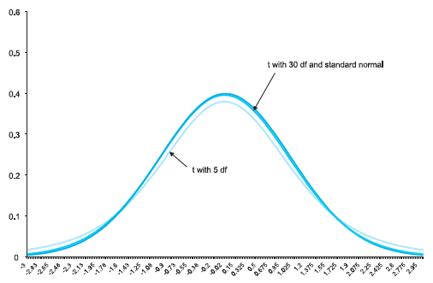
The t Distribution (slide 2 of 2)
The t distribution looks very much like the standard normal distribution.
It is bell-shaped and centered at 0.
The only difference is that it is slightly more spread out, and this increase in spread is greater for small degrees of freedom.
When n is large, so that the degrees of freedom is large, the t distribution and the standard normal distribution are practically indistinguishable, as shown below.

Slide 6
Other Sampling Distributions
The t distribution, a close relative of the normal distribution, is used to make inferences about a population mean when the population standard deviation is unknown.
Two other close relatives of the normal distribution are the chi-square and F distributions.
These are used primarily to make inferences about variances (or standard deviations), as opposed to means.

Slide 7
Confidence Interval for a Mean (slide 1 of 2)
To obtain a confidence interval for μ, first specify a confidence level, usually 90%, 95%, or 99%.
Then use the sampling distribution of the point estimate to determine the multiple of the standard error (SE) to go out on either side of the point estimate to achieve the given confidence level.
If the confidence level is 95%, the value used most frequently in applications, the multiple is approximately 2. More precisely, it is a t-value.
A typical confidence interval for μ is of the form:
where

Slide 8
Confidence Interval for a Mean (slide 2 of 2)
To obtain the correct t-multiple, let α be 1 minus the confidence level (expressed as a decimal).
For example, if the confidence level is 90%, then α = 0.10.
Then the appropriate t-multiple is the value that cuts off probability α/2 in each tail of the t distribution with n − 1 degrees of freedom.
As the confidence level increases, the width of the confidence interval also increases.
As n increases, the standard error s/√n decreases, so the length of the confidence interval tends to decrease for any confidence level.

Slide 9
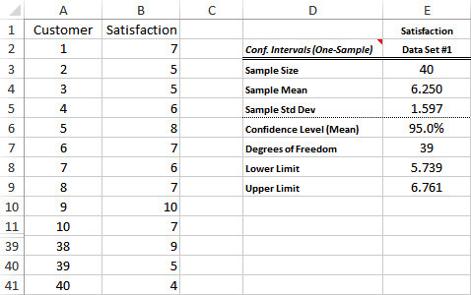
Example 8.1: Satisfaction Ratings.xlsx (slide 1 of 2)
Objective: To use StatTools’s One-Sample procedure to obtain a 95% confidence interval for the mean satisfaction rating of the new sandwich.
Solution: A random sample of 40 customers who ordered a new sandwich were surveyed. Each was asked to rate the sandwich on a scale of 1 to 10.
The results appear in column B below.
Use StatTools’s One-Sample procedure on the Satisfaction variable.

Slide 10
Example 8.1: Satisfaction Ratings.xlsx (slide 2 of 2)
In this example, two assumptions lead to the confidence interval:
First, you might question whether the sample is really a random sample. It is likely a convenience sample, not really a random sample.
However, unless there is some reason to believe that this sample differs in some relevant aspect from the entire population, it is probably safe to treat it as a random sample.
A second assumption is that the population distribution is normal, even though the population distribution cannot be exactly normal.
This is probably not a problem because confidence intervals based on the t distribution are robust to violations of normality, and the normal population assumption is less crucial for larger sample sizes because of the central limit theorem.

Slide 11
Confidence Interval for a Total (slide 1 of 2)
Let T be a population total we want to estimate, such as the total of all receivables, and let be a point estimate of T based on a simple random sample of size n from a population of size N.
First, we need a point estimate of T. For the population total T, it is reasonable to sum all of the values in the sample, denoted T_{s}, and then “project” this total to the population with this equation:
The mean and standard deviation of the sampling distribution of are given in the equations below:

Slide 12
Confidence Interval for a Total (slide 2 of 2)
Because σ is usually unknown, s is used instead of σ to obtain the approximate standard error of given in the equation below:
The point estimate of T is the point estimate of the mean multiplied by N, and the standard error of this point estimate is the standard error of the sample mean multiplied by N.
As a result, a confidence interval for T can be formed with the following two step-procedure:
Find a confidence interval for the sample mean in the usual way.
Multiply each endpoint of the confidence interval by the population size N.

Slide 13
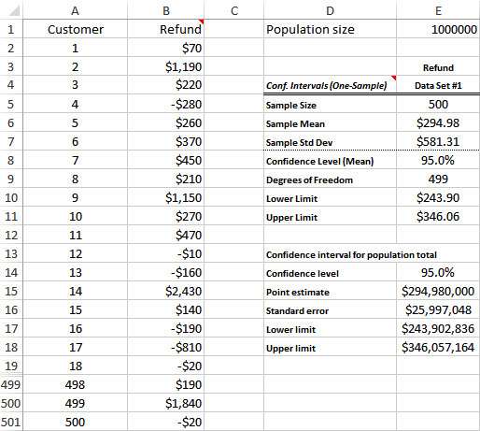
Example 8.2: IRS Refunds.xlsx
Objective: To use StatTools’s One-Sample Confidence Interval procedure, with an appropriate modification, to find a 95% confidence interval for the total (net) amount the IRS must pay out to a set of 1,000,000 taxpayers.
Solution: Data set is the refunds from a random sample of 500 taxpayers.
First use StatTools to find a 95% confidence interval for the population mean.
Next, project these results to the entire population.

Slide 14
Confidence Interval for a Proportion
Surveys are often used to estimate proportions, so it is important to know how to form a confidence interval for any population proportion p.
The basic procedure requires a point estimate, the standard error of this point estimate, and a multiple that depends on the confidence level:
It can be shown that for sufficiently large n, the sampling distribution of is approximately normal with mean p and standard error .
Standard error of sample proportion:
Confidence interval for a proportion:

Slide 15
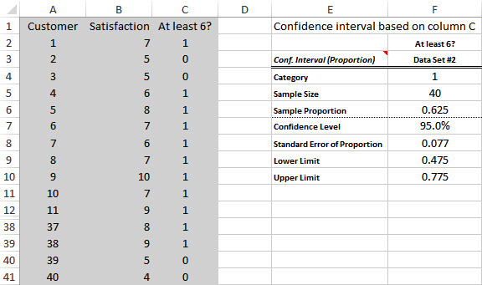
Example 8.3: Satisfaction Ratings.xlsx (slide 1 of 2)
Objective: To illustrate the procedure for finding a confidence interval for the proportion of customers who rate the new sandwich at least 6 on a 10-point scale.
Solution: A random sample of 40 customers who ordered a new sandwich were surveyed. Each was asked to rate the sandwich on a scale of 1 to 10. The results are shown in column B below.
First, create a 0/1 column that indicates whether a customer’s rating is at least 6.
Then have StatTools analyze the proportion of 1s.

Slide 16
Example 8.3: Satisfaction Ratings.xlsx (slide 2 of 2)
Confidence intervals for proportions are fairly wide unless n is quite large.
To obtain a 95% confidence interval of 3 percentage points for a population proportion, where the population consists of millions of people, only about 1000 people need to be sampled.
When auditors are interested in how large the proportion of errors might be, they usually calculate one-sided confidence intervals for proportions.
They automatically use lower limit p_{L} = 0 and determine an upper limit p_{U} such that the 95% confidence interval is from 0 to p_{U}.

Slide 17
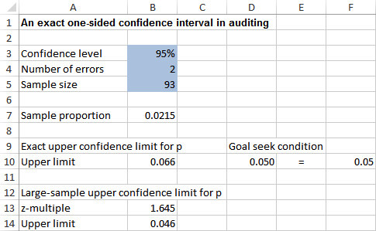
Example 8.4: One-Sided Confidence Interval.xlsx
Objective: To find the upper limit of a one-sided 95% confidence interval for the proportion of errors in the context of attribute sampling in auditing.
Solution: An auditor checks 93 randomly sampled invoices and finds that two of them include price errors.
StatTools is not used to find the upper limit because it does not include a procedure for one-sided confidence intervals.
The large-sample approximation might not be valid. A more valid procedure, based on the binomial distribution, appears in row 10.
If p_{U} is the appropriate upper confidence limit, then p_{U} satisfies the equation:

Slide 18
Confidence Interval for a Standard Deviation
There are cases where the variability in the population, measured by σ, is of interest in its own right.
The sample standard deviation s is used as a point estimate of σ.
However, the sampling distribution of s is not symmetric—it is not the normal distribution or the t distribution.
The appropriate sampling distribution is a right-skewed distribution called the chi-square distribution.
Like the t distribution, the chi-square distribution has a degrees of freedom parameter.

Slide 19
Example 8.5: Part Diameters.xlsx (slide 1 of 2)
Objective: To use StatTools’s One-Sample Confidence Interval procedure to find a confidence interval for the standard deviation of part diameters, and to see how variability affects the proportion of unusable parts produced.
Solution: A supervisor randomly samples 50 parts during the course of a day and measures the diameter of each part to the nearest millimeter.
Each part is supposed to have diameter 10 centimeters.
Because the supervisor is concerned about the mean and the standard deviation of diameters, obtain 95% confidence intervals for both.
Use StatTools’s One-Sample Confidence Interval procedure for Mean/Std. Deviation.
Then create a two-way data table to take this analysis one step further and calculate the proportion of unusable parts.

Slide 20
Example 8.5: Part Diameters.xlsx (slide 2 of 2)

Slide 21
Confidence Interval for the Difference Between Means
One of the most important applications of statistical inference is the comparison of two population means.
There are many applications to business.
For statistical reasons, independent samples must be distinguished from paired samples.

Slide 22
Independent Samples
The appropriate sampling distribution of the difference between sample means is the t distribution with n₁ + n₂ – 2 degrees of freedom.
Confidence interval for difference between means:
Pooled estimate of common standard deviation:
Standard error of difference between sample means:

Slide 23
Example 8.6: Treadmill Motors.xlsx (slide 1 of 2)
Objective: To use StatTools’s Two-Sample Confidence Interval procedure to find a confidence interval for the difference between mean lifetimes of motors, and to see how this confidence interval can help SureStep choose the better supplier.
Solution: SureStep Company installs motors from supplier A on 30 of its treadmills and motors from supplier B on another 30 of its treadmills.
It then runs these treadmills and records the number of hours until the motor fails.
Use StatTools’s Two-Sample Confidence Interval procedure to find a confidence interval for the difference between mean lifetimes of the motors of the two suppliers.

Slide 24
Example 8.6: Treadmill Motors.xlsx (slide 2 of 2)

Slide 25
Equal-Variance Assumption
This two-sample analysis makes the assumption that the standard deviations of the two populations are equal.
How can you tell if they are equal, and what do you do if they are clearly not equal?
A statistical test for equality of two population variances is automatically shown at the bottom of the StatTools Two-Sample output.
If there is reason to believe that the population variances are unequal, a slightly different procedure can be used to calculate a confidence interval for the difference between the means.
The appropriate standard error of is now:

Slide 26
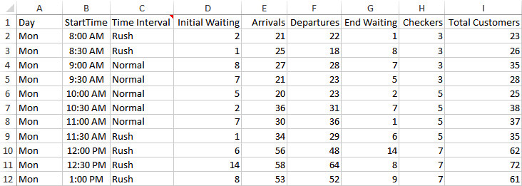
Example 8.7: Customer Checkouts.xlsx (slide 1 of 2)
Objective: To use StatTools’s Two-Sample Confidence Interval procedure to find a confidence interval for the difference between mean waiting times during the supermarket’s rush periods versus its normal periods.
Solution: Data set contains a week’s worth of data on customer arrivals, departures, and waiting at R&P Supermarket.
There are 48 observations per day, each taken at the end of a half-hour period.
Rename the seven time intervals so that there are only three: Rush, Normal, and Night.
Then perform the statistical comparison between the End Waiting variables for the Rush and Normal periods.

Slide 27
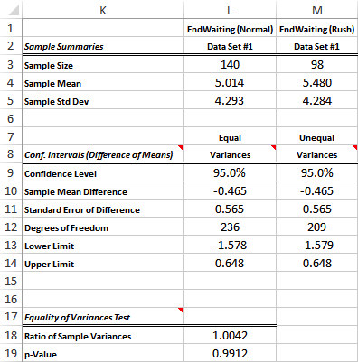
Example 8.7: Customer Checkouts.xlsx (slide 2 of 2)

Slide 28
Paired Samples
When the samples to be compared are paired in some natural way, such as a pretest and posttest for each person, or husband-wife pairs, there is a more appropriate form of analysis than the two-sample procedure.
The paired procedure itself is very straightforward:
It does not directly analyze two separate variables (pretest scores and posttest scores, for example); it analyzes their differences.
For each pair in the sample, calculate the difference between the two scores for the pair.
Then perform a one-sample analysis on these differences.

Slide 29
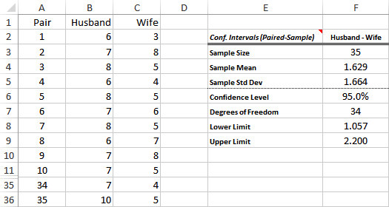
Example 8.8: Sales Presentation Ratings.xlsx
Objective: To use StatTools’s Paired-Sample Confidence Interval procedure to find a confidence interval for the mean difference between husbands’ and wives’ ratings of sales presentations.
Solution: A random sample of husbands and wives are asked (separately) to rate the sales presentation at Stevens Honda-Buick automobile dealership on a scale of 1 to 10.
Use the paired-sample procedure to perform the analysis because the samples are naturally paired and there is a reasonably large positive correlation between the pairs.

Slide 30
Confidence Interval for the Difference between Proportions
The basic form of analysis is the same as in the two-sample analysis for differences between means.
However, instead of comparing two means, we now compare proportions.
Confidence interval for difference between proportions:
Standard error of difference between sample proportions:

Slide 31
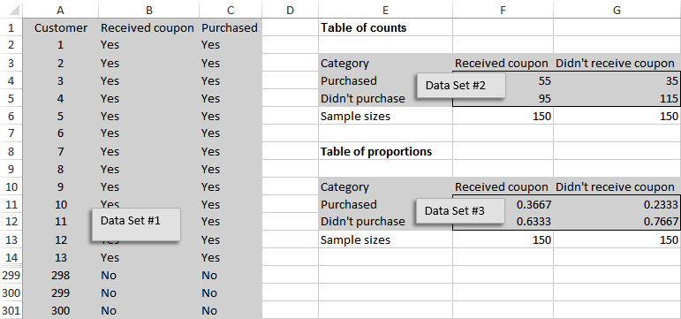
Example 8.9: Coupon Effectiveness.xlsx (slide 1 of 2)
Objective: To find a confidence interval for the difference between proportions of customers purchasing appliances with and without 5% discount coupons.
Solution: An appliance store selects 300 of its best customers and randomly divides them into two sets of 150 customers each.
It then mails a notice about a sale to all 300 but includes a coupon for an extra 5% off the sale price to the second set of customers only.
As the sale progresses, the store keeps track of which of these customers purchase appliances.
The resulting data appear below.

Slide 32
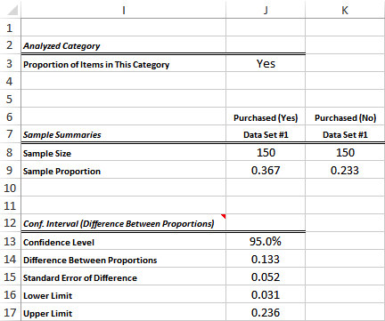
Example 8.9: Coupon Effectiveness.xlsx (slide 2 of 2)
Use StatTools to find a confidence interval for the difference between proportions of customers who purchased appliances with and without the discount coupons.

Slide 33
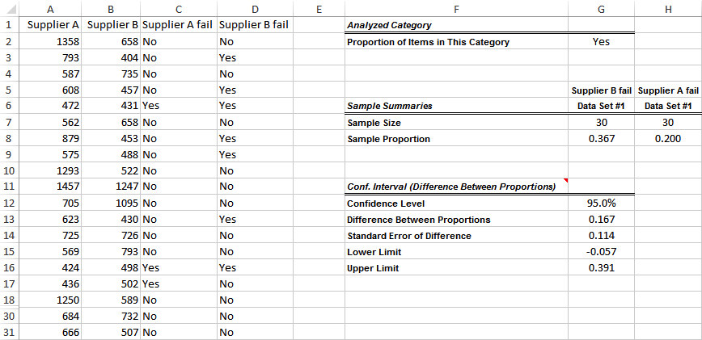
Example 8.10: Treadmill Warranty.xlsx
Objective: To find a confidence interval for the difference between proportions of motors failing within the warranty period for the two suppliers.
Solution: Each SureStep treadmill carries a three-month warranty on the motor, and SureStep translates this warranty period into approximately 500 hours of treadmill use.
The data set is the same as in Example 8.6.
Use StatTools to analyze the data and obtain the confidence interval for the difference between proportions of motors failing before 500 hours across the two suppliers.

Slide 34
Sample Size Selection (slide 1 of 2)
Confidence intervals are a function of three things:
Data in the sample—directly affect the length of a confidence interval through their sample standard deviation(s).
There are random sampling plans that can reduce the amount of variability in the sample and hence reduce confidence interval length.
Variance reduction is also possible in randomized experiments.
Confidence level—as it increases, the length of the confidence interval increases as well.
However, the confidence level is rarely used to control the length of the confidence interval.
Instead, confidence level choice is usually based on convention, and 95% is by far the most commonly used value.
Sample size(s)—the most obvious way to control confidence interval length is to choose the sample size(s) appropriately.

Slide 35
Sample Size Selection (slide 2 of 2)
The goal is to make the length of a confidence interval sufficiently narrow.
Each confidence interval discussed so far (with the exception of the confidence interval for a standard deviation) is a point estimate plus or minus some quantity.
The “plus or minus” part is called the half-length of the interval.
The usual approach is to specify the half-length B you would like to obtain. Then you find the sample size(s) necessary to achieve this half-length.

Slide 36
Sample Size Selection for Estimation of the Mean
The appropriate sample size for estimation of the mean can be calculated from the formula for the confidence interval for the mean, by setting and solving for n:
Unfortunately, sample size selection must be done before a sample is observed, and value s is not yet available.
The usual solution is to replace s by some reasonable estimate σ_{est} of the population standard deviation, and to replace the t-multiple with the corresponding z-multiple from the standard normal distribution.
The resulting sample size formula is:

Slide 37
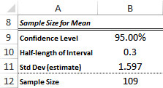
Example 8.11: Satisfaction Ratings.xlsx
Objective: To find the sample size of customers required to achieve a sufficiently narrow confidence interval for the mean rating of the new sandwich.
Solution: The fast-food manager in Example 8.1 surveyed 40 customers, each of whom rated a new sandwich on a scale of 1 to 10.
Based on the data, a 95% confidence interval for the mean rating of all potential customers extended from 5.739 to 6.761, with a half-length of 0.511.
Use StatTools’s Sample Size Selection procedure to find how large a sample would be needed to reduce this half-length to approximately 0.3.

Slide 38
Sample Size Selection for Estimation of Other Parameters
The sample-size analysis for the mean carries over with very few changes to other parameters.
Sample Size Formula for Estimating a Proportion:
Sample Size Formula for Estimating the Difference Between Means:
Sample Size Formula for Estimating the Difference Between Proportions:

Slide 39
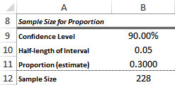
Example 8.12: Satisfaction Ratings.xlsx
Objective: To find the sample size of customers required to achieve a sufficiently narrow confidence interval for the proportion of customers who have tried the new sandwich.
Solution: The data set is the same as in Examples 8.1 and 8.11.
Now the fast-food manager wants to estimate the proportion of customers who have tried its new sandwich.
She wants a 90% confidence interval for this proportion to have half-length 0.05.
If she is fairly sure that the proportion who have tried the new sandwich is around 0.3, she can use p_{est} = 0.3.
Use StatTools and enter the values as shown below.

Slide 40
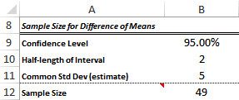
Example 8.13: Sample Size Selection for Analyzing Complaints
Objective: To see how many employees in each experimental group must be sampled to achieve a sufficiently narrow confidence interval for the difference between the mean numbers of complaints.
Solution: A customer service center has two types of employees: those who have had a recent course in dealing with customers (but little actual experience) and those with a lot of experience dealing with customers (but no formal course).
The company wants to estimate the difference between the two types of employees in terms of the average number of customer complaints regarding poor service in the last six months.
The company plans to obtain information on a randomly selected sample of each type of employee, using equal sample sizes.
Use the StatTools Sample Size Selection procedure to determine the number of employees that should be in each sample to achieve a 95% confidence interval with approximate half-length 2.

Slide 41
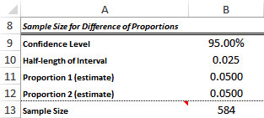
Example 8.14: Sample Size Selection for Analyzing Proportions of Out-of-Spec Products
Objective: To see how many products in each plant must be sampled to achieve a sufficiently narrow confidence interval for the difference between the proportions of out-of-spec products.
Solution: A supervisor at a company with two plants wants to know how much the proportion of out-of-spec products differs across the two plants.
He suspects the proportion of out-of-spec products in each plant is in the range of 3% to 5%, and he wants a 99% confidence interval to have approximate half-length 0.005.
However, his initial calculations yield a sample size that is almost certainly prohibitive, so he decreases the confidence level to 95% and increases the desired half-length to 0.025.
Use StatTools’s Sample Size Selection procedure to determine how many items he should sample from each plant, using these revised goals.

