Slide 1
Army Cost Management & Financial Transparency
Executive Comptroller Course
22 October, 2015
Ft Belvoir - Humphrey Engineer Center
Mort Anvari
Director, Programs and Strategy
US Army, ASA(FM&C)
http://www.anvari.net/
http://h222767.temppublish.com/

Slide 2
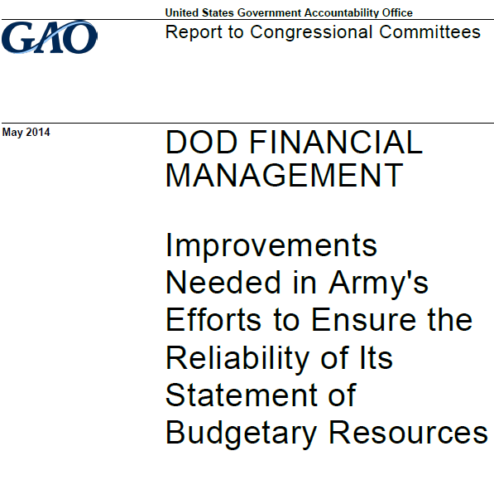
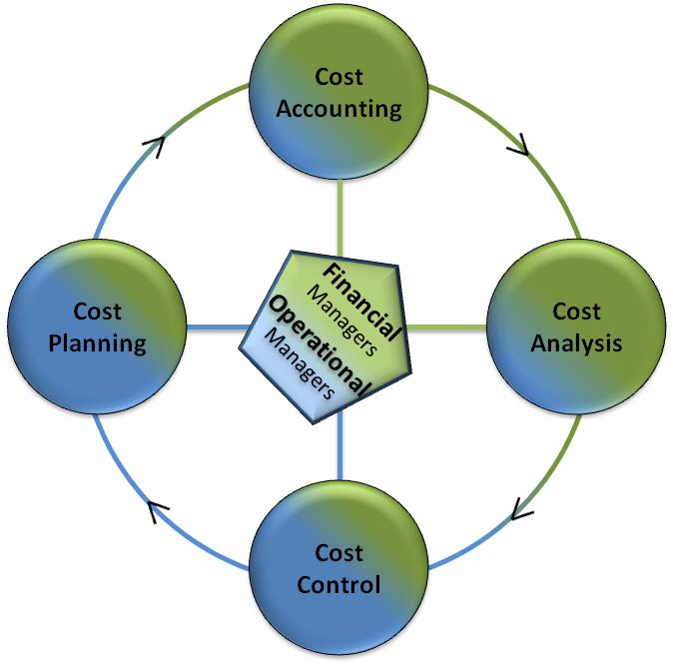
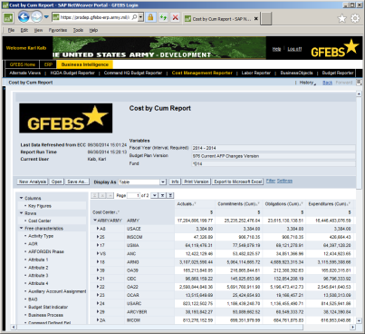
Army Financial Transparency
Challenges
DOD Audit Readiness
Visibility into Cost and Spending
Meaningful Business Analytics for Decision Making
Financial System Interface Errors and Rework
Opportunity
Army Cost Data Capture Strategy and CM
Progress
Cost Culture and Cost Management (CM) Initiatives
Army General Fund Enterprise Business System (GFEBS)
Addressing Financial Material Weaknesses - LSS
Army Financial Benefits Reporting and Tracking (AFBRT)
Army CM Steering Group
Army Financial Management Optimization (AFMO)
2

Slide 3
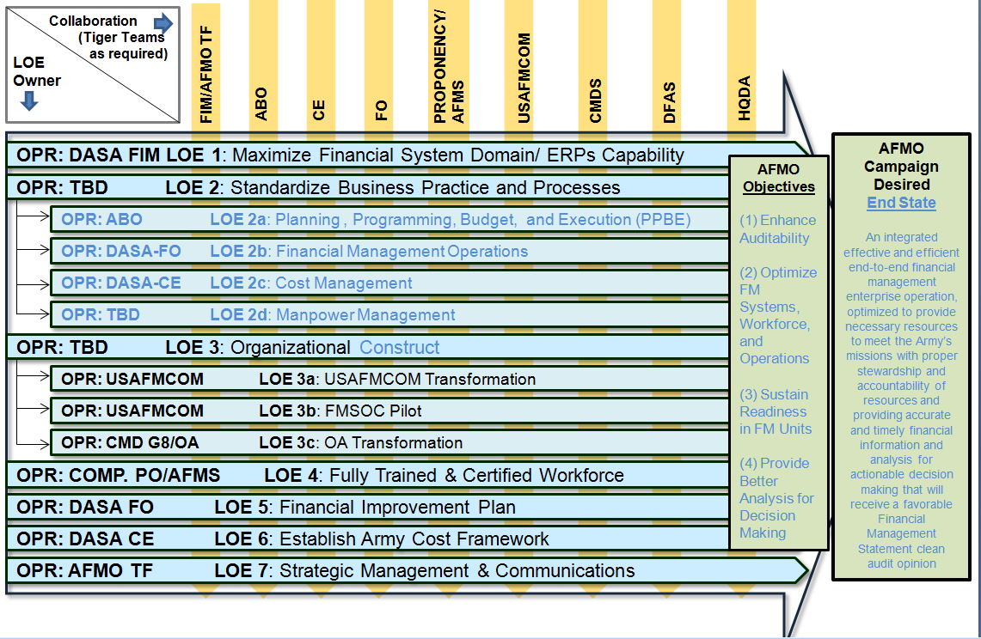
Army Financial Management Optimization
Notes:
As part of the AFMO initiative, DASA CE has been tasked to Establish Army Cost Framework. The previous slides defines one perspective of how DASA CE is building this framework.

Slide 4
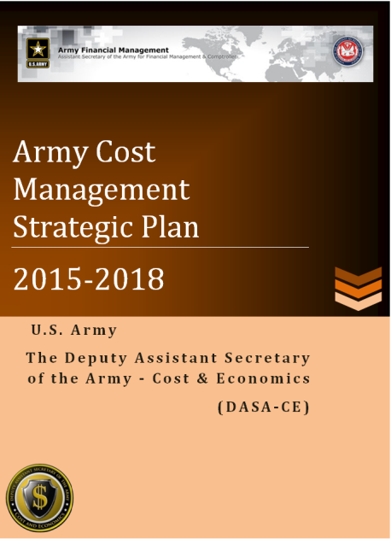
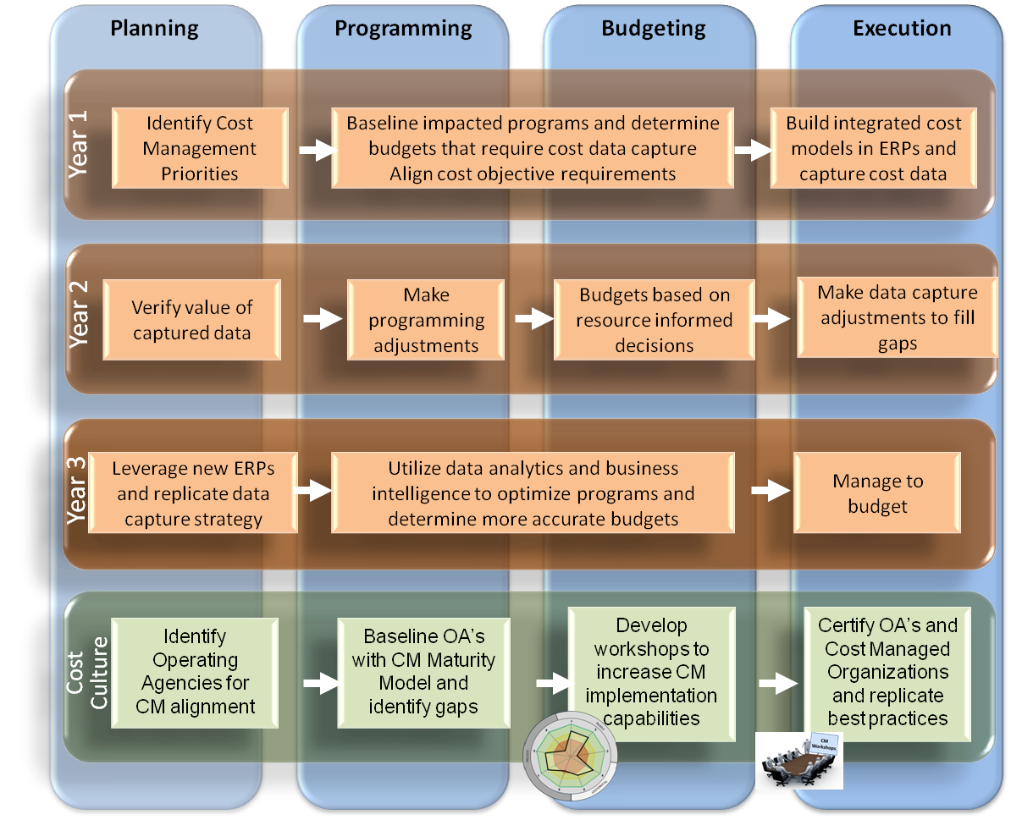
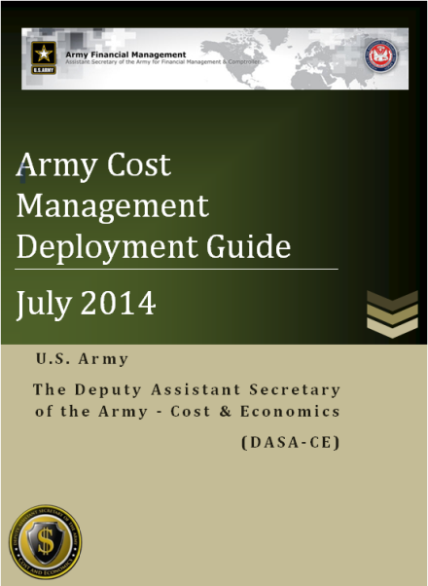
Cost Management Data Capture Strategy
Improve data quality and cost data visualization tools for decision making.
Incorporate rigorous Cost Management in funding decision to reduce future cost risk.
Plan for capture of execution data in support of CM and PPBE processes.
Prioritized, Aligned, and Optimized Cost Data Capture
Integrate Cost Management into PPBE and Core
End-to-End processes
4

Slide 5



Enterprise CM Data Need
1. Customers
Views
Full Visibility - Big Cost Data
2.Contracts
1
# Tables = N * (N-1) / 2
for 10 views 45 cost visibility table is needed
2. Contracts
Multi-dimensional Polygon Cost Visibility
  1- Customers by Contracts
  2- Customers by Services
  3- Customers by Funding
  4- Customers by Cost Centers
  5- Contracts by Service
  6- Contracts by Funding
  7- Contracts by Cost Centers
  8- Services by Funding
  9- Service by Cost Centers
  10 –Funding by Cost Centers
3.Services
2
5
3. Services
4.Funding
3
6
8
4. Funding
5.Cost Centers
4
7
9
10
.
.
.
.
.
.
.
Org, Year, Supplier, Type . . ?
5

Slide 6
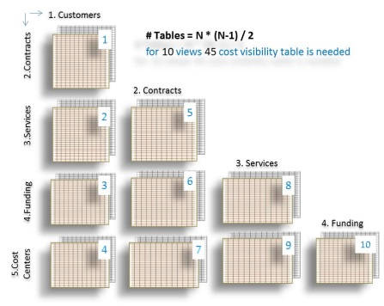
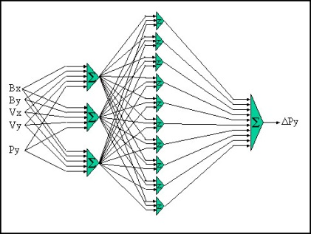
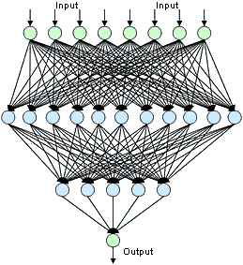
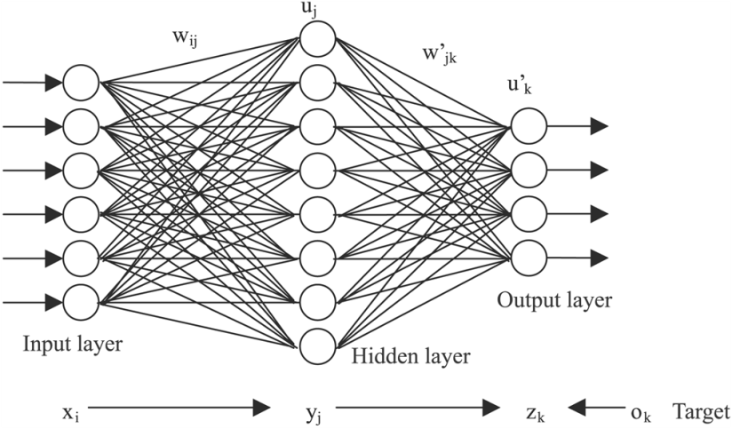
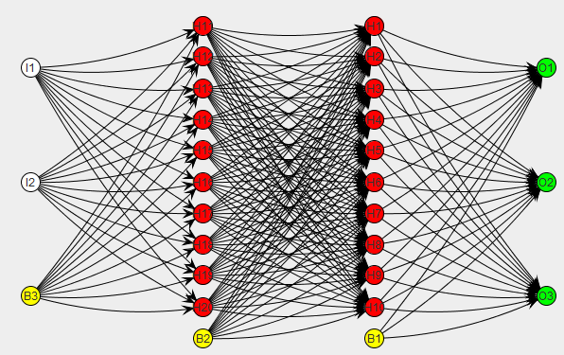
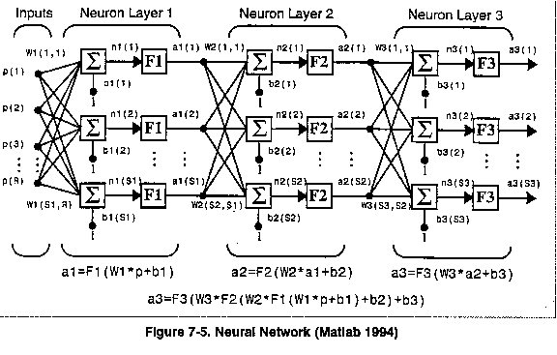
Cost Attribution Models
Data Views
6

Slide 7
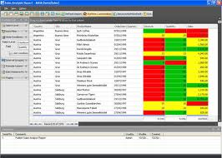
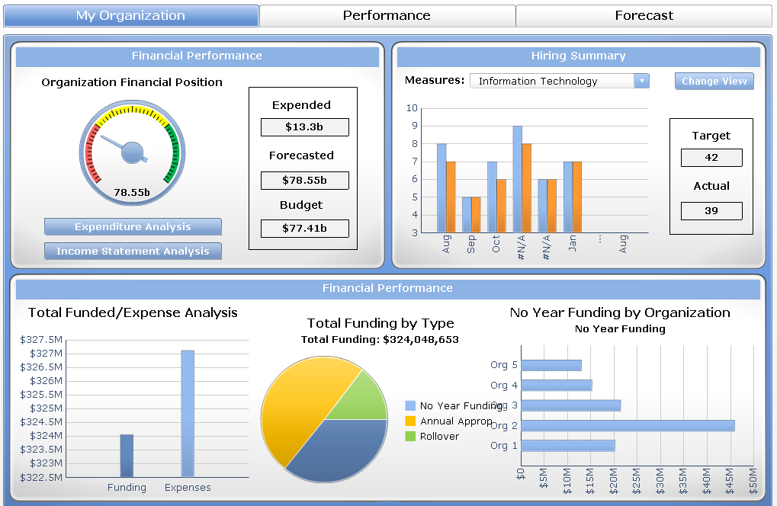
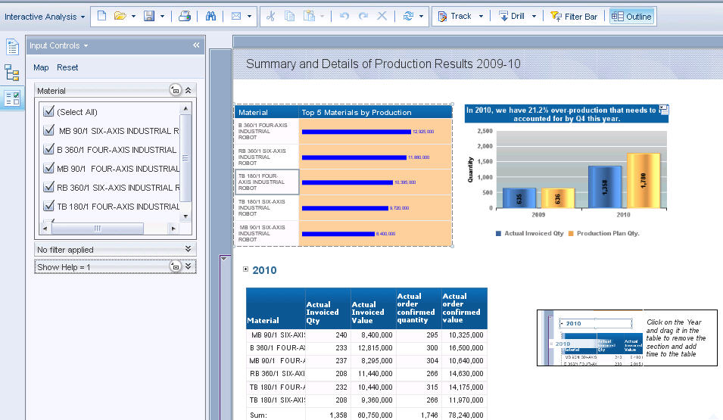
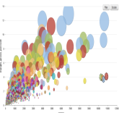


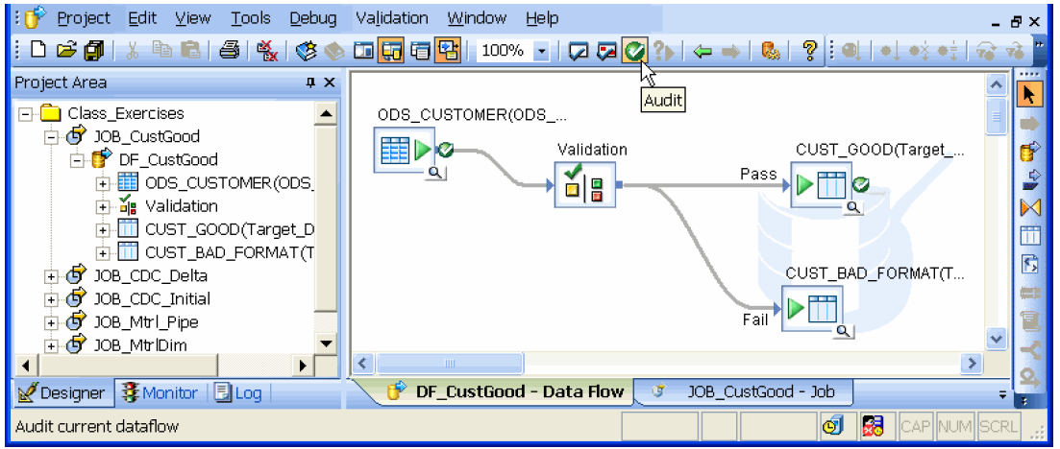




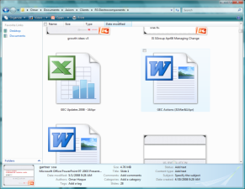
Cost Management Data Architecture
Reports
Dash Boards
Analysis
Presentation
Layer
Data
Standardization
A
Data
Warehouse
& Information
Management
Layer
BI Engine
OLAP
Data Warehouse
(AESIP)
Data Marts
Common Data Value
Common Exchange Mechanism
Common Entity Model
Data
Integration
Layer
Unstructured Data
ETL
Data Sources
Layer
IPPS-A
GCSS-A
GFEBS
B
Sources
Databases
Unstructured Data
File
Systems
ERPs
SOA, ESB,
Web
GFM-DI
High Cost of Data Standardization at Data Source Layer ?
7

Slide 8




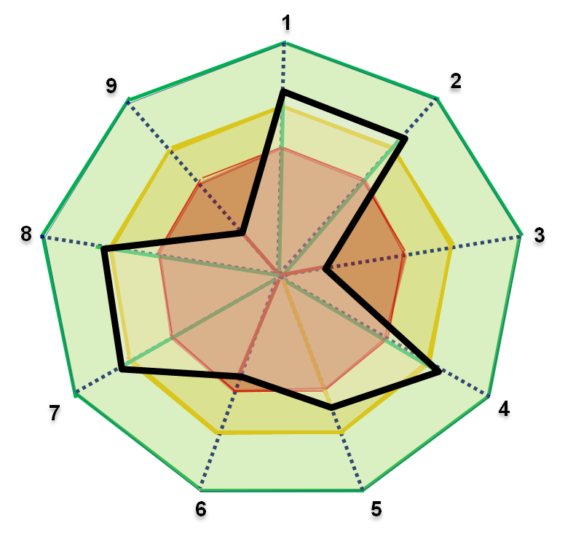
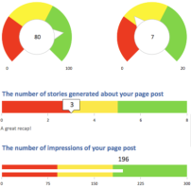
Army Cost Management (CM) is working
People
Leadership Commitment
Training
FM Workforce (AFMO)
CM Process Model
Technology
Data Quality (ERP Cost Data, Performance Metrics)
Tools & Models (Analytics, BI)
Process
Cost Planning (Cost Estimates, …...)
Cost Analysis (CBA, AoA, ….)
Cost Integration to Requirement, Acquisition & Resource
Cost Control (LSS, AFBRT, …..)
Training
CM Maturity Model
CM Goal: Better Value for Lower Cost
Stewardship of nation’s resources
Cost informed decision making
Continuous improvement
Accountability for costs
Tracking progress
Data Quality
Cost Analysis
8

Slide 9
Army Cost Management End-to-End Process
Develop & Maintain Cost Model
Perform Cost Planning
Perform Cost Accounting
Perform Cost Analysis
Perform Cost Controlling
Determine Cost Objectives
Maintain Cost Model
CM Process Activities Level One
Establish Planned Output
Establish Planned Costs (inputs)
Develop Cost and Performance Targets
Develop Metrics
Capture Actual Costs
Capture Actual Outputs
Perform Cost Assignment
Perform Period End Close
Capture Actual Costs
Capture Actual Outputs
Perform Cost Assignment
Perform Period End Close
CM Process Activities Level Two
Compare Results to Plan
Process Improvement
Adjust Targets
Select Method of Control
Implement (changes to) Policies & Procedures
Manage Tradeoffs
9

Slide 10
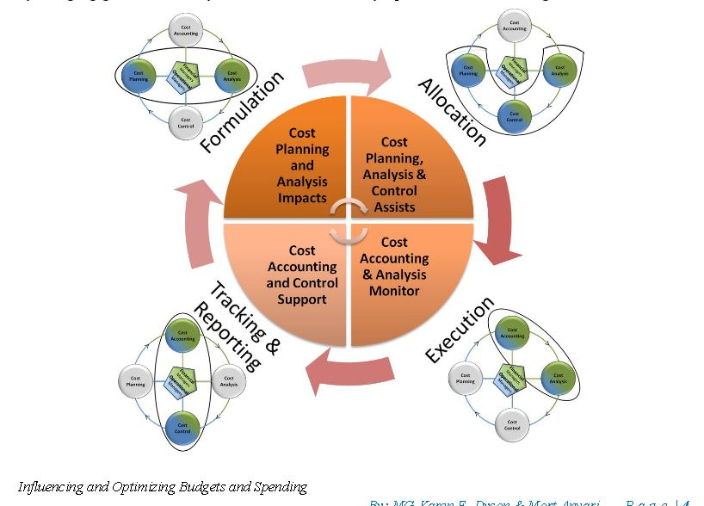
Army Cost Management and PPBE
Integrating Cost Management with PPBE Process
10

Slide 11
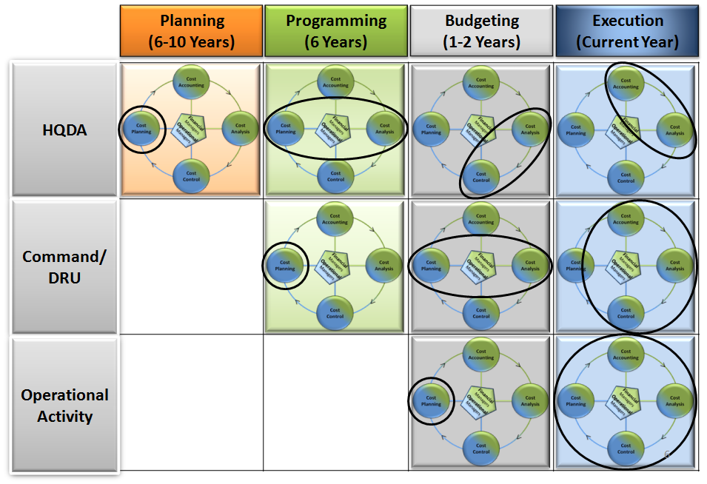
Aligned CM to PPBE
11

Slide 12
CM Activities and PPBE Phases
Planning
Programming
Budgeting
Execution
(6 - 10 Years)
(6 Years)
(1-2 Years)
(Current Year)
Strategic Decision-Making:
Outyear Forecasting:
Formulation / Justification:
Allocation/Funds Distribution:
- Cost Benefit Analysis
- Cost Factors & Models
- Cost Factors
- Cost Analysis to Support
- Analysis of Alternatives
* TRM/OSMIS
* OPTEMPO Cost Factors
* Cash Management
- Army Cost Position (LCCE)
* FORCES Costing Model
* Mil Pay Rates
* Reprogramming
HQDA
- Cost Models / Tools
* AMCOS / Civ Pay Rates
* Civ Pay Rates
* Rate of Executution
* FORCES Costing Model
- Army Cost Position (LCCE)
- Cost & Spend Plans
- Budget vs Actual (Variance)
* Capability Costing Tool
- Contingency Cost Model
- Include AFBRT Initiatives
- Monitor Will /Should Cost
- Cost of Army
- CBA's, LSS
- Historical Trend Analysis
- Track Cost Savings (ARFIT)
- Workforce Analysis
- Incorporate AFBRT Benefits
- Establish Should Cost Goals
- Mid-Year Reviews
Strategic Planning:
Outyear Plans / Controls:
Measure & Control:
- Cost Benefit Analysis
- Cost Targets/
- Variance Analysis
- Cocept Plans
- Annual Efficiency Goals
(Cost & Output)
Command
- Workforce Mgmt
- Assess Cost & Spend Plans
- Benchmarking Best Practices
- Submit Initiatives to AFBRT
- Plan Output (Capacity Mgmt)
- Adjust Cost Targets
/ DRU
- Trend Analysis
- Cost Benefit Analysis
- Mid-Year Reviews
- Cost Models / Tools
- Trade Space Analysis
- Measure Reduction Initiatives
- Investment Decisions
- Establish AFBRT Milestones
- Adjust Allocation Rules
- Identify Efficiency Initiatives
- TRAPS
Operational Planning:
Continuous Improvement:
- Establish Annual Cost Plans
- Qtrly Cost Mgmt Reviews
- Set Output Goals / Objectives
- Variance Analysis
Operational
- Optimize Capacity
* Resources (Inputs)
- Adjust to Directives
* Labor Rates
Activity
(e.g. TRAPS)
* Output (Unit Cost, Qty)
- Establish Activity Rates
- Budget vs Actual (Variance)
(Labor / Equip)
- OH Allocations
- Estimate OH Allocations
- Product/Service $, Customer $
12

Slide 13
Current Situation
Costs are typically tracked vertically either by organization level and then by commodity (examples: Civilian labor at AMC HQ, Fuel at the 101st CAB, travel costs at ATEC) OR by key 4 line of accounting
  Fund (APPN, FY, Base/Supplemental); Command; SAG/APE; and MDEP
The costs for “horizontal” Army processes are typically not tracked, particularly those that cross organizational boundaries, yet processes are how the Army accomplishes its primary Title 10 missions—training, equipping, recruiting, acquiring, maintaining, etc.
The full fielding of the General Fund Enterprise Business System (GFEBS) provides unprecedented capability to better determine Army costs
Budget constraints place a greater emphasis on better informed decision making
13

Slide 14



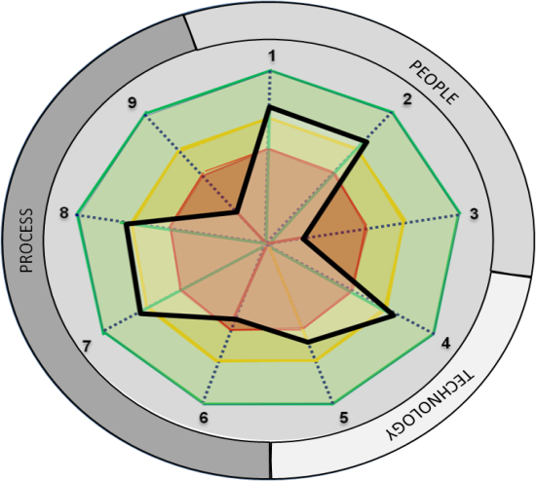

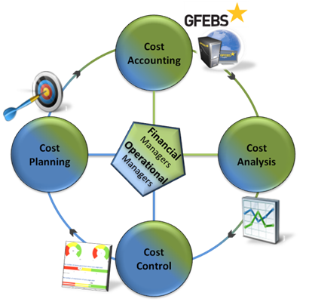
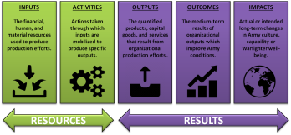
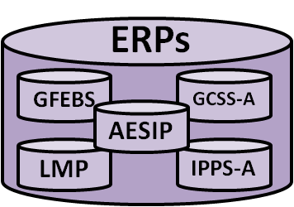
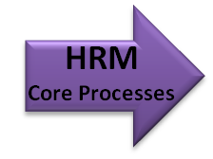
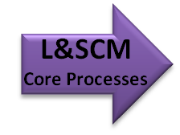
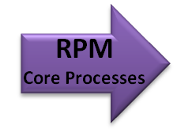
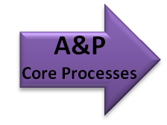
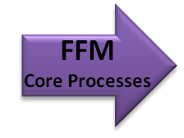

Financial Management & Performance Assessment
Decision Makers Span of Control & Influence (SC&I)
What questions are decision makers asking regarding cost & performance?
Customer
DECISIONS
What knowledge is required to make cost & performance decisions?
Reports
CM Maturity
Dash Boards
Analysis
Output
KNOWLEDGE
How do organizations correlate cost to performance?
Process
Correlate
COST MANAGEMENT
PERFORMANCE
MANAGEMENT
INFORMATION
Which systems provide cost & performance data?
Input
DATA SOURCES, FILE SYSTEMS, dB’s
UNSTRUCTURED DATA
ERP SYSTEMS
DATA
Which processes generate the cost & performance data?
Supplier
14
Notes:
The data capture architecture is also the basis of an enterprise strategy to understand the relationship of data to information to knowledge and decisions regardless of where
the decision maker is as long as the decisions are within the decision makers Span of Control & Influence.
The SC&I scopes the decision making framework that aligns the data sources to the eventual reports and dashboards needed for knowledge to make accurate decisions.
Cost management and Performance Management are correlated to enable the decision maker to iterate the process to achieve better knowledge and understand the impacts of cost performance to non-financial measures of performance,
such as quality, cycle time, or other measures of effectiveness and efficiency.
At each level of the SIPOC, questions must be answered in order to understand how the decision maker should correlate cost and performance into an integrated resource informed decision making environment.

Slide 15
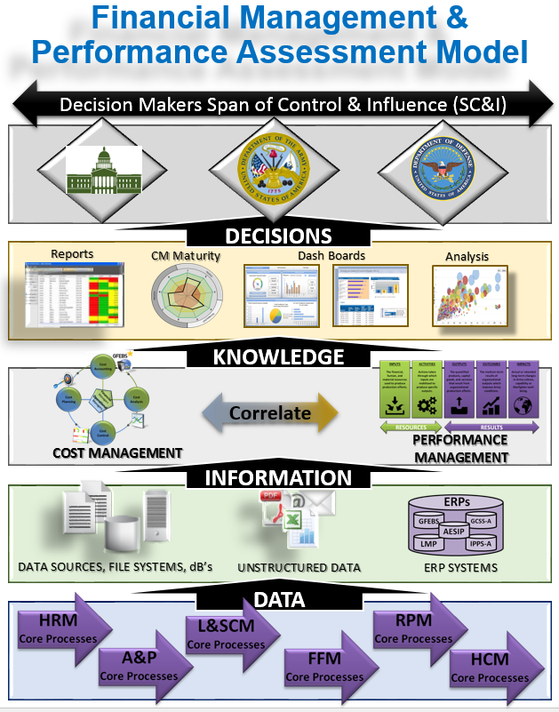
Improve Financial Management and Performance Assessment (FPA)
Timeline/Milestones
Strategic Alignment:
SD 3, SA 6, FMC 1, 2, 4
Concept Initiatives
Data Capture Strategy
FM and PM Correlation
Cost of Training
Cost of Recruiting
Development
Financial Management & Performance Assessment (FPA) Model
SAG 432 Improve OP-5 project
Build PM architecture
Cost of Logistics Readiness
Implementation
Improve all SAG
Design dashboards based on SAG FPA
Implement FPA to support Resource Informed Decision Making (RIDM)
Realization
Integrate FPA into PPBE process
CPI SAG OP-5 process
Expand RIDM model to Enterprise
Manage and evolve
Oct 2014 – Aug 2015
Sept 2015 – Dec 2015
Jan 2016 – Sept 2016
Sept 2016 – 2017
Goal: To develop a repeatable and scalable process to correlate financial resources to performance measures that align with readiness and effectively measure outcomes throughout the Army Enterprise that aligns with the overall Defense Strategy.
Initiatives: FM&C has actively been working Cost Management, Performance Management, Cost of Training and Cost of Recruiting initiatives to enable improved Resource Informed Decision Making across the Army Enterprise.
Next Steps:
Utilize the Justification Books to define Performance Criteria and Evaluation Summaries to set FPA measures, align with Title 10 Functions and E2E Processes
Complete a proof-of-concept project to improve the OP-5 report for SAG 432 for O&M.
Begin addressing Cost of Logistics Readiness.
Replicate best practices from SAG 432 project to all SAGs and all appropriation J-Books.
Develop a FPA architecture to design strategically relevant and aligned dashboards for Enterprise wide RIDM.
Integrate FPA into PPBE process, POM development and budget formulation process for optimized financial execution.
15

Slide 16
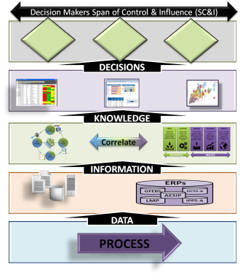
Financial and Performance Assessment (FPA)
Align to Title 10 Functions
TITLE 10 FUNCTIONS
(1) Recruiting
(2) Organizing
(3) Supplying
(4) Equipping
(5) Training
(6) Servicing
(7) Mobilizing
(8) Demobilizing
(9) Administering
(10) Maintaining
(11) Construction-E
(12) Construction-B
Which Title 10 function best describes the mission?
Identify the span of control and influence your organization has on that function?
What performance measures are needed to show the organization is meeting the Title 10 requirements?
What data sources are available or need to be discovered that will reflect resource execution?
Which process are utilized to deliver products and services that meet Title 10 deliverables?
16

Slide 17
Financial and Performance Assessment (FPA)
Align to E2E Processes
ARMY End-to-End Processes
Procure-to-Pay (P2P)
Order-to-Cash (O2C)
Budget-to-Report (B2R)
Cost Management (CM)
Acquire-to-Retire (A2R)
Hire-to-Retire (H2R)
Deploy-to-Redeploy/Retrograde (D2RR)
Concept-to-Product (C2P)
Environmental Liabilities (EL)
Service Request-to-Resolution (SR2R)
Plan-to-Stock (P2S)
Market-to-Prospect (M2P)
Prospect-to-Order (P2O)
Service-to-Satisfaction (S2S)
Proposal-to-Reward (P2R)
1. Identify Span of Control and Influence along an E2E process.?
2. What decisions will be made that require information and financial resources?
3. What performance measures are needed and what BI is required for dashboards?
4. What systems and data will provide the data for resource informed decision making?
17

Slide 18
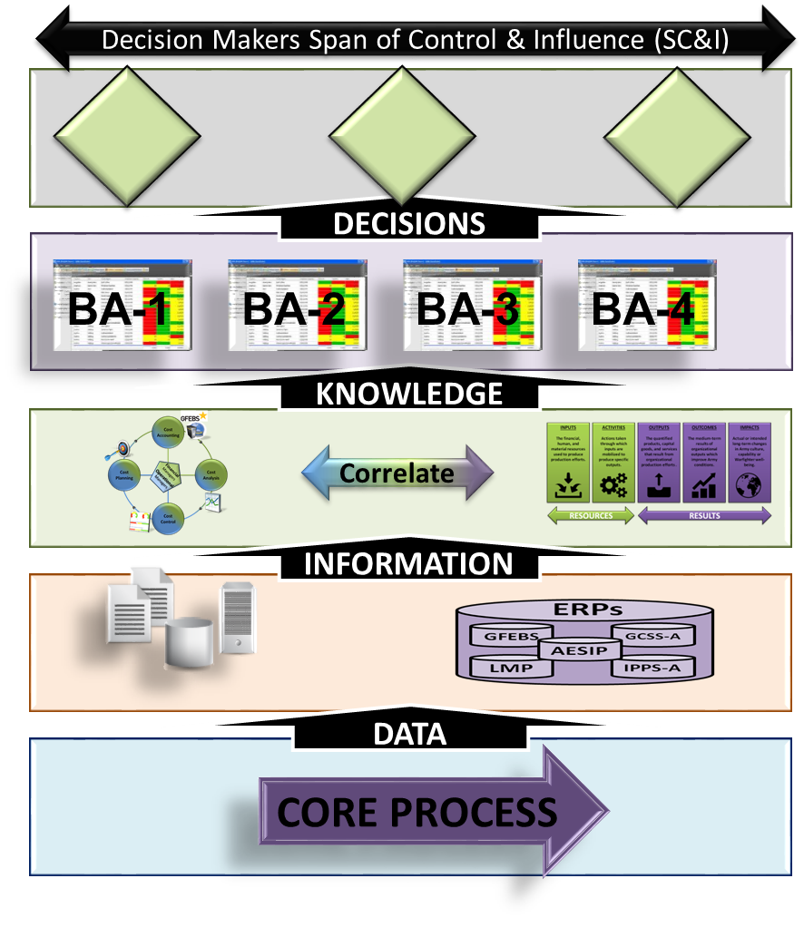
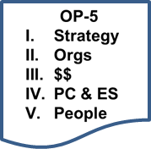
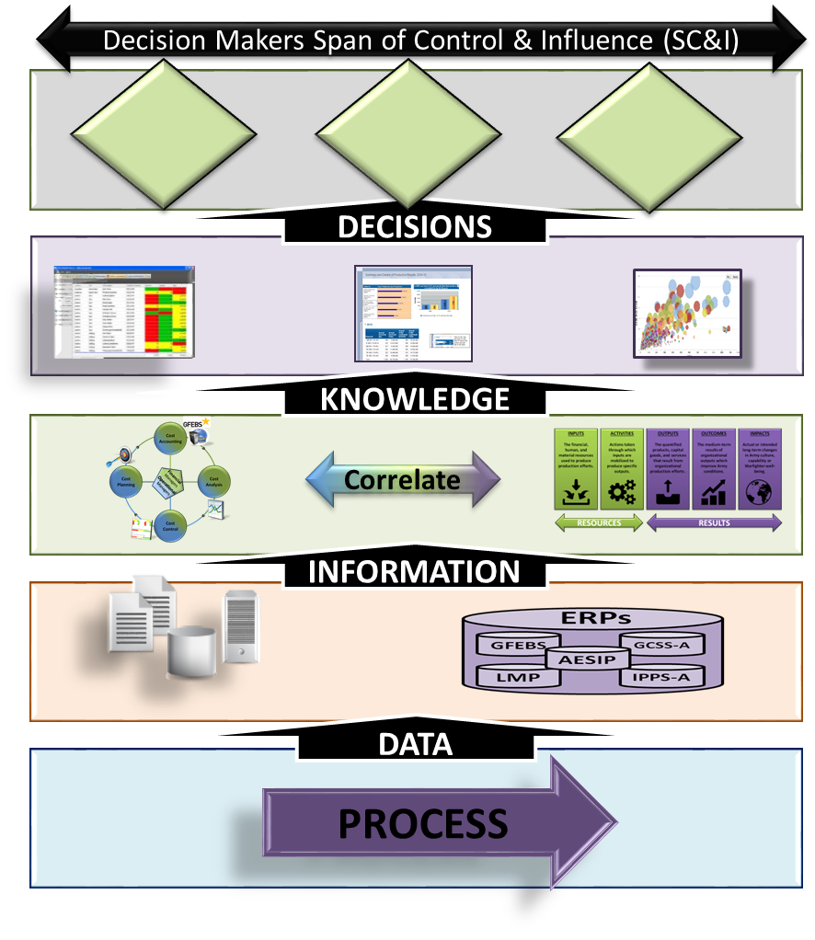
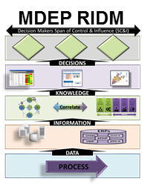
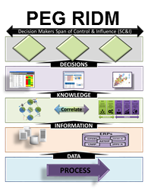
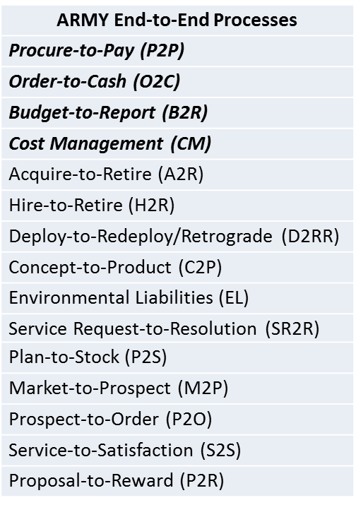
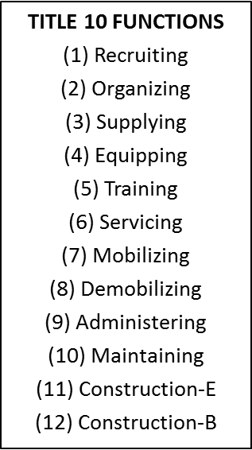
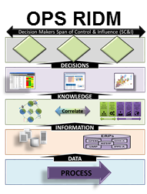
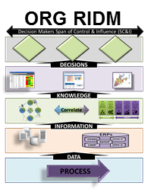
Enterprise FPA
ARMY STRATEGIC PLAN
Readiness RIDM
SAG Financial Summary
OUTCOMES
FULL SPECTRUM CAPABILTIES
ARMY MISSION
DRUs, PEOs, PMs, etc
18

Slide 19
Recruiting Cost Management Case Study
Overall objective: Develop a transferable Army framework which will allow leaders to see the total and sub-elements of cost for key Army processes which will then enable better decision-making
Method:
  Lay out the process steps and stakeholders
  Determine the relevant costs and where the data resides
  Determine the measures of performance desired from the process
  Determine how Army leaders could best use cost and correlated performance data to make better decisions regarding Army recruiting
  Based on feedback and results, develop the necessary policy and DOTLMPF implications needed to expand the framework and methodology to other Army processes
Why Recruiting for this Pilot?
  Multiple stakeholders and organizations
  Varied costs
  Outcomes are critical for the Army
20

Slide 20



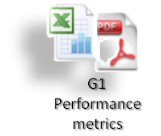
Correlate Recruiting Costs to Performance
Decision Makers Span of Control & Influence (SC&I)
Army leaders can assess cost/recruit, advertising effectiveness, retention rates, and other decisions
Customer
DECISIONS
Recruiting knowledge can analyzed through BI reports, dashboards, and analysis
Reports
CM Maturity
Dash Boards
Analysis
Output
KNOWLEDGE
DASA-CE & OBT provide
USAREC, USAMEPCOM, & TRADOC cost and performance correlation support
Process
Correlate
COST MANAGEMENT
PERFORMANCE
MANAGEMENT
INFORMATION
Recruiting cost and budget data, along with other data sources
GFEBS
PROBE
Input
DATA
Recruiting, assessment & training cost and performance data from core processes
Financial Flow Management
Core Processes
Human Resource Management
Core Processes
Supplier
20
Notes:
Here is the CM SIPOC applied to the Cost of Recruiting.
Note the data sources, and where the data is integrated for information and ultimately through CM & PM correlation, reports and dashboards for knowledge and decision making.
This model should align with the Recruiting strategic plan which outlines the processes and measures of performance expected from the recruiting and retention process defined by the Army.

Slide 21

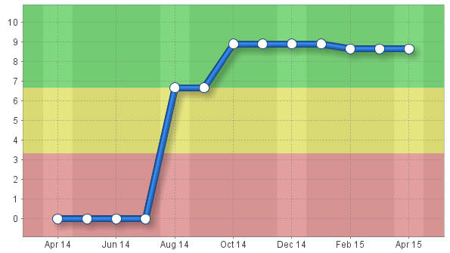
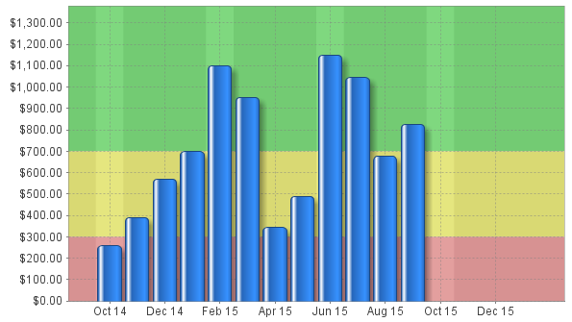
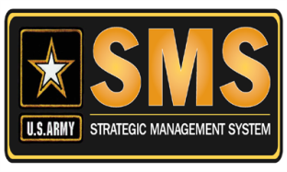
SMS Dashboards (Notional)
Recruiting Performance Dashboard
Retraining
USMEPCOM reject rates
TRADOC Pass rates
Delays-TTHS
USAREC Monthly Costs
Retention Score
Notes:
Before a leader can conduct RIDM, they must understand what financial and non-financial measures that will be included on their dashboards and in reports.
These measures are the results of strategic planning, where goals lead to measures, measures lead to metrics, and the organization monitors processes that generate cost and performance data.
The Strategic Management System, SMS, is the preferred tool to design these dashboards and utilize the SMS hierarchy to manage the organization and align with other Army/Command strategies.

Slide 22

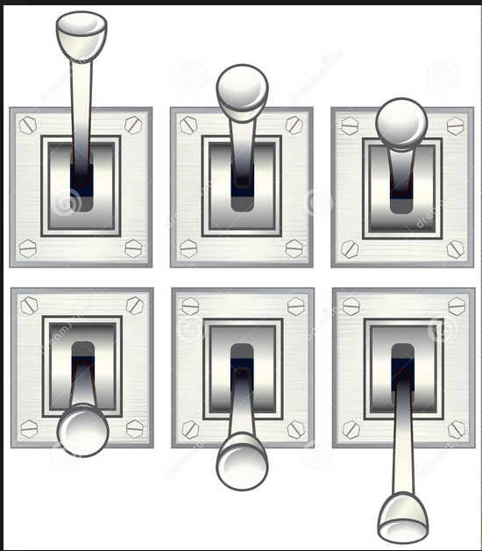
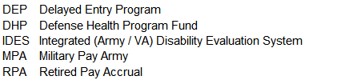
Army Enlisted Accession Landscape
Army Goals
Increase quality of recruits
Decrease attrition
Decrease disability discharges
Optimize mix of recruiters, incentives & marketing
Enhance mental toughness and resilience
Minimize time to surge
External Factors
National Unemployment Rate
Military Propensity
Service sector pay & benefits
Perceived risk of war, injury, family separation
Initial Military Training
Levers
Enlistment Incentives
Recruiter Staffing
Advertizing Resources
AFQT Minimum Standards
Physical Qualification Standards
Waiver Policy
Longer DEP / Basic Physical Conditioning
Physical Conditioning
Mental Toughness
AFQT
Quality Input
Trained & Ready
Soldiers
Attrition
Enlistment Incentives
Base Pay
Signing Bonus
Educational Benefits
Army Schools
IMT Attrition (12%)
1st Unit Attrition (24%)
Misconduct
Drug or Alcohol
Physical Condition not Disability
Parenthood/Pregnancy
Disability
B
Balancing trade space between resources, quality, and quantity
Notes:
Disability attrites enter the Integrated Disability Evaluation System (IDES). Cost to the government include: VA Disability Payments; DHP evaluation & treatment; TRICARE; and Army Retirement which eventually increases Retired Pay Accrual (RPA) rates.

Slide 23
Army Recruiting Functions by Organizations

Slide 24








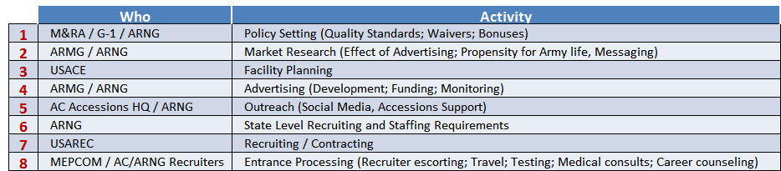
Army Enlisted Recruiting (FY14 Look)
# 65K
Notional Example:
State Level Recruiting
Recruiting
Outreach
$834M
6
7
$1,427M
Entrance Processing
#5,621
#8,604
$49M
5
8
Initial Military
Training
$128M
#233
#262
# 53K
Army Recruiting
Army Recruiting $2.9B
# 60K
# 16M
$325M
4
1
Advertising
2
Policy Setting
$95M
3
$1M
Facility Planning
Market Research
#5
$50M
#19
$2.9B Army Recruiting
Includes: AC/RC OMA & MPA
#14,700 Soldier Recruiters & Staff
#60K AC Mission;
43,650 ARNG; 18,300 USAR Mission
$24,000 Recruiting $/Recruit AC/RC
$25,000 Recruiting $/ Recruit AC only
24
Notes:
Includes:
OMA
Staff Mil Pay
Enlistment Bonus
Enlisted accession PCS

Slide 25


Army Enlisted Recruiting & IMT Pipeline
FY14 OMA Cost Drivers
$97
$121
# 5,621
$345
#9,879
# 262
# 11,961
$97
$706
$298
# 252
$
Recruiting and IMT, AC/RC
OMA $1.8B
MPA $4.7B
AMMO $0.1B
Total $6.7B
Mil Staff Auth #28,000
Student FTE #41,500
Notes:
Dollars in millions of FY14 $
Green #s are Authorized Military Strength
USAREC TDA Authorized Mil (less Medical, SOF and Cadet Cmd) + 945 Directed Mil Overstrength (DMO) = 8,604
Recruiting cost shown includes $250M in USACE OMA support of recruiting stations. These stations support Army, Navy, USAF, Cost Guard, active and reserve.
Initial Military Training (Basic + Advanced Individual Training) includes a fair share of school house cost + AMC/IMCOM support minus Commissioned and Non Commissioned Officer (NCO) training. Cost estimates for IMT vary depending on split of school house cost assigned to Officer training; Enlisted IMT; and Enlisted mid career courses.
The Army is the executive agent for U.S. MEPCOM which serves support Army, Navy and USAF active and reserve.
Army mission of 60,000 active and 62,000 reserve component, represents 57% of DOD throughput.
IMT Cost are highly dependent on allocation of school house / center of excellence execution to: Enlisted IMT; Officer Training; Advanced specialized skill training; and Doctrine.

Slide 26


Cost of Recruiting (Scope)
Notional Example:
Costs selected are
foundational to
answer performance questions:
Recruiting Performance Measures:
USAREC Retention Rates
USMEPCOM reject rates
TRADOC Pass rates
Delays-TTHS
Issues
Rework
Retraining
Early Discharge
Accessions rate
1. O&M
2. Staff MPA
3. Student MPA
4. Base Ops
Notes:
Mission Statements:
USMEPCOM evaluates applicants by applying established DoD standards during processing in order to determine eligibility for military service.
USAREC recruits professional, volunteer Soldiers; Soldier 2020, capable of effectively executing operations in the Army's complex
TRADOC Training and Doctrine Command develops, educates and trains Soldiers, civilians, and leaders; supports unit training; and designs, builds and integrates a versatile mix of capabilities, formations, and equipment to strengthen the U.S. Army as America's Force of Decisive Action.
A menu of costs associated with a particular process can be generated and depending on the span of control and influence perspective, a cost can be determined.
This cost can then be a predictor of non-financial performance measures. And S-curve analysis can be used to determine if cost reductions or reallocations is having an impact on outcomes.

Slide 27


Visualization of Cost Interdependencies
Notes:
Army activity, process, product, or service costs can be visualized as a polyhedron sphere, like a soccer ball, of interrelated costs. These costs can be generalized as O&M, Staff MPA, base ops, and other MPA costs to name a few.
When a question is asked to calculate the cost of an Army product or service, the calculations are “pulled” from the interior of the sphere and the total cost is determined by the category of cost and the percentage applied
depending on who is pulling out the section and what costs they want to consider based on what there span of control and influence is.
Because a single section of the sphere is based on cost interdependencies, the total costs of all Army activities will always exceed the total budget because costs can be represented in many types of cost of something.

Slide 28


Army Cost Management Steering Group
1st meeting on
18 November 2014
Cost and
Performance Knowledge enables Resource Informed
Decision Making
28

Slide 29





















Army Cost Management Architecture
APS
Internal
TAA
FORCE 2025
External
BIG DATA
PPBE
ERP
Data
PPBE
PPBE Enterprise Cost Models
Big Data Analytics & BI
Army Strategic Priorities
COST & PERFORMANCE MANAGEMENT
AFBRT
Enterprise CM Data Capture Strategy
PM Dashboards
CM Model
CM E2E Process
Enterprise Cost Management
CM Training & Workshops
CM Technology Tools
Identify CM Data
Needs
Cost Management Capabilities
Provide CM Guidance
Build CM Capabilities
29

Slide 30

Army Cost Management Architecture
Army Enterprise Cost Management Needs & FM Transparency
Data Capture Strategy (Big Data)
Advanced Analytics
Advanced Capabilities
Cost Performance knowledge will improve with subsequent iterations
30

Slide 31
Cost of Readiness Example
Why Readiness Costing is Needed?
    Major funding reductions put readiness at risk.
    If we don’t know what readiness cost how can we say it’s not enough.
  External
    To aid in building budget materials.
    Justify budget decisions to OSD and congressional staff.
  Internal (Army Senior Leader questions)
  What is the readiness impact if we assume more risk in funding?
  How much funding can be reduced and still maintain minimum required deployable units?
  Where is the knee in the curve between cost and readiness?
31

Slide 32



Readiness & Requirements Capacity & Cost
Over
Capacity
Target Readiness Level
Minimum Readiness Level
Target
Capacity
Marginal
Capacity
Readiness/Requirements
As-Is Requirements
Future Requirements
Under Capacity
D
C
B
A
Cumulative Distribution/Density Function (CDF)
Capacity/Cost
A Conceptual Model
32

Slide 33

Cost of Readiness Example
Readiness/Requirements vs. Capacity/Cost
Notional Example:
Cost of Readiness for Personnel
Requirement
Cost
Illustrative Data
Illustrative Data
Capacity’s Impact on Readiness
Readiness Component Capacity Baseline
Zone | Capacity/Cost | Readiness
A |  | No Change
B
C
D | Under Capacity | Below Minimum
Readiness Component | A | B | C | D
Personnel | P
Supply-on hand |  | P
Readiness-Equipment | P
Training |  |  | P
Illustrative Data
33

Slide 34

Big Data !
34

Slide 35
Table of Acronyms
AESIP - Army Enterprise Systems Integration Program
AFBRT - Army Financial Benefits Reporting and Tracking
AFMO - Army Financial Management Optimization
AoA - Analysis of Alternatives
BI - Business Intelligence
CBA - Cost benefit Analysis
CM - Cost Management
ERP - Enterprise Resource Planning
ESB - Enterprise Service Bus
ETL - Extraction Transformation and Load
GCSS-A - Global Combat Support System-Army
GFEBS - General Fund Enterprise Business System
GFM-DI - Global Force Management Data Initiative
IPPS-A - Integrated Personnel and Pay System-Army
OLAP - Online Analytical Processing
PPBE - Planning, Programing, Budgeting, and Execution Process
SOA - Service Oriented Architecture

Slide 36
Table of Acronyms
ABO | Army Budget Office
AC | Active Component
AG | Adjutant General
AR | Army Reserve
AESIP | Army Enterprise Systems Integration Program
AFMIS | Army Food Management Information System
AFMO | Army Financial Management Optimization
AFMS | Army Financial Management School
AFQT | Armed Forces Qualification Test
APE | Army Program Element
APM | Acquisition & Procurement Management
APPN | Appropriation
AMRG | Army Marketing Research Group
ARNG | Army National Guard
ASVAB | Armed Services Vocational Aptitude Battery
BAG | Budget Activity Group
BI | Business Intelligence
BOS | Base Operations Support
CE | Cost & Economics
CM | Cost Management
CMD | Command
CONUS | Continental United States
COPIS | Customers, Outputs, Process, Inputs, Suppliers
CSRB | Critical Skills Retention Bonus
DASA-CE | Deputy Assistant Secretary of the Army for Cost & Economics
DASA-FIM | Deputy Asst. Secretary of the Army for Financial Information Management
DASA-FO | Deputy Assistant Secretary of the Army for Financial Operations
dB's | Databases
DFAC | Dining Facility
DFAS | Defense Finance & Accounting Services
DHP | Defense Health Program
DLA | Defense Logistics Agency
DSS | Decision Support System
ERP | Enterprise Resource Planning
ESB | Enterprise Service Bus
ETL | Extract, Transform, Load
F&PM | Financial & Performance Management
FCM | Funds Control Module
FFM | Financial Flow Management
FIM | Financial Information Management
FM | Financial Management
FM&C | Financial Management & Comptroller
FMSOC | Financial Management Support Operations Center
FO | Financial Operations
GCSS-A | Global Combat Support System-Army
GFEBS | General Fund Enterprise Business System
GFM-DI | Global Force Management Data Initiative
HM | Healthcare Management
HQDA | Headquarters Department of the Army
HRM | Human Resource Management
IDES | Integrated Disability Evaluation System
IMCOM | U.S. Army Installation Management Command
IMT | Initial Military Training
IPSS-A | Integrated Personnel and Pay System-Army
LMP | Logistics Modernization Program
LOE | Line of Effort
LSCM | Logistics & Supply Chain Management
M&RA | Manpower & Reserve Affairs
MDEP | Management Decision Package
MEDCOM | Medical Command
MEPCOM | Military Entrance Processing Command
MOS | Military Occupation Specialties
MP | Military Police
MPA | Military Pay Army
NGB | National Guard Bureau
O&M | Operations & Maintenance
OA | Operating Agency
OCS | Officer Candidate School
OBT | Office of Business Transformation
OLAP | Online Analytical Processing
OMA | Operation and Maintenance
OPA | Other Procurement Army
OPR | Official Party Responsible
OSD | Office of the Secretary of Defense
OTJAG | Office of the Judge Advocate General
PCS | Permanent Change of Station
POS | Point of Service
PPBE | Programming, Planning, Budgeting, & Execution
PROBE | Program Optimization and Budget Evaluation
RBM | Results Based Management
RC | Reserve Component
RIDM | Resource Informed Decision Making
ROTC | Reserve Officers Training Corps
RPM | Real Property Management
RSW (OA22) | Resource Services Washington (Operating Agency22)
SAG | Sub Activity Group
SC&I | Span of Control & Influence
SMS | Strategic Management System
SOA | Service Oriented Architecture
SOF | Special Operations Forces
SRB | Selective Reenlistment Bonus
STORES | Subsistence Total Order and Receipt Electronic System
TF | Task Force
TRADOC | Training & Doctrine Command
TTHS | Trainees, Transients, Holdees, & Students
UIC | Unit Identification Code
USACE | United States Army Corps of Engineers
USAFMCOM | United States Army Financial Management Command
USAREC | United States Army Recruiting Command
USASOC | United States Army Special Operations Command
USMA | United States Military Academy
USMEPCOM | United States Military Entrance Processing Command
Notes:
Please note any acronyms that may have been missed

