Slide 1
chapter 2
Basic Math

Slide 2
Rounding
Provides ease of writing numbers
Reduces accuracy
Too much rounding or rounding repeatedly at each step in a process can greatly impact the final result in a recipe or costing exercise.

Slide 3
Rounding Terminology
4.87315
The 8 is in the tenths place
The 7 is in the hundredths place
The 3 is in the thousandths place

Slide 4
How to Round
Identify the place to which to round (the target place)
If the number to the right of the target is below 5, drop all digits right of the target
If the number to the right of the target is 5 or higher, increase the target by 1 and then drop all digits to the right of the target
When rounding up, if the target is a 9, you will have to “carry the one” as in addition.

Slide 5
Example 2a
Round 71.8972 to the nearest hundredth.
“9” is in the hundredths place
“2” is to the right of it
Round down to 71.89

Slide 6
Example 2b
Round 71.897 to the nearest hundredth.
“9” is in the hundredths place
“7” is to the right of it
Round up to 71.90

Slide 7
When to Round and By How Much
In multi-step calculations, only round in the final step
How much depends on the measurement tools available
How accurately can the following tools measure?
    digital scale
    beam scale
    volume measures
Money is only relevant to the nearest penny

Slide 8
Example 2c
An adjusted recipe calls for 16.34 ounces of flour measured on a digital scale.
Round appropriately
The scale only measures to one-tenth of an oz
Round to 16.3 oz

Slide 9
Example 2d
Round $23.469 appropriately.
Money rounds to the nearest penny
The answer is $23.47

Slide 10


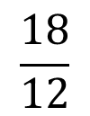

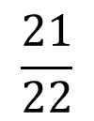
Numerators and Denominators
Identify numerators and denominators.
Which are less than “1”?
Which are greater than “1”?
Which are equal to “1”?
Note: computers often format as ⁴/₉

Slide 11
Mixed Numbers
2 ¾
The “2” is the whole number
The “¾” is the fraction

Slide 12
Converting a Mixed Number to a Fraction
1. Multiply the whole number times the denominator
2. Add the result from step 1 to the numerator
3. Place the result from step 2 over the original denominator

Slide 13
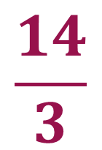
Example 2e
Convert 4 2/3 to a fraction.
1. Multiply the whole number times the denominator
4 (whole) x 3 (dem.) = 12
2. Add the result from step 1 to the numerator
12 + 2 (num.) = 14
3. Place the result from step 2 over the original denominator

Slide 14
Converting a Fraction to a Mixed Number
Divide numerator ÷ denominator
2. Result is whole number and remainder
3. Write whole number and place remainder over original denominator

Slide 15
Example 2f
Convert 9/4 to a mixed number.
1. Divide numerator ÷ denominator
9÷ 4 = 2 remainder 1
2. Write whole number and place remainder over original denominator
2 ¼

Slide 16
Converting to a Mixed Number Using a Calculator
Divide numerator ÷ denominator
2. Subtract the whole number
3. Multiply decimal by original denominator (to get the “remainder”)
4. Write whole number followed by remainder over the denominator

Slide 17
Example 2g
Write 27/8 as a mixed number using calculator.
27 ÷ 8 = 3.375
Subtract whole number to get 0.375
Multiply 0.375 X 8 (denominator) = 3
Answer is 3 ³/₈

Slide 18
Multiplying by Fractions
Multiply the numerators
2. Multiply the denominators
3. Place the multiplied numerators over the multiplied denominators

Slide 19
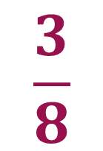
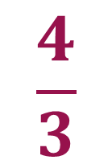
Example 2h
X
=
Multiply 3 X 4 = 12
Multiply 8 X 3 = 24
Answer is ¹²/₂₄

Slide 20
Dividing Fractions
Invert the second fraction (flip it upside-down)
2. Multiply the two fractions

Slide 21
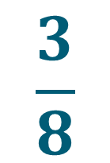
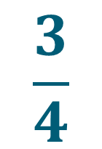
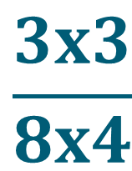
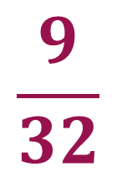
Example 2i
÷
=
Invert 2nd fraction and multiply:
X
=
=

Slide 22
Reducing Fractions
Dividing numerator and denominator by the same number does not impact the fraction’s value, only its appearance
2. It is as if you are dividing or multiplying by 1
3. The only challenge is finding a number that divides into both numerator and denominator

Slide 23
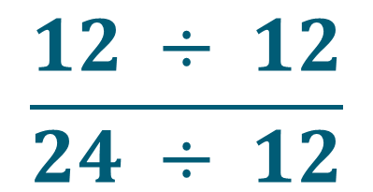
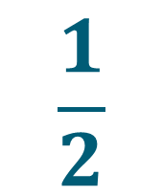
Example 2j
Reduce 12/24 to simpler terms.
12 and 24 are both divisible by 12
=

Slide 24
Converting Fractions to Decimals
Using a calculator, simply enter:
Numerator ÷ Denominator

Slide 25
Example 2k
Convert 4/9 to a decimal.
Enter 4 ÷ 9 into a calculator to get 0.4444…
Answer is 0.444 (rounded)

Slide 26
Converting Decimals to Fractions
In the kitchen, this is done for practical measurement purposes.
Relevant fractions are multiples of
1/16 1/8 1/4 1/3 1/2

Slide 27
Converting Decimals to Fractions
16
Oz in a pound
Tbsp in a cup
Cups in a Gal
8
Oz in a cup

Slide 28
How to Convert a Decimal to a Useful
Kitchen Fraction
Multiply the decimal (to the right of the decimal point only) by 8 or 16, depending on the unit of the original number and the unit desired
For example:
8 to go from cups to oz
16 to go pounds to oz or cups to Tbsp
2. Round the result to the nearest whole number
3. Place that rounded result over the multiplier you used (8 or 16)
4. Reduce if necessary

Slide 29
Example 2l
Convert 0.875 pounds to a useful measure.
Multiply 0.875 X 16 = 14
Answer is ¹⁴/₁₆
or 14 oz

Slide 30
Example 2m
Convert 0.325 cups to a useful measure.
Don’t calculate!
Notice that 0.325 is close to or rounds to 0.333
From Table 2.1, 0.333 = ¹/₃
Answer = ¹/₃ cup

Slide 31
Example 2n
Convert 0.192 cups to a useful measure.
Multiply 0.192 X 8 = 1.536
Round 1.536 to 2
Write as ²/₈, which reduces to ¼
Answer = ¼ cup
The answer is not exact, but it can be measured in a kitchen while 0.192 cups cannot.

Slide 32
Percents
A percent is a ratio or way of expressing a decimal or fraction in comparison to a constant of 100.

Slide 33
How to Convert a Number to a Percent
Move the decimal point for the number two places to the right
2. Add the percent sign

Slide 34
Example 2o
Convert 0.849 to a percent.
Move the decimal point two places to the right (84.9) and add the percent sign
Answer = 84.9%

Slide 35
How to Convert a Percent to a Decimal
Remove the percent sign
Move the decimal point two places to the left

Slide 36
Example 2o
Convert 4.6% to a decimal.
Move the decimal point two places to the left
Note: This requires the addition of a zero to make an extra place
Answer is 0.046

Slide 37
Part-Whole-% Graphic Formula
Part
Whole x %

Slide 38
Part-Whole-% Graphic Formula
To use the graphic formula, cover up the variable you wish to find (solve for) and follow the remaining instructions.
In this formula, the % is always written in its decimal form
That is: no % sign and the decimal point moved two places to the left
In word problems, “is” = part; “of” = whole

Slide 39
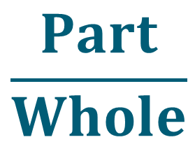
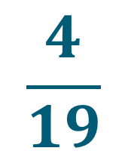
Example 2p
4 is what percent of 19?
% =
=
=
0.2105 or 21.05%
The answer rounds to 21.1%

Slide 40
Example 2q
What is 22% of 78?
Part = Whole x %
= 78 x 0.22
= 17.16

Slide 41
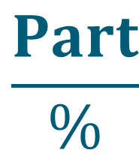
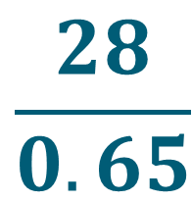
Example 2r
28 is 65% of what number?
Whole =
=
=
43.076 or 43.08

Slide 42
Closing Thoughts
Basic Math may seem disconnected from kitchen work, but the two are intertwined.
Manipulating fractions is critical for measuring.
Decimals work easily in a computer.
Percents help with pricing and cost control.
The part-whole-% graphic formula appears in many forms throughout cost control.
Having mastered these simple computations, you are now ready to tackle cost control.

