Slide 1

Chapter 4:
Values

Slide 2

Let’s discuss
Kheng Guan Toh
“The more boundless your vision, the more real you are.”
~Deepak Chopra

Slide 3
When were you last highly motivated?
Were you completing a task? What kind?
Were you meeting your needs?
Were you trying to please someone?
Or strengthen a relationship?

Slide 4
Maslow’s Hierarchy of Needs
Self-
actualization
Self-esteem
Belonging
Safety needs
Physiological needs

Slide 5
Intrinsic vs. extrinsic motivation
Intrinsic
Self-acceptance
Connectedness
Community feeling
Physical health
Extrinsic
Earning money
Pleasing others
Being attractive
Popular or famous

Slide 6
Values as motivators
Work that motivates you
Improves performance
Increases your value to an employer
Better job assignments
Greater responsibility

Slide 7

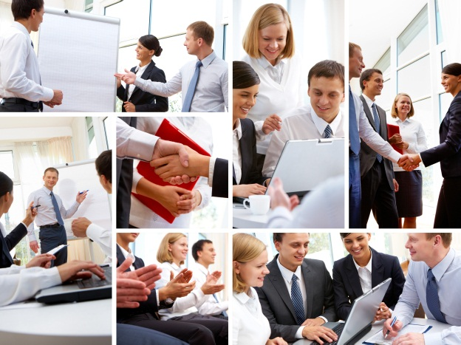


Values and your career
Tasks | Environment
Relationships | Work-life balance
Yuri Arcurs
Dmitriy Shironosov
Dmitriy Shironosov
wavebreakmedia ltd

Slide 8
Personal values in the workplace
How would others describe you?
How would you describe yourself?
What reputation do you want to build?

Slide 9
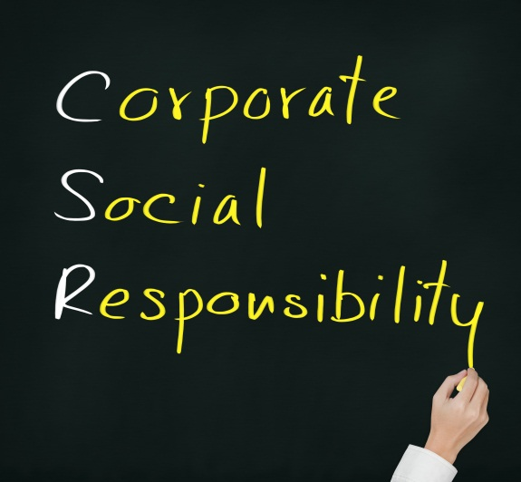
Work with awareness:
Corporate Social Responsibility
Business world’s activities that benefit society, not just shareholders and the bottom line.
Dusit

Slide 10



Examples of CSR programs
Cienpies Design
Ruth Black
BLANKartist
Photosani

Slide 11

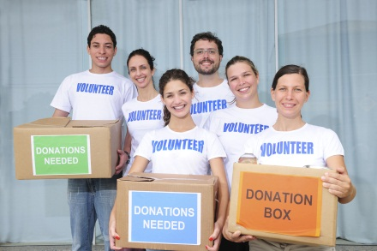

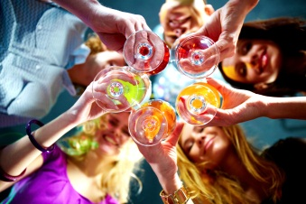

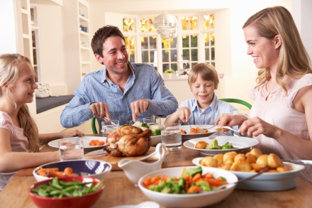

Building your Reputation
The message you send
Your relationships
Your activities
Your lifestyle
Your appearance
Alexander Raths
mangostock
wrangler
Dmitriy Shironosov
Nomad_Soul
9lives
Monkey Business Images
Bine

Slide 12

TECH SAVVY: Your Online Persona
Cleaning up digital dirt
Wash over it
Wash it out
Wait it out
Mihai Simonia

Slide 13
Regional foods
Punctuality
Jargon
Dress
American Cultural Values

Slide 14
Understanding cultural differences
Perception and thinking
View distant situations as related
Only clearly connected concepts are related
Communication
Language
Non-verbal behavior
Social relations
Class and social position is rigid
Assumption of equality
Heritage, inheritance, dialect important

Slide 15
Optimizing your Experiences
~Mihaly Csikszentmihalyi
“Flow”
Set challenging goals | Immersed in chosen activities
Pay attention to what’s happening | Enjoy immediate experiences

Slide 16
Aiming to flourish
“Authentic Happiness”
Five specific elements
Positive emotion
Engagement
Positive relationships
Meaning
Accomplishment

Slide 17
Thought questions
Can you identify your values?
Have you identified values that will be important for you to consider in your career?
Have you identified any areas where your personal, family, career, or cultural values might conflict with your career interests or career goals?

